Slide 1



Identification and Validation of Hepatitis B Virus Host-Susceptibility Factors
Collins Oduor Owino,
The Science of HBV Cure Meeting 2022

Slide 2
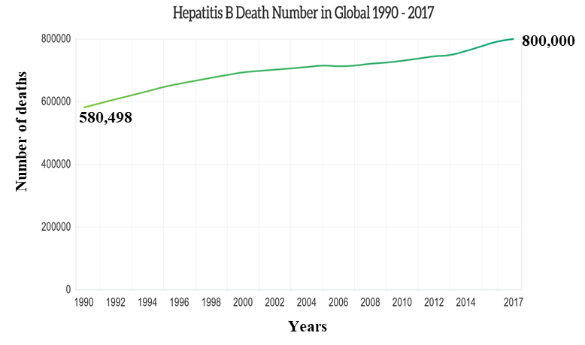
Increasing death globally due to viral hepatitis
Chronically infects over 300 million
The figures were generated from the Institute for Health Metrics and Evaluation (IHME)
Infection with HBV leads to an incompletely understood complex network of host-virus interactions.
Human host factors that support HBV infection and persistence remain to be fully identified.

Slide 3
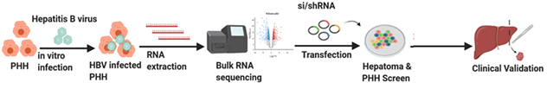
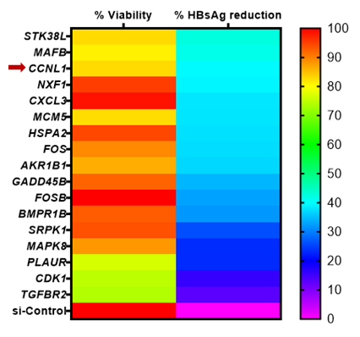
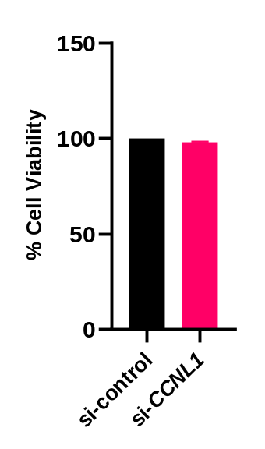
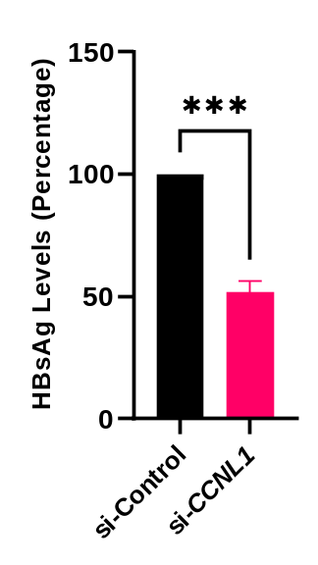
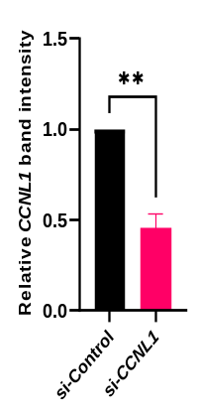
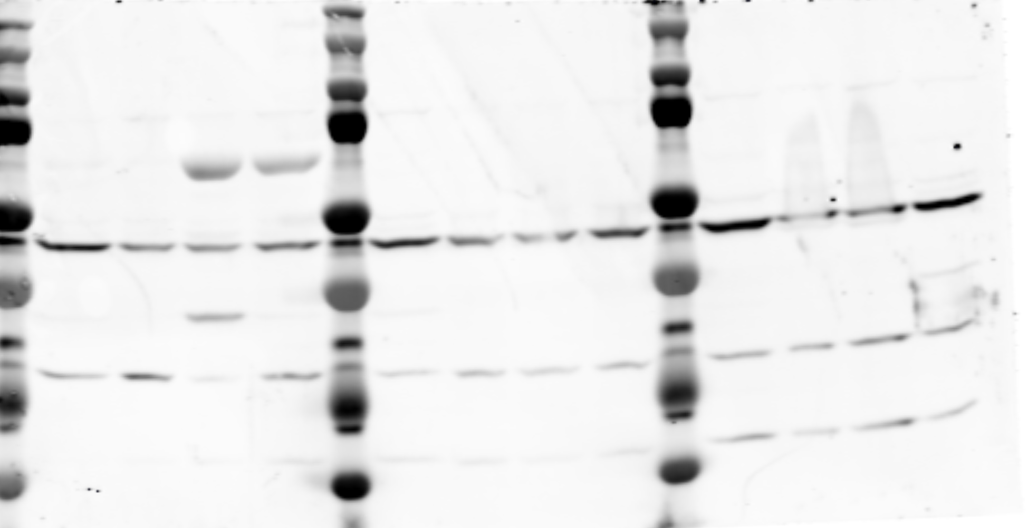
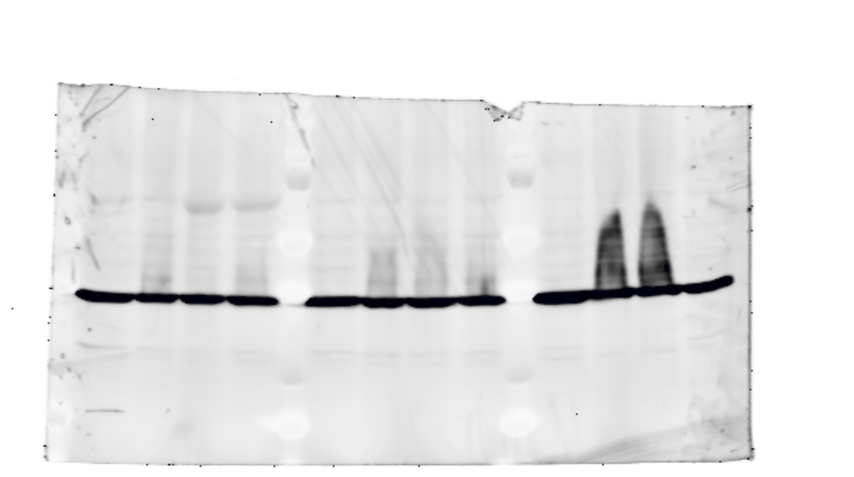
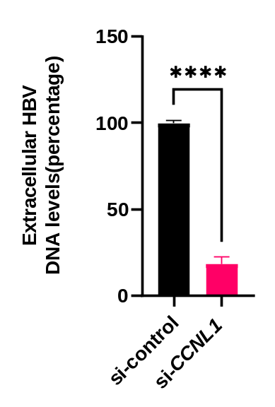
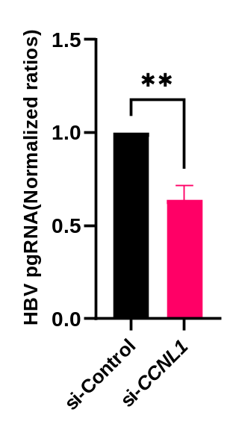

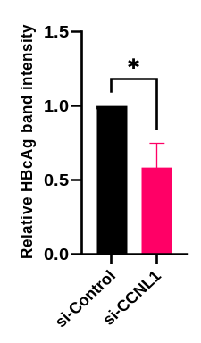
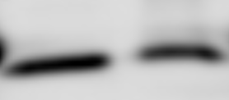
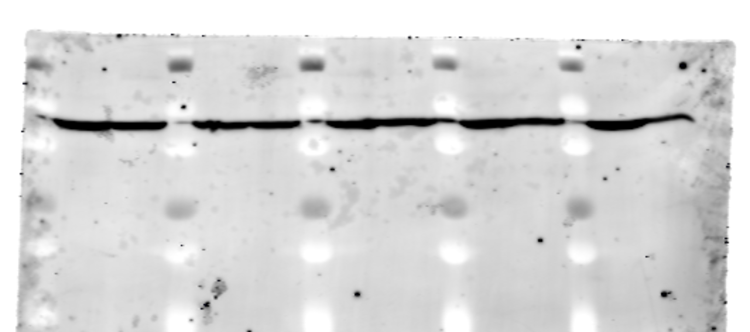
Identification of CCNL1 as a host susceptibility factor in HBV infection
A
B
C
D
D’
E
F
siRNA transfection
si-Control
Harvest samples
si-CCNL1
Seed cells
Wash cells
50 kDa
CCNL1
37 kDa
GAPDH
D-1
D0
D1
D3
G
H
I
J
J’
si-Control
si-CCNL1
25 kDa
HBcAg
37 kDa
GAPDH

Slide 4
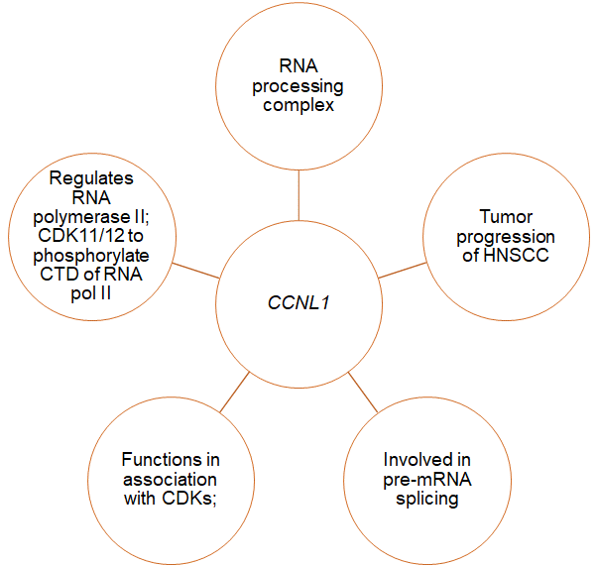
Cyclins and CDK partners
Cyclins and their CDK partners
Canonical cyclins ; A,B,D and E
Atypical cyclins ; G,I,J, O, P and Y
Transcriptional regulators /non-canonical; C, H, K, L, Q and T
Cell cycle regulators
Binds to CDKs to form complexes involved in the regulation of transcription, pre-mRNA processing
shRNA based functional validation of the role of CCNL1 in HepG2-NTCP and PHH

Slide 5
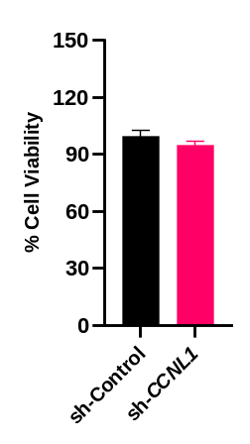

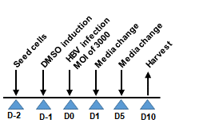
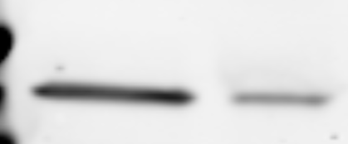
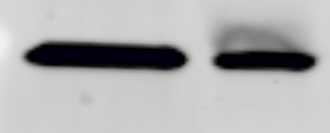
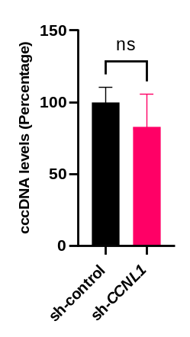
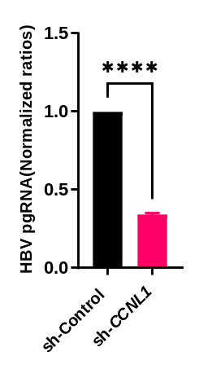
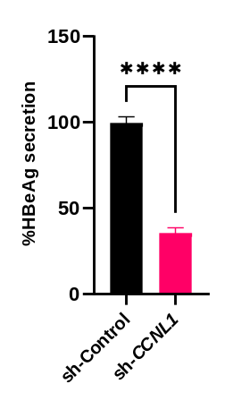
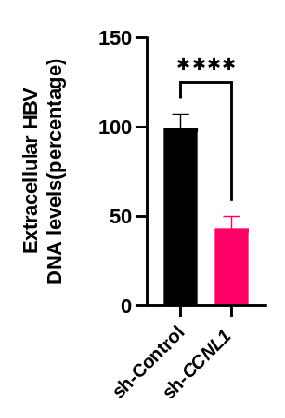
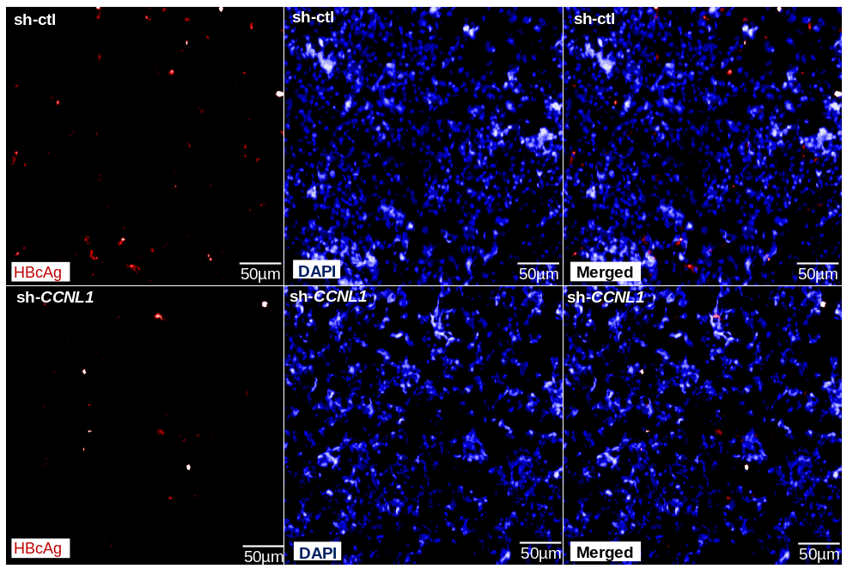
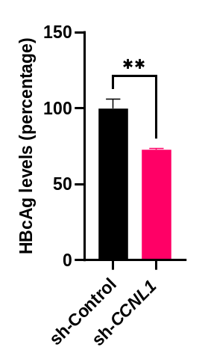
Loss of function of CCNL1 inhibits HBV infection in HepG2-NTCP
A
B
C
sh-control
sh-CCNL1
50 kDa
CCNL1
37 kDa
GAPDH
D
E
F
G
H

Slide 6
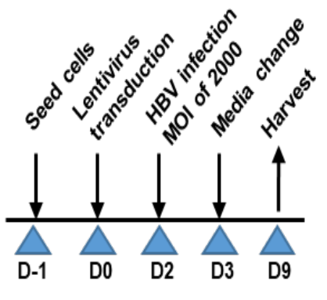
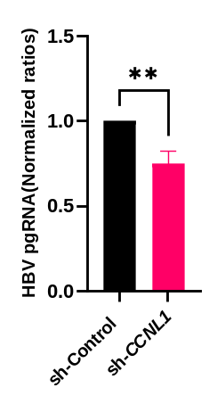
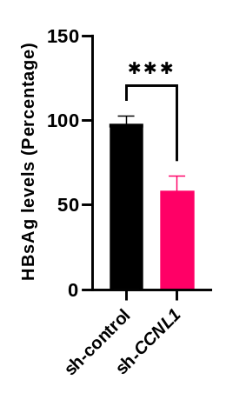
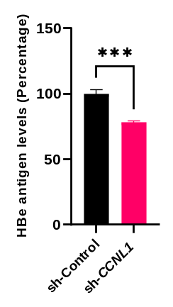
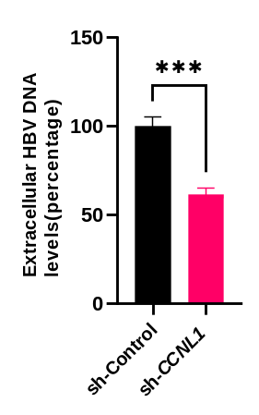
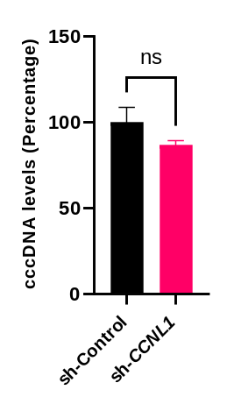
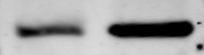
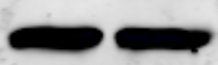

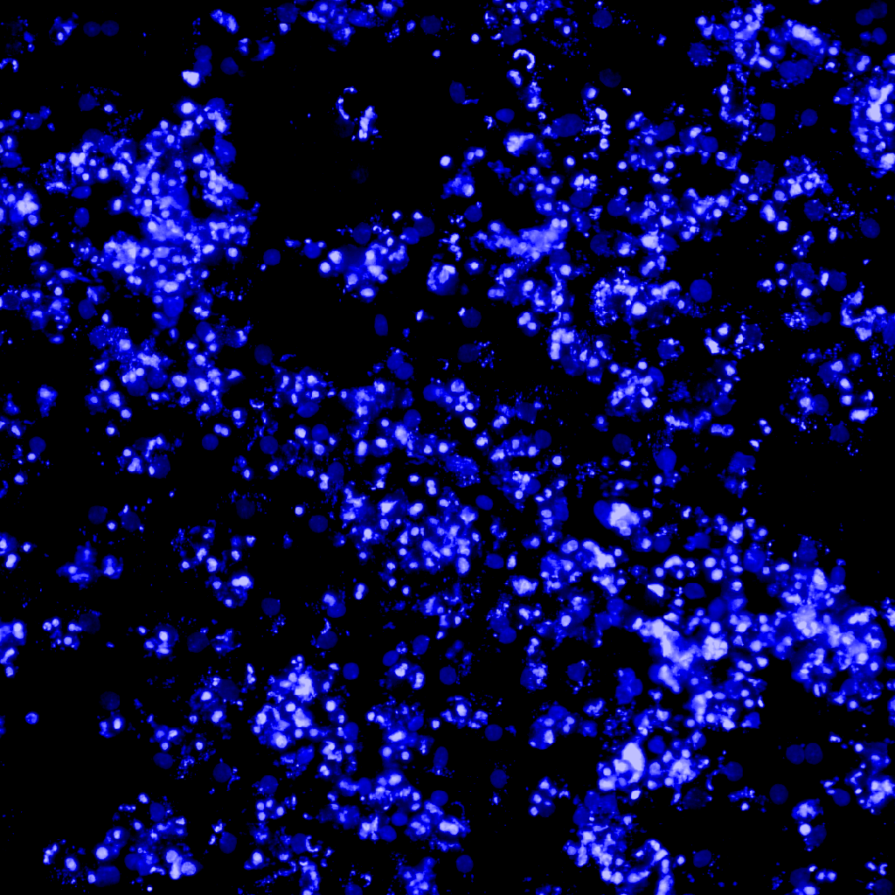
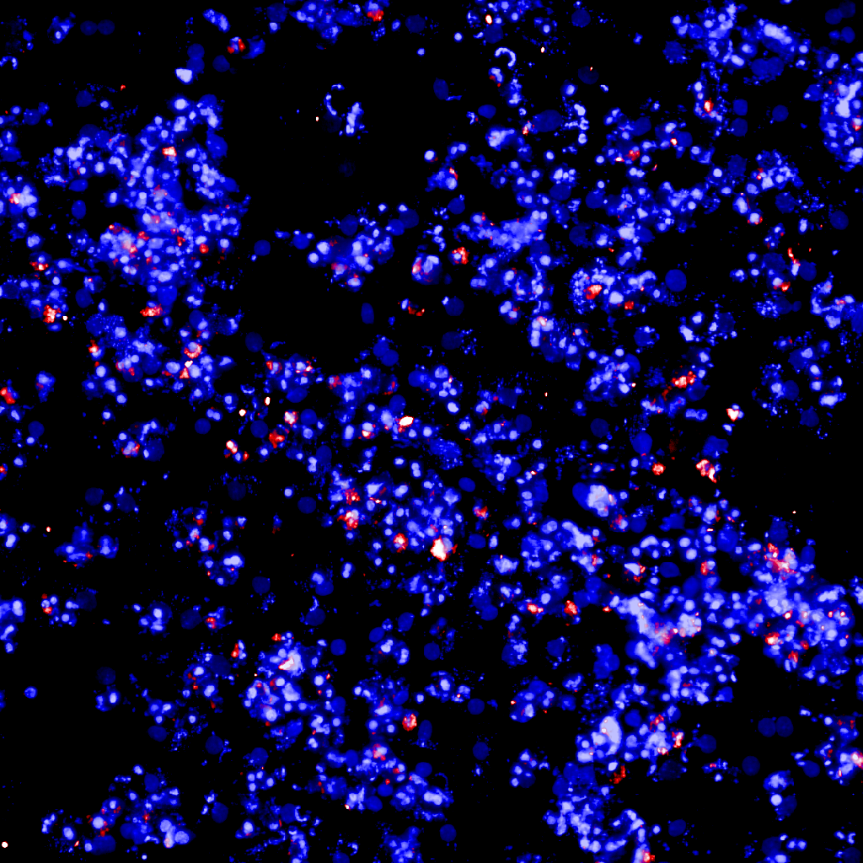
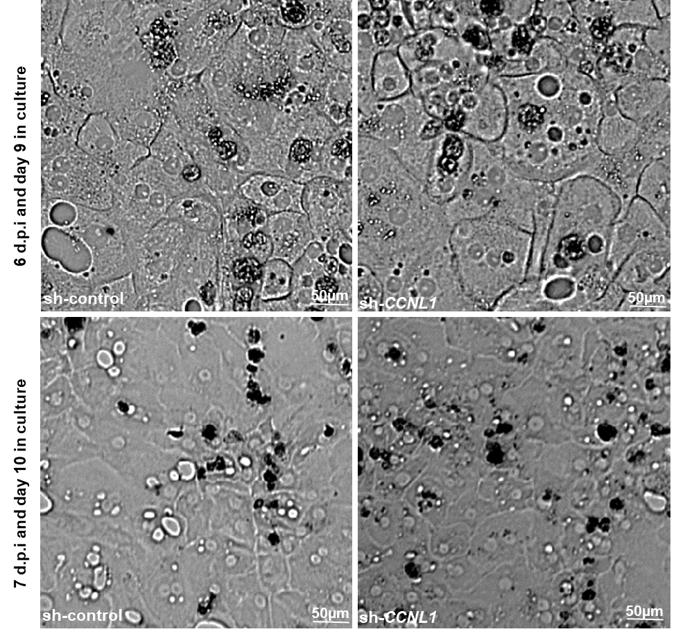
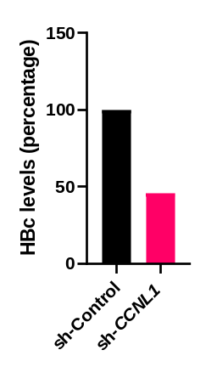
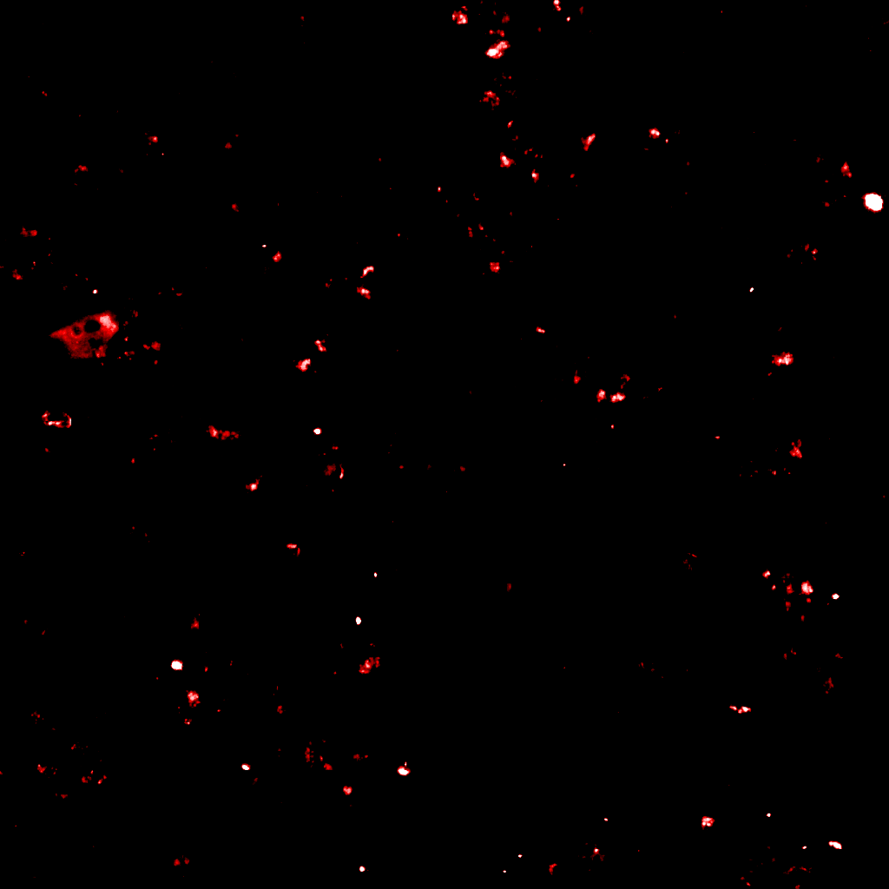

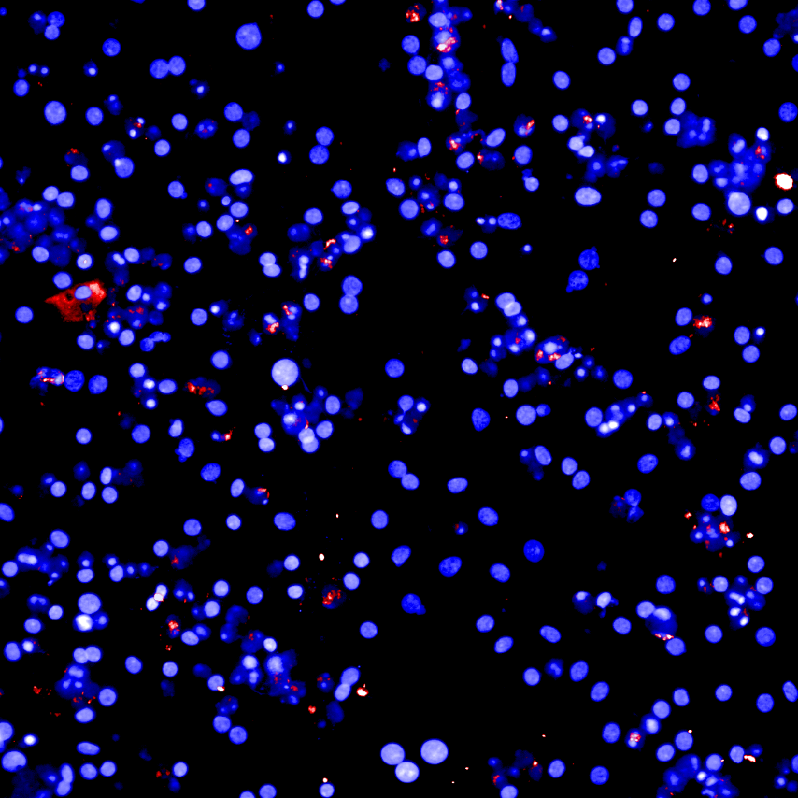
Loss of function of CCNL1 inhibits HBV infection in PHH
A
B
C
D
E
F
G
sh-CCNL1
sh-Control
CCNL1
GAPDH
H
I
sh-ctl
sh-ctl
sh-ctl
HBcAg
50µm
Hoechst
50µm
Merged
50µm
sh-CCNL1
sh-CCNL1
sh-CCNL1
HBcAg
50µm
Hoechst
50µm
Merged
50µm

Slide 7
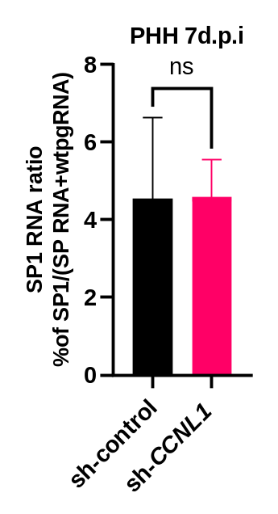
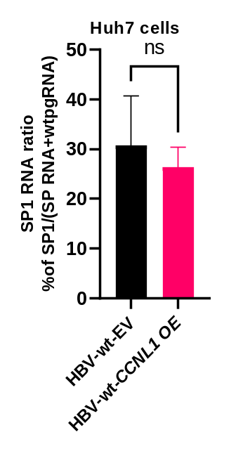
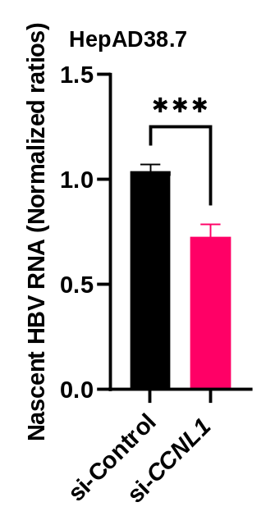
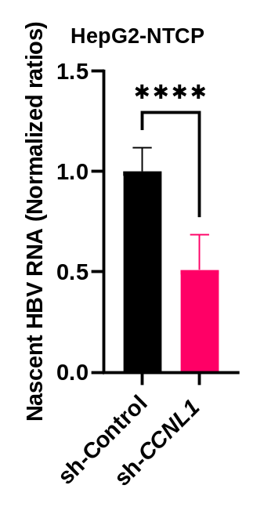
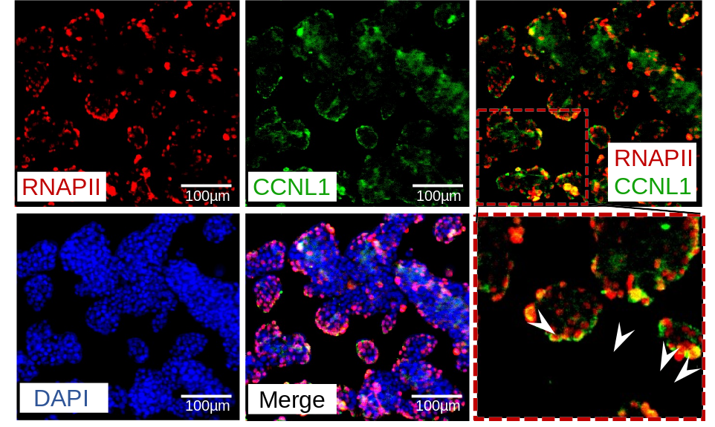
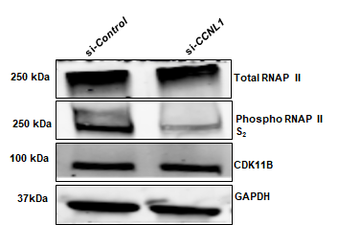
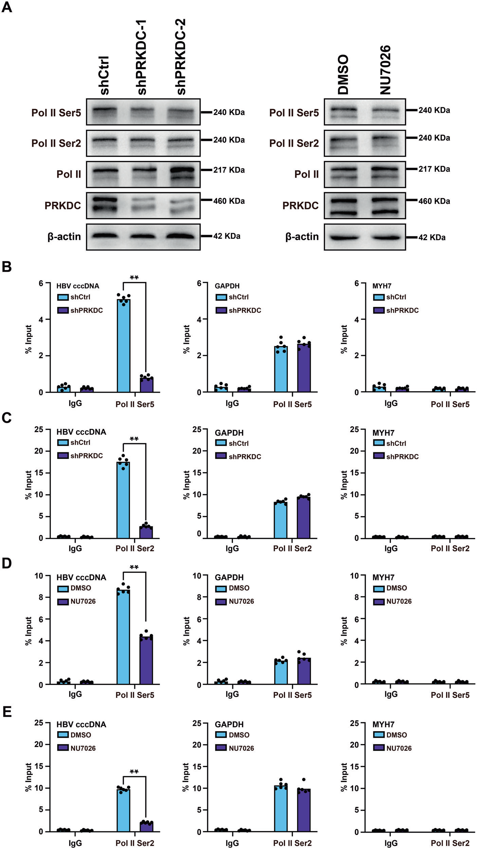
CCNL1 controls expression levels of HBV RNA and splice products by modulating phosphorylation of total RNAPII
A
B
C
D
E
Effect on splicing
Role in production of nascent HBV RNA
F
HepAD38.7
Fan and colleagues, 2022
https://www.nature.com/articles/s41419-022-04852-3

Slide 8
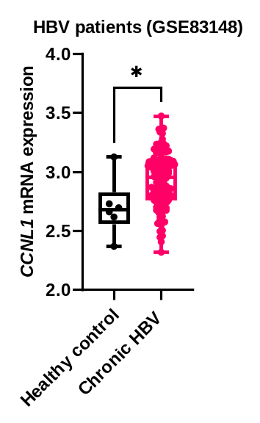
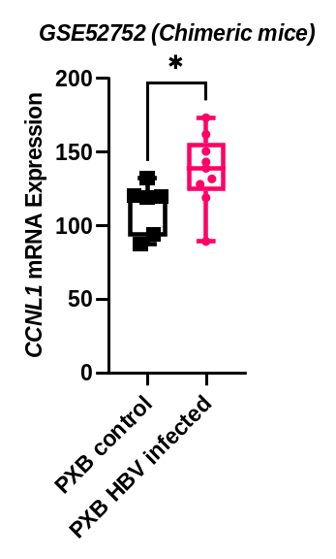
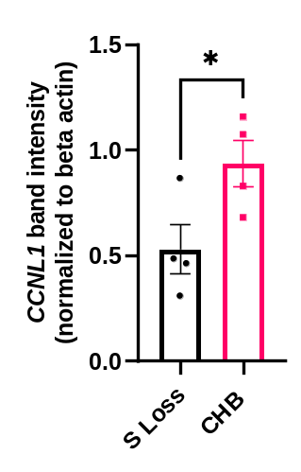
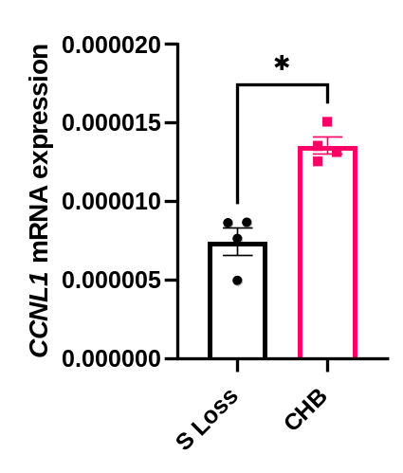
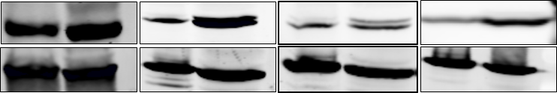


CCNL1 expression is associated with CHB infection
A
B
C
D
D’
Patient 1-S Loss
Patient 3-S Loss
Patient 4-CHB
Patient 5-S Loss
Patient 6-CHB
Patient 7-S Loss
Patient 8-CHB
Patient 2-CHB
50 kDa
CCNL1
42 kDa
β-actin
E
F

Slide 9


Summary
Identified numerous HBV host factors including CCNL1 as HBV host factor
Expression of CCNL1 is associated with chronic HBV infection and liver disease
Loss of function of CCNL1 results in reduced production of HBV nascent RNA
Novel target for possible host directed anti-HBV therapy

Slide 10



















Acknowledgments

Slide 11


