Slide 1

Achieving clearance of subviral particles with NAPs:
A critical milestone for HBsAg loss and functional cure
Andrew Vaillant, Ph.D.
Chief Scientific Officer
Replicor Inc.

Slide 2
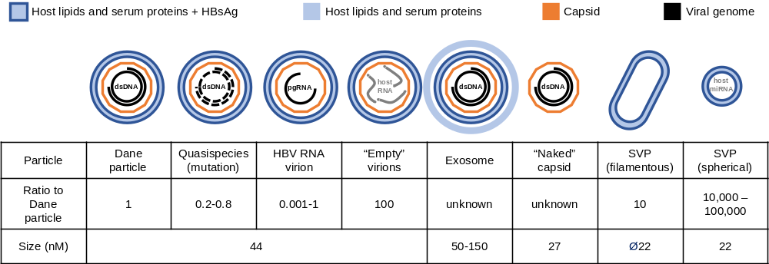
Particle production in chronic HBV infection
99.99% of HBsAg
is derived from
subviral particles
(SVP)
Active cccDNA
?
Integrated HBV DNA
Vaillant, ACS Inf Dis 2021; 7: 1351-1368

Slide 3
Production of SVP drives chronicity of HBV infection
Immunoinhibitory properties of SVP (HBsAg)
Immune function | Target of inhibition | Effect observed
Immune function | Target of inhibition | Effect observed
Innate SVP block inactivation of cccDNA | TLR function | In vitro, in vivo, in humans
 | Cytokine signalling | In vitro, in humans
 | Monocyte and macrophage function | In vitro
 | Dendritic cell function | In vitro
 | NK cell function | In vitro, in vivo, in humans
 | Repression of interferon response genes | In humans
Immune function | Target of inhibition | Effect observed
Innate SVP block inactivation of cccDNA | TLR function | In vitro, in vivo, in humans
 | Cytokine signalling | In vitro, in humans
 | Monocyte and macrophage function | In vitro
 | Dendritic cell function | In vitro
 | NK cell function | In vitro, in vivo, in humans
 | Repression of interferon response genes | In humans
Adaptive SVP inhibit clearance of integrated HBV DNA | Sequester anti-HBs | In vitro
 | HBV specific B-cell function | In humans
 | HBV specific CD4+ T-cell function | In humans
 | HBV specific T-cell tolerance | In vitro, in vivo
 | HBV specific T-cell exhaustion | In vivo, in humans
Vaillant, ACS Inf Dis 2021; 7: 1351-1368
SVP must be cleared from the circulation
Allow efficient clearance of integrated HBV DNA
Restore control over cccDNA reactivation

Slide 4
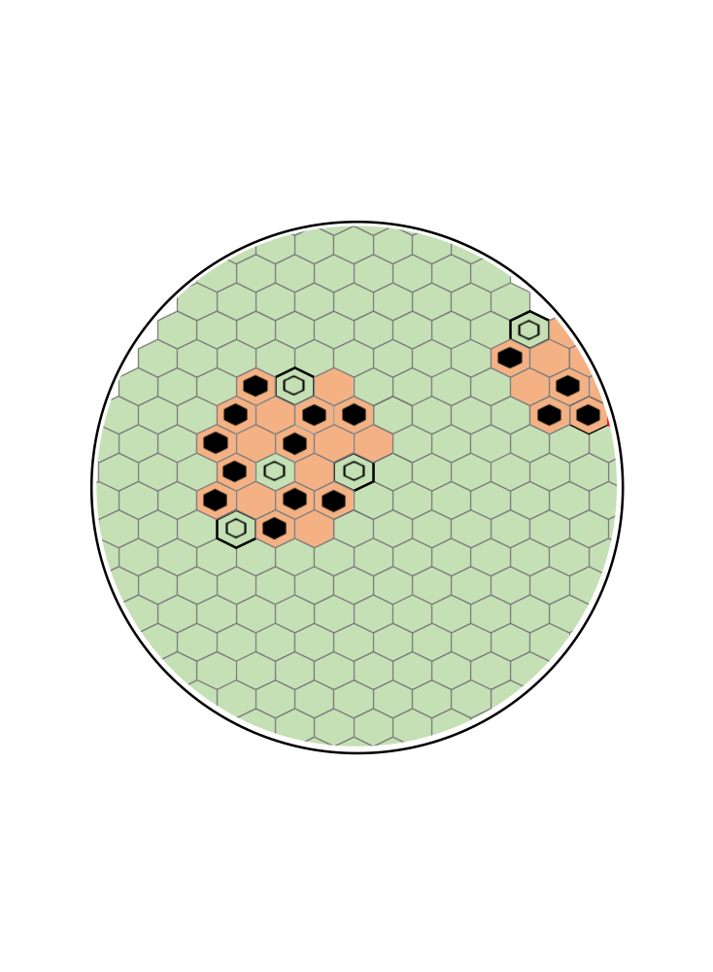
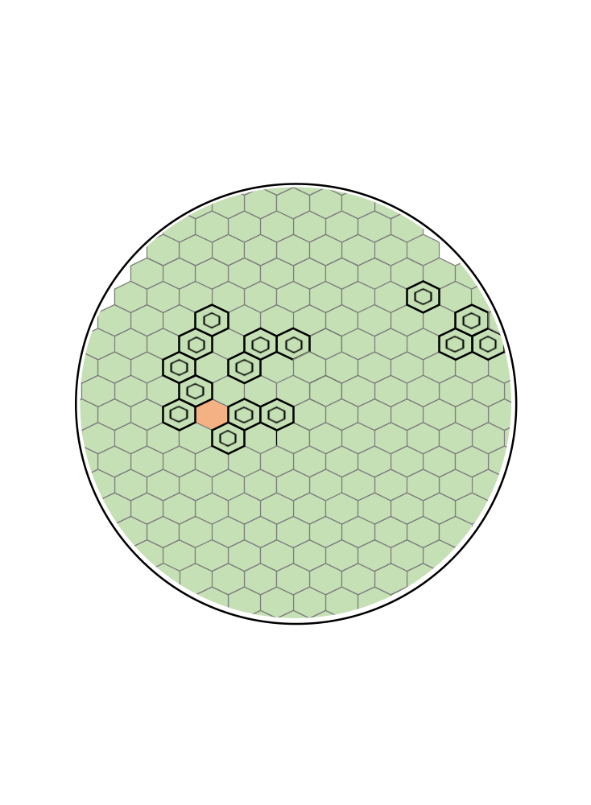
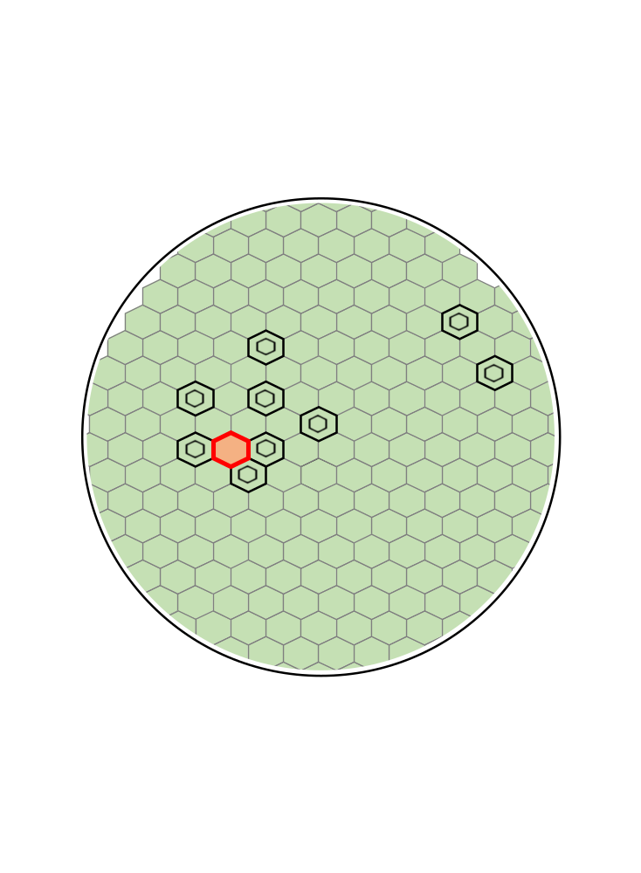
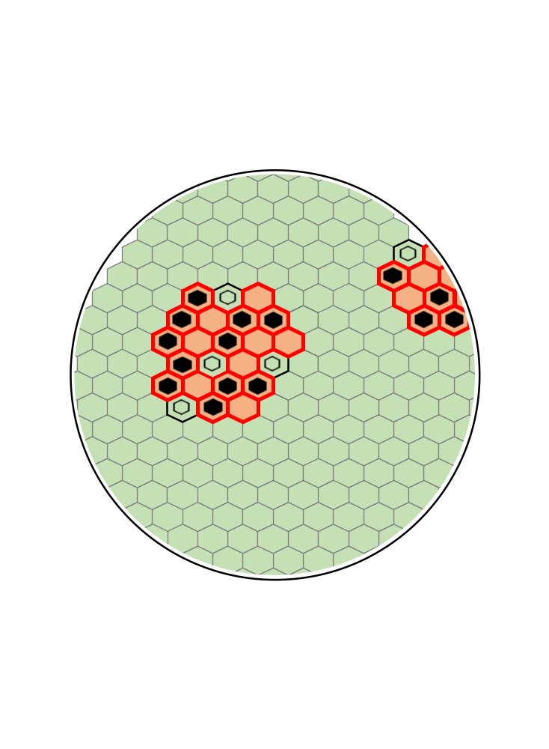
The path to functional cure
Chronic HBV
Clearance of circulating SVP
Immune stimulation
including HBsAg-specific T-cell response
Removal of therapy
Viremia
controlled
cccDNA
silencing
cccDNA
silencing
Integrated HBV DNA
(SVP)
Normal
cells
Slow
cccDNA
Reduction?
Latent cccDNA
(inactive)
Control of SVP production from cccDNA and integrated HBV DNA
Removal of integrated HBV DNA
HBsAg
production
controlled
Active cccDNA
(virus + SVP)
HBsAg
(SVP)
Restore innate immune function
Exhausted HBsAg-specific T-cell response can be restored
Cytolytic removal of hepatocytes with integrated HBV DNA
Transaminase flares
(host mediated) signal removal of integrated HBV DNA
Persistent control of latent cccDNA enabled by elimination of HBsAg production in the liver
HBsAg blocks immune control
Progression of liver disease
Risk of HCC
Vaillant, ACS Viruses 2021; 13: 745

Slide 5
Nucleic acid polymers (NAPs):
a unique molecular mechanism in HBV
SVP sphere
morphogenesis
DNAJB12
ERGIC
NAPs target DNAJB12 to inhibit HBV spherical SVP morphogenesis
spheres
Golgi
Spherical SVP
>99.99% of circulating
HBsAg
filaments
IC
S-HBsAg
IC transit to ERGIC
COPII
M-HBsAg
Replenishment of SVP is blocked.
ER lumen
Rapid turnover of SVP (1-6 days ½ life)
results in host mediated clearance of SVP.
L-HBsAg
Hsp70 / Hsc70?
DNAJB12
NUCs
CAMs
PreS1 translocation
DNAJB1 / DNAJB4
dsRNA→TLR3?
(RNAi)
capsid
MVB
Dane particles
RNA virus
“Empty” virions
L-HBsAg
enrichment
γ2-adaptin
capsid
<0.001% of circulating
HBsAg
Vaillant, ACS Infectious Dis 2021; 7: 1351-1368
Boulon et al., AASLD 2021 Poster 836
SVP filaments

Slide 6
HBsAg isoform response during therapy can identify antiviral effects
SVP turn over rapidly
99.99% of HBsAg
Isoform
composition
S-HBsAg
M-HBsAg
1
SVP
spheres
10,000 fold
excess
L-HBsAg
ERGIC-Golgi
90%
Constitutive
secretion
1
Selective decline in S-HBsAg
Signals inhibition of spherical SVP release
HBV mRNA degradation
Inhibition of SVP assembly
1
10%
HBV
mRNA
Trace
L-HBsAg
2
65%
SVP filaments
1,000 fold excess
Virions
2
Selective decline in M/L-HBsAg
Inhibition of virion assembly?
Inhibition of exocytosis of virions / filaments?
Enhanced autophagy?
Multivesicular
body
Exocytosis
Enrichment of
L-HBsAg
10%
25%
L-HBsAg
Vaillant, ACS Inf Dis 2021; 7: 1351-1368

Slide 7
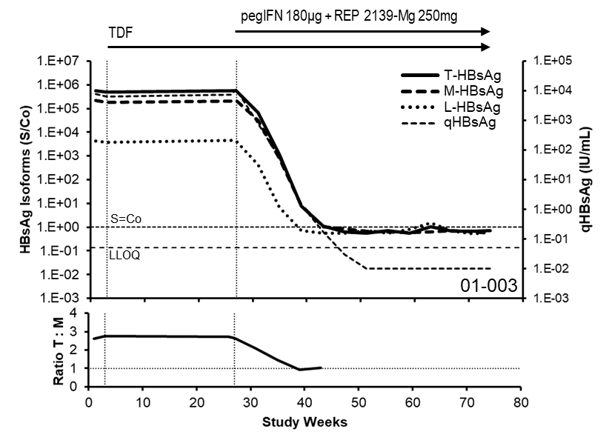
REP 301 / 401: Validating the NAP mechanism in the clinic
Change in S-HBsAg content: change in ratio of total HBsAg (S+M+L) : preS2 (M+L) over time
HBsAg response
Strong HBsAg declines with NAPs are accompanied by selective decline of S-HBsAg
Correlation between selective S-HBsAg clearance during therapy and qHBsAg response
(all 52 participants in REP 301 + REP 401)
qHBsAg response during therapy (decline from baseline) | Total | Selective S-HBsAg decline | p-value
< 2 log₁₀ IU/mL | 10 | 1 | < 0.01
> 2 log₁₀ IU/mL | 42 | 39
Strong HBsAg decline with NAPs is accompanied by clearance of SVP
(from cccDNA and integrated HBV DNA)
Does not occur with RNAi (AB-729)
Thi et al., J Hepatol 2021; 75: S760
Bazinet et al., Hepatology Comm 2022; April 2

Slide 8
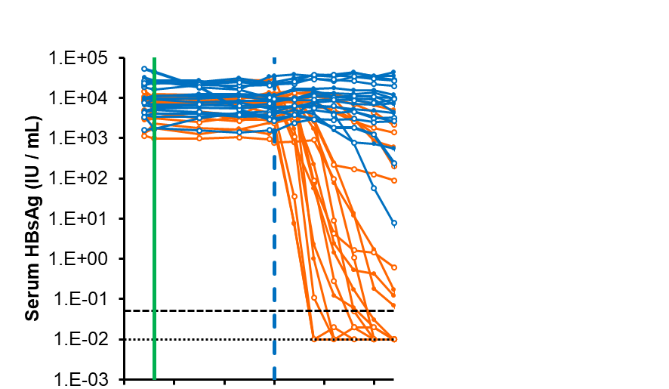
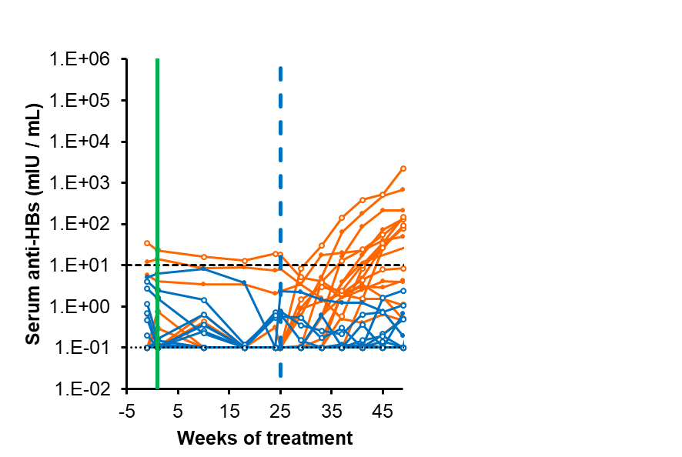
REP 401 study:
NAPs dramatically improve response to TDF + pegIFN
TDF + pegIFN+ NAP
TDF
TDF + pegIFN
NAP monotherapy:
REP 2055 or REP 2139
Up to 7 log₁₀ HBsAg reduction at 12 weeks
HBsAg seroconversion
Low rates of HBV functional cure
NAPs + TDF + pegIFN
HBsAg < 0.005 IU/mL (60%)
HBsAg seroconversion
Inactivation of cccDNA
Host mediated transaminase flares (95%)
High rates of HBV functional cure (39%)
No further therapy required in 78% of patients
GT D functional cure rate
TDF + pegIFN = 0%
(Marcellin et al, Gastroenterology 2016; 150: 134-144)
NAPs + TDF + pegIFN = 39%
Up to 8 log₁₀ decline from baseline
(to < 0.005 IU/mL)
Potent HBsAg decline
Rapid HBsAg seroconversion
Bazinet et al., Gastroenterol. 2020; 158: 2180-2194
Al-Mahtab et al., PLoS One; 2016; 11: e0156667

Slide 9
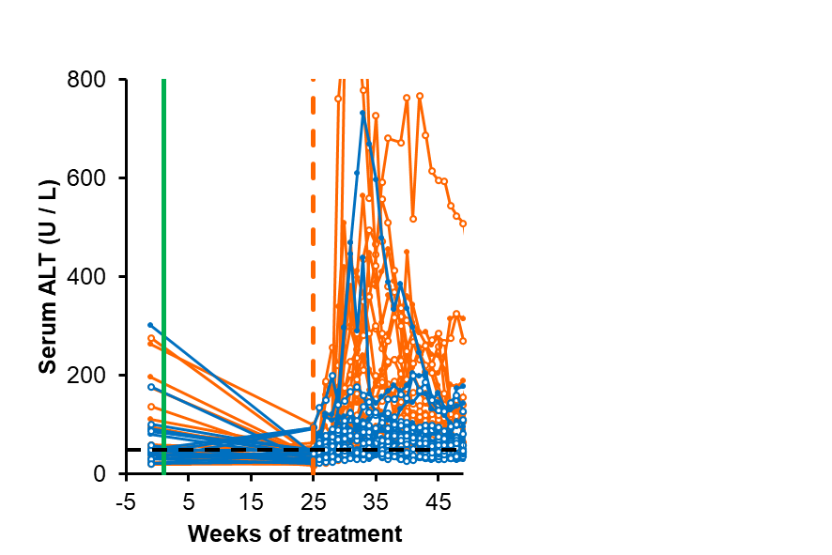
REP 401 study:
Host mediated transaminase flares are required for functional cure
TDF + pegIFN+ NAP
TDF
TDF + pegIFN
NAPs drive a dramatic increase in immunotherapy driven, host mediated transaminase flares¹
occur in 95% of participants²
no alteration in liver function / asymptomatic²
similar in magnitude and duration to host mediated flares observed during natural course of disease, during NUC therapy or with pegIFN monotherapy
correlated with functional cure (when HBsAg is also < 1 IU/mL)²
Signals the removal of cccDNA and integrated HBV DNA³
Consistent with the safe and beneficial nature of host mediated transaminase flares during therapy with approved agents, even in cirhottics⁴
Bazinet et al., Gastroenterol. 2020; 158: 2180-2194
Bazinet et al., J Viral Hep 2021; 28: 817-825
Bazinet et al., Hepatol Comm 2021; 28: 817-825
Vaillant, Viruses 2021; 131: 745

Slide 10
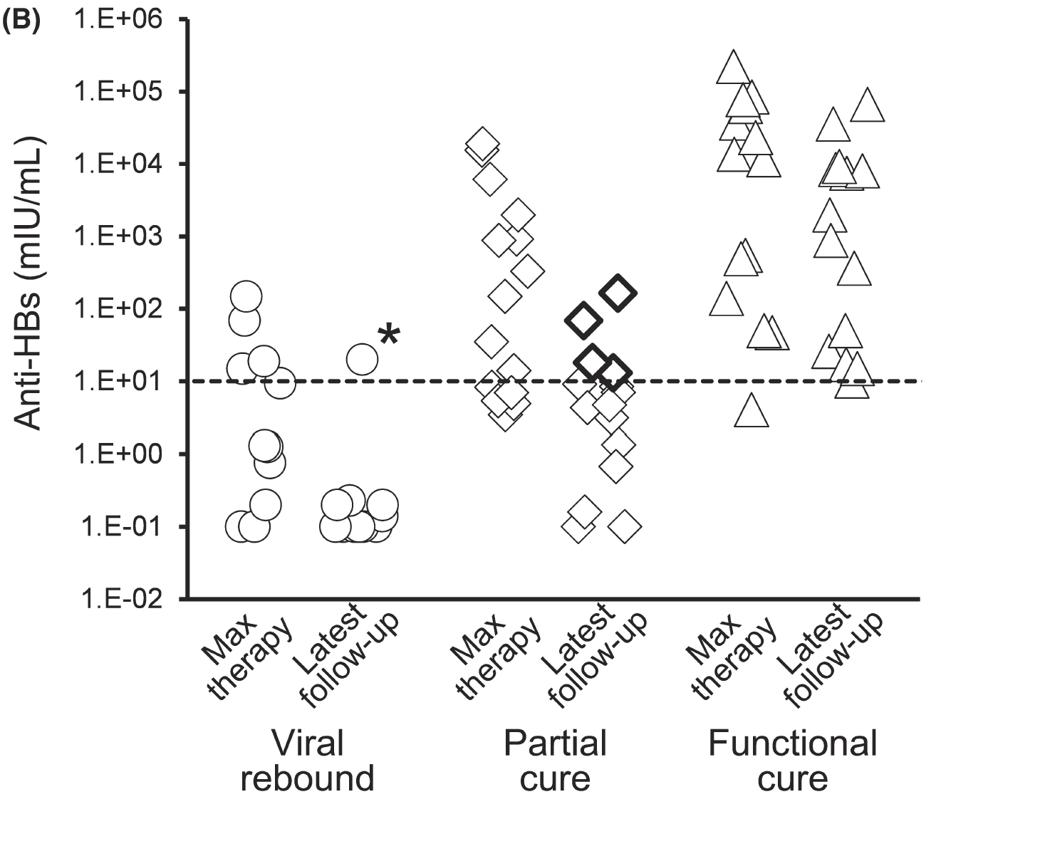
REP 401 study:
Anti-HBs response on therapy versus outcome
“Pseudo” functional cure
All HBsAg < 1 IU/mL
HBV DNA < LLOQ
HBsAg seroconversion and
anti-HBs elevation during therapy do not predict outcome
Incomplete
partial cure
seroconversion
But HBsAg seroconversion persists in functional cure!
HBsAg seroconversion lost with partial cure

Slide 11
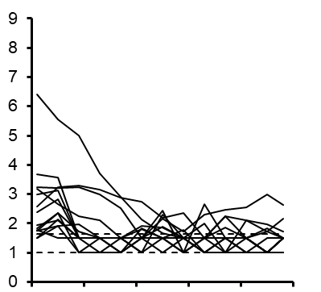
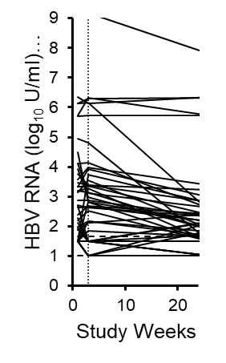
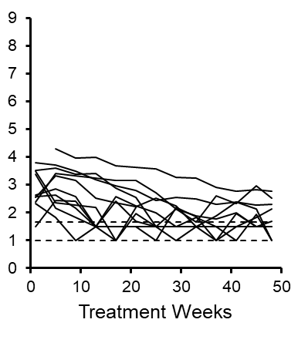
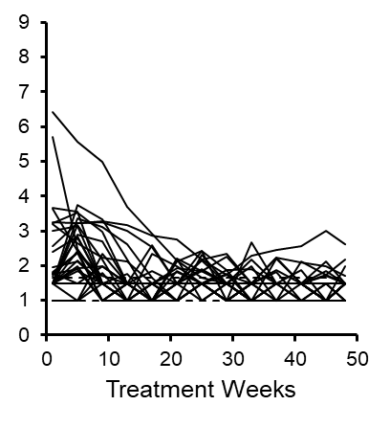
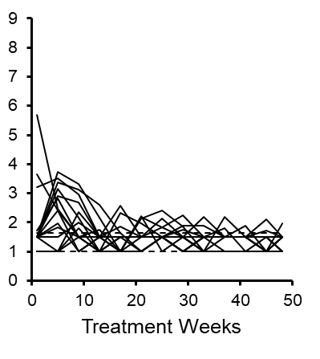
REP 401 study:
HBV RNA response on therapy versus outcome
48 weeks TDF + pegIFN + NAP
Partial cure (15/29)
24 weeks TDF
lead-in (n=40)
Rebound during
follow-up (n=11)
HBV DNA < 2000 IU/mL
During follow-up (n=29)
Functional cure (14/29)
All HBV RNA TND
during follow-up
HBV RNA response does not predict
clinical outcome
Bazinet et al., Hepatol Comm 2021, 5: 1873-1887

Slide 12
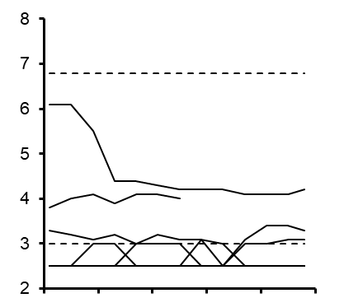
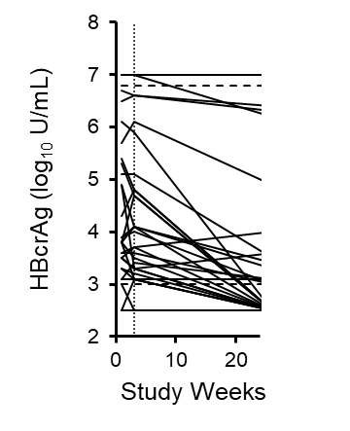
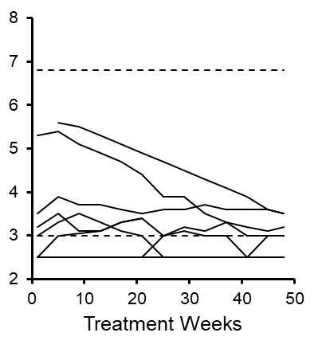
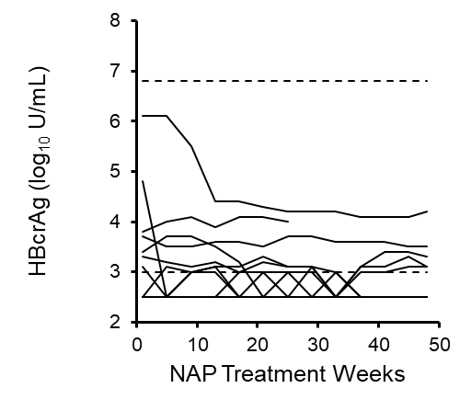
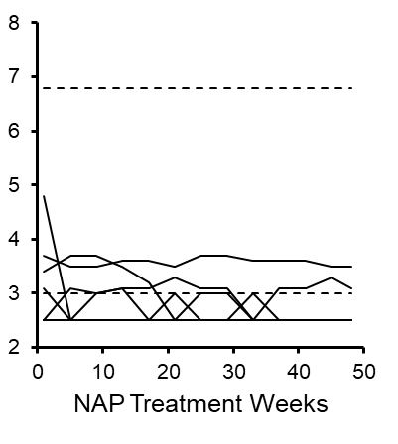
REP 401 study:
HBcrAg response on therapy versus outcome
48 weeks TDF + pegIFN + NAP
Partial cure (15/29)
24 weeks TDF
lead-in (n=40)
Rebound during
follow-up (n=11)
HBV DNA < 2000 IU/mL
During follow-up (n=29)
Functional cure (14/29)
All HBcrAg < LLOQ
during follow-up
HBcrAg response does not predict
clinical outcome
Bazinet et al., Hepatol Comm 2021, 5: 1873-1887

Slide 13
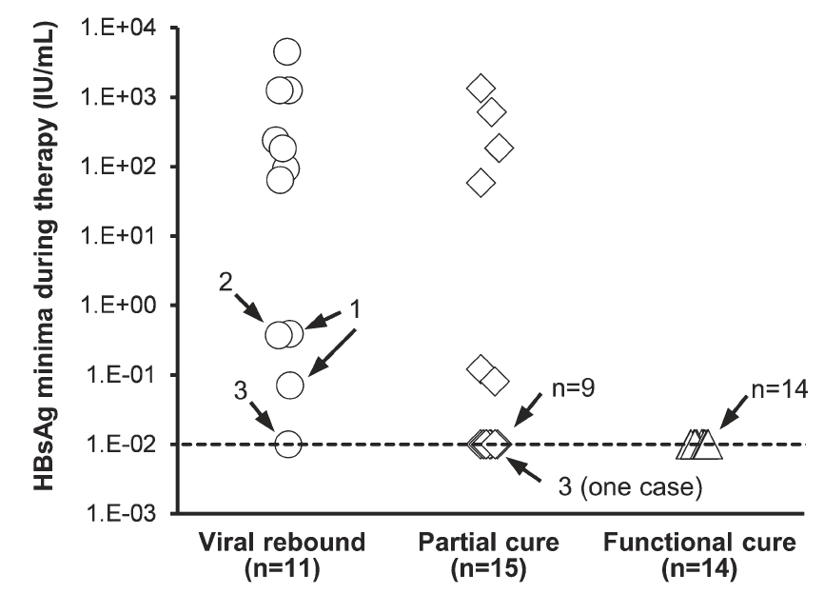
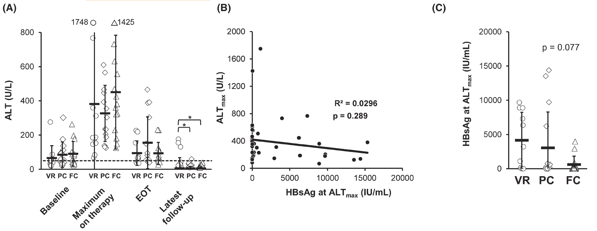
REP 401 study:
Extent of HBsAg clearance during transaminase flares predicts functional cure
HBsAg loss is necessary but insufficient
for functional cure
Transaminase flares do not
predict outcome
HBsAg minima during flare
predicts outcome
Engagement of HBsAg specific T-cell function
may be essential to achieve functional cure
VR = virologic rebound
PC = partial cure
FC = functional cure
Bazinet et al., J Viral Hep 2021; 28: 817-825

Slide 14
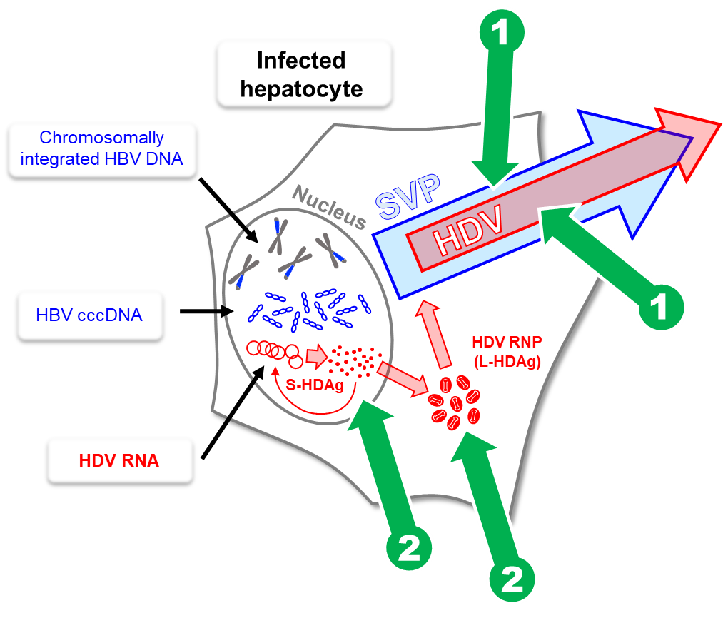
Targeting HDV with nucleic acid polymers
Multiple molecular mechanisms
Clinical effects during therapy³:
Clearance of HDV RNA
Clearance of HBsAg
Host (immune) mediated transaminase flares with introduction of pegIFN
Clinical outcomes⁴:
Normalization of liver function off therapy
Progressive reversal of fibrosis off therapy
Functional cure of HDV: 7/11 (HDV RNA TND, normal ALT) for 3.5 years off therapy
  4 with functional HBV cure, 3 with partial HBV cure
1
Bind HSP40 chaperone DNAJB12 (ERGIC)¹
Inhibition of HBV SVP assembly
Inhibition of HDV RNP envelopment
2
Bind small and large isoforms of HDAg (nucleus)²
Inhibition of HDV RNA replication
Inhibition of HDV RNP assembly
Boulon et al., AASLD 2020 LP-42
Shamur et al., Hepatology 2017; 66: 504A
Bazinet et al., Lancet Gastroenterol Hepatol 2017; 2: 877-889
Bazinet et al., Hepatol Comm. 2020; 5: 189-202

Slide 15
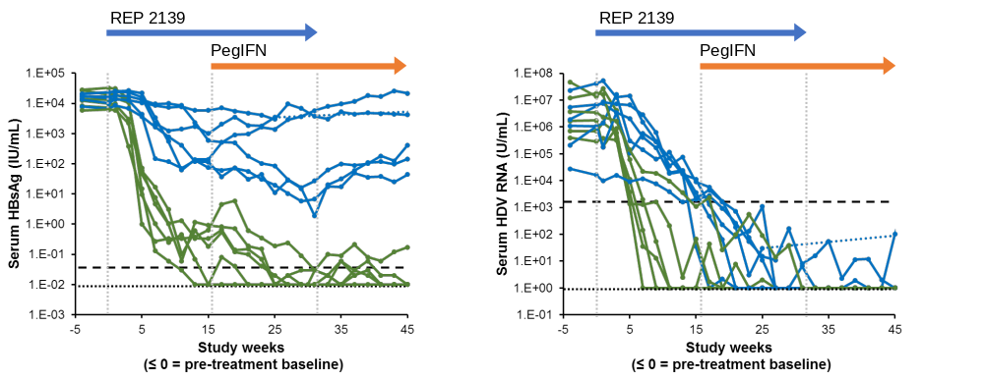
Understanding clinical responses to NAPs in HBV / HDV
Strong HDV RNA declines with NAPs occur even when inhibition of SVP assembly is attenuated
Inhibition of HDV replication
(NAP-HDAg interaction)
Inhibition of HDV replication
+
Inhibition of HDV envelopment
(inhibition of SVP assembly)
Mild inhibition
Strong inhibition
Strong inhibition
Strong inhibition
Bazinet et al., Lancet Gastroenterol Hepatol 2017; 2: 877-889 (supplemental data)

Slide 16
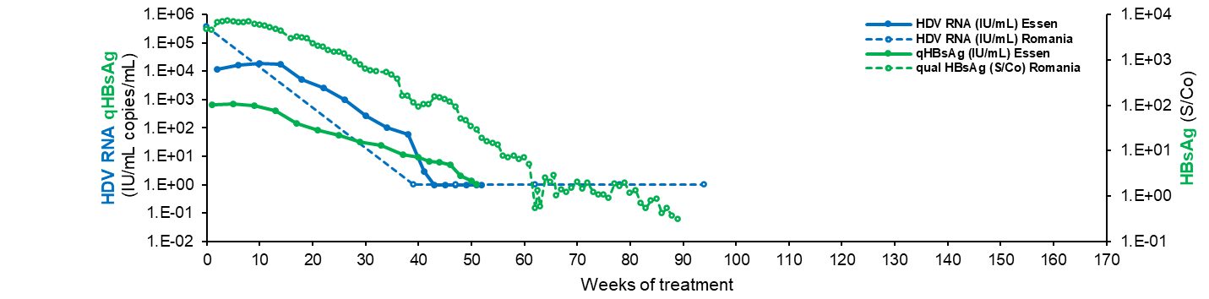
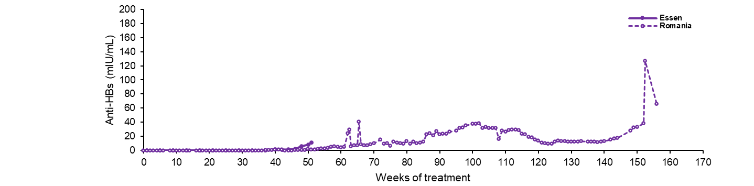
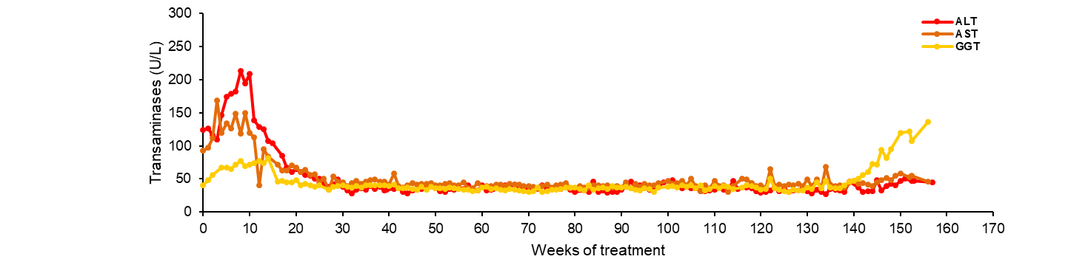
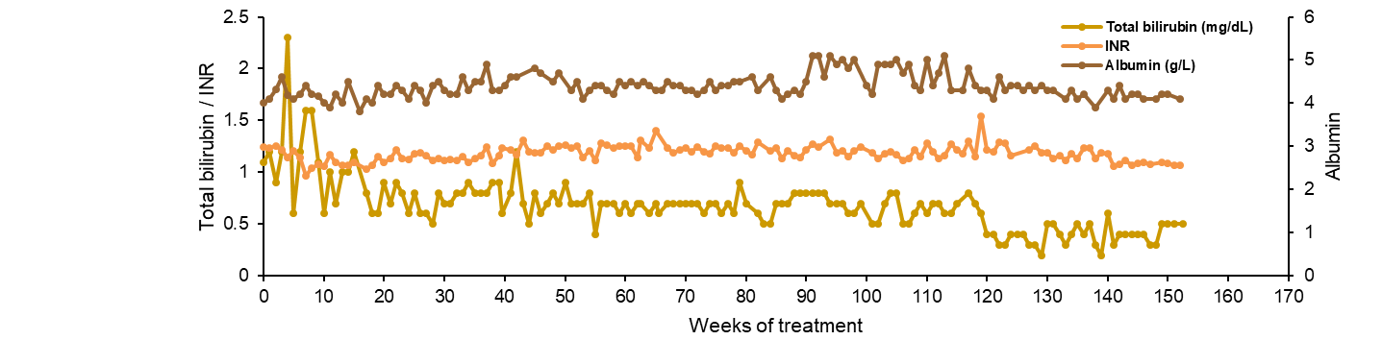
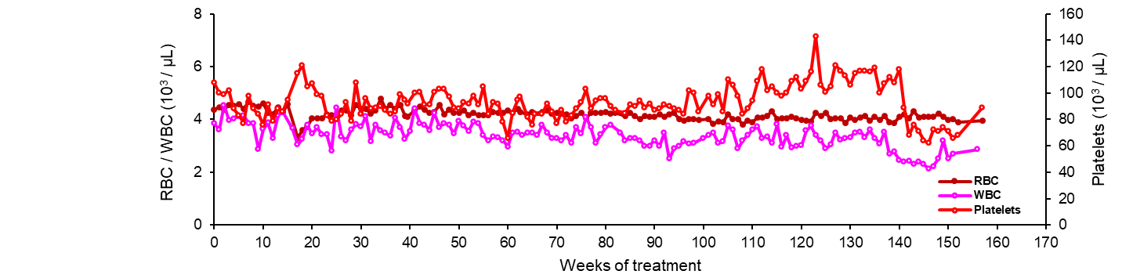
Compassionate use of NAPs in cirrhotic HBV/HDV co-infection
300mg TDF
Patient #1
Caucasian male, 51 years old
Chronic HBV / HDV infection
Decompensated cirrhosis (with varices)
(Adrian Streinu-Cercel, Bucharest, Romania)
Previous NUC exposure
250mg REP 2165-Mg (IV)
Thymosin α1
pegIFN 45
Prehevbrio
(Sci-B-Vac)
Removal of REP 2165-Mg and pegIFN
(3 months)
HDV RNA target not detected
HBsAg negative (qualitative)
Anti-HBs 24.97 mIU/mL
HBV DNA target not detected (with TDF)
ALT 31 U/L
AST 36 U/L
GGT 104 U/L
Bilirubin 13.34 µmol/L
Platelets 141 x 10³/µL (recovering)
WBC 4.31 x 10³/µL (recovering)

Slide 17
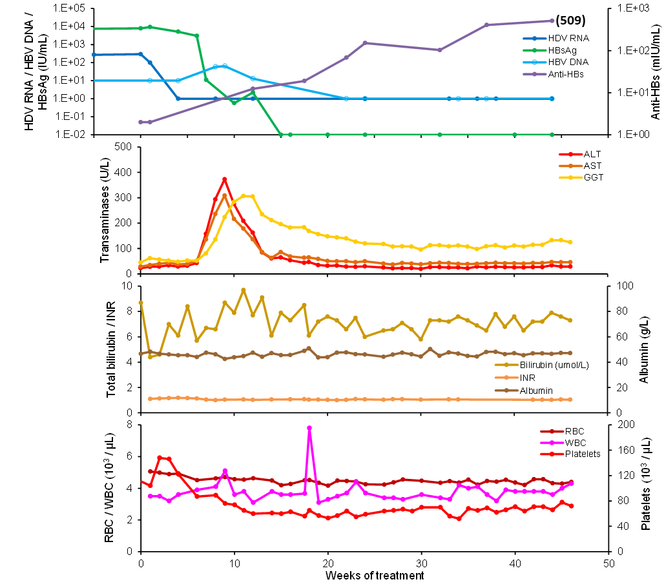
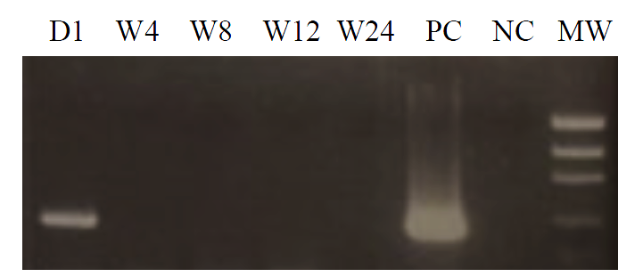
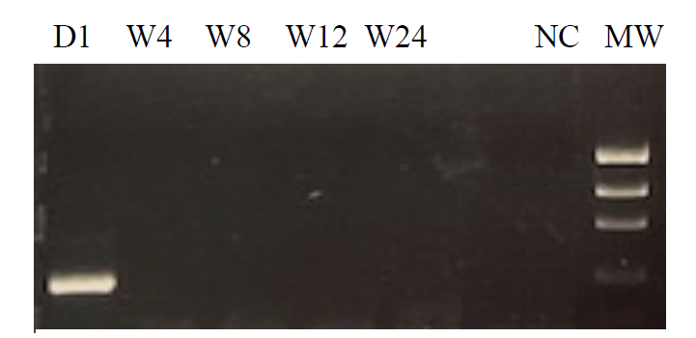
Transition of REP 2139-Mg to subcutaneous administration
Pan-genotypic HDV RT-PCR
(Emmanuel-Gordien)
TDF + pegIFN + REP 2139-Mg
Patient #2
Senegalese male, 51
HBV / HDV (GT5)
Compensated cirrhosis
(Marc Bourlière, Marseille France)
Previous HDV failure on:
TDF + pegIFN
TDF + pegIFN + 2mg bulvertide
Combination regimen (48 weeks)
300mg TDF qD PO
90 µg pegIFN qW SC
250mg REP 2139-Mg qW SC
transition to 125mg IV @ week 20
RT-PCR
Nested
RT-PCR
Removal of REP 2139-Mg and pegIFN
(1 month)
HBsAg not detected (< 0.05 IU/mL)
Anti-HBs 896 mIU/mL (509 at EOT)
ALT 32, AST 49, GGT 146 U/L
T-BIL 8.2 µmol/L, ALB 48.9 g/L, INR 1.09
Platelets 117x10³ /µL (recovering)
Other results pending…

Slide 18
Additional compassionate use
Patient #3
Caucasian Male, 47
Chronic HBV/HDV infection
Compensated cirrhosis (Child A5, stage 1 esophageal varices)
(Veronique Loustaud-Ratti, Limoges, France)
Previous HDV failure on:
TDF + pegIFN
TDF + pegIFN + bulvertide 2mg
Combination regimen:
300mg TDF qD PO
90 µg pegIFN qW SC
250mg REP 2139-Mg qW SC
SC administration well tolerated
8 weeks: HBsAg decline to 0.26 IU/mL (baseline 4650 IU/mL)
≤ 4 weeks: HDV RNA target not detected (baseline 5.78 log₁₀ IU/mL)
Other results pending…
Patient #4
Asian Male, 54
Chronic HBV / HDV infection
Compensated cirrhosis
(Christiane Stern, Clichy, France)
Previous HDV failure on:
TDF + pegIFN
TDF + pegIFN + bulvertide 2mg
TDF + pegIFN + bulvertide 10mg
Combination regimen:
300mg TDF qD PO
90 µg pegIFN qW SC
250mg REP 2139-Mg qW SC
SC administration well tolerated
Efficacy results pending…

Slide 19
Summary
Subviral particles (SVP): > 99.99% of circulating HBsAg
Prevent immune control and function of immunotherapy
Removal during therapy is essential for functional cure
Poorly targeted by direct acting antivirals (NUCs / CAMs / RNAi / antisense)
Integrated HBV DNA: Bulk of SVP production in HBeAg negative infection
        HBsAg specific T-cell response is required to target efficiently
        Therapeutic transaminase flares signal removal of integrated HBV DNA from the liver
NAPs target SVP production and HDV replication
High rates of HBsAg loss and host mediated transaminase flares translate to:
High rates of functional cure of HBV (with TDF + pegIFN)
High rates of functional cure of HDV (HDV RNA TND, normal ALT with no therapy) (with pegIFN)
Successful transition of REP 2139-Mg to once weekly SC administration
SC administration appears to have improved efficacy versus IV administration
Potent activity against HBV and HDV in compensated and decompensated cirrhosis.
Expansion of compassionate use program is in progress
Key to Functional Cure
Key to Functional Cure

