Slide 1

Antiviral effects of oral farnesoid X receptor agonist vonafexor combined with pegylated interferon alpha2a in untreated patients with chronic hepatitis B
Dr HANSEN, Bettina E [1,2] CHOI, Hannah S.J [2]; TANGKIJVANICH, Pisit [3]; REESINK, Henk [4];
ERKEN, Robin [4]; GIRMA, Hugo [5]; LE MEAUX, Virginie [5]; MARTIN, Isabelle [5]; ODOUL, Marion [5]; SCALFARO, Pietro [5]; JANSSEN, Harry L.A [1,2]
1 - Erasmus MC Rotterdam, The Netherlands; 2 – University of Toronto, Canada; 3 - Chulalongkorn University, Faculty of Medicine, Bangkok, Thailand; 4 – Leiden University Medical Center (LUMC) Department of Gastroenterology and Hepatology,
The Netherlands; 5 – ENYO Pharma SA, Lyon, France.
Singapore 02nd June 2022

Slide 2
Disclaimer
I disclose the following financial relationship(s) with a commercial interest:
Enyo Pharma SA
CymaBay Therapeutics
Intercept Pharma
Ipsen
Mirum
Albireo
Eiger
Calliditas

Slide 3
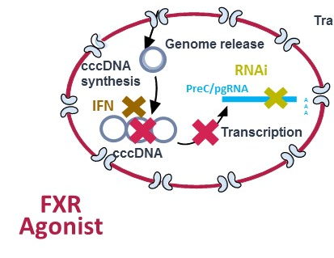
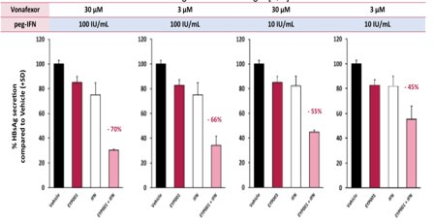
INTRODUCTION
Nucleosides/nucleotide analogues (NA) and peg-IFN for CHB often fail to induce a sustained loss of HBsAg. There is a need for better treatment options to improve functional cure rates.
The nuclear farnesoid X receptor (FXR) regulates bile acid homeostasis and is also involved in HBV replication.
The HBV cccDNA genome promoter region has response elements for FXR.
In primary human hepatocytes a synergy between FXR agonist vonafexor and peg-IFN was shown (David Durantel's lab INSERM Lyon).
Notes:
Chronic hepatitis B standard of care drugs nucleoside analogues and interferon often fail to induce a sustained loss of HBS antigen. Therefore a need for better treatment options leading to improved functional cure rates exists.
The nuclear farnesoid X receptor is expressed in hepatocytes, the GI tract and kidney. It plays a key role in bile acid homeostasis. FXR is also involved in HBV replication: the viral cccDNA in the hepatocyte nucleus has response elements to FXR and the resulting complex recruits viral HBx. As shown schematically in the upper right cartoon an FXR agonist can therefore interfere with the HBV viral replication cycle by destabilising this complex.
In experiments with primary human hepatocytes it was shown that FXR agonist Vonafexor reduces HBsAg (the red bars in the lower right cartoon), this similarly to interferon (the white bars). Interestingly the combination of interferon with vonafexor increased this effect further (pink bars).

Slide 4
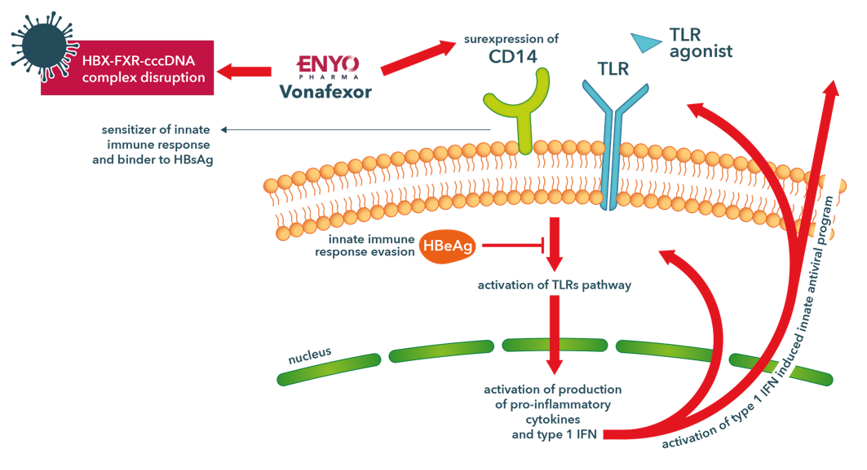
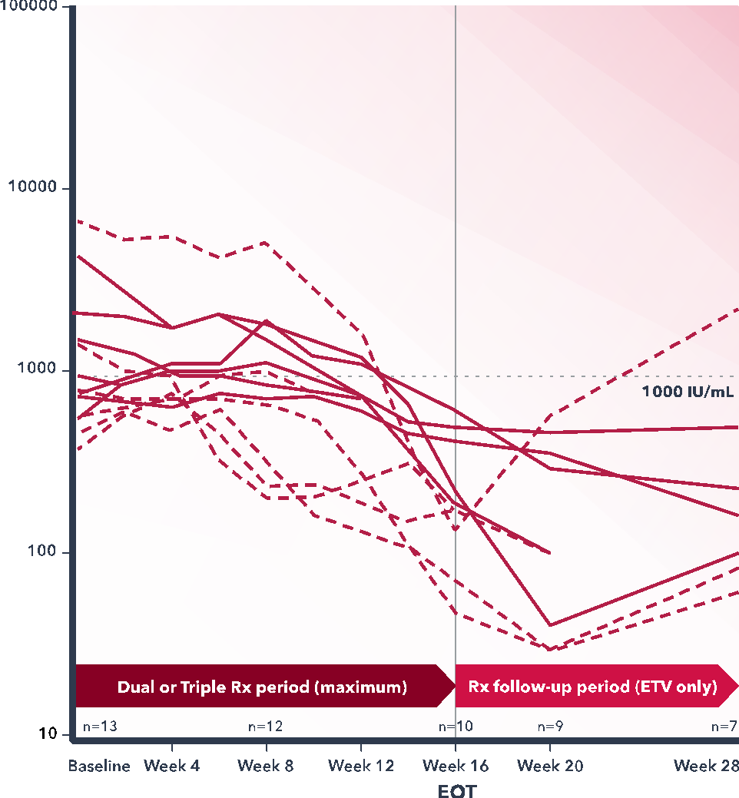
INTRODUCTION
A new hypothetical mechanistic explanation is based on FXR related pathways connecting to the innate immunity (Fiorruci S, 2018; Frontiers in immunol. Vavassori, 2009; J Immunol).
Vonafexor in addition to its effect in the hepatocyte nucleus ccc-DNA transcription complex could increase the expression of CD14 and the activation of TLR pathway.
Vonafexor impacted HBsAg levels in CHB patients with a peg-IFN synergy (Erken R. J Viral Hepat. 2021, Scalfaro P, EASL PO-2844, 2021).
W16 -0.9 (0.1) log10 IU/ml (p<0.001)
Notes:
This dose-dependent reduction of up to 70% of HBsAg secretion seen in the primary human hepatocytes, led to a new hypothetical mechanistic explanation. It has been previously described that FXR related pathways connect to the innate immunity. Vonafexor in addition to its effect in the hepatocyte nucleus ccc-DNA transcription complex, could increase the expression of CD14 and the activation of TLR pathway and a type 1 interferon induced innate antiviral program as shown in the upper right cartoon.
In patients with chronic hepatitis B an early proof-of-concept showed HBsAg decline: a synergy of vonafexor with pegylated interferon was reported. The diagram on the right shows the individual plasma HBs levels declining during a 16 weeks treatment course combining vonafexor with peg IFN and beyond after end of treatment with in average a close to one log10 reduction. However, the trial did not have an interferon monotherapy control arm.
Ref: Fiorruci S et al; Frontiers in immunology (2018); Vavassori et al. J Immunol (2009) Ref: Vanlandschoot P. et al.: Recombinant HBsAg, an apoptotic-like lipoprotein, interferes with the LPS-induced activation of ERK-1/2 and JNK-1/2 in monocytes. Biochem Biophys Res Commun. 2002 Sep 27;297 (3): 486-91. doi: 10.1016/S0006-291X(02)02243-X
TLR = Toll-like receptor. CD14 = cluster of differentiation 14, a glycosylphosphatidylinositol cell surface anchored protein. This human protein made mostly by macrophages as part of the innate immune system.

Slide 5
AIM
To confirm the synergic effect between Vonafexor and peg-IFN in untreated CHB patients

Slide 6
METHOD
A retrospective analysis was conducted to compare the antiviral effect seen in the phase 2 study (Scalfaro P et al. (2021, EASL):
  Vonafexor with peg-IFNα-2a +/- ETV over 16 weeks, followed by 24 weeks ETV to
  historic external matched cohort of patients treated with peg-IFN with or without NA. Patient level data was extracted from external CHB controls from published academic trials:
Janssen H. et al. HBV-99-01 Study Group (2005, Lancet):
  peg-IFNα-2b with or without Lamivudine over 52 weeks
Rijckborst V. et al. PARC Study Group (2010, Am J Gastroenterol):
  peg-IFNα-2a with or without Ribavirin over 48 weeks
Tangkijvanich P. et al. (2016, J Viral Hepat):
  peg-IFNα-2b with or without ETV over 48 weeks
De Niet A, et al. (2017, Lancet Gastroenterol Hepatol):
  peg-IFNα-2a with or without Nucleotide over 48 weeks
External CHB cohort
N=561
Vonafexor
N=20
Vonafexor
N=20
Notes:
Janssen HL, van Zonneveld M, Senturk H, Zeuzem S, Akarca US, Cakaloglu Y, Simon C, So TM, Gerken G, de Man RA, Niesters HG, Zondervan P, Hansen B, Schalm SW; HBV 99-01 Study Group; Rotterdam Foundation for Liver Research. Pegylated interferon alfa-2b alone or in combination with lamivudine for HBeAg-positive chronic hepatitis B: a randomised trial. Lancet. 2005 Jan 8-14;365(9454):123-9. doi: 10.1016/S0140-6736(05)17701-0. PMID: 15639293.
Rijckborst V, ter Borg MJ, Cakaloglu Y, Ferenci P, Tabak F, Akdogan M, Simon K, Raptopoulou-Gigi M, Ormeci N, Zondervan PE, Verhey E, van Vuuren AJ, Hansen BE, Janssen HL; PARC Study Group. A randomized trial of peginterferon alpha-2a with or without ribavirin for HBeAg-negative chronic hepatitis B. Am J Gastroenterol. 2010 Aug;105(8):1762-9. doi: 10.1038/ajg.2010.186. Epub 2010 May 11. PMID: 20461068.
Tangkijvanich P. Chittmittraprap S, Poovorawan K, Limothai U, Khlaiphuengsin A, Chuaypen N, Wisedopas N, Poovorawan Y. A randomized clinical trial of peginterferon alpha-2b with or without entecavir in patients with HBeAg-negative chronic hepatitis B: Role of host and viral factors associated with treatment response. J Viral Hepat. 2016 Jun;23(6):427-38. doi: 10.1111/jvh.12467. Epub 2015 Sep 21. PMID: 26387494.
de Niet A, Jansen L, Stelma F, Willemse SB, Kuiken SD, Weijer S, van Nieuwkerk CMJ, Zaaijer HL, Molenkamp R, Takkenberg RB, Koot M, Verheij J, Beuers U, Reesink HW. Peg-interferon plus nucleotide analogue treatment versus no treatment in patients with chronic hepatitis B with a low viral load: a randomised controlled, open-label trial. Lancet Gastroenterol Hepatol. 2017 Aug;2(8):576-584. doi: 10.1016/S2468-1253(17)30083-3. Epub 2017 May 15. PMID: 28522204.

Slide 7
METHOD
Vonafexor CHB cohort (n=20; HBeAg negative n=13, HBeAg positive n=7) was matched using a propensity scores method:
  Controlling for sex, age, HBV genotype B and C, baseline ALT, HBeAg, quantitative HBV DNA and quantitative HBsAg levels.
  The nearest neighbor range of the achieved propensity score was used with a window 0.05 to identify external controls.
External CHB cohort
N=561
Vonafexor
N=20
Controls
N=70

Slide 8
TREATMENTS & STATISTICAL
Vonafexor & PEG IFN +/- ETV 16 wk (N=20)
24 wk Follow-up ETV
weeks
16
28
40
2
4
6
8
10
12
14
20
PEG IFN +/- NA 48-52 wk (N=70)
weeks
4
12
16
24
48
52
20
Selection of external controls with propensity score method
Patient level data collected at all black timepoints. Interpolated data at grey timepoints. qHBsAg, HBV DNA and ALT during treatment up to week 16 and 20 were compared between the vonafexor CHB cohort (N=20) versus external control cohort (n=70) using repeated measurement analysis.
External RCT ‘s of PEG IFN +/- NUC 48-52 wk (N=561)

Slide 9
RESULTS – Demographics
 |  | External control N=70 | Vonafexor cohort N=20
Age | Mean (SD) | 46 (11) | 47 (9)
 | Median | 47 | 46
Sex N (%) | Male | 40 (57.1%) | 10 (50.0%)
Race N (%) | Caucasian | 4 (5.7%) | 0 (0.0%)
 | Asian | 62 (88.6%) | 20 (100%)
 | Other | 4 (5.7%) | 0 (0.0%)
 |  | External control N=70 | Vonafexor cohort N=20
HbeAg N (%) | Negative | 53 (75.7%) | 13 (65.0%)
 | Positive | 17 (24.3%) | 7 (35.0%)
Genotype N (%) | B | 40 (57.1%) | 15 (75.0%)
 | C | 30 (42.9%) | 5 (25.0%)
ALT x ULN | Mean (SD) | 1.34 (0.50) | 0.74 (0.32)
 | Median | 1.35 | 0.69
HBV DNA (log10) | Mean (SD) | 5.43 (1.92) | 5.71 (1.91)
 | Median | 5.20 | 5.15
HBsAg (log10) | Mean (SD) | 3.42 (0.73) | 3.46 (0.74)
 | Median | 3.31 | 3.25
All parameters, except for ALT, were well balanced. ALT were significantly higher at baseline in the external control cohort.

Slide 10
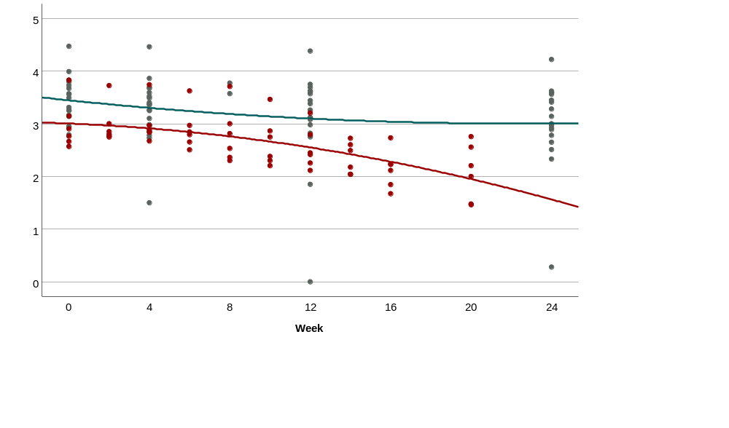
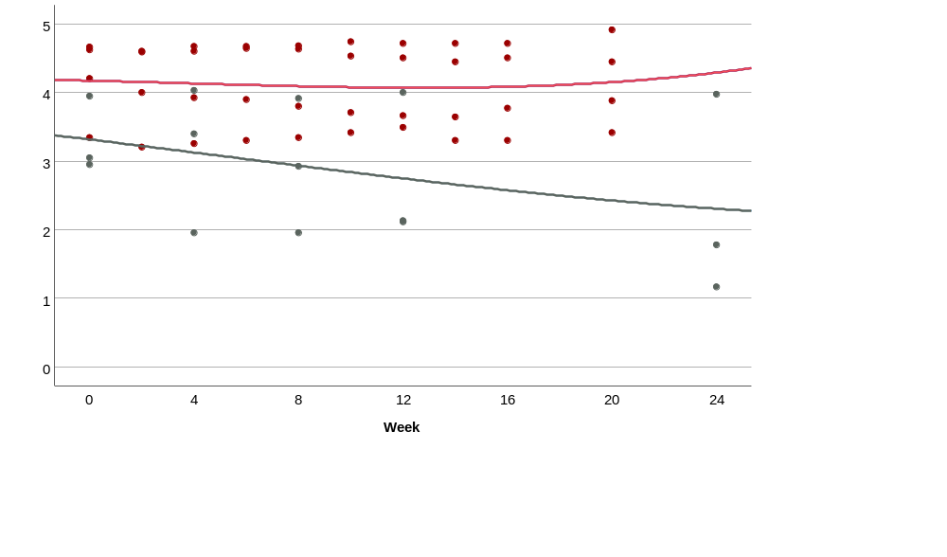
RESULTS – Peg-IFN monotherapy: cubic trend HBsAg decline per HBeAg status
HBeAg negative
HBeAg positive
Peg-IFN (n=18)
Peg-IFN + Vonafexor (n=4)
Peg-IFN (n=3)
Peg-IFN + Vonafexor (n=6)
The HBeAg negative group HBsAg (log 10 IU/mL)
had declines from baseline (mean, SD):
peg-IFN with Vonafexor:
  -0.8 (0.3, p<0.0001) at W16
  -1.0 (0.3, p<0.0001) at W20
peg-IFN external control cohort:
  -0.4 (0.2, p<0.0001) at W16
  -0.4 (0.2, p<0.0001) at W20
The HBeAg positive vonafexor group had a decline of -0.1 (0.4) at W16 and -0.0 (0.5) at W20 compared to -0.7 (0.4) at W16 and -0.9 (0.6) at W20 in the external cohort (p=0.06).
-> At week 20, the -1.0 (0.4) difference of HBsAg levels between cohorts was significant (p=0.02) favoring peg-IFN + Vonafexor.
-> At week 20, the -1.7 (0.8) difference of HBsAg levels between cohorts was significant (p=0.03) favoring peg-IFN.
Notes:
qHBsAg plasma level time series per HBeAg baseline status: negative (left figure) and positive (right figure). Patients treated by vonafexor and peg-IFN (vonafexor cohort) or peg-IFN monotherapy (external control cohort).
HBeAg negative subjects in the vonafexor cohort had a decline (mean, SD) of –0.8 (0.3) and –1.0 (0.3) at W16, W20 resp. (p<0.0001 both) compared to –0.4 (0.2) and –0.4 (0.2) (p<0.0001 both) in the external control cohort. The interpolated HBsAg concentration difference between cohorts was 1.0 (0.4) (p=0.02) at W20.
For HBeAg positive at week 20, the interpolated 1.7 (0.8) difference between HBsAg levels of both cohorts was significant (p=0.02) favoring peg-IFN monotherapy.

Slide 11
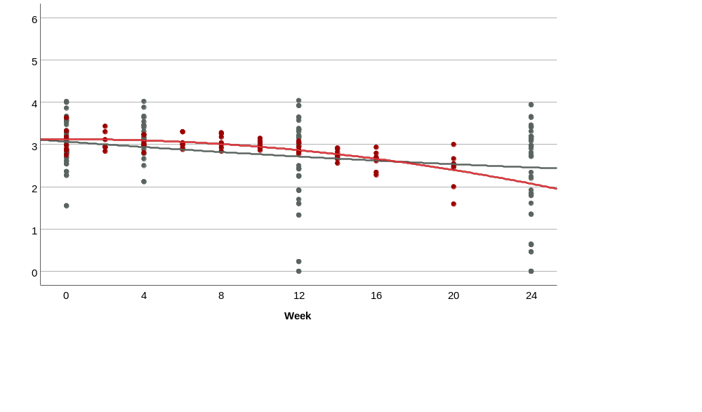
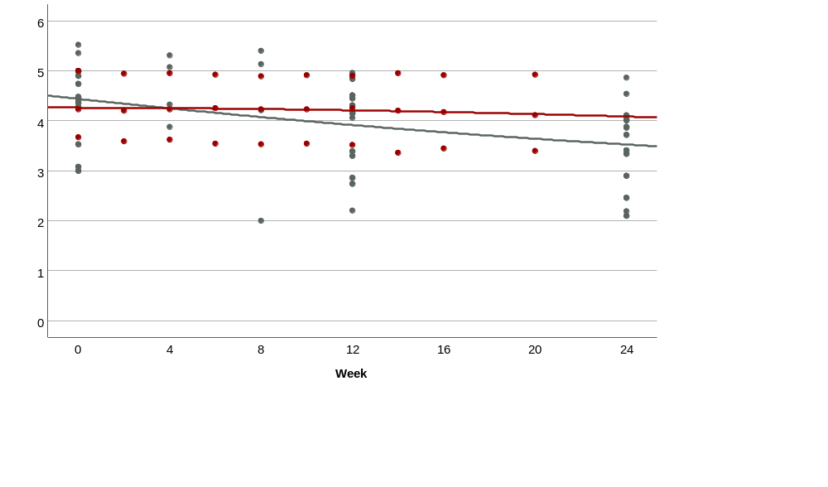
RESULTS – Peg-IFN & NA bitherapy: cubic trend HBsAg decline per HBeAg status
HBeAg negative
HBeAg positive
Peg-IFN+ETV+ Vonafexor (n=3)
Peg-IFN+NA (n=35)
Peg-IFN+ETV+ Vonafexor (n=7)
Peg-IFN+NA (n=14)
The HBeAg negative had HBsAg (log 10 IU/mL) declines from baseline (mean, SD):
peg-IFN and ETV and Vonafexor:
  -0.4 (0.2, p<0.0001) at W16
  -0.7 (0.2, p<0.0001) at W20
peg-IFN and NA external control cohort:
  -0.4 (0.2, p<0.0001) at W16
  -0.5 (0.2, p<0.0001) at W20
➔ No significant difference of HBsAg levels decline between cohorts.
  In the HBeAg positive vonafexor group a decline -0.1 (0.4) at W16 and -0.1 (0.5) at W20 compared to -0.7 (0.4) at W16 and -0.8 (0.2) at W20 in the external cohort.
  The W20 difference of 0.7 was not significant (p=0.13)

Slide 12
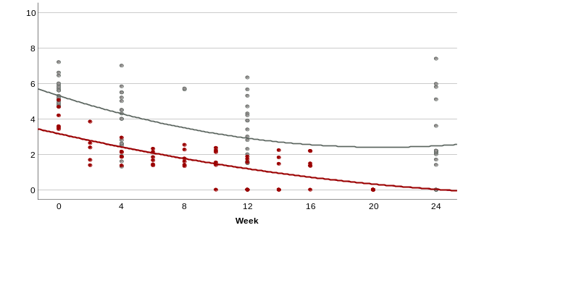
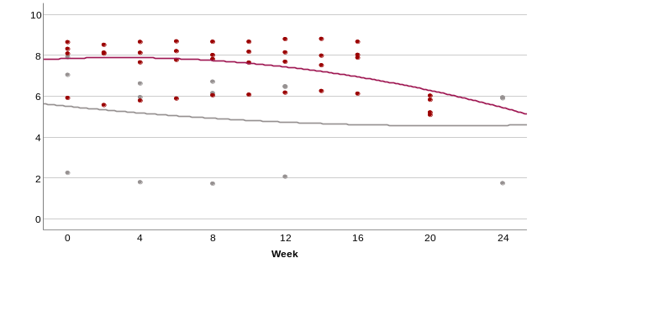
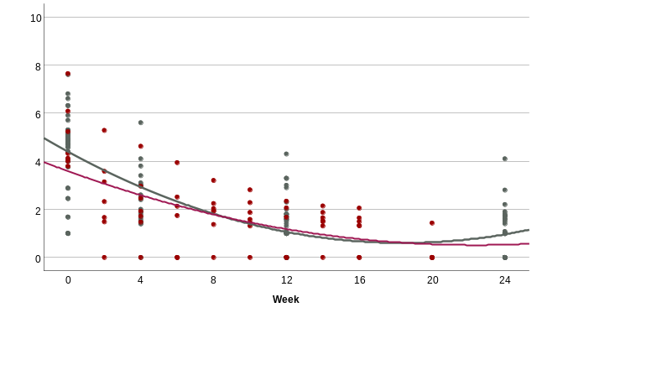
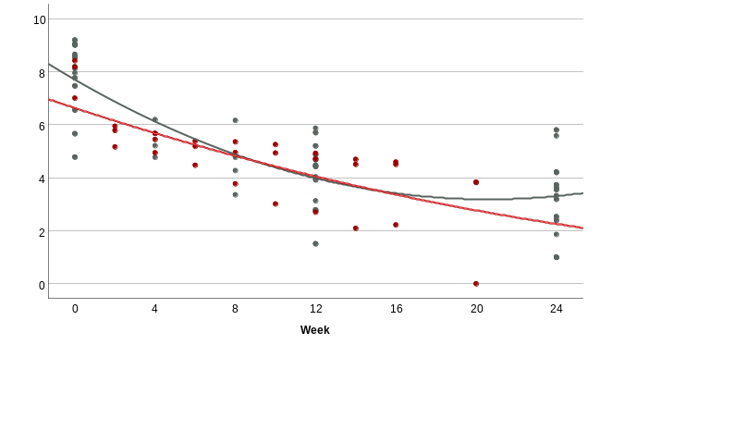
RESULTS – HBVDNA decline per HBeAg status and treatment
HBeAg negative
HBeAg positive
Peg-IFN+ Vonafexor
Peg-IFN
Peg-IFN+ Vonafexor
Peg-IFN
Cohort difference was -2.4 (log10 IU/mL) at baseline and -2.8 at W20 (p=0.0001 both). Difference in change from baseline was -0.4 (p=0.61) favoring Vonafexor. 6/6 (100%) in vonafexor group (not shown) were <LOQ at W40.
Cohort difference was 1.8 (log10 IU/mL) (p=0.28) at baseline and 0.4 at W20 (p=0.72). Difference in change from baseline was -1.3 (p=0.11). 0/4 (0%) vonafexor (not shown) were <LOQ at W40.
Peg-IFN+NA
Peg-IFN+NA
Peg-IFN+ETV+ Vonafexor
Peg-IFN+ETV+ Vonafexor
Cohort difference was -1.1 (log10 IU/mL) (p=0.07) at baseline and -1.4 at W20 (p=0.002). Difference in change from baseline was -0.3 (p=0.61). 6/7 (86%) in vonafexor groupp (not shown) were <LOQ at W40.
Cohort difference was -1.2 (log10 IU/mL) (p=0.15) at baseline and -1.6 at W20 (p=0.11). Difference in change from baseline was -0.4 (p=0.61). 1/3 (33%) vonafexor (not shown) was <LOQ at W40.
Notes:
Similar decline of HBV DNA was noted at W20 in both HBeAg negative and HBeAg positive patients in the Vonafexor cohort compared to the external.
In HBeAg negative patients the vonafexor cohort showed a somewhat more pronounced effect with PEG-IFN monotherpy translating into a -2.8 log 10 difference with the external cohort compared to -1.4 log10 between cohort difference compared to PEG-IFN with ETV.
In addition during the follow-up period under ETV monotherapy after end of Vonafexor until W40 more patients had undetectable DNA in the HBeAg negative patients (86 to 100%) compared to HBeAg positive (0 to 33%). This compared to ?? % < undectable HBV DNA at end of treatment with PEG-IFN mono or PEG-IFN with NA in the external matched cohort.

Slide 13
RESULTS – ALT Flares
Subjects were assessed for the highest ALT values and graded per CTCAE, with the highest counted once at timepoints W4, W12 and W20 (Vonafexor group) and W24 (external group).
ALT flares Grade 2 (moderate >3x to <5xULN) or Grade 3 (severe >5x to <20xULN) were observed in more subjects in the vonafexor cohort than in the external control in the HBeAg negative group.
No other liver biology or clinical anomalies were noted.
Using all timepoints in the vonafexor-treated cohort no correlation with HBsAg decline could be shown: of the HBeAg-negative (n=13) with grade 2 or 3 ALT flares (n=11) the HBsAg change (LS mean, log₁₀ IU/mL) was -0.78 (Gr2 –0.53, Gr3 –0.83) at W20 compared to -0.34 and -1.37 (log₁₀ IU/mL) in two HBeAg-negative patients without flares. A single HBeAg-positive patient had a Gr3 flare with a -0.27 HBsAg decline.
Patients (N)​ | ALT
 | Grade 2 or 3​
HBeAg-negative and positive​
Vonafexor cohort (n=20)​ | 8​ (40%)
External control (n=70)​ | 3 (4%)​
HBeAg-negative​
Vonafexor cohort (n=13)​ | 8 (62%)​
External control (n=53)​ | 1 (2%)​
HBeAg-positive​
Vonafexor cohort (n=7)​ | 0 (0%)
External control (n=17)​ | 2 (12%)​
Notes:
NOTE: Vonafexor cohort – ALT was measured biweekly; so only took measurements at weeks 4, 12, and 20 to match the frequency of measurements in the external cohort (ALT available at weeks 4, 12, and 24)
TABLE: Table counts only at 3 timepoints for ALT taken from weeks 4, 12, and 20 (vonafexor)/24 (external cohort) to adjust for differences in the frequency of measurements between cohorts.
“Overall, this mirrors somehow the observed anti-viral and can be interpreted as therapeutic flares, although drug induced lesions can not be entirely excluded.” – could be said verbally but would not put this in the slide for an oral presentation

Slide 14
CONCLUSION
Vonafexor in combination with peg-IFN administered over 16 weeks induced a significantly higher HBsAg decline in HBeAg negative untreated well matched CHB patients compared to peg-IFN monotherapy. No difference was seen in HBeAg positive patients.
Adding ETV to vonafexor with peg-IFN did not increase this effect, like adding NA to peg-IFN did not show a stronger anti-viral effect.
Vonafexor in combination with peg-IFN induced more often isolated ALT flares in HBeAg negative patients (62%) compared to peg-IFN monotherapy (4%). No difference in flares occurred in HBeAg positive patients. No correlation between ALT flares and HBsAg decline was seen. Flares were interpreted as therapeutic flares.
Vonafexor's mechanism of action needs further investigation as to the cellular pathways involving FXR with the innate immunity. ALT flares may reflect hepatocyte death through an immune mediated clearance of infected, non-functional hepatocytes.
Overall, the findings need to be confirmed and support further investigation of vonafexor in combination with peg-IFN in HBeAg negative CHB patients administered over a longer treatment duration and at different dose levels.

Slide 15
ACKNOWLEDGEMENTS
Our gratitude goes to all the patients, to the investigators involved with these trials and to the academic researchers for the data contribution.

Slide 16
BACKUP – ALT VONAFEXOR COHORT
Subjects were assessed for highest ALT values and graded per CTCAE, the highest counted once.
No other liver biology or clinical anomalies were noted.
Cut off CTCAE for ALT normal at baseline:
Grade 1 mild >ULN, <3xULN
Grade 2 moderate >/=3xULN, <5xULN
Grade 3 severe >/=5xULN, <20xULN
Grade 4 life-threatening >/=20xULN
NB:
Similar multiples for Baseline > ULN
The vonafexor cohort had 10 timepoints of ALT measurements over 20 weeks.
Visit Grade Hbsag Decrease
Week 20 (Follow-up Visit 1) 1 -0.94
Week 20 (Follow-up Visit 1) 2 -0.53
Week 20 (Follow-up Visit 1) 3 -0.83
Patients (N)​ | ALT​
 | Grade 1​ | Grade 2​ | Grade 3​ | Grade 4​ | Grade ≥ 2​
HBeAg-negative and positive​
Vonafexor cohort (n=20)​ | 6 | 3 | 9 | 0​ | 12​ (60%)
HBeAg-negative​
Vonafexor cohort (n=13)​ | 2 | 2​ | 9 | 0​ | 11 (85%)​
HBeAg-positive​
Vonafexor cohort (n=7)​ | 4 | 1 | 0 | 0 | 1 (14%)

Slide 17
BACK-UP Vonafexor cohort ALT & ASL Grade 2 or 3 flares
ALT | Arm 1 Triple VONA-200 & peg IFN & ETV |  |  |  | Arm 2 Dual VONA-200 & peg IFN
 | all n=10 | HBeAg- n=7 | HBeAg+ n=3 |  | all n=10 | HBeAg- n=6 | HBeAg+ n=4
baseline mean U/L (SD) | 34 (12) | 32 (13) | 41 (6) |  | 32 (17) | 36 (20) | 26 (9)
mean of maximal value U/L (SD) observed between W1 and W16 | 305 (239) | 388 (241) | 110 (53) |  | 195 (165) | 285 (154) | 59 (39)
Grade 2 (>3xULN) n (%) from W1 to W16 | 3 (30%) | 2 (29%) | 1 (33%) |  | 0 | 0 | 0
Grade 3 (>5xULN) n (%) from W1 to W16 | 5 (50%) | 5 (71%) | 0 |  | 4 (40% | 4 (67%) | 0
Grade 2 or 3 (>5xULN) n (%) from W17 to W40 | 1 (10%) | 1 (14%) | 0 |  | 0 | 0 | 0
AST | Arm 1 Triple VONA-200 & peg IFN & ETV |  |  |  | Arm 2 Dual VONA-200 & peg IFN
 | all n=10 | HBeAg- n=7 | HBeAg+ n=3 |  | all n=10 | HBeAg- n=6 | HBeAg+ n=4
baseline mean U/L (SD) | 27 (9) | 25 (9) | 31 (12) |  | 29 (9) | 31 (11) | 26 (6)
mean of maximal value U/L (SD) observed between W1 and W16 | 241 (193) | 273 (200) | 166 (188) |  | 175 (153) | 250 (159) | 64 (27)
Grade 2 (>3xULN) n (%) during W1 to W16 | 3 (30%) | 3 (43%) | 0 |  | 1 (10%) | 1 (17%) | 0
Grade 3 (>5xULN) n (%) during W1 to W16 | 4 (40%) | 3 (43%) | 1 (33%) |  | 3 (30%) | 3 (50%) | 0

Slide 18
BACK-UP Vonafexor cohort tablulated DNA and HBsAg results
HBV DNA | Arm 1 Triple VONA-200 & peg IFN & ETV |  |  |  | Arm 2 Dual VONA-200 & peg IFN
 | all n=10 | HBeAg- n=7 | HBeAg+ n=3 |  | all n=10 | HBeAg- n=6 | HBeAg+ n=4
mean log10 IU/mL (SE) at baseline | 5.9 (1.8) | 5.0 (1.4) | 7.9 (0.8) |  | 5.5 (2.1) | 4.1 (0.7) | 7.7 (1.2)
Mean change log10 IU/mL (SE) HBV DNA at W16 | -3.5 (0.4) | -3.7 (0.3) | -3.8 (0.5) |  | -1.4 (0.4) | -2.7 (0.3)§# | 0.2 (0.4)
Mean change log10 IU/mL (SE) HBV DNA at W20 | -4.4 (0.5)§ | -4.3 (0.5)§ | -4.6 (0.7)§ |  | -2.4 (0.5) | -3.2 (0.5)§ | -1.5 (0.6)§
Mean change log10 IU/mL (SE) HBV DNA at W40 | -4.3 (0.3) | -4.0 (0.3) | -4.9 (0.4) |  | -3.7 (0.3) | -3.4 (0.3) | -4.2 (0.4)
HBV DNA < LLOQ n (%) at W16 | 2 (20%) | 2 (29%) | 0 |  | 1 (10%) | 1 (17%) | 0
HBV DNA < LLOQ n (%) at W40 | 7 (70%) | 6 (86%) | 1 (33%) |  | 6 (60%) | 6 (100%) | 0
HBsAg | Arm 1 Triple VONA-200 & peg IFN & ETV |  |  |  | Arm 2 Dual VONA-200 & peg IFN
 | all n=10 | HBeAg- n=7 | HBeAg+ n=3 |  | all n=10 | HBeAg- n=6 | HBeAg+ n=4
mean log10 IU/mL (SE) at baseline | 3.5 (0.7) | 3.1 (0.3) | 4.3 (0.7) |  | 3.5 (0.8) | 3.0 (0.5) | 4.2 (0.6)
Mean change log10 IU/mL (SE) HBV HBsAg at W16 | -0.3 (0.1) | -0.5 (0.1)§ | -0.1 (0.3) |  | -0.5 (0.1)§ | -0.9 (0.2)§# | -0.1 (0.2)
Mean change log10 IU/mL (SE) HBV HBsAg at W20 | -0.4 (0.2)§ | -0.7 (0.1)§ | -0.1 (0.3) |  | -0.5 (0.2)§ | -0.9 (0.2)§# | 0.0 (0.3)
Mean change log10 IU/mL (SE) HBV HBsAg at W40 | -0.5 (0.1) | -0.6 (0.1) | -0.2 (0.2) |  | -0.4 (0.1) | -0.6 (0.1) | -0.2 (0.2)
Responder n (%) < 100 IU/mL at W16 | 0 | 0 | 0 |  | 2 (20%) | 2 (33%) | 0
Responder n (%) < 100 IU/mL at W40 | 0 | 0 | 0 |  | 1 (10%) | 1 (14%) | 0
 | mean (SE) or n (%) are shown |  |  |  | LLOQ limit of quantification: 1.3 log10 IU/mL = 20 IU/mL ca. 112 copies/mL
 | § p<0.001 vs. baseline |  |  |  | # p<0.001 HBeAg- vs. HBeAg+

