Slide 1
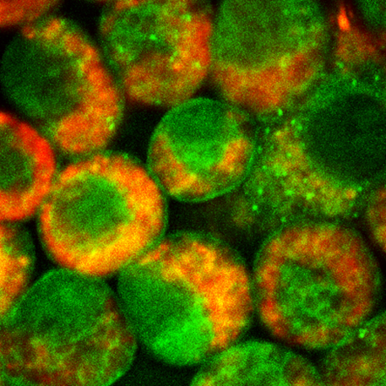
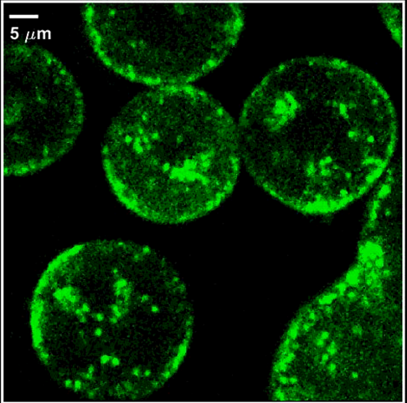
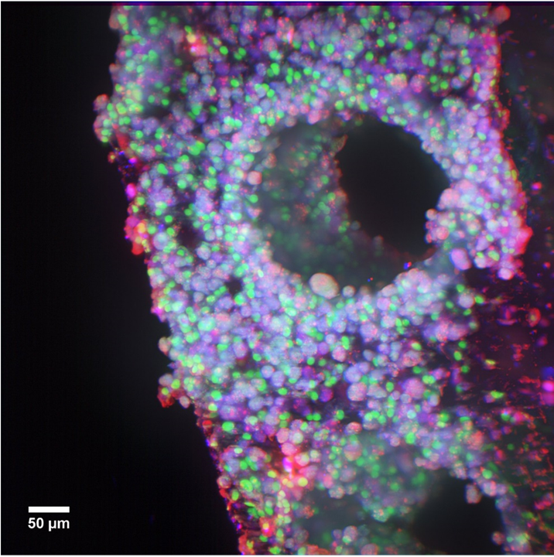
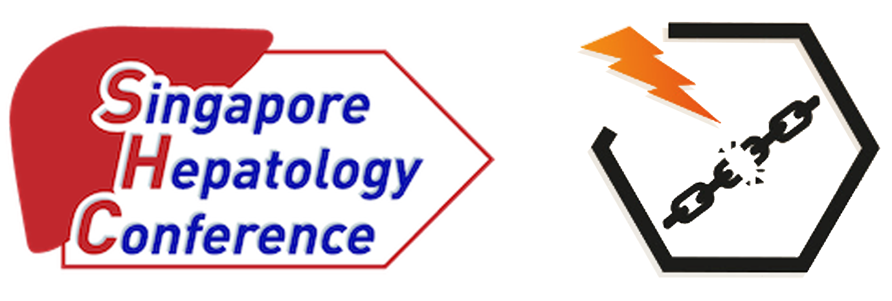
Studying the Hepatic distribution of ASOs using Multimodal Imaging
Steve Hood, GSK
SHC 2022
31st May 2022
steve.r.hood@gsk.com

Slide 2
A tale of 2 oligos - ASO to treat patients with CHB
Meet the Molecules
GSK3228836 (GSK836 aka ISIS 505358) is a 20mer ASO gapmer targeting a shared region in all HBV mRNAs
  The sequence is specific to HBV (no cross-reactivity with cellular mRNAs) and is highly conserved (>90%) across all HBV genotypes
  GSK836 co-developed with Ionis since 2015 and in-licenced in 2019
GSK3389404 (GSK404) is a GalNAc conjugated GSK836 designed to enhance hepatocyte uptake via ASGPR
  Circulates as GSK404 in plasma but rapidly converted to GSK836 on uptake into the tissues
  GSK404 was developed by GSK from 2015 and in-licenced in 2019
Non-clinical Package
Efficacy in in vitro and in vivo HBV models
Full pre-clin tox package (sc) in mouse and cyno + repro, safety pharm etc
Sensitive LCMS assay developed to measure GSK404 & GSK836 in plasma and tissue
Clinical Package
Ph1 study in Healthy Volunteers (UK & Canada)
Ph2a Studies in Asian patients

Slide 3
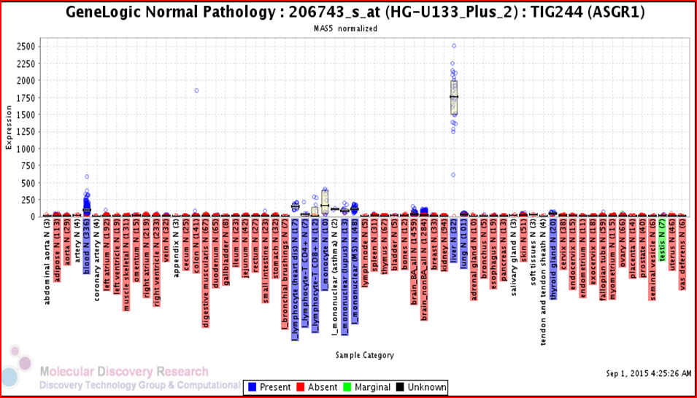
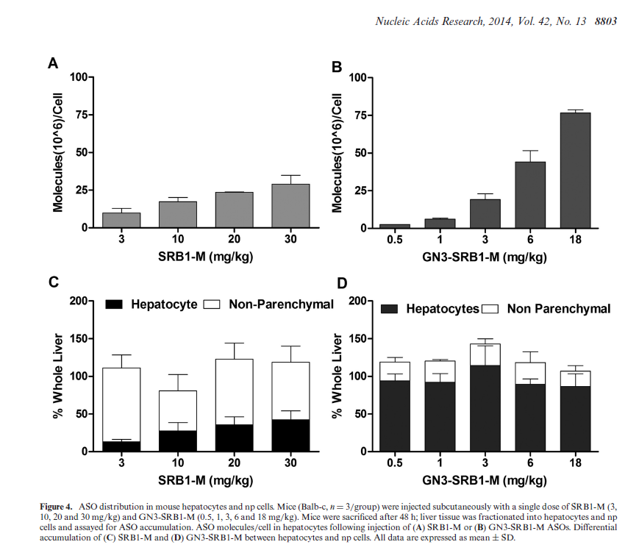
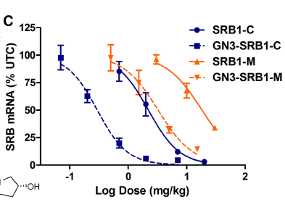
GalNAc enhances hepatocyte uptake (literature)
Prakash et al (2014) Nuc Acid Res, 42(13) 8796-8807

Slide 4
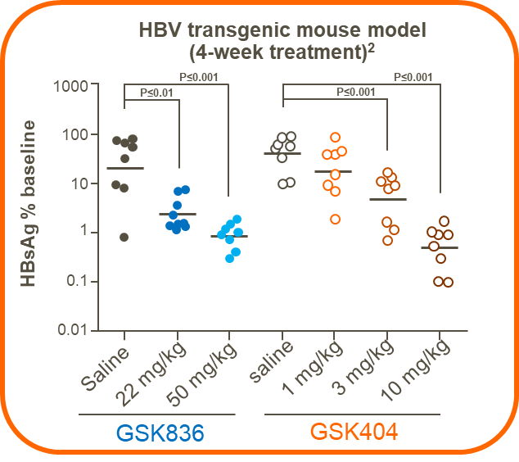
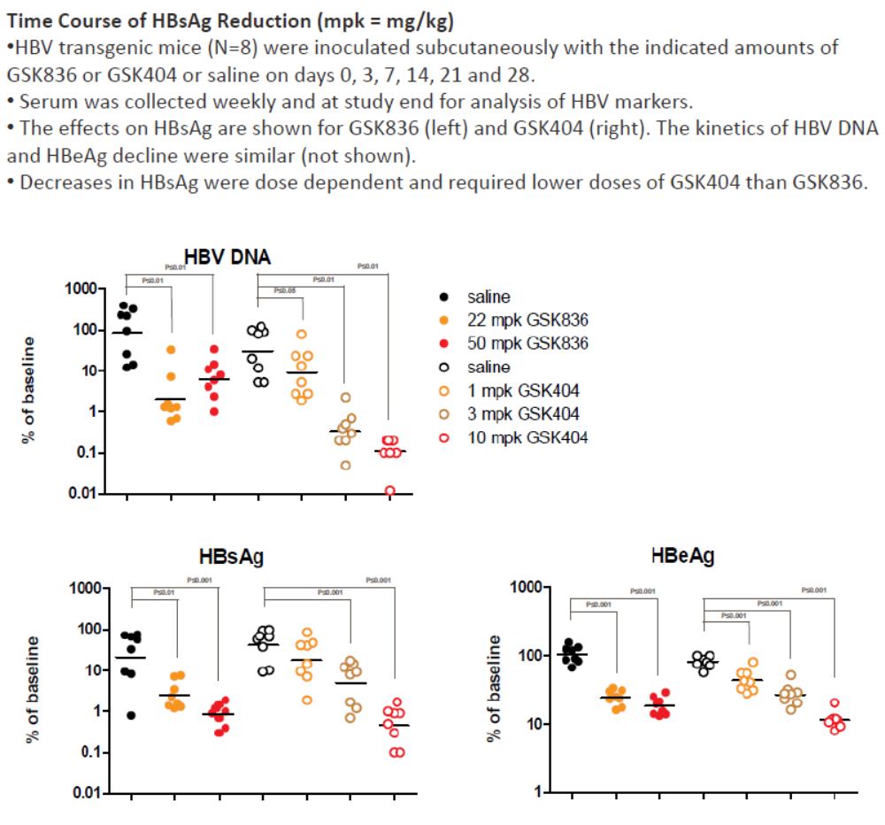
Preclinical demonstration of improved potency of the GalNAc over the parent
Transgenic mouse models
  HBV transgenic mice (n-8) were dosed subcutaneously with GSK404, GSK836 or saline on days 0, 3, 7, 14, 21 & 28
  Serum was collected weekly for HBV biomarkers - Comparison of Day 0 and Day 28 shown
Experiment | Outcome
Pre-clin efficacy | GSK404 8-10 fold more potent than GSK836
✓
You et al, 2016; Poster presented at International HBV meeting 2016, Seoul, Korea.

Slide 5
Phase 2a clinical study designs were different
Aim: compare clinical efficacy of GSK836 and GSK404 using data from two Phase 2a studies
 | GSK3228836 ‘Naked’ or ‘Parent’ molecule | GSK3389404 GalNAc-conjugated molecule
Phase 2a: study details | IONIS Study 505358 - CS3 completed | GSK Study 205670 completed
Duration of treatment | 4 weeks† | 12 weeks
HBV population | Treatment-naïve & Stable NUC | On stable NUC
Treatment groups SC dose (TMD), mg | Placebo 150 qW§ (900) 300 qW§ (1800) | Placebo 30 qW (120) 60 qW (240) 120 qW (480) 120 qoW (240)
*Patients in post-treatment follow-up; †followed by a 6-month course of tenofovir initiated on Day 29; ‡study also included a cohort on stable NUC but data for this cohort are incomplete and not presented here;
§includes loading dose on Day 4 and Day 11
NCT02981602 and NCT03020745
GalNAc, N-acetyl galactosamine; HBV, hepatitis B virus; NUC, nucleos(t)ide; qoW, bi-weekly; qW, weekly; SC, subcutaneous; TMD, total monthly dose
D. Theodore et al, HepDART 2019

Slide 6
Greater HBsAg reduction with GSK836 treatment for 4 weeks compared with GSK404 treatment for 12 weeks
Greater reductions in HBsAg were observed after 4 weeks of treatment with GSK836 than with 12 weeks of treatment with GSK404
0.5
GSK404
0.0
PBO qW (n=10)
30 mg qW (n=6)
60 mg qW (n=20)
120 mg qoW (n=15)
120 mg qW (n=15)
−0.5
HBsAg (log₁₀ IU/mL),
mean (SEM)
−1.0
GSK836
PBO (n=6)
150 mg (n=6)
300 mg (n=12)
−1.5
−2.0
0
10
20
30
40
50
60
70
80
90
Day
GSK836 study: HBV response was assessed at baseline (Day 1) and on Days 15, 23, 29; GSK404 study: HBV response was assessed at baseline (Day 1) and on Days 8, 15, 22, 29, 36, 43, 50, 57, 64, 71, 78, 85, 92, 99, 113, 141, 169
HBsAg, hepatitis B surface antigen; PBO, placebo; qW, weekly; qoW, biweekly; SEM, standard error of the mean
Theodore et al, 2019 HepDART 2019; Yuen et al (2021) Nature Medicine 27 (10) 1725-34

Slide 7
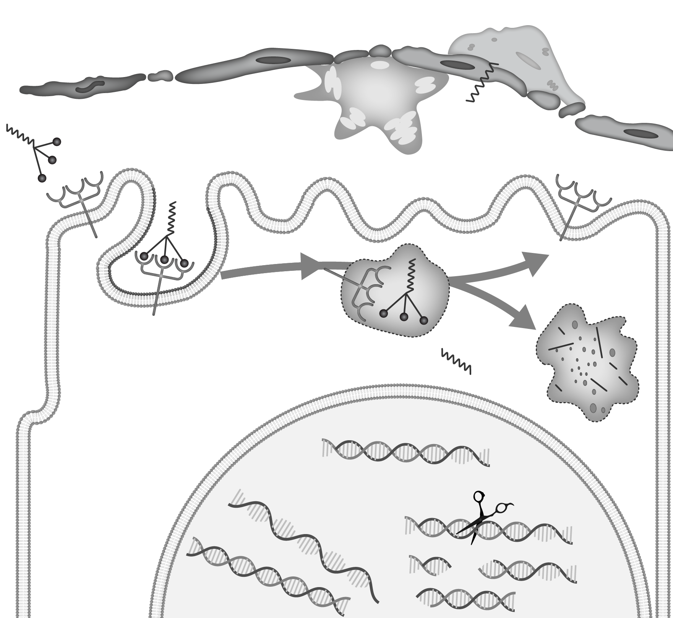
Hypotheses for clinical efficacy of GSK836 vs GSK404
Conclusion
Comparing these separate studies, while both GSK836 and GSK404 demonstrated target engagement with dose-dependent declines in mean HBsAg, more robust dose-related reductions of HBsAg levels were observed with the unconjugated ASO (GSK836) Further elucidation of mechanisms of the clinical efficacy observed with ASO in patients with CHB is warranted
Liver sinusoid endothelial cells
Kupffer cell
Stellate
cell
GaINAc₃-ASO
Receptor-mediated
ASO uptake into
hepatocytes
Perisinusoidal
space
ASGPR
Recycling
ASGPR
Patient population (naïve vs treatment experienced)
PK difference (Age, body wt, liver function)
Altered ASGPR distribution or function in virally-infected hepatocytes
Change in the ‘shuttling’ of GalNAc within virally-infected hepatocytes
Immunostimulatory effect of GSK836 in nonparenchymal cells
Clathrin-coated pit
mRNA:ASO duplex
Lysosome
Hepatocyte
mRNA
RNase H1
recognizes
duplex
DNA
Cytoplasm
Nucleus
RNA is cleaved
Figure adapted from Crooke et al. Nucleic Acid Ther 2019;29:16–32 (the publisher for this copyrighted material is Mary Ann Liebert, Inc. publishers)
ASGPR, asialoglycoprotein receptor; ASO, antisense oligonucleotide; GalNAc, N-acetyl galactosamine; HBsAg, hepatitis B surface antigen; PK, pharmacokinetic
D. Theodore et al, 2019

Slide 8
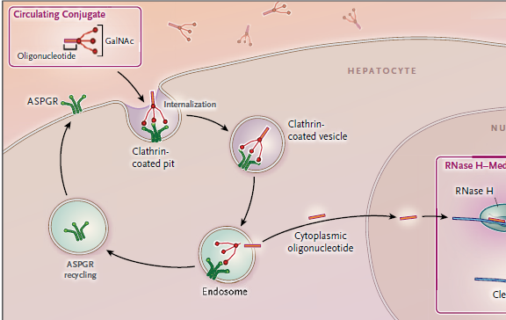
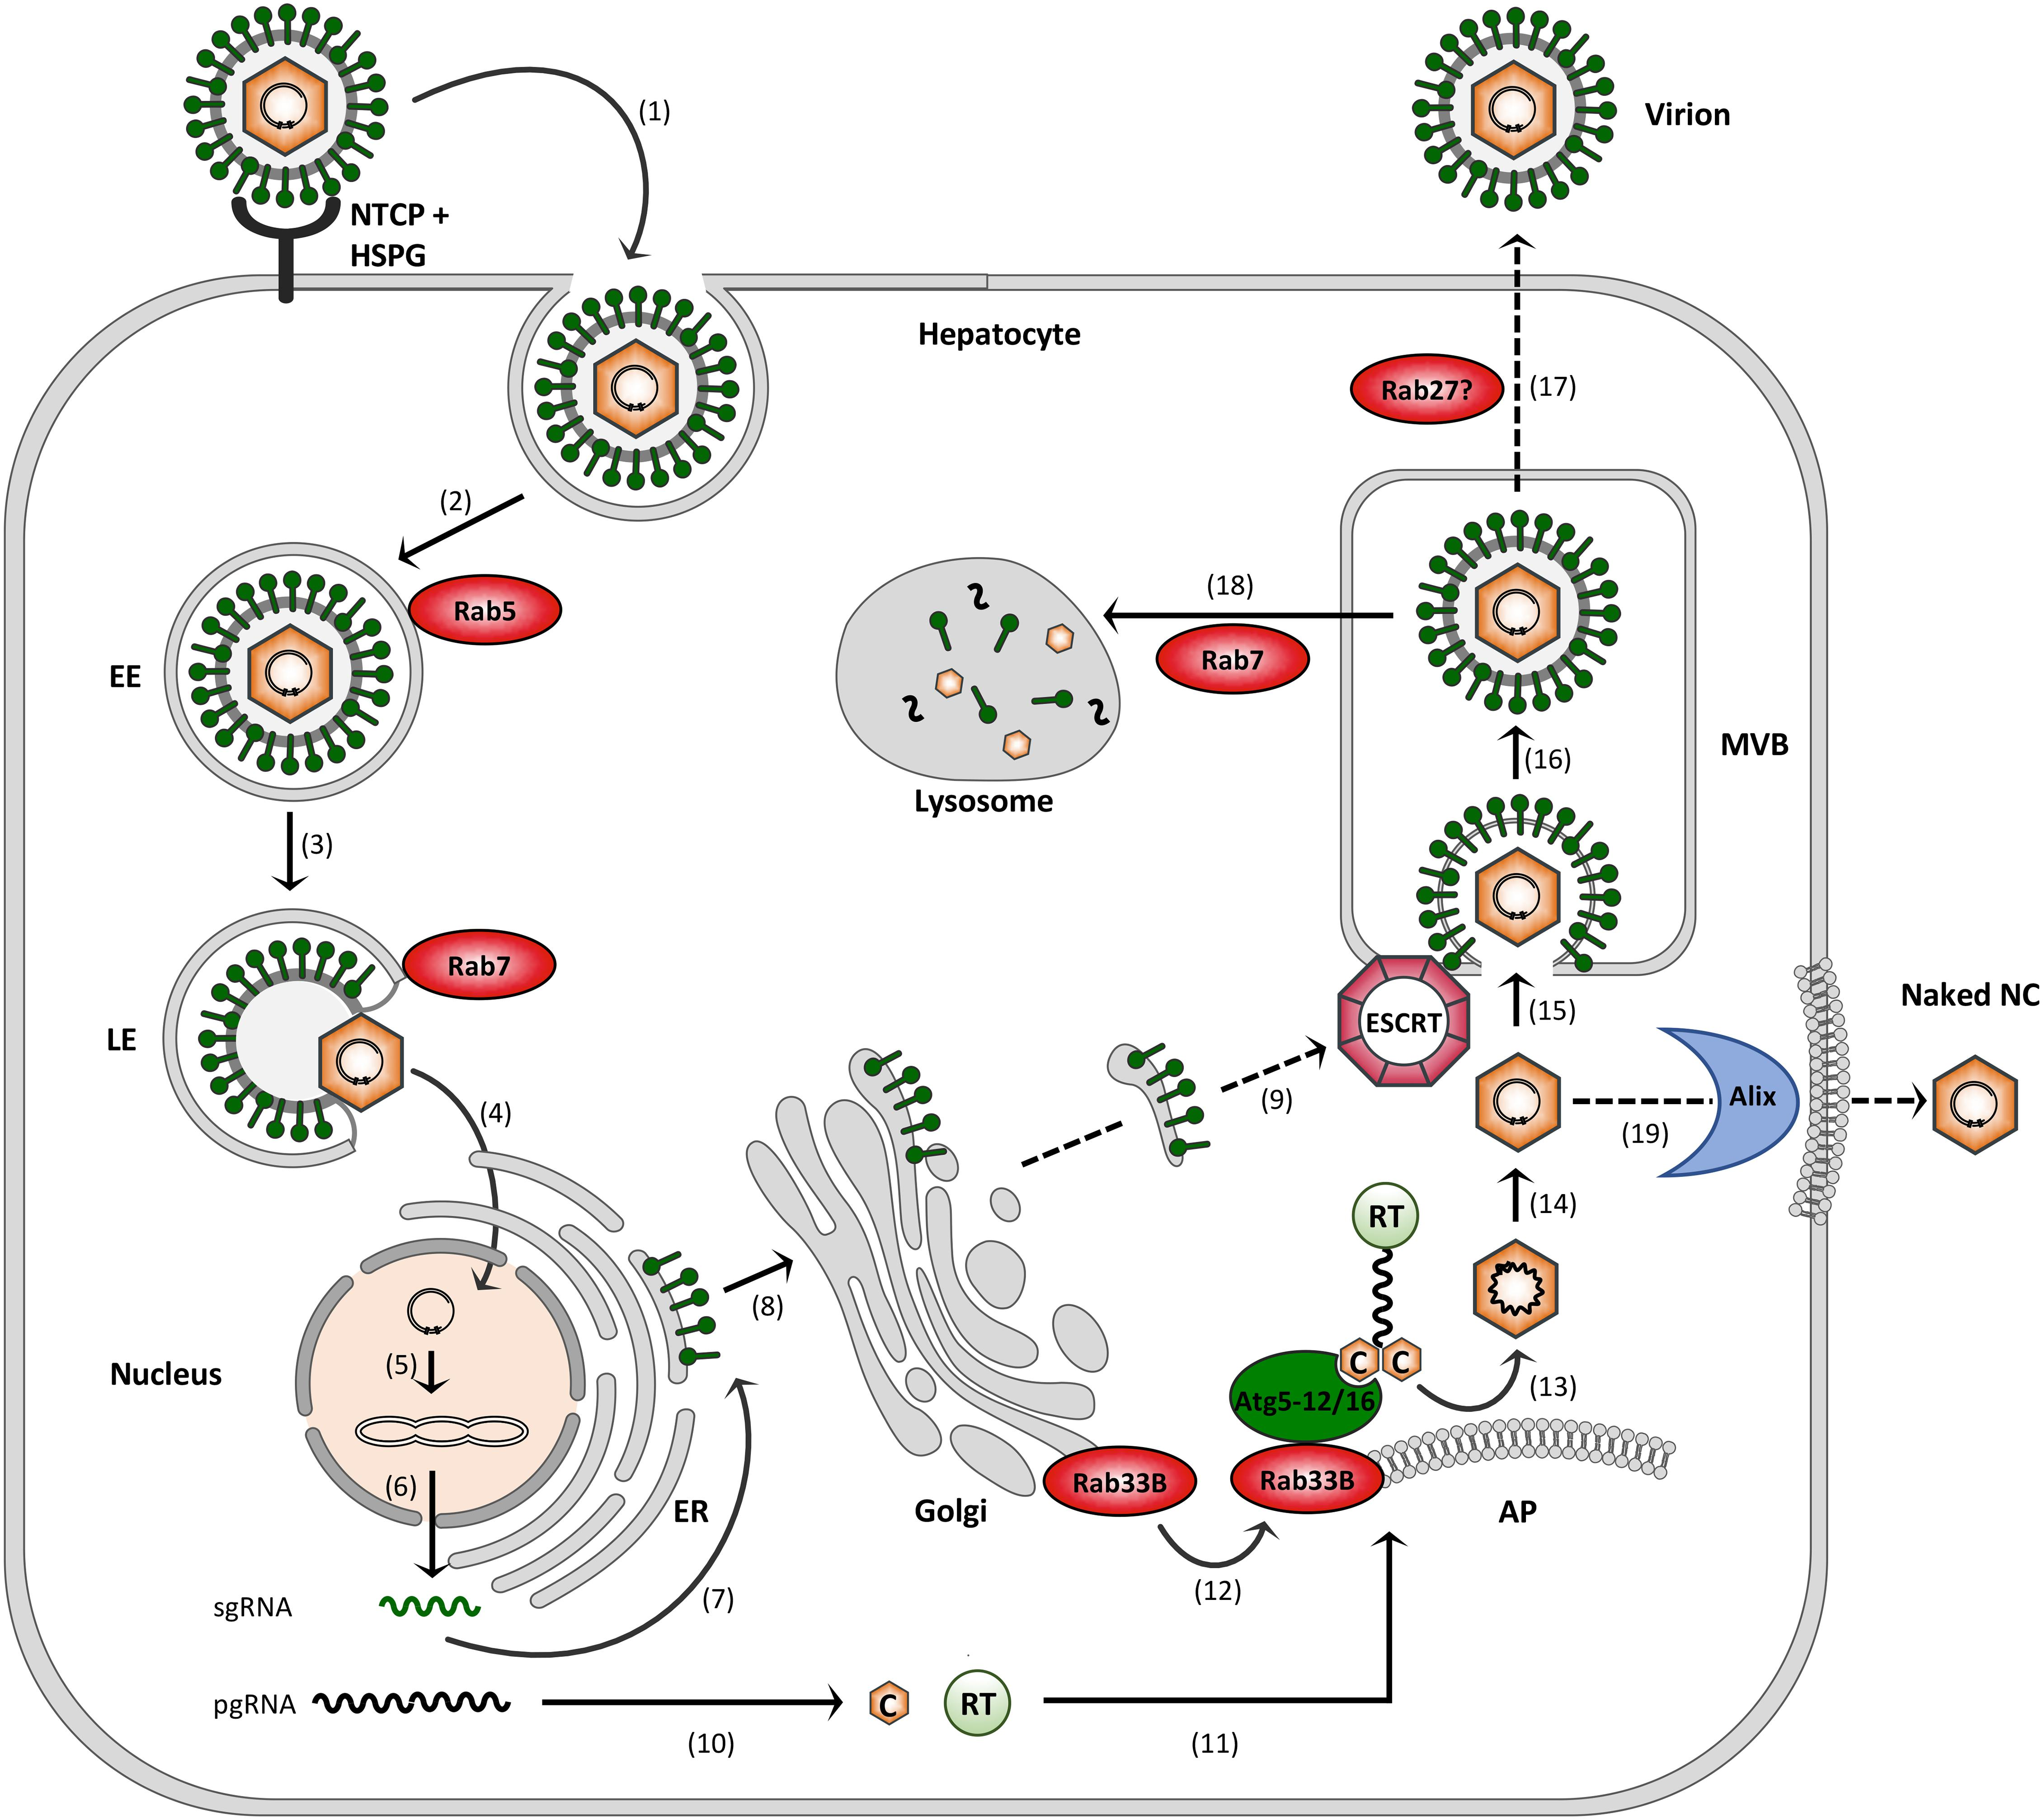
Transporter competition? – “not enough taxis at the airport”
Levin, AA (2017) NEJM 376:86
Zeyen and Prange (2018) Frontiers in Cell Dev Biol; 6,154

Slide 9

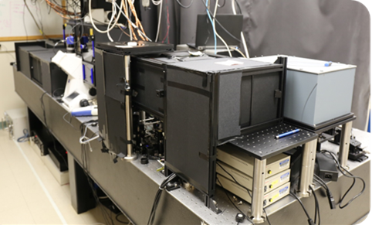
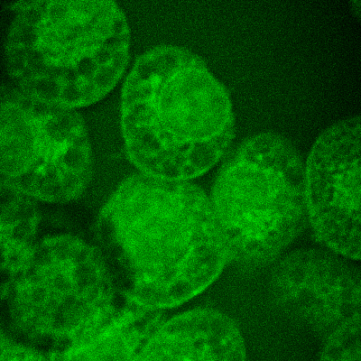
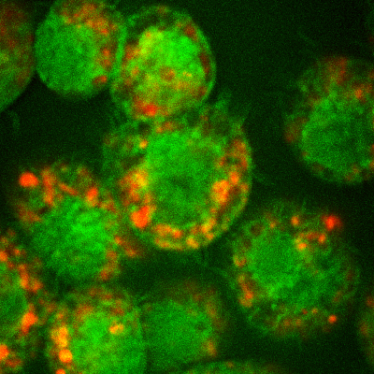

Mouse Macrophages – ASO uptake
CARS image at -CH₂ vibration frequency (lipid)
Fluorescence image of Alexa647-ASO
Control
4hr post-treatment
24hr post-treatment
GSK Center for Optical Molecular Imaging (COMI)
University of Illinois
Urbana Champaign
25 µm
CARS (Lipid region)
Alexa647-tagged ASO
SRB1 oligos donated by Punit Seth (Ionis) for this work
Prabuddha Mukherjee, Derek Shi, Edita Aksamitiene, Aneesh Alex, Chi Zhang, Ken Frazier, Steve Hood, Steve Boppart

Slide 10
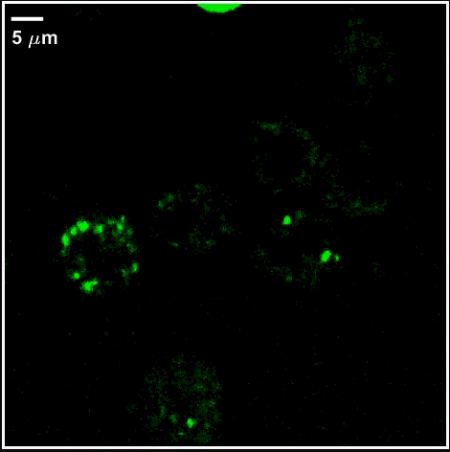
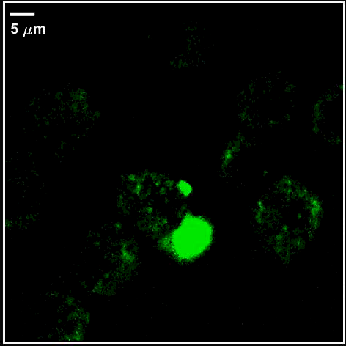
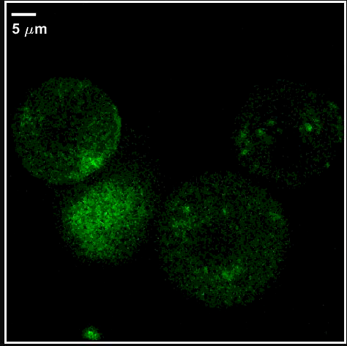
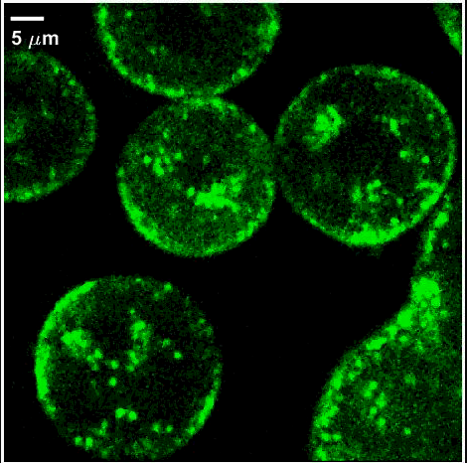
GN-ASO/ASO uptake Kinetics
60 min duration time lapse video started 30 mins after dosing with oligo (50nM)
Mouse Macrophages
Cryopreserved Mouse Hepatocytes
ASO
GN-ASO
ASO
GN-ASO
Published Online:19 Nov 2021 https://doi.org/10.1089/nat.2021.0059
Prabuddha Mukherjee, Derek Shi, Edita Aksamitiene, Aneesh Alex, Chi Zhang, Steve Boppart

Slide 11
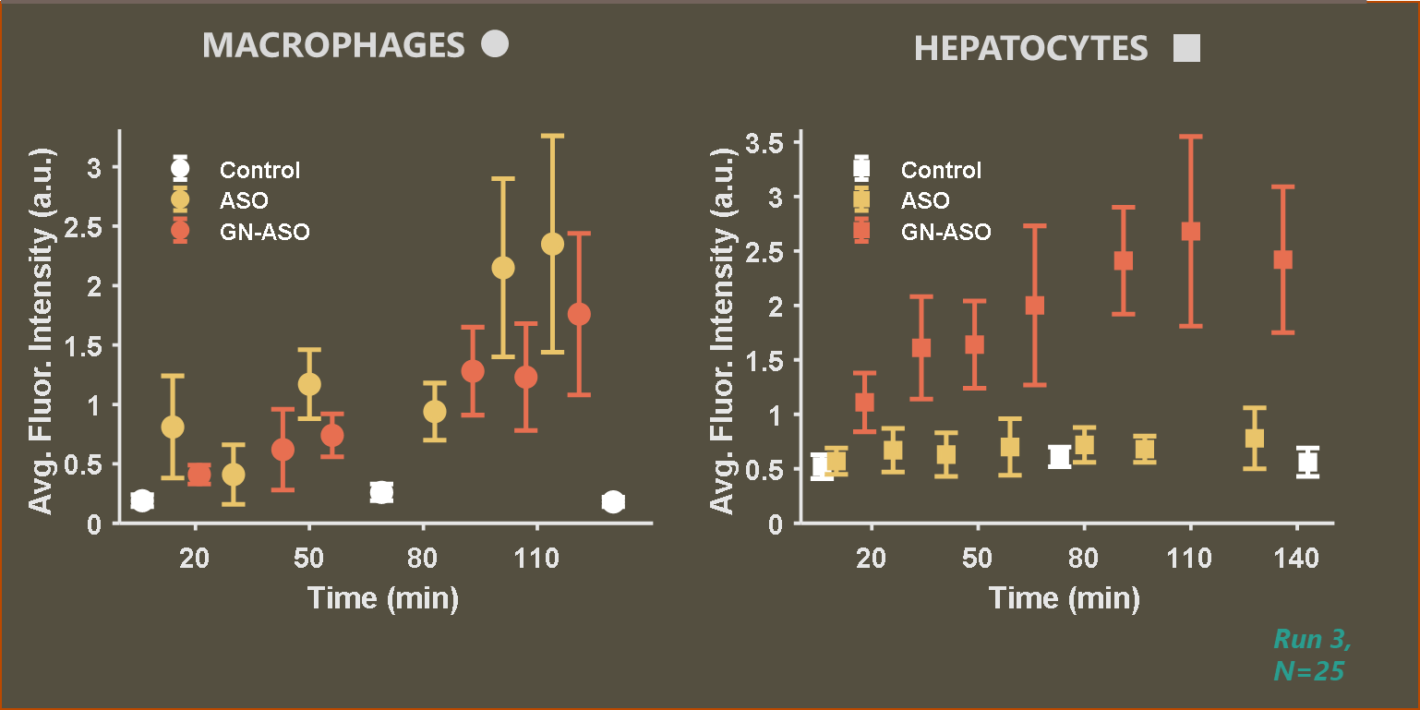
GN-ASO/ASO uptake Kinetics
Oligo conc - 50nM
Prabuddha Mukherjee, Derek Shi, Edita Aksamitiene, Aneesh Alex, Chi Zhang, Steve Boppart

Slide 12

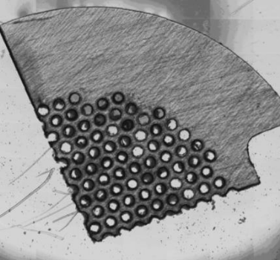
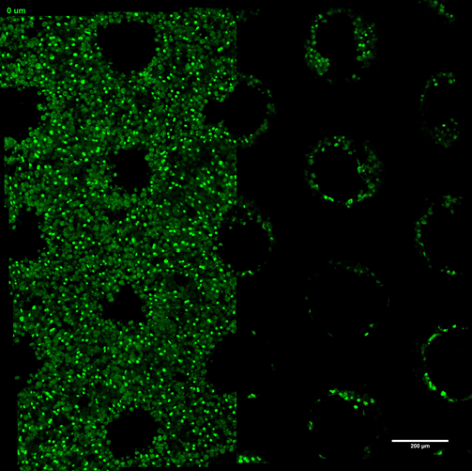

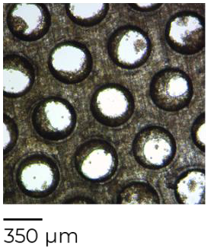
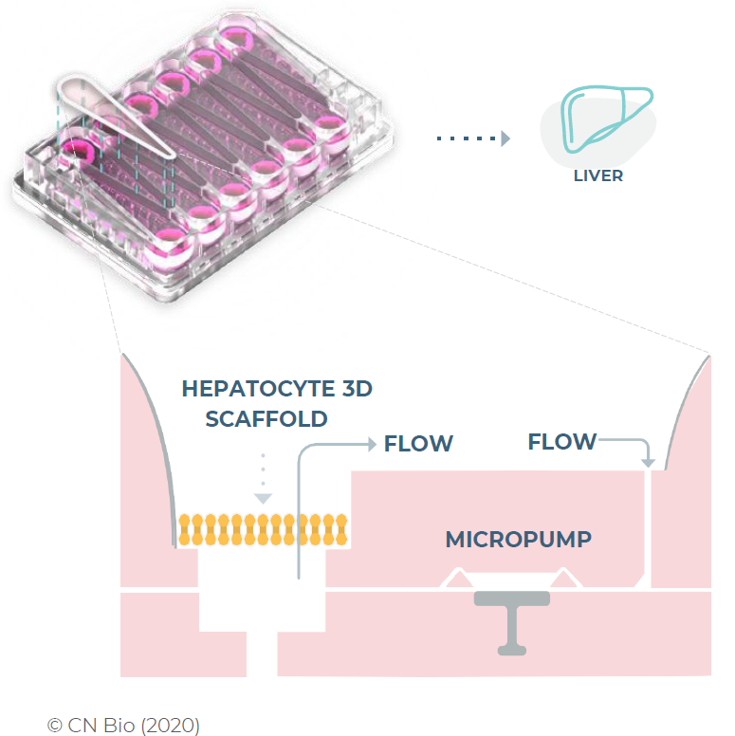
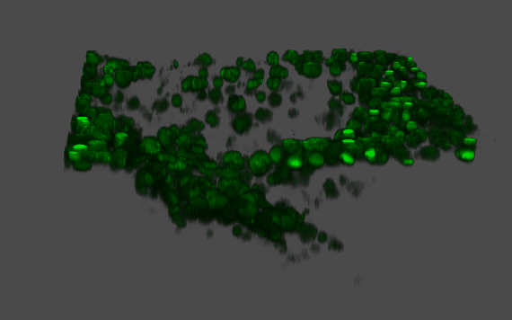
Imaging of complex in vitro liver cultures
Primary hepatocyte + Kupffer cell co-culture dosed with A488-tagged oligo
Fluorescence confocal microscopy
Fluorescence
d_{pore} = 310 µm
0 µm
-28.5 µm
anti-sense oligo A488
200µm
© CN Bio (2020)
GSK, ELN19075
Jan Majer – MUSIQ ESR - GSK

Slide 13
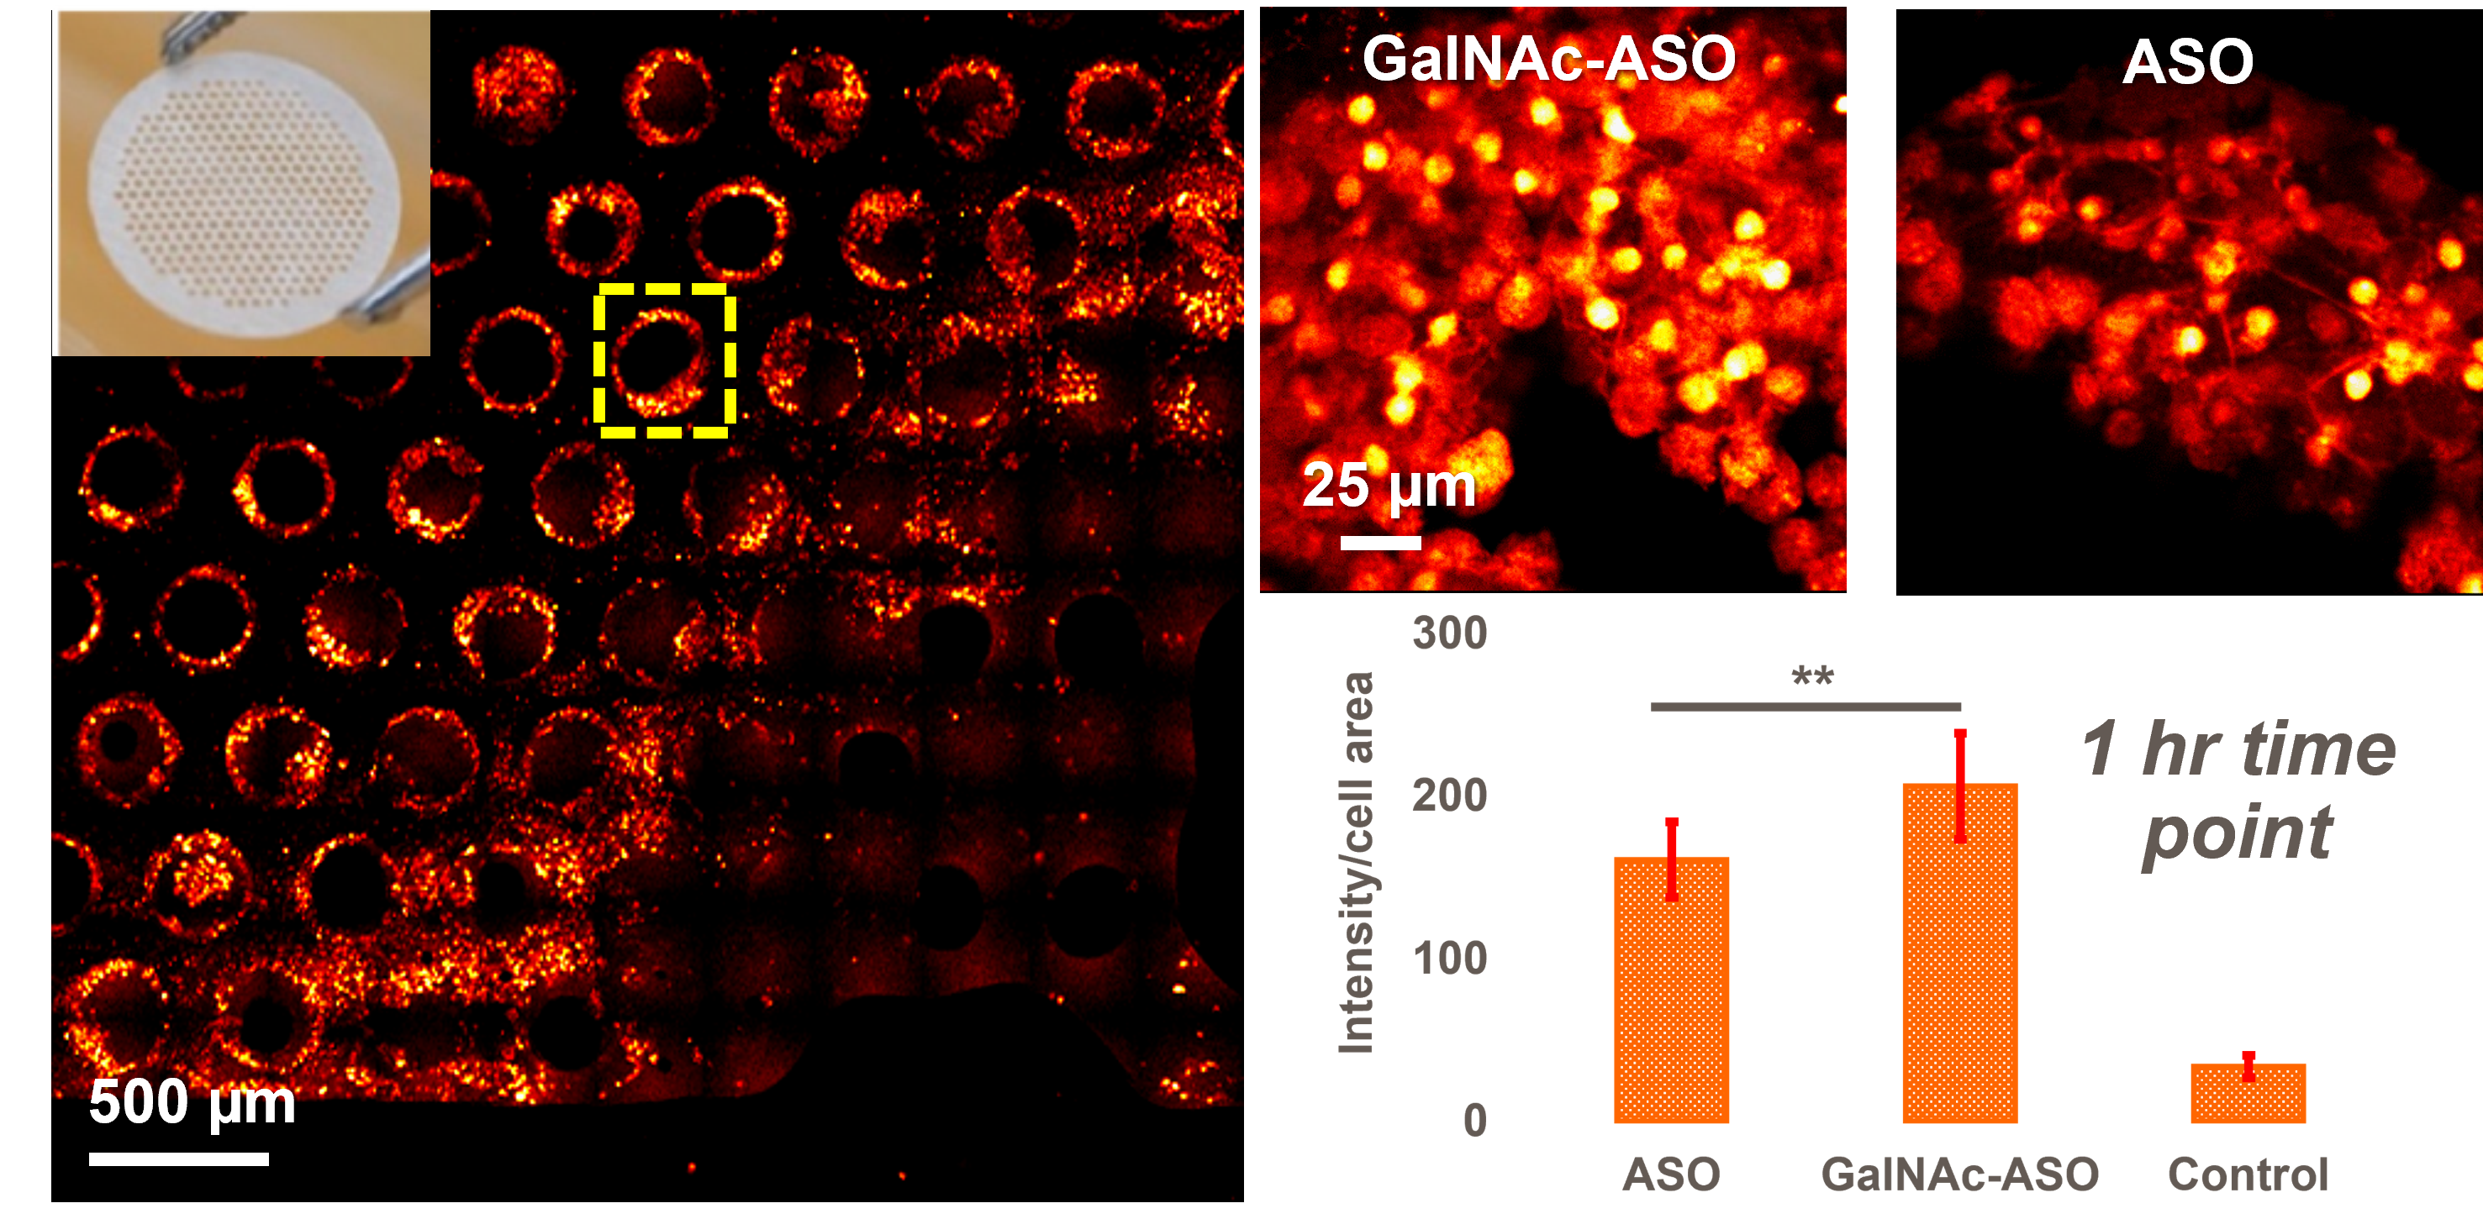
Differential uptake of GalNAc- ASO vs ASO in CIVM
Prabuddha Mukherjee, Derek Shi, Aneesh Alex, Steve Boppart

Slide 14
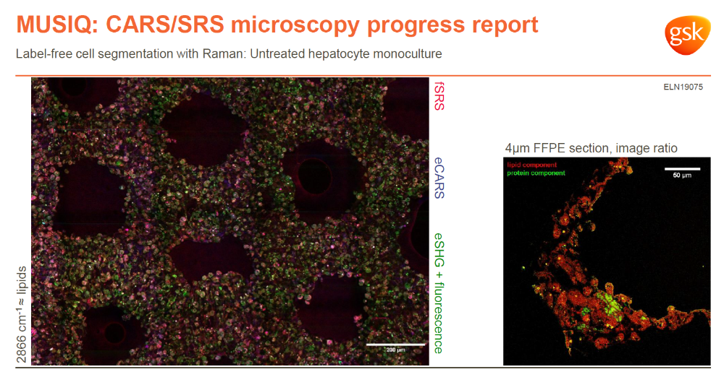
Imaging CNBio chips on Leica SP8 CARS/SRS
Jan Majer – MUSIQ ESR - GSK

Slide 15


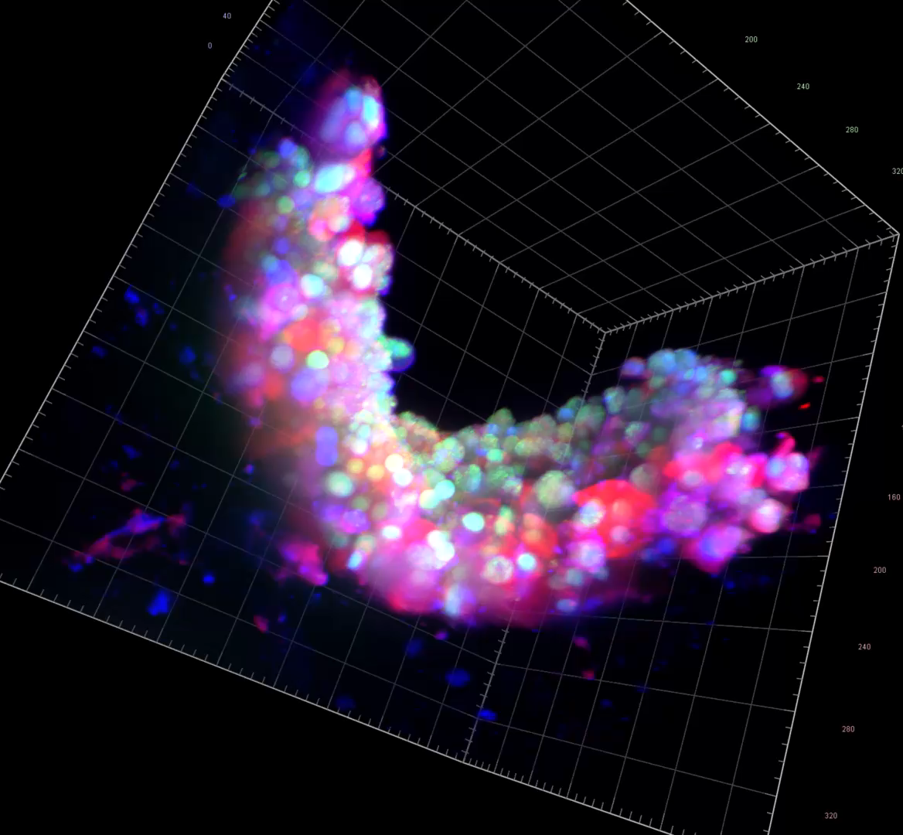
Same Chips – Imaging on Lightsheet at Cardiff
Hoechst – nucleus
CellMask™ – plasma membrane
Concanavalin A – plasma membrane
ELN36734
Jan Majer (GSK), Pete Watson (Cardiff)

Slide 16
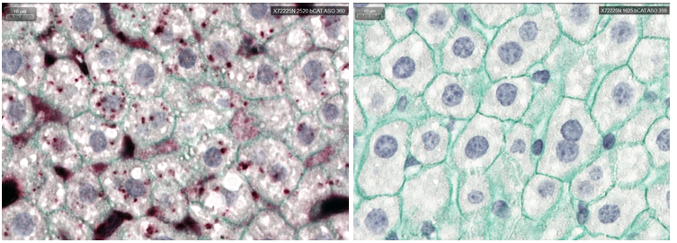
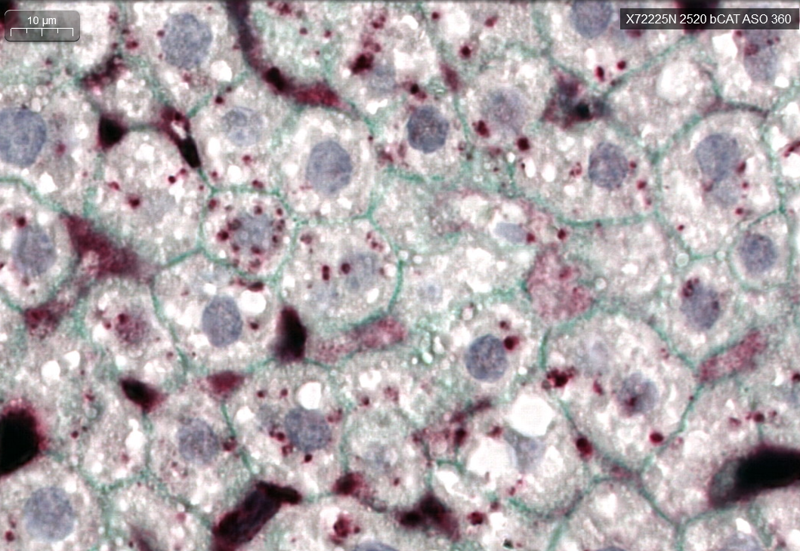
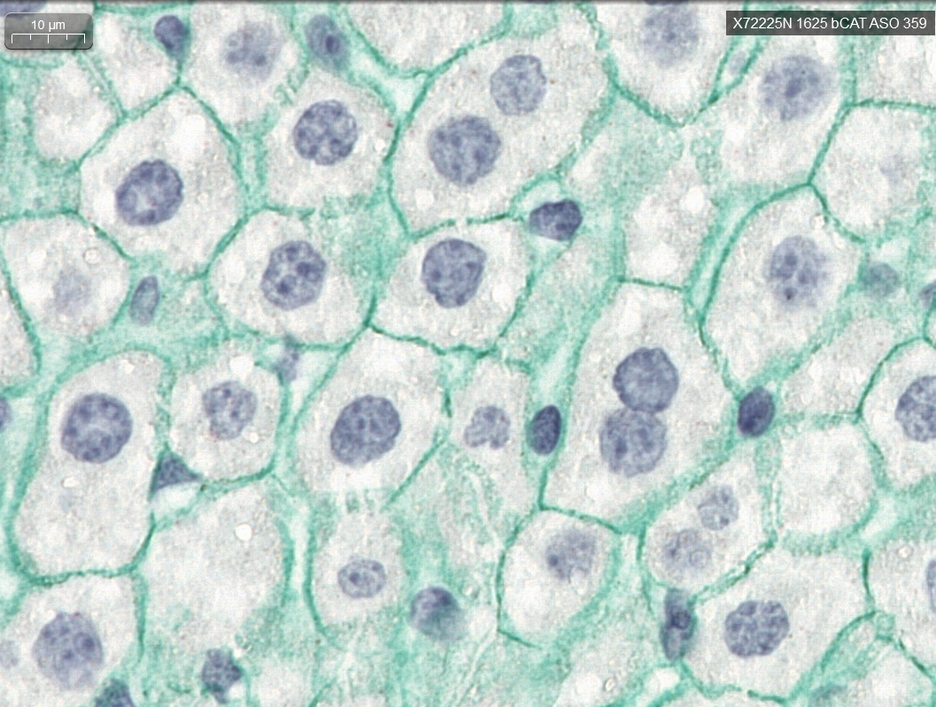
ASO ISH + β-Catenin IHC (outlining hepatocytes) on FFPE mouse liver samples from ASO 13 wk mouse toxicology study
In situ hybridisation (ISH) and Immuno-histochemistry (IHC) of liver samples taken from mice dosed with 0 & 4 mg/kg/wk ASO in a 13wk Mouse Toxicology study
Scale bar = 10um
Bradley Spencer-Dene, GSK

Slide 17
Does HBV infection negate the advantages of GalNAc ASO targeting?
The parallel development of GSK836 and GSK404 has given us a rare opportunity to compare the same ASO +/- GalNAc
  Efficacy in in vitro and in vivo HBV models
  Full pre-clin tox package (sc) in mouse and cyno + repro, safety pharm etc
  Ph1 study in Healthy Volunteers
  Ph2a Studies in Asian patients
Clinical efficacy data in HBV patients indicates that GalNAc conjugation of GSK836 does not provide the treatment enhancements seen with other liver targeted ASOs.
  while both GSK836 and GSK404 demonstrated target engagement with dose-dependent declines in mean HBsAg, more robust dose-related reductions of HBsAg levels were observed with the unconjugated ASO (GSK836)
We now have an in vitro model to investigate the effect of HBV infection on GalNAc ASO uptake ……………..

Slide 18
GSK 404/836 Project Team
steve.r.hood@gsk.com
“All studies were conducted in accordance with the GSK Policy on the Care, Welfare and Treatment of Laboratory Animals and were reviewed the Institutional Animal Care and Use Committee either at GSK or by the ethical review process at the institution where the work was performed.”

