Slide 1
The argument for
cccDNA elimination
Dr. Thomas Tu (Twitter - @thatliverguy)
Co-Group Leader (Viral Hepatitis Pathogenesis)
Storr Liver Centre
t.tu@sydney.edu.au
Westmead Institute for Medical Research
Notes:
Cover slide version 1

Slide 2
cccDNA elimination is:
  a better conceptual approach for cure than silencing
  what we should be striving for
  achievable

Slide 3
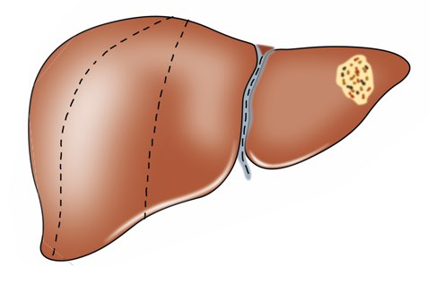
cccDNA elimination is molecular resection
Suppress its growth/spread?
Resect/destroy tumour?
Why would you do any different for cccDNA?

Slide 4

Nothing in nature is 100%
…except extinction
With such a juicy evolutionary prize at the end (reinfection of an entire liver), positive selective pressure for reactivation after silencing is huge
Routes for reactivtion are many:
  HBx from integrated HBV DNA
  Natural ebb and flow of histone acetylases/DNA demethylases
  Leaky transcription
Once started, it‘s a feed-forward process
Dead species don‘t evolve – no chance of reactivation with cccDNA elimination

Slide 5

Why are we here?
The patients
Fear of reactivation: HBeAg-neg, on treatment, even HBs-loss
Complete cure would releive this

Slide 6
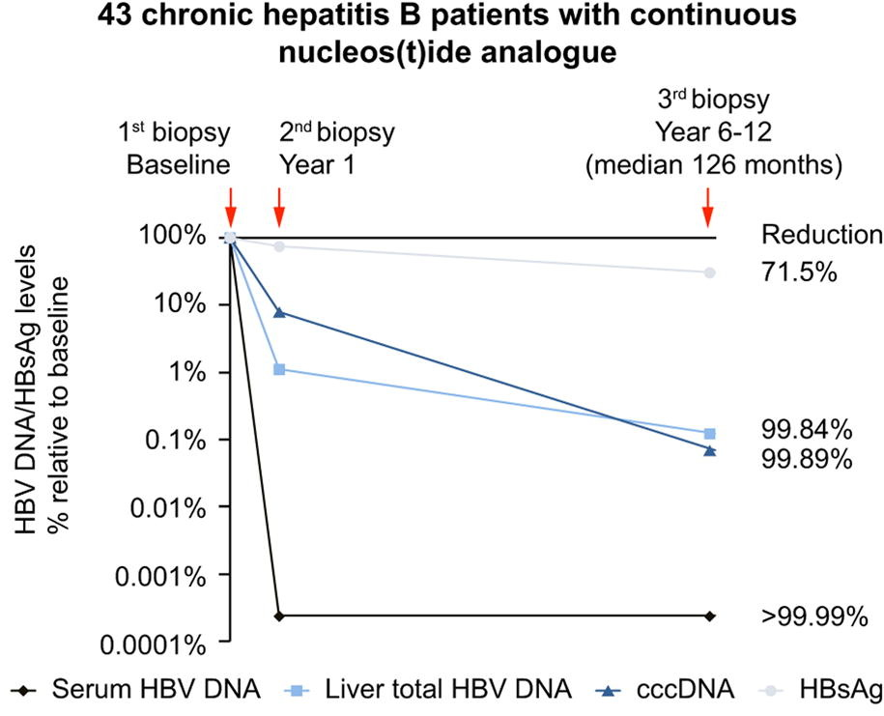
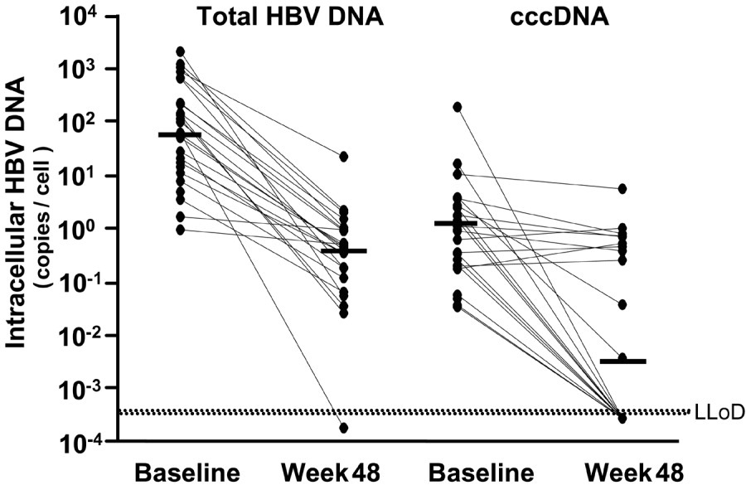
Elimination is not impossible
ETV/TDF only
Combination ADV + IFN
Lai et al. 2016 J Hepatol
Wursthorn et al. 2006 Hepatology
cccDNA loss already associated with current treatments
Challenge: increasing the degree of loss
Evolution, not necessarily revolution

Slide 7
Approaches
Direct cccDNA loss (CRISPR, TALENS, ZFN, base editing, etc)
CAR-T cells (direct killing of infected cells)
Immunomodulators to induce mitosis or direct killing of infected cells (IFN, TLR agonists, IAP inhibitors, etc.)
Unexplored avenues...

Slide 8
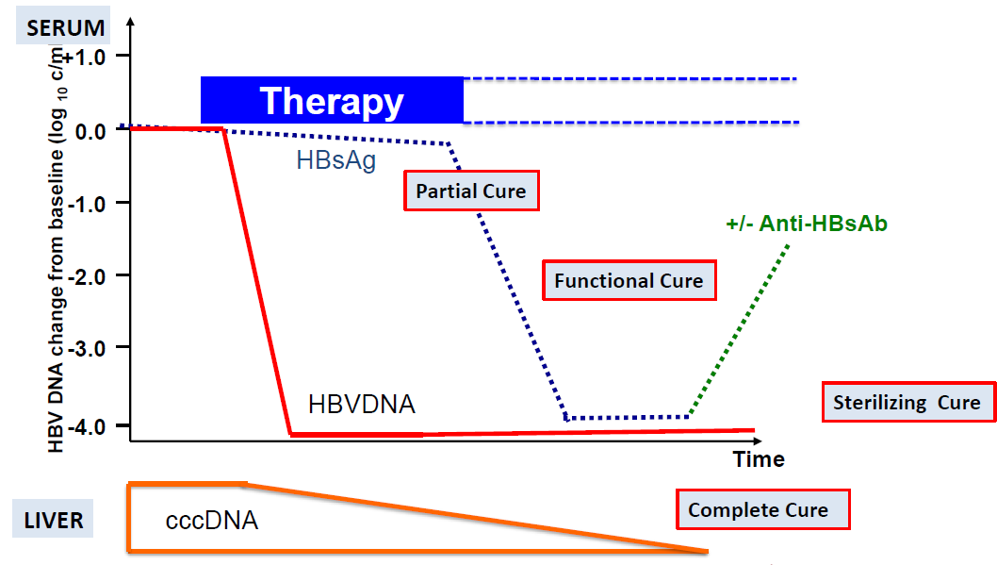
Trial endpoints are linked to lower cccDNA
Lok et al. 2018, J Hepatol
Even if not all cccDNA is lost, elimination likely helps us achieve other end states

Slide 9
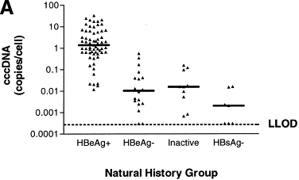
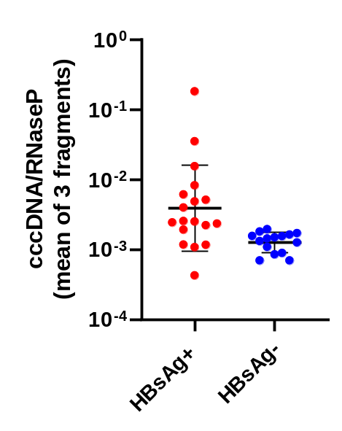
HBsAg-loss is linked with cccDNA elimination
HBeAg-neg patients
**
Werle-Lapostolle et al. (2004) Gastro
Tu et al. (unpublished)
cccDNA reduction
↓HBsAg levels
↓HBV levels => ↓integration

Slide 10
Final thoughts
cccDNA elimination:
  Creates a more stable state than silencing
  Is achievable by multiple approaches
  Likely facilitates other cure states
  Is what we should be aiming for

