Slide 1
Hepatitis B virus DNA integration and functional cure
Dr. Thomas Tu (Twitter - @thatliverguy)
Co-Group Leader (Viral Hepatitis Pathogenesis)
Storr Liver Centre
t.tu@sydney.edu.au
Westmead Institute for Medical Research
Notes:
Cover slide version 1

Slide 2
HBV replication cycle
rcDNA genome (~95%)
NTCP
vRNAs
cccDNA
pgRNA
Reverse transcription
HBV DNA integration
dslDNA genome (~5%)

Slide 3
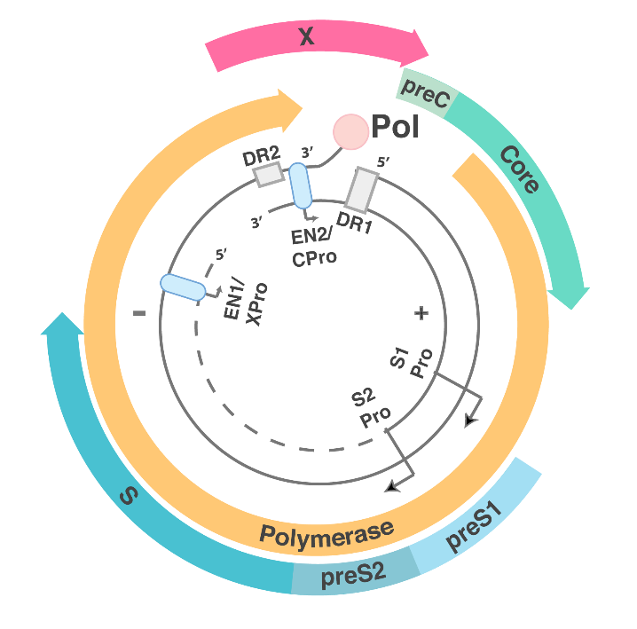
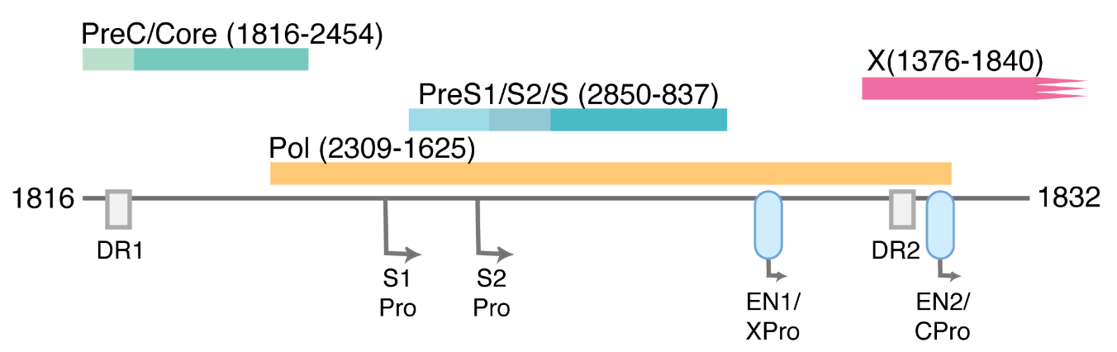
HBV DNA integration
Integration occurs at dsDNA breaks in 1 per ~10⁴ cells
Integrated HBV DNA is linked with HCC (>60% tumours)
  Can drive expression of downstream genes –> cis-activation
  May code for viral proteins -> trans-activation
Integrated HBV DNA can maintain expression of HBsAg
  Can it affect functional cure, i.e. HBs-loss?
Circular form
(replication-competent)
Integrated dslDNA form
(replication-deficient)
Tu et al. 2018, Viruses

Slide 4
Key questions in HBV integration biology
What are HBV DNA integrations doing?
Do HBV DNA integrations prevent functional cure?
How can we stop, reduce, or eliminate integrations?

Slide 5
1 - Cellular changes driven by integrations
Integrations themselves alter host DNA
  Insertional mutagenesis
  Translocations
HBx from integrated DNA
  Associated with DNA damage
HBs from integrated DNA
  Associated with ER stress

Slide 6
History of detecting integrations
Southern blot era: Integrations classically associated with late-stage disease (characterisation in tumour and cirrhotic tissues), decades after infection
PCR era: Integrations detected after 6 days of acute in vivo infection (woodchuck and chimp models)
In vitro infection model era: Integration occurs prior to de novo virus replication (decades prior to HCC)
Each discovery lowered the likely strength of the pro-oncogenic effects of integrations
Koshy, et al. 1981, J Gen Virol; Brechot et al. 1980 Nature
Summers et al., 2003 PNAS; Yang & Summers,1999. J Virol.
Tu et al., 2021 JHEP Reports; Tu et al., 2018 J Virol.

Slide 7
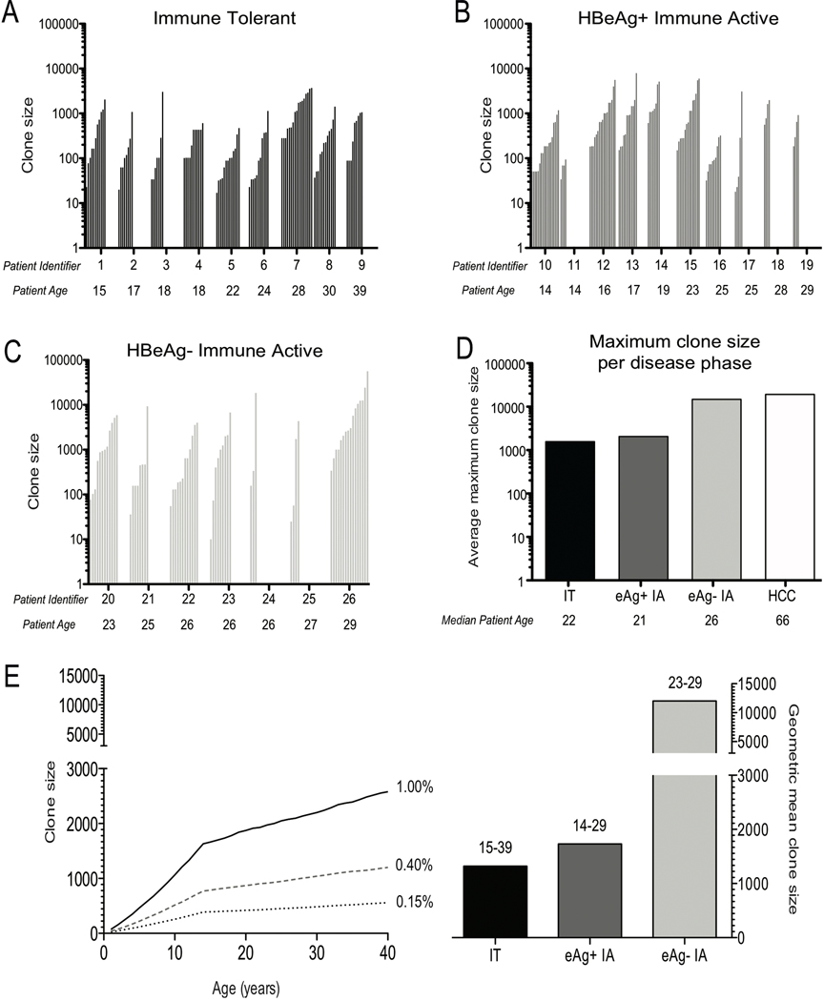
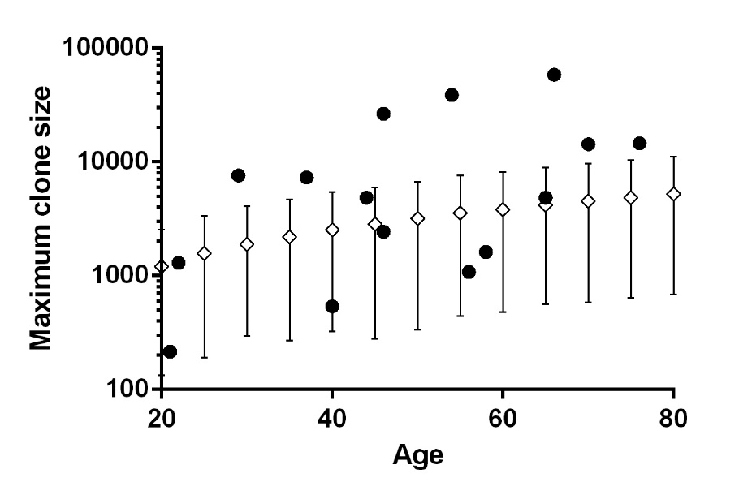
Natural history of integrations
• = Observed clones
✵ = Simulation of random liver turnover
Tu et al. (2015) J Viral Hepatitis
Integrations increase over course of infection primarily through clonal expansion (esp. HBeAg seroconversion)
Clones have selection advantage
Mason et al. (2016) Gastroenterology

Slide 8
HBV DNA integration sites
n=1,024
n=161
No significant enrichment of integrations in:
Expressed vs. non-expressed genes
Transcriptional start sites
Genes of specific functional pathways
Cancer-related genes
Random distribution even after clonal expansion
=> Cis effects (e.g. insertional mutagenesis) are weak
n=367
n=194
Budzinska, ... Tu (2018) Emer. Micro. & Infect.
Budzinska, ... Tu (2018) Genes
Notes:
3 groups separated based on selection pressure after HBV infection: in vitro model (minimal selection pressure) with 15 independent infections , eAg(+) (some inflammation/moderate selection pressure) with total 22 patients, and eAg(-) (strongest anti-immune response/highest selection pressure) and 19 patients.

Slide 9
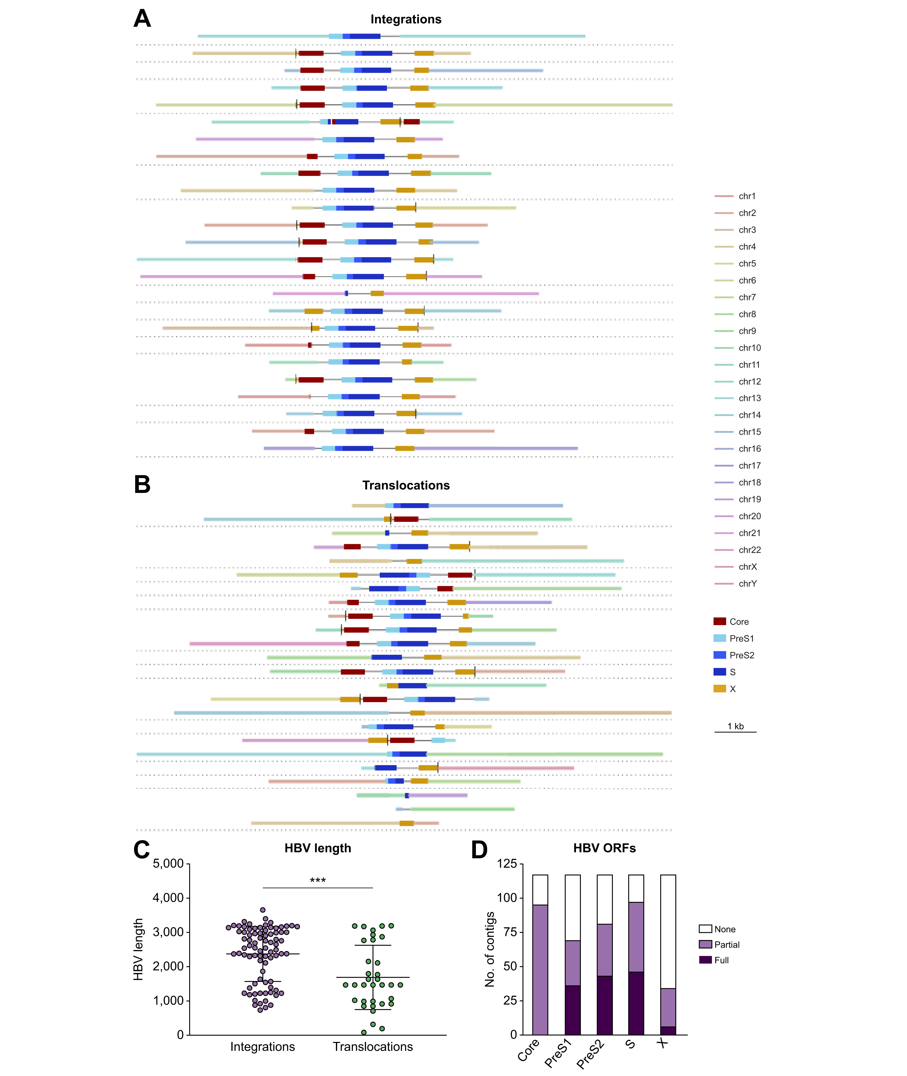

Integrations can be associated with chromosomal translocations
Long-read sequencing of HBV core biopsies.
Translocations seen in 13 of 42 samples with HBV integration bridges (non-tumour tissue)
van Buuren et al. (2022) J Hepatol

Slide 10
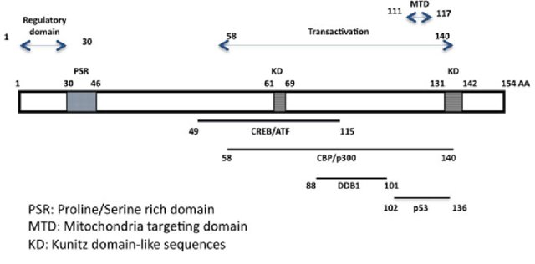
Cellular changes driven by HBx
HBx induces Smc5/6 degradation
Decorsière et al. (2016), Nature
Terminus of dslDNA
Rivière, Ducroux, & Buendia (2014) Viruses and Human Cancer
HBx from integrations probably induces Smc5/6 degradation

Slide 11
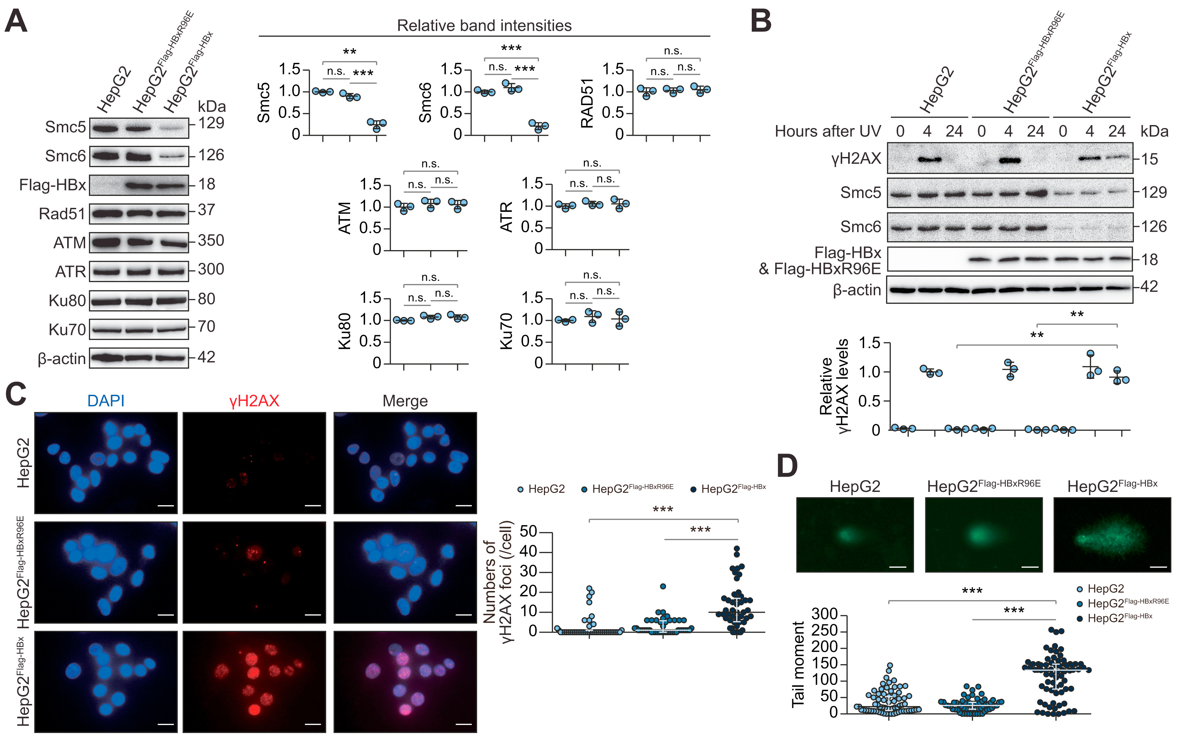
Cellular changes driven by HBx
HBx => DNA damage via disruption of Smc5/6 complex
Sekiba et al. (2022) Hepatology

Slide 12
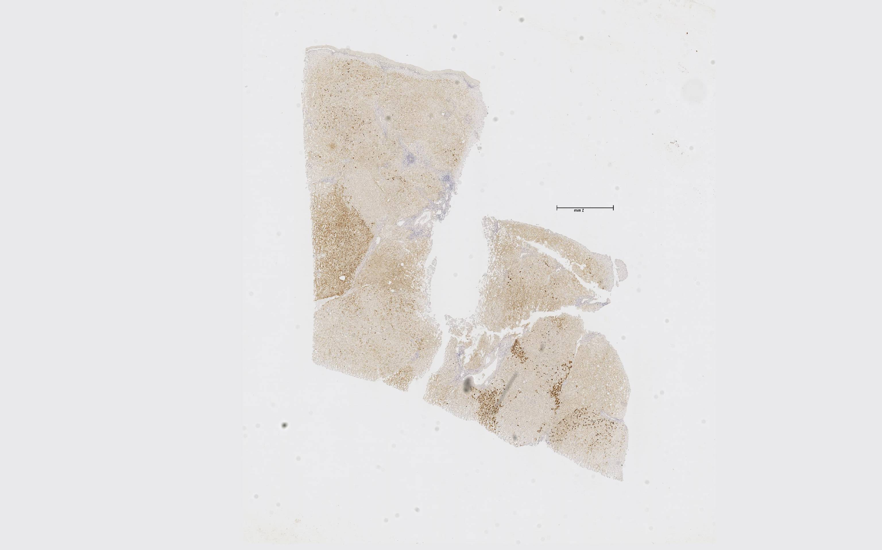
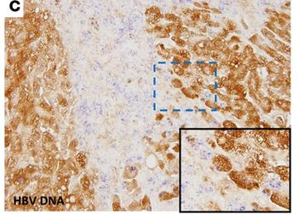
Cellular changes driven by integrated HBs
HBsAg
HBV DNA
HBsAg IHC
Zhang et al. (2016) JCI
HBsAg clusters do not replicate virus
=> likely intergrated
Tu et al. (2015) J Viral Hepatitis

Slide 13
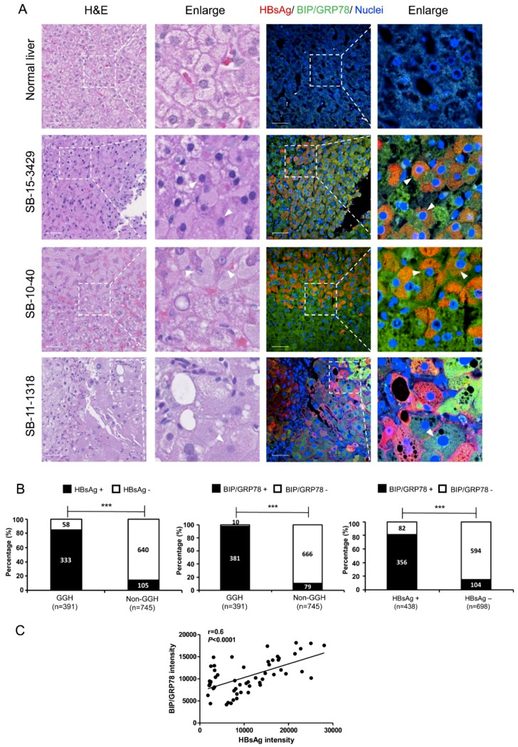
Cellular changes driven by integrated HBs
HBsAg clusters express UFP response markers
Li et al. (2019) Viruses

Slide 14
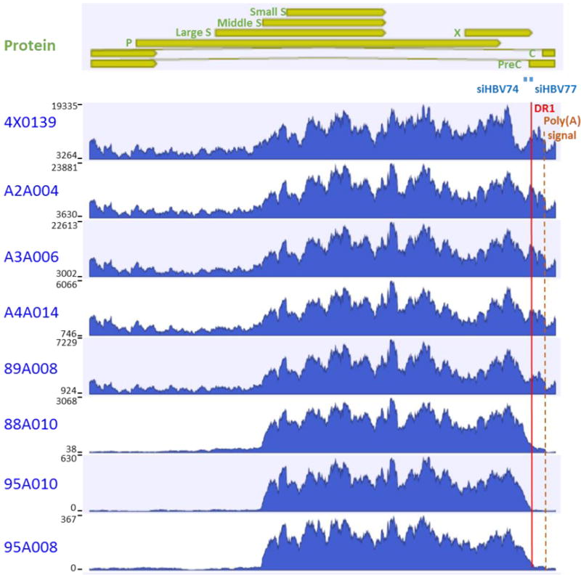
2 - Integration and functional cure
Integrations can be major sources of HBsAg
Wooddell et al. (2018) Sci Trans Med
~1% mRNA from integrated HBV DNA
HBe-pos
Transitioning
>60% mRNA from integrated HBV DNA
HBe-neg
Consistent with human data from long-read sequencing
van Buuren et al. (2022) Hepatology

Slide 15
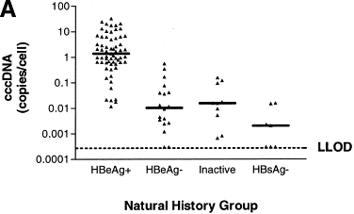
Integrations increase and cccDNA decreases after HBeAg-seroconversion
Tu et al. (2015) J Viral Hepatitis
Werle-Lapostolle et al. (2004) Gastro
Likely due to clonal expansion of hepatocytes:
↑ integrations and ↓cccDNA with cell mitosis

Slide 16
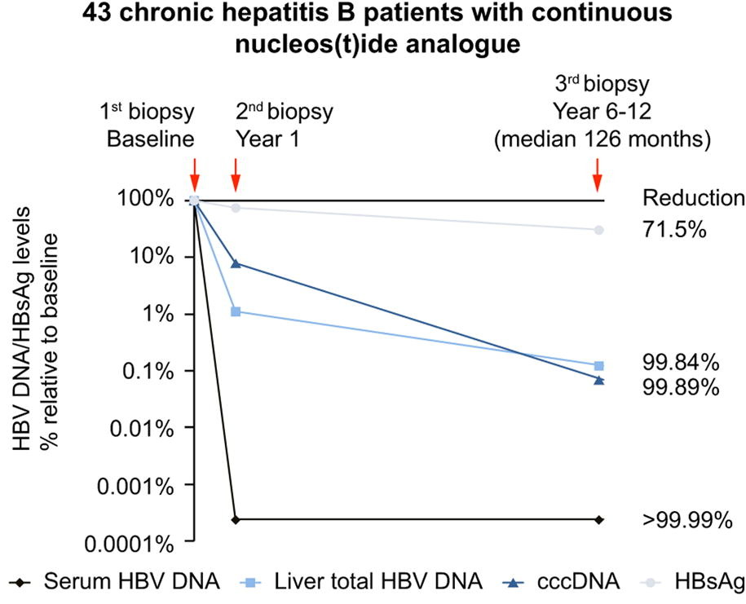
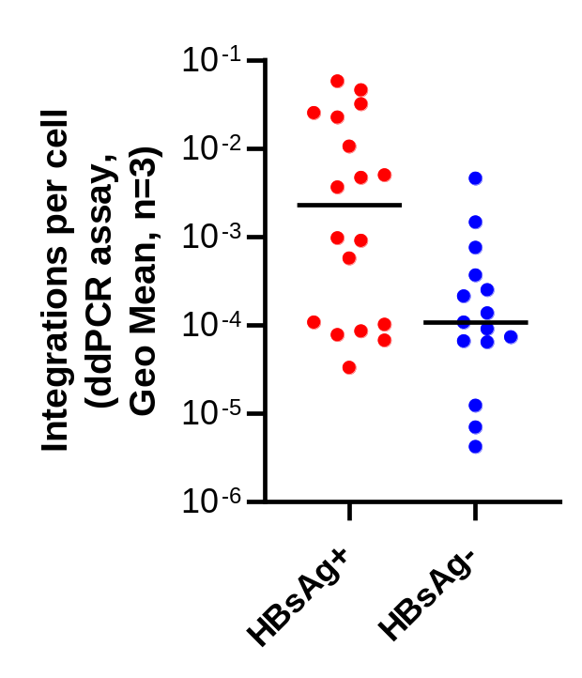
Integration rate and clearance
Nucs drive cccDNA reduction, but not much HBsAg reduction
Natural clearance linked to reduced integration
**
Lai et al. 2016 J Hepatol
Tu et al. (unpublished)

Slide 17
3 - Reducing integrations
What increases integration frequency?
Inflammation => clonal proliferation => more of the same integrations
New infection events => more integration
What can reduce integration frequency?
Inhibiting inflammation?
Inhibiting new infection events?
Direct destruction of integrated DNA (or the cells containing them)

Slide 18
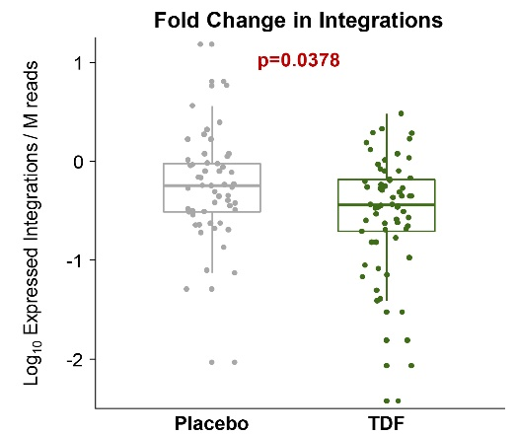
3 - Reducing integrations with NAs
Reduction in integration-derived transcripts with TDF (3yr)
Reduction in hepatocyte clone size after NUC treatment (1yr)
p=0.003
4x10⁵
3x10⁵
Median hepatocyte clone size
2x10⁵
1x10⁵
-0.258 (±0.139)
-0.516 (±0.143)
0
Baseline
Year 1
Hsu et al. (2022) Gastroenterology
Chow et al. (2022) Clin Infect Dis

Slide 19
Upcoming approaches
(repeat of cccDNA debate)
Direct targeting of DNA (CRISPR, TALENS, ZFN, base editors, etc)
CAR-T cells (killing of infected cells)
Immunomodulators to induce direct killing of infected cells (IFN, TLR agonists, IAP inhibitors, etc.)
Unexplored avenues...

Slide 20
Conclusions
HBV DNA integrations:
occur early and increase in frequency over time
can drive multiple phenotypical effects (translocations, DNA damage, ER stress)
Driver(s) of selective clonal expansion unknown
Can be the main source of HBV RNAs (esp. in HBeAg-negative phase)
Current and upcoming therapies may reduce integrations
NAs limit clonal expansion driven by inflammation or new integrations?
Early NA treatment to limit integrations?
New antiviral approaches

Slide 21

Thanks to the organisers for sponsoring my attendance
Questions?

