Slide 1
CODONS UNDER POSITIVE SELECTION IN THE S OPEN READING FRAME OF THE GENOTYPE B2 HEPATITIS B VIRUS

Slide 2
INTRODUCTION 1
Defining the repertoire of amino acids in HBV proteins that are vulnerable to immune attack may assist with the development of novel immunotherapies.
This can be done using PAML, a program that identifies codons in which non-synonymous mutations occur at a greater rate than predicted by genetic drift (Pr (ω>1) >95%).

Slide 3
INTRODUCTION 2
The input for PAML is a phylogenetic tree built from complete haplotypes of the relevant open reading frame (ORF).
Complete haplotypes have usually been obtained by Sanger sequencing of cloned PCR products containing the full ORF from HBeAg-negative subjects.
This is laborious for a number of reasons.

Slide 4
INTRODUCTION 3
MinION sequencing technology routinely produces read lengths of between 10-30,000 bases, but at a cost of an increased error rate that is believed to be random.
To overcome the problem of random errors, we have used MinION technology to sequence concatemers comprised of 6-10 repeats of a single PCR amplimer that contains the S ORF.

Slide 5
INTRODUCTION 4
The sequence of that amplimer is then taken as the consensus of these repeats.

Slide 6
Extract HBV-DNA from 6 HBeAg-negative subjects with a chronic genotype B infection
6-10 PCR amplifications of the S ORF using external primers
Nested PCR producing
2.1 kb amplimers
AT clone
Pool PCR amplimers
Circularise Amplimers
Sanger sequence 6-10
independent S ORF
haplotypes per subject
Rolling circle amplification to
produce linear concatemers
MinION sequencing

Slide 7
MinION METHOD
Nested PCR primers include
  same HBV recognition sequence as the cloning primers
  5’ 12mer followed by EcoR1 recognition sequence
  different 8mer patient-specific barcodes on forward and reverse primers
  7mer sequence-specific barcode on lower primer
EcoR1-digested amplimers circularised with T4 DNA ligase

Slide 8
MinION METHOD
Linear concatemers were removed with plasmid-safe DNase
Rolling circle amplification was conducted
  using phi29 DNA polymerase which has strand displacement activity
  using primers with a phosphothiorate bond between the 3’ nucleotides to combat the 3’ to 5’ ssDNA exonuclease activity of phi29
  using forward and reverse sequencing primers recognising a sequence within the nested primer sequences.

Slide 9
Rolling Circle Amplification of Denatured Plasmids
= forward sequencing primer
= reverse sequencing primer
Primer binding sites
Strand displacement by phi29

Slide 10
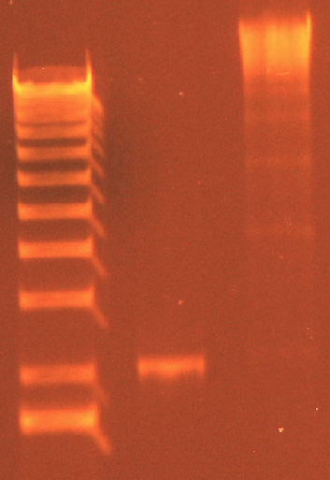
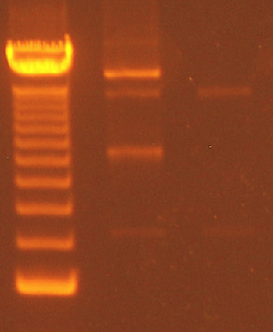
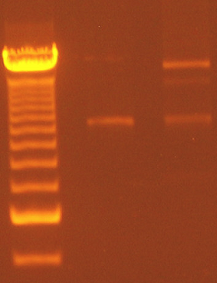
Results – Production of Concatemers
RC = relaxed circular plasmid
SC = supercoiled plasmid
12kb
6.3kb
4.2kb
RC
2.1kb
2.1kb
2.1kb
SC
Rolling Circle
Amplification
Plasmid Safe
DNase
Ligation

Slide 11
Results – Analysis of Concatemers
Subject ID | 106 | 1281 | 1432 | 1907 | 3922 | 10969 | Total
Concatemers with >6 repeats | 41 | 203 | 92 | 136 | 242 | 36 | 750
Wild-type or Poor Quality Sequence | 3 | 7 | 5 | 5 | 5 | 2 | 27
Indels and Nonsense Mutations | 3 | 47 | 23 | 20 | 56 | 9 | 158
Repeated Haplotypes | 0 | 18 | 0 | 2 | 2 | 0 | 22
Suitable for PAML Analysis | 35 | 131 | 64 | 109 | 179 | 25 | 543

Slide 12
Results – Substitution Mutations in Nucleotide Sequences
Subject ID | 106 | 1281 | 1432 | 1907 | 3922 | 10969 | Mean + sem
In 6-10 cloned Sequences* | 26 | 12 | 21 | 10 | 30 | 5 | 17 + 4
In MinION Sequences * # $ | 65 | 95 | 48 | 61 | 94 | 30 | 66 + 10
* = The number of total S ORF nucleotides (out of 1200) in which at least 2 haplotypes
have a substitution mutation (ie common mutations)
# = All mutations detected in the clones were also found in the MinION sequences
$ = The difference between cloned and MinION sequences, Wilcoxon SR p=0.03

Slide 13
Results – Codons Containing Substitution Mutations
Subject ID | 106 | 1281 | 1432 | 1907 | 3922 | 10969 | Mean + sem
In 6-10 cloned Sequences* | 23 | 12 | 21 | 10 | 30 | 5 | 17 + 3
In MinION Sequences * $ | 57 | 85 | 46 | 56 | 87 | 29 | 60 + 9
* = The number of total S ORF codons (out of 400) in which at least 2 haplotypes
have a substitution mutation
$ = The difference between cloned and MinION sequences, Wilcoxon SR p=0.03

Slide 14
Codons under Strong Positive Selection (Pr(ω>1) > 95%)
4 | 33 | 47 | 83 | 87 | 102 | 108 | 114 | 141 | 165
167 | 173 | 179 | 195 | 214 | 224 | 308 | 335 | 388 | 391
XX
= codons in which no non-synonymous mutations were present in clones from any
subject. Positive selection could not therefore be detected from the cloning data.

Slide 15
Codons under Positive Selection in Both Genotypes B and C
4 | 33 | 47 | 83 | 87 | 102 | 108 | 114 | 141 | 165
167 | 173 | 179 | 195 | 214 | 224 | 308 | 335 | 388 | 391
XX
= codon under strong positive selection in 298 genotype C clones from 36 subjects
XX
= codon under weak positive selection in 298 genotype C clones from 36 subjects

Slide 16
Summary
The advantages of a MinION-based relative to a cloning-based approach to studies of HBV sequence variability are
  less work and expense
  more sensitive detection of common mutations
  more sensitive detection of positive selection
Most codons under selection pressure in genotype B HBVs are not under selection pressure in genotype C HBVs

Slide 17
Conclusions
MinION sequencing of RCA-generated S ORF haplotypes is possible
Minion sequencing of RCA-generated S ORF haplotypes is a sensitive method for detecting positively selected codons in the S ORF
Finding different repertoires of positively selected codons between patients with genotype B and C HBVs raises the possibility that genotype-specific immunotherapies may be required for treatment of chronic hepatitis B.

Slide 18
Acknowledgements
Bioinformatics
  Dr. Klaus Lehnert
  Dr. Peter Tsai
Sequencing
  Kristine Boxen
  Andrew Jiang
Clinical Samples
  New Zealand Hepatitis B Screening Program
Clinical Advice
  Professor Edward Gane
Funding
  Health Research Council of New Zealand

