Slide 1
Progress in the Development in Core Inhibitors for the Treatment of Chronic Hepatitis B Infection
William Delaney
Chief Scientific Officer
The Science of HBV Cure – May 30 – June 2, 2022
Singapore

Slide 2
Cautionary Note Regarding Forward-Looking Statements
The information in this presentation contains forward-looking statements that are subject to certain risks and uncertainties that could cause actual results to materially differ. These risks and uncertainties include: Assembly Bio’s ability to initiate and complete clinical studies involving its therapeutic product candidates, including studies contemplated by Assembly Bio’s clinical collaboration agreements, in the currently anticipated timeframes; safety and efficacy data from clinical studies may not warrant further development of Assembly Bio’s product candidates; clinical and nonclinical data presented at conferences may not differentiate Assembly Bio’s product candidates from other companies’ candidates; results of nonclinical studies may not be representative of disease behavior in a clinical setting and may not be predictive of the outcomes of clinical studies; continued development and commercialization of Assembly Bio’s hepatitis B virus (HBV) product candidates, if successful, in the China territory will be dependent on, and subject to, Assembly Bio’s collaboration agreement governing its HBV-related activity in the China territory; Assembly Bio’s ability to maintain financial resources necessary to continue its clinical studies and fund business operations; any impact that the COVID-19 pandemic may have on Assembly Bio’s business and operations, including initiation, enrollment and continuation of its clinical studies or timing of discussions with regulatory authorities; and other risks identified from time to time in Assembly Bio’s reports filed with the U.S. Securities and Exchange Commission (the SEC). You are urged to consider statements that include the words may, will, would, could, should, might, believes, hopes, estimates, projects, potential, expects, plans, anticipates, intends, continues, forecast, designed, goal or the negative of those words or other comparable words to be uncertain and forward-looking. Assembly Bio intends such forward-looking statements to be covered by the safe harbor provisions contained in Section 27A of the Securities Act of 1933, as amended, and Section 21E of the Securities Exchange Act of 1934, as amended. More information about Assembly Bio’s risks and uncertainties are more fully detailed under the heading “Risk Factors” in Assembly Bio's filings with the SEC, including its most recent Annual Report on Form 10-K, Quarterly Reports on Form 10-Q and Current Reports on Form 8-K. Except as required by law, Assembly Bio assumes no obligation to update publicly any forward-looking statements, whether as a result of new information, future events or otherwise.

Slide 3
HBV is a Major Global Public Health Problem
Prevalence: 296M¹
Diagnosed
30M¹
Treated
5M¹
  Up to 1M people die each year from HBV-related causes
  Treatments are life-long and reduce but do not eliminate the virus, resulting in very low cure rates
  Opportunity to improve outcomes and increase number
  of patients diagnosed and treated, with development of finite and curative therapies
    No new MOAs approved for HBV
    in >25 years
Source: ¹WHO (2021)

Slide 4
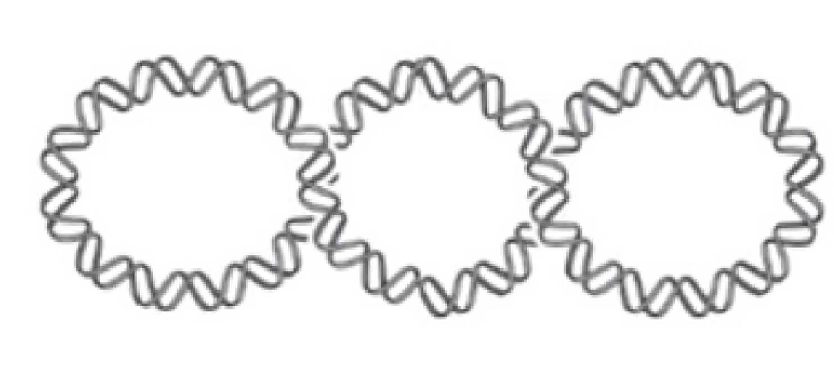
Stopping HBV Replication is a Key Component of HBV Cure Strategies
Inhibit HBV
T
B
Core
Inhibitors
assembly
s
s
s
s
s
formation
Engage
Immune System
‹#›

Slide 5
Core Inhibitors Target Multiple Steps of the HBV Replication Cycle
1
pgRNA encapsidation
& DNA replication
RNA-containing particle (pgRNA)
cccDNA
Infectious virion (DNA)
2
Capsid disassembly
& cccDNA formation
3
cccDNA amplification
Potent activity against both viral replication ( ) and cccDNA formation ( , ) may be crucial for optimal patient responses
Next-generation core inhibitors are more potent against cccDNA formation than the first generation
1
2
3
‹#›

Slide 6
Optimization of Core Inhibitor-Containing Regimens
1st Generation
Core Inhibitors
1st Generation Core Inhibitor
Combination Regimens
1st Generation
Core Inhibitors
Combination with complementary mechanisms of action
Favorable safety profile
Favorable safety profile
Deeper viral suppression when added
to NrtI
  ↓DNA
  ↓RNA
Minimal impact on viral antigens
Minimal impact on cccDNA
With NrtI alone, did not lead to cure
Next Generation
Core Inhibitors
Increased antiviral potency and prevention of cccDNA formation
Improved PK, target coverage
Favorable safety profile
Next-Generation
Core Inhibitors
‹#›

Slide 7
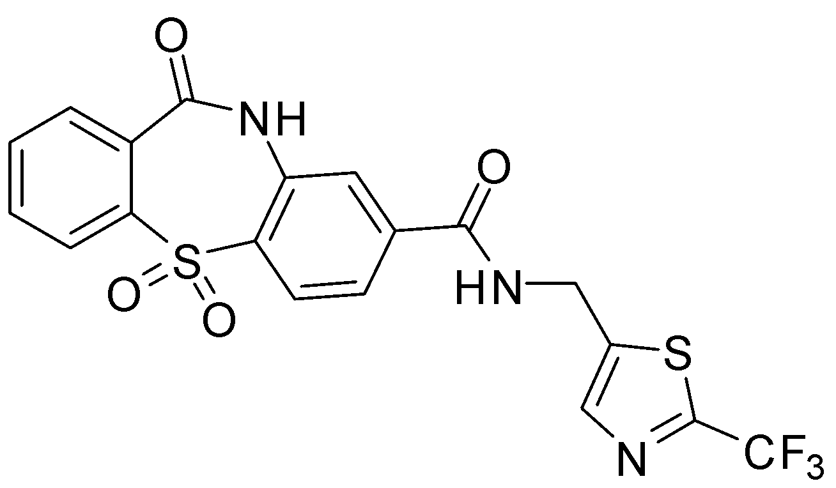
Vebicorvir: A Novel Clinical Stage First-Generation HBV Core Inhibitor
Disrupts HBV capsid by allosteric binding resulting in misassembly
Broad in vitro antiviral activity
  pangenotypic and fully active against NrtI-resistant HBV
Administered orally, once daily at 300 mg without regard to food
24 hour elimination half-life in patients
No drug interaction with NrtIs
In 28 day phase 1b studies HBV nucleic acid reductions at 300 mg
  HBV DNA – 2.8 log₁₀ IU/mL
  HBV RNA – 2.0 log₁₀ copies/mL
Phase 2 combination studies of VBR with NrtIs
  safe & well tolerated
  enhanced suppression of both HBV DNA & RNA
  Did not lead to cure
EC₅₀ = 173 nM
CC₅₀ = >10,000 nM
Huang et al. AAC 2020; Yuen et al, Lancet 2020; Yuen, et al. EASL 2020; Fung, et al. EASL 2020; Jacobson, et al. AASLD 2020. Gane, et al. EASL 2021.
‹#›

Slide 8
Developing Next-Generation CI’s and Optimizing the Profile
Core Inhibitors have 3 MOAs:
Block assembly of new virus
Prevent establishment of new cccDNA from incoming virus
Prevent amplification of cccDNA within cells
Greater potency required to inhibit MOA 2 & 3 vs MOA 1
3733
4334
Potently inhibits MOA 1, 2, & 3
21 hour T_{1/2} in healthy volunteers
Anticipate 300 mg dose
Enhanced formulation
Phase 1b 1st half of 2022
Potently Inhibits MOA 1, 2, & 3
Projected 15 hour T_{1/2} (QD)
2 nM potency against cccDNA formation
Conventional formulation, Dose TBD
Phase 1a in 2H 2022
The core inhibitor with the best safety and efficacy profile will move into advanced combination studies

Slide 9
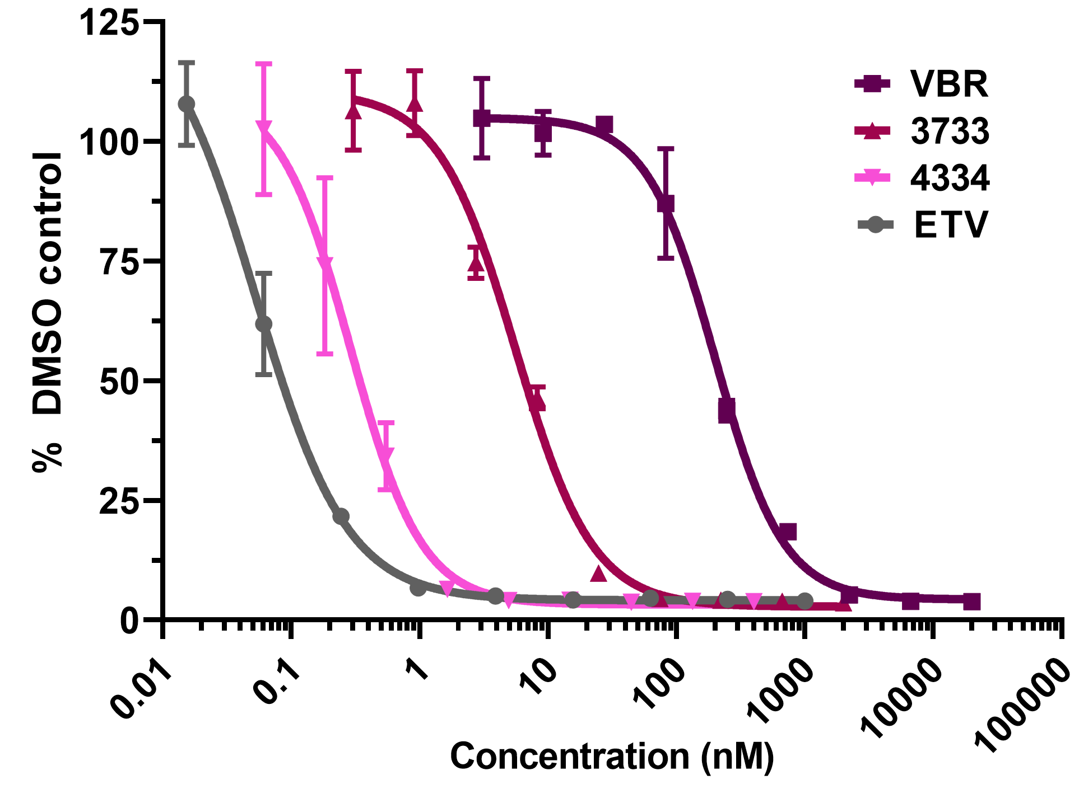
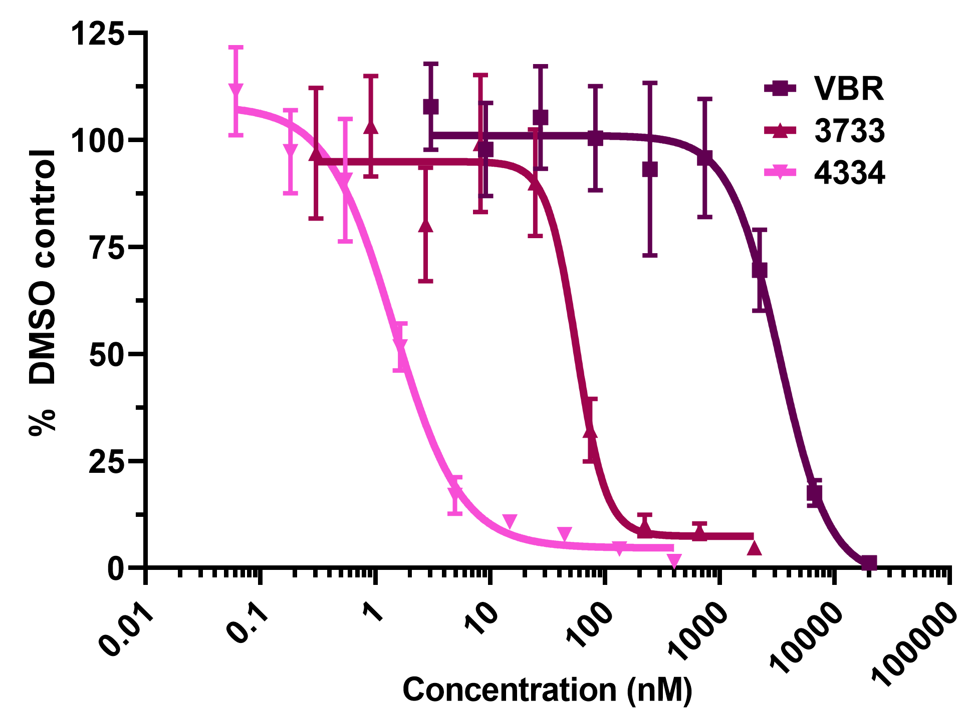
Increased Potency of Next-Generation HBV Core Inhibitors in
Primary Human Hepatocytes
Intracellular viral DNA
HBeAg
 | VBR | 3733 | 4334 | ETV
PHH DNA replication EC₅₀ (nM) | 200 ± 14.3 | 5.6 ± 0.5 | 0.3 ± 0.1 | 0.1 ± 0.01
PHH cccDNA formation EC₅₀ (nM) | 3300 ± 600 | 56 ± 8.3 | 1.5 ± 0.2 | >1000

Slide 10
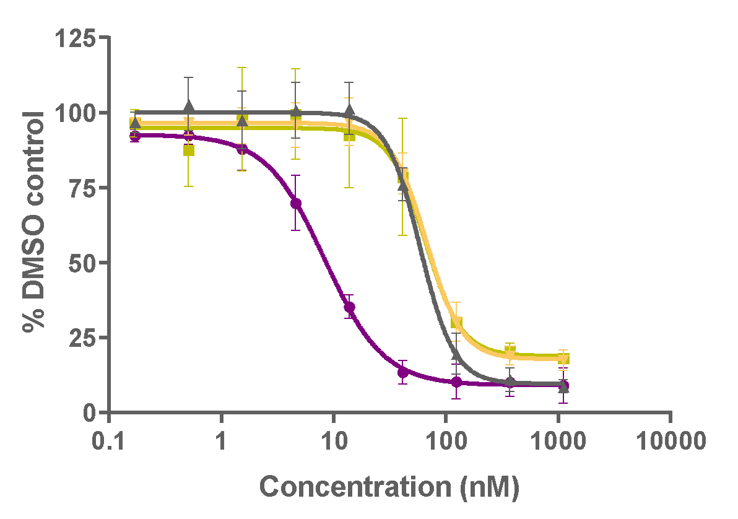
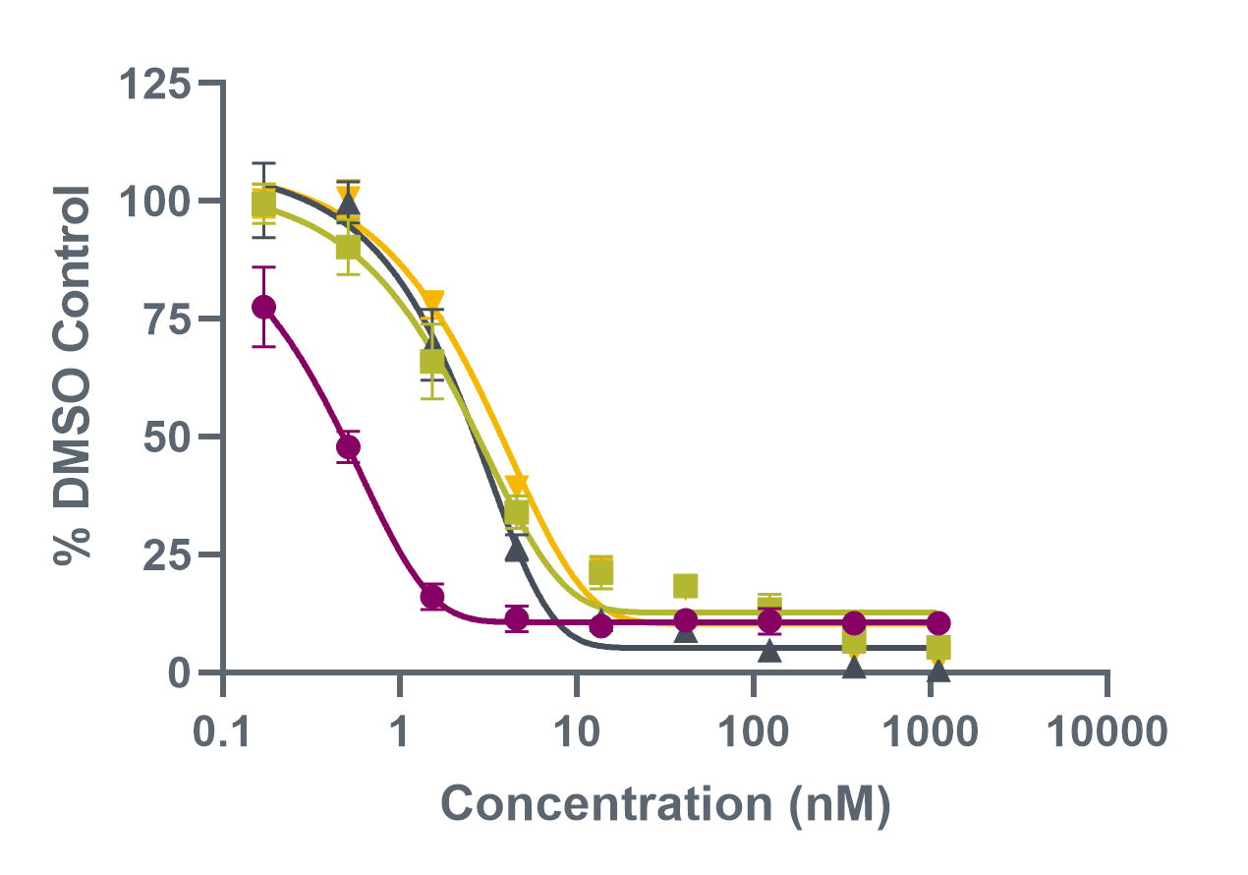
3733 and 4334 Demonstrate Potent Inhibition of
Multiple HBV Endpoints In Primary Human Hepatocytes
3733
4334
HBV DNA
pgRNA
HBeAg
HBsAg
As expected, most potent activity for both compounds is against replication of new HBV DNA
Potency against HBeAg, HBsAg and pgRNA (all cccDNA derived endpoints) is similar
  3773 EC₅₀ values for cccDNA endpoints are ~ 60 nM
  4334 EC₅₀ values for cccDNA endpoints are ~ 2-4 nM
Xu et al. AASLD 2021.

Slide 11
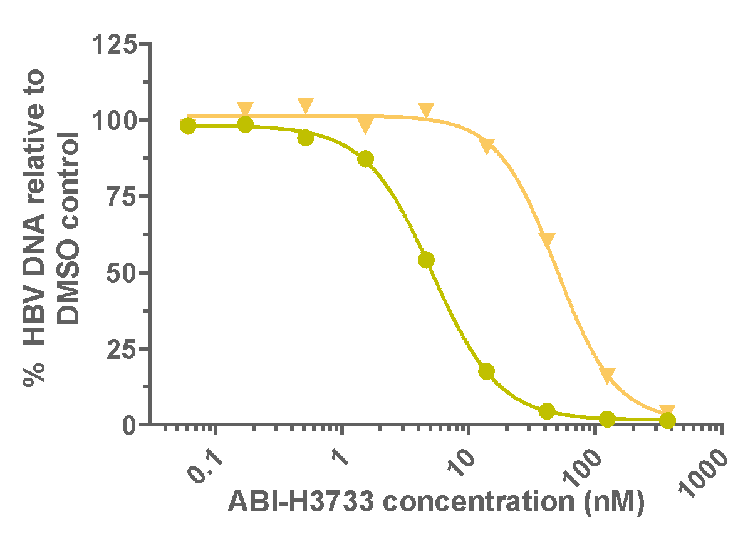
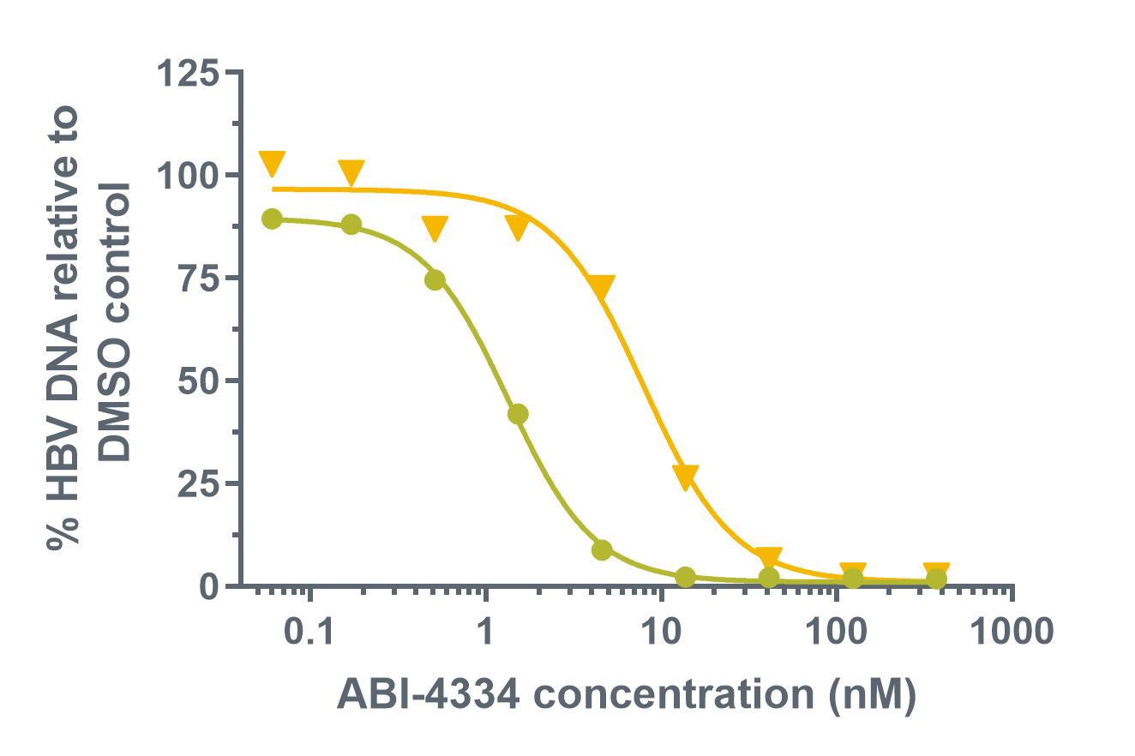
Serum Protein Shifts for 3733 and 4334
2% FBS
45 mg/mL HSA + 0.7 mg/mL AAG
Parameter | 3733 (n = 3) | 4334 (n = 3)
Serum protein shift (fold) | 9.7 ± 2.6 | 5.5 ± 0.3
pgRNA encapsidation paEC₅₀ (nM) | 120.3 | 2.8
cccDNA formation paEC₅₀ (nM) | 598.5 | 13.2
Xu et al. AASLD 2021.

Slide 12
Relative Potency of Assembly Core Inhibitors
Assembly Bio Portfolio of Core Inhibitors
 | HBV DNA EC₅₀ (nM) | C_{min} Total/ Protein adjusted HBV DNA EC₅₀ | cccDNA EC ₅₀ (nM) | C_{min} Total/ Protein adjusted cccDNA EC₅₀
Vebicorvir 300 mg | 154 | 3 | 2210 | 0.2
3733 300 mg | 12 | 150¹ | 62 | 29¹
4334 (projected at 300mg) | 0.5 | 196² | 2.4 | 42²
¹Projected based on preclinical evaluation of an improved tablet formulation and solution PK in healthy volunteers ²Projected values using modeled human PK based on preclinical species
Vebicorvir drives potent antiviral activity
3733 & 4334 discovered and designed to ultimately maximize inhibition of cccDNA formation

Slide 13
3733 and 4334 Exhibit Pan-Genotypic Activity Against HBV
Genotype | 3733 (nM) | 4334 EC₅₀ (nM) | ETV EC₅₀ (nM)
A | 2.6 | 0.9 | 0.7
B | 3.5 | 0.8 | 0.9
C | 2.6 | 0.7 | 0.9
D | 4.6 | 1.3 | 1.1
E | 3.2 | 4.5 | 1.6
Xu et al. AASLD 2021.

Slide 14
4334 and 3733 Have Improved Resistance Profiles Against
Core Inhibitor Binding Pocket Substitutions
3733
4334
ETV
EC₅₀ (nM)
Fold change in EC₅₀ vs WT
Core protein substitution | VBR | 3733 | 4334 | ETV
D29G | 20.2 | 1.2 | 0.7 | 1.0
T33N | 20.9 | >104.7 | 15.8 | 0.7
I105T | 2.2 | 3.2 | 2.0 | 1.2
T109I | >68.4 | 0.3 | 0.9 | 0.8
Y118F | 14.2 | 8.8 | 0.7 | 0.8
Xu et al. AASLD 2021.

Slide 15
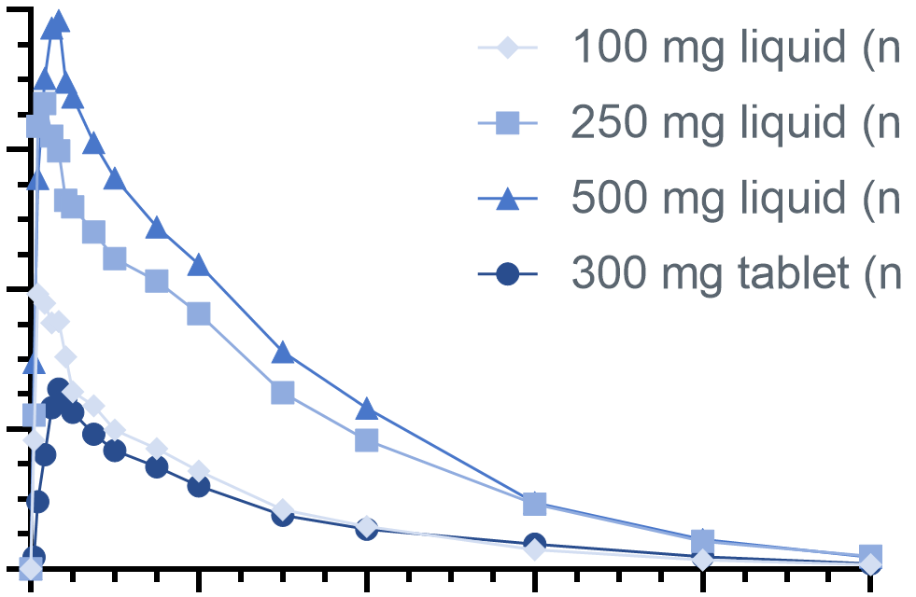
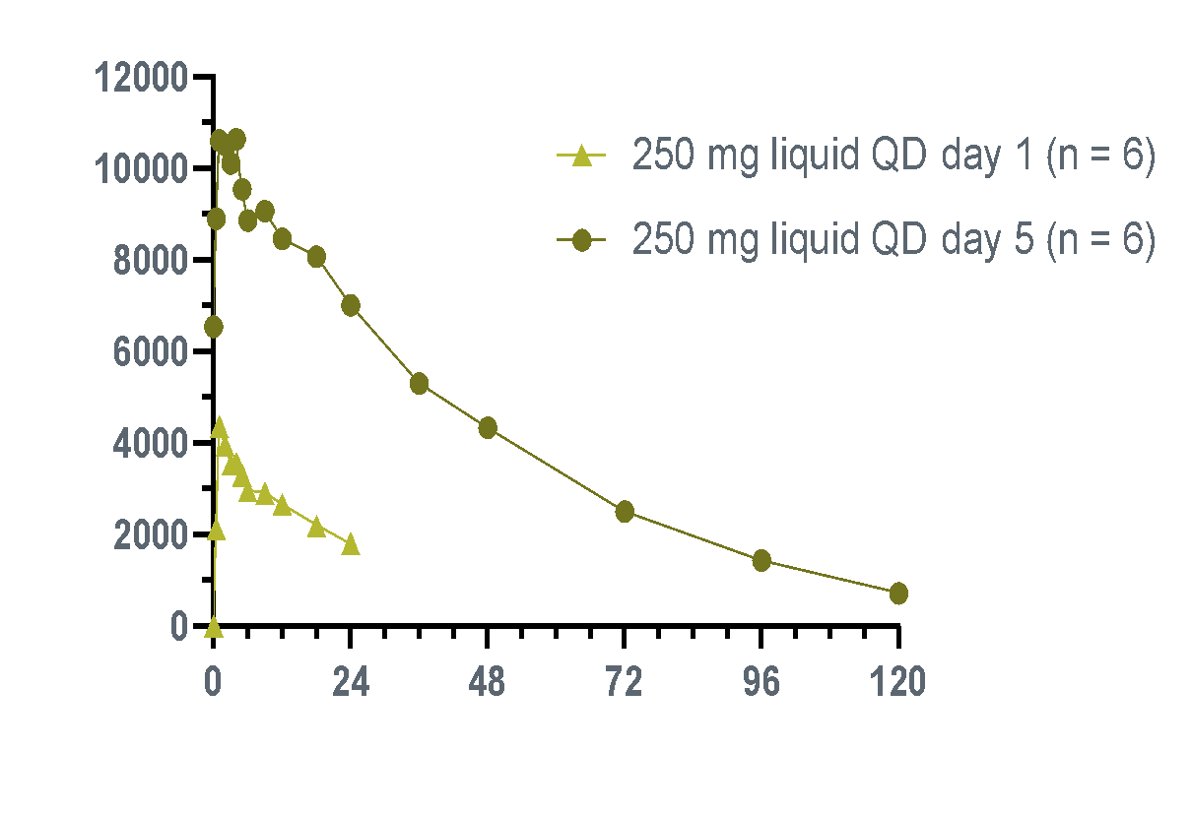
3733 Phase 1a Results:
Half-life and Exposure Support Once Daily Dosing
Mean 3733 Single-Dose
Plasma Concentrations
Mean 3733 Multiple-Dose
Plasma Concentrations
4000
100 mg liquid (n=6)
12000
250 mg liquid QD, day 1 (n=6)
250 mg liquid (n=6)
10000
3000
250 mg liquid QD, day 5 (n=6)
500 mg liquid (n=6)
8000
Mean 3733
concentration (ng/mL)
300 mg tablet (n=6)
Mean 3733
concentration (ng/mL)
2000
6000
4000
1000
2000
0
0
0
24
48
72
96
120
0
24
48
72
96
120
Time, hours
Time, hours
Gane et al. AASLD 2021.

Slide 16
Summary
Maximal inhibition of viral replication is a critical part of HBV Cure strategies
HBV Core protein is essential both early and late during viral replication; core inhibitors provide three additional MOAs to inhibit HBV replication compared to NrtIs
First-generation Core Inhibitors have demonstrated greater viral suppression in combination with NrtIs compared to NrtIs alone
  Dual therapy with VBR and NrtIs did not increase cure rates
  Triple combination studies are underway to test ability of 3rd agents to increase cure rates on antiviral backbone of NrtIs & Core Inhibitors
Next-generation Core Inhibitors 3733 and 4334 offer greatly increased potency against cccDNA formation and are moving into phase 1b and phase 1a this year, respectively

Slide 17
Thank you!

