Slide 1
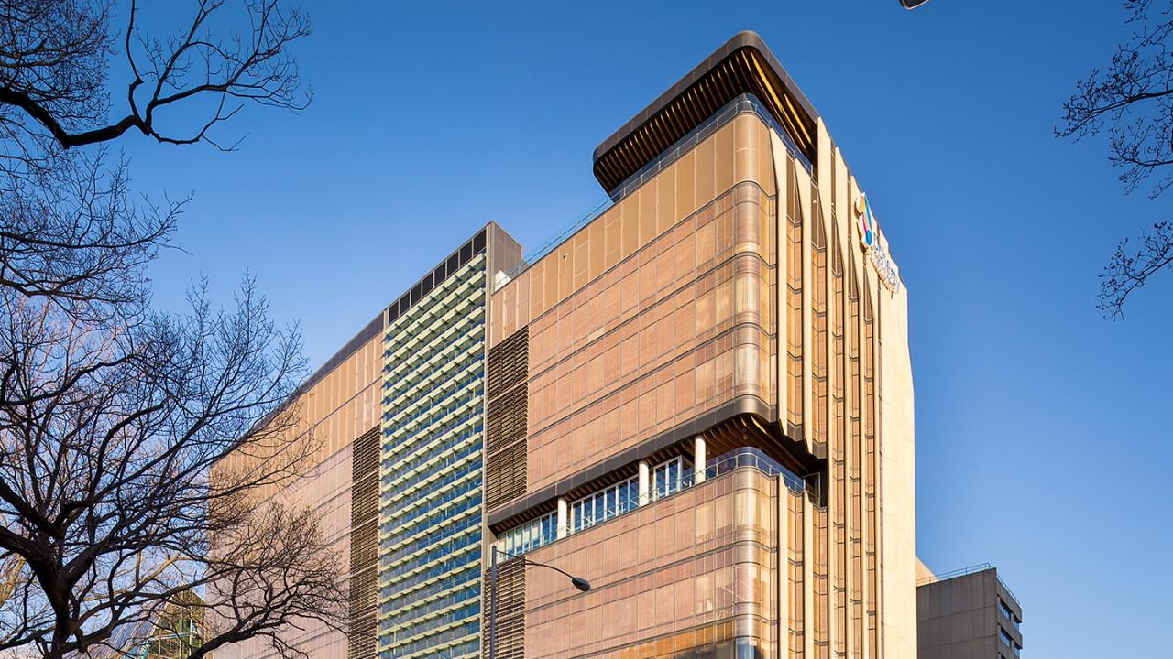
HIV-1 Tat stimulates HBsAg expression in hepatocytes co-infected with HIV and HBV
Wei Zhao, Kasha Singh, Fernando Rossello, Tina Sozzi, Bang Tran, Megan Crane, Luciano Martelotto, Jennifer M Zerbato, Jennifer Audsley, Ajantha Rhodes, Chris Chiu, Jenny Anderson, Danielle Fong, Elizabeth Vincan, Peter Revill, Sharon R Lewin

Slide 2
HIV-HBV co-infection
  Globally around 7.6% HIV infected individuals are co-infected with HBV globally. [1-2]
  HIV infection has a significant impact on the natural history of chronic HBV infection compared to HBV mono-infection. [3]
    increased levels of HBV DNA
    accelerated progression of liver disease
    increased liver-associated mortality
  Despite effective antiretroviral therapy (ART), which controls HIV and HBV replication, life expectancy of HIV-HBV co-infected individuals remains reduced and liver morbidity and mortality remain accelerated. [4, 5]
[1] Leumi et al 2020 Clin Infect Dis; [2] Platt et al 2020 J Viral Hepat; [3] Thio et al 2010 Lancet; [4] Singh et al 2017 AIDS; [5] Klein et al 2016 Clin Infect Dis.

Slide 3
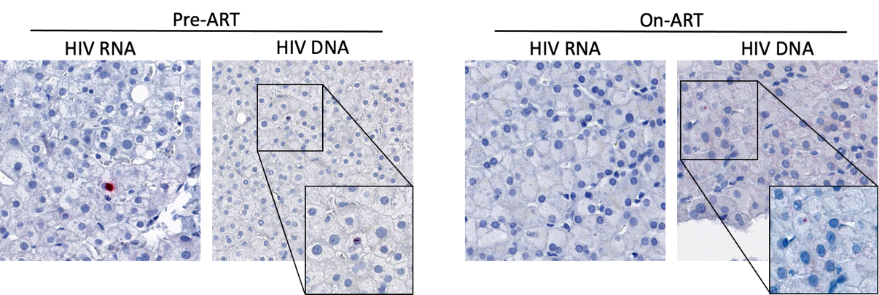
Direct HIV infection of hepatocytes
  HIV RNA and DNA have been detected in hepatocytes in liver biopsies from HIV-infected individuals off ART using in situ studies. [1-3]
  In vitro, HIV enters hepatic cell lines via CXCR4 or CCR5 [4]
[1] Cao et al 1992 AIDS; [2] Housset et al 1993 J Hepatol; [3] Zerbato et al 2022, unpublished; [4] Iser et al 2010 JVI;
Notes:
Hepatocytes hybridized with RNA probe
HIV RNA by in situ hybridization
Huh7.5 cells could be infected with HIV at low level. Kong et al 2012 Virology Journal
HepG2 infected with various striain of HIV-1, p24 production Banerjee et al 1992 AIDS
Five hepatoma cell lines, including CZHC/8571, PLC/PRF/5, Hep3B, HepG2, and HUH7, Cao et al 1990 J virol
Covalently closed circular DNA

Slide 4
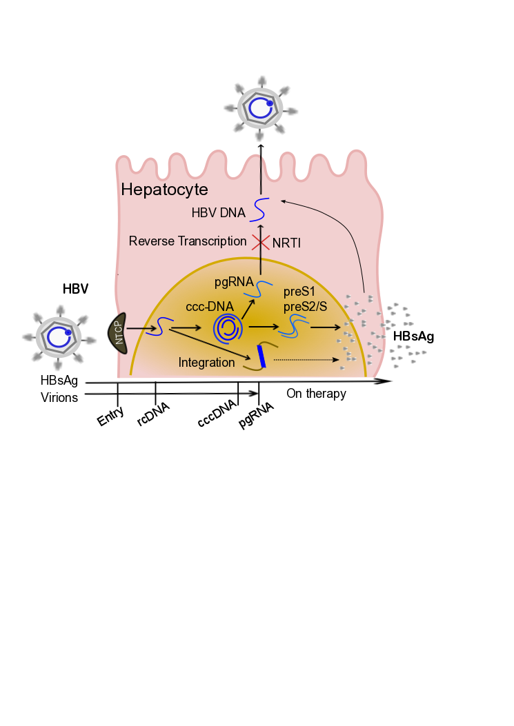

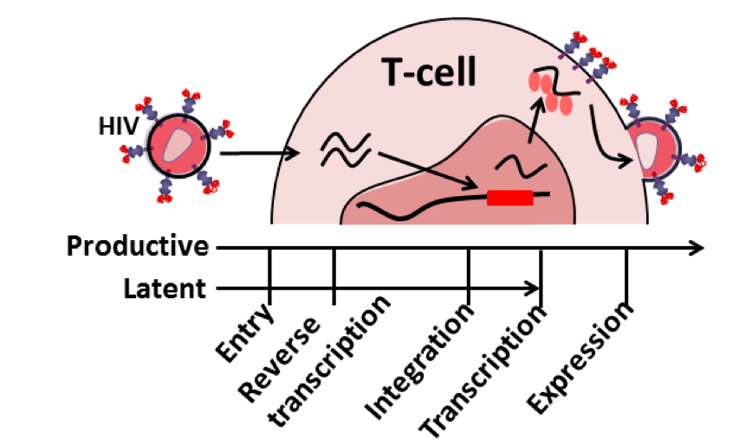
HIV / HBV life cycle
HIV - EGFP
HBV
NTCP = Na+-taurocholate co-transporting polypeptide
Iser et al 2010 J Virol; Singh et al 2017 AIDS.
Notes:
Typical retrovirus, directly infect t-helper cells
Upon receptor and chemokine co-receptor binding, followed by membrane fusion，
Single strand viral RNA. Insert into host chromosome.
HIV mRNA encoding for different viral proteins are transcribed.
Eventually, progeny virions bud off at the cell surface.
However, integrated HIV DNA can also stay dormant in T cells, which leads to HIV latency.

Slide 5
Hypothesis
  HIV infected hepatocytes persist in the liver in HIV-HBV co-infected individuals on HBV-active ART and ongoing production of HIV RNA drives increased production of HBsAg, hepatocyte apoptosis and adverse liver outcomes.
Aims
  Establish in vitro models that mimic treated HIV-HBV co-infection in the liver
  Identify which component of the HIV life cycle drives the increase in HBsAg
  Identify the cellular signalling pathway that has an impact on HBV replication

Slide 6

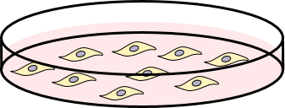

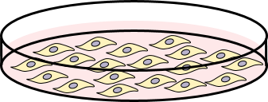
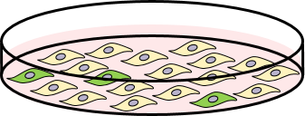

In vitro HIV-HBV co-infection model with hepatic cell lines
RAL / EFV
(HIV inhibitors)
RAL / EFV
(HIV inhibitors)
AD38 (HBV-expressing)
VSV.G-HIV-ΔEnv-EGFP
24 h
24 h
Overnight
72 h
+
+
+
HBV
HepG2-NTCP
Overnight
5-10 days
+
Assay:
FACS: HIV production
Alu-PCR: HIV Integration
Western: HBsAg
Northern / qPCR: HBV RNA
scRNA-seq: transcriptome
VSV.G = vesicular stomatitis virus glycoprotein
RAL = raltegravir (integrase inhibitor); EFV = efavirenz (non-nucleoside reverse transcriptase inhibitor)

Slide 7
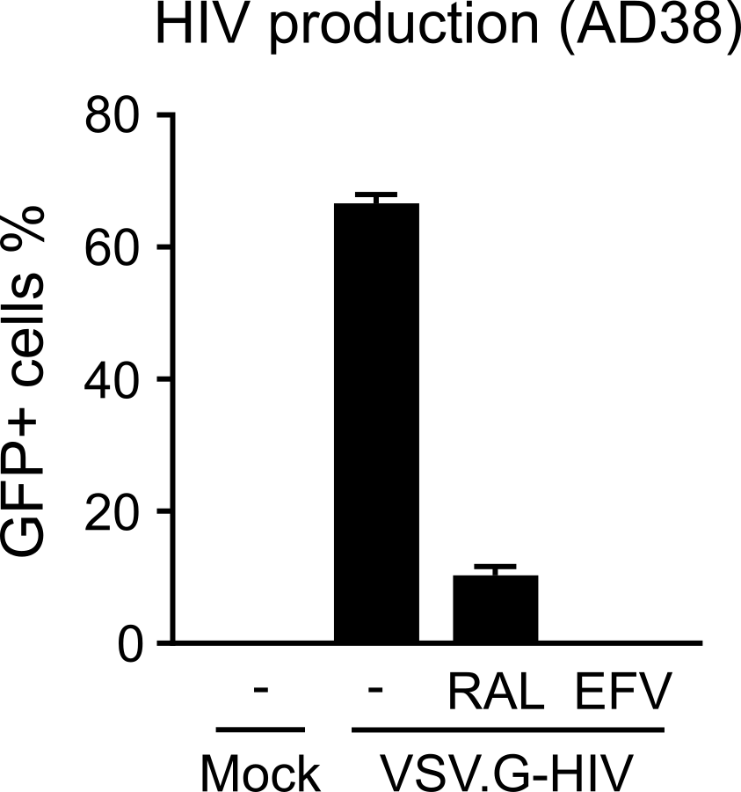
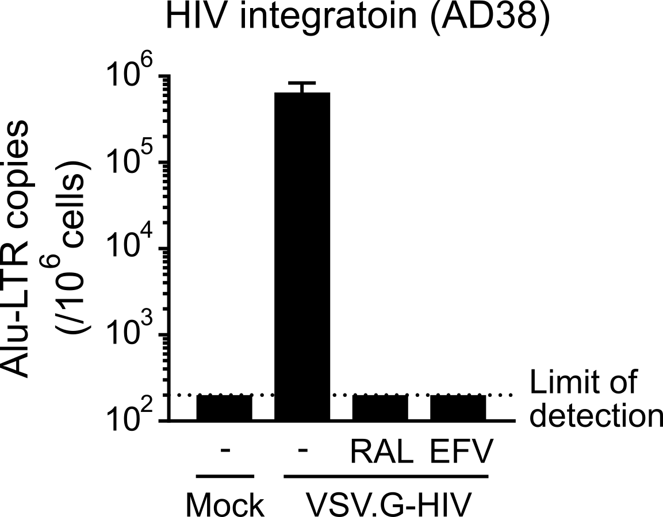
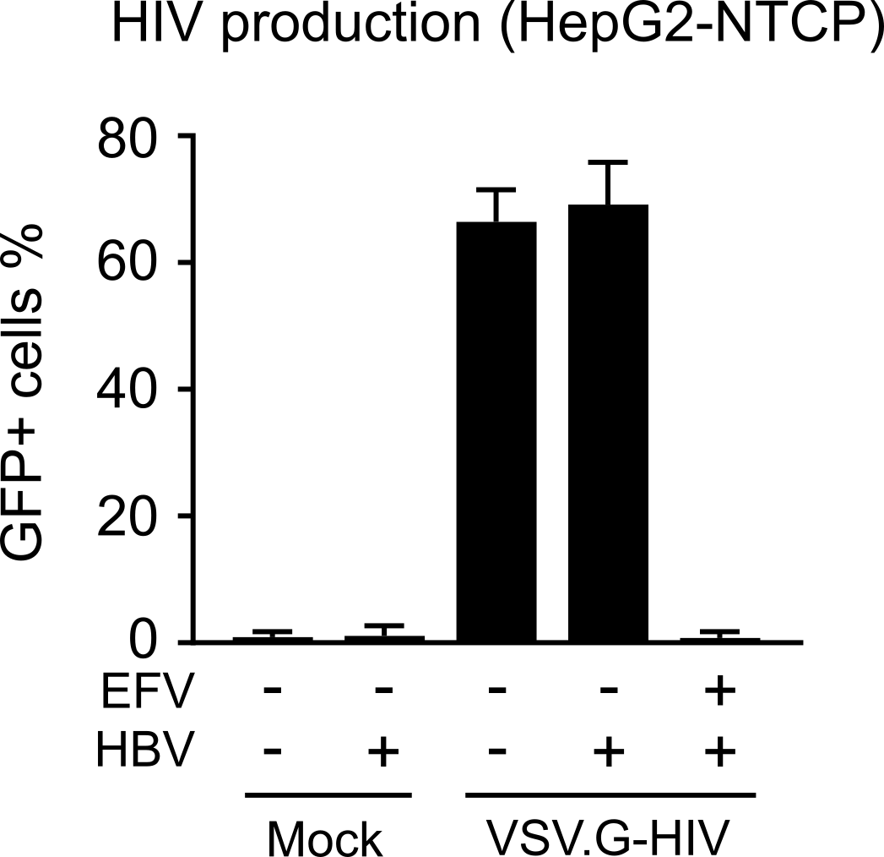
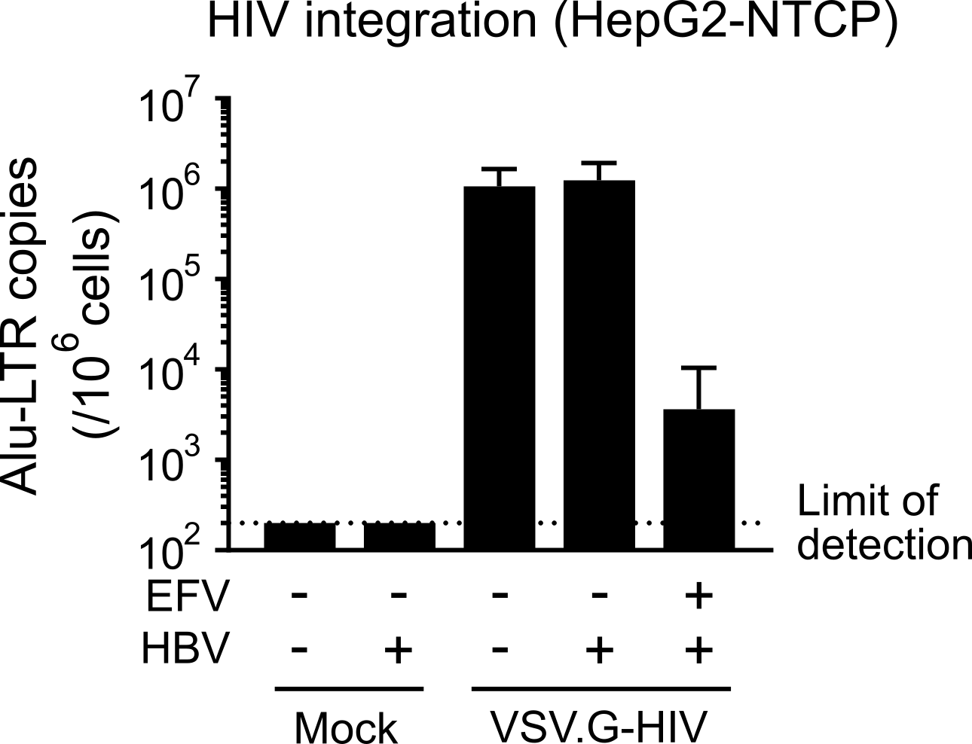
VSV.G-pseudotyped HIV infection led to high HIV production and integration
AD38
HepG2-NTCP
VSVG = VSV.G-HIV-EGFP
n = 3, mean + SEM

Slide 8


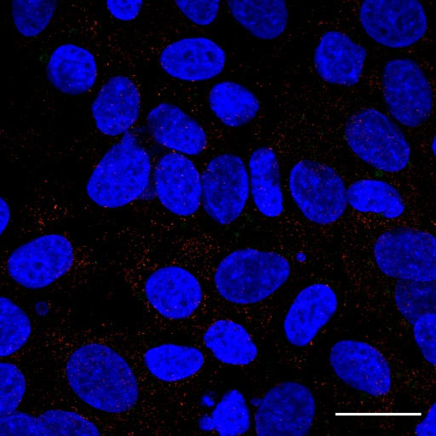
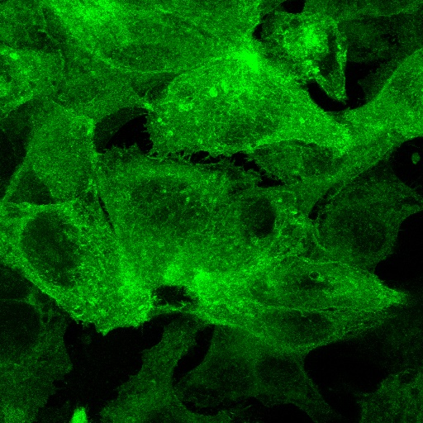
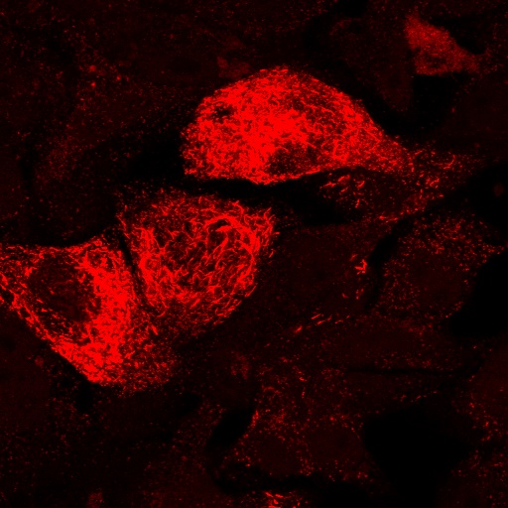
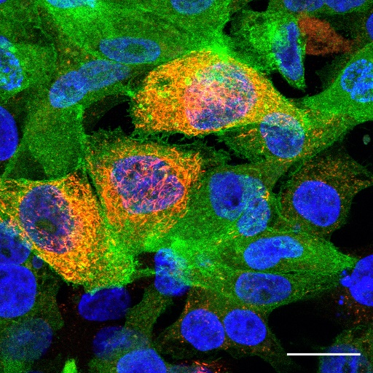

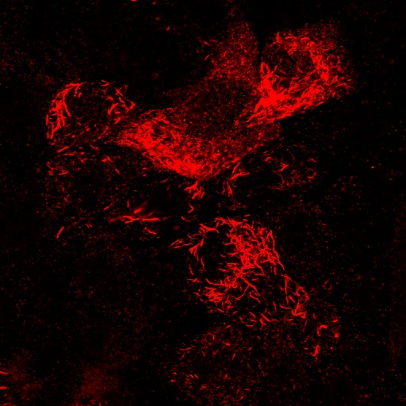
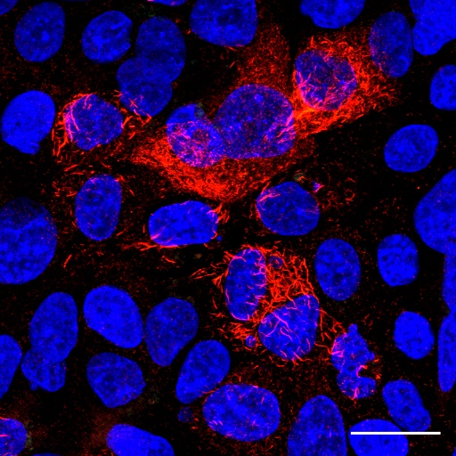
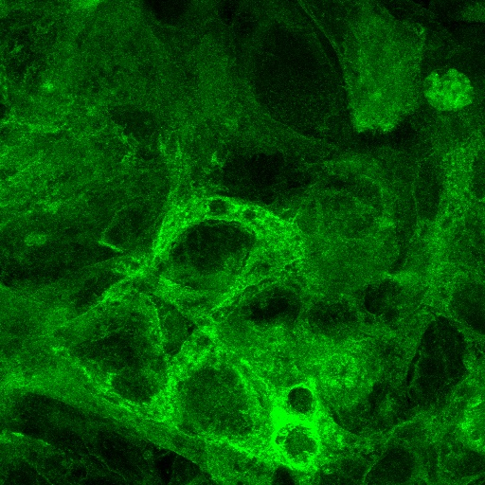

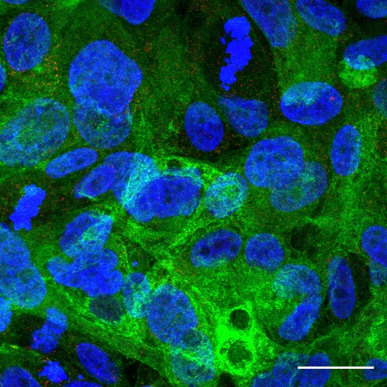
HBV-HIV co-infection led to expression of GFP and HBsAg in HepG2-NTCP cells
GFP (HIV)
HBsAg
Merge with DAPI
Mock
GFP (HIV)
HBsAg
Merge with DAPI
HBV
HBV + VSV.G-HIV
VSV.G-HIV

Slide 9
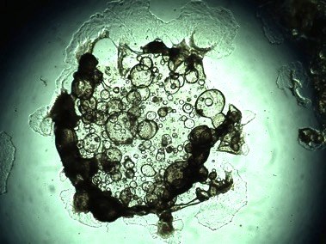
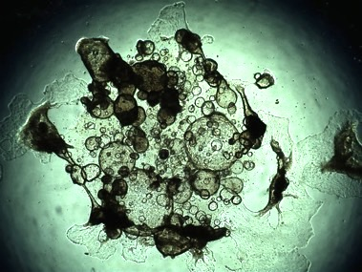
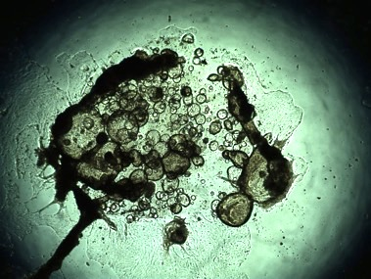
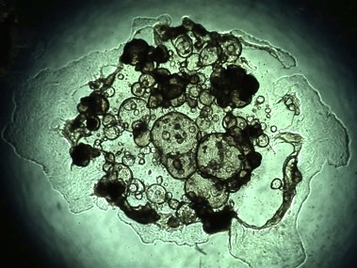
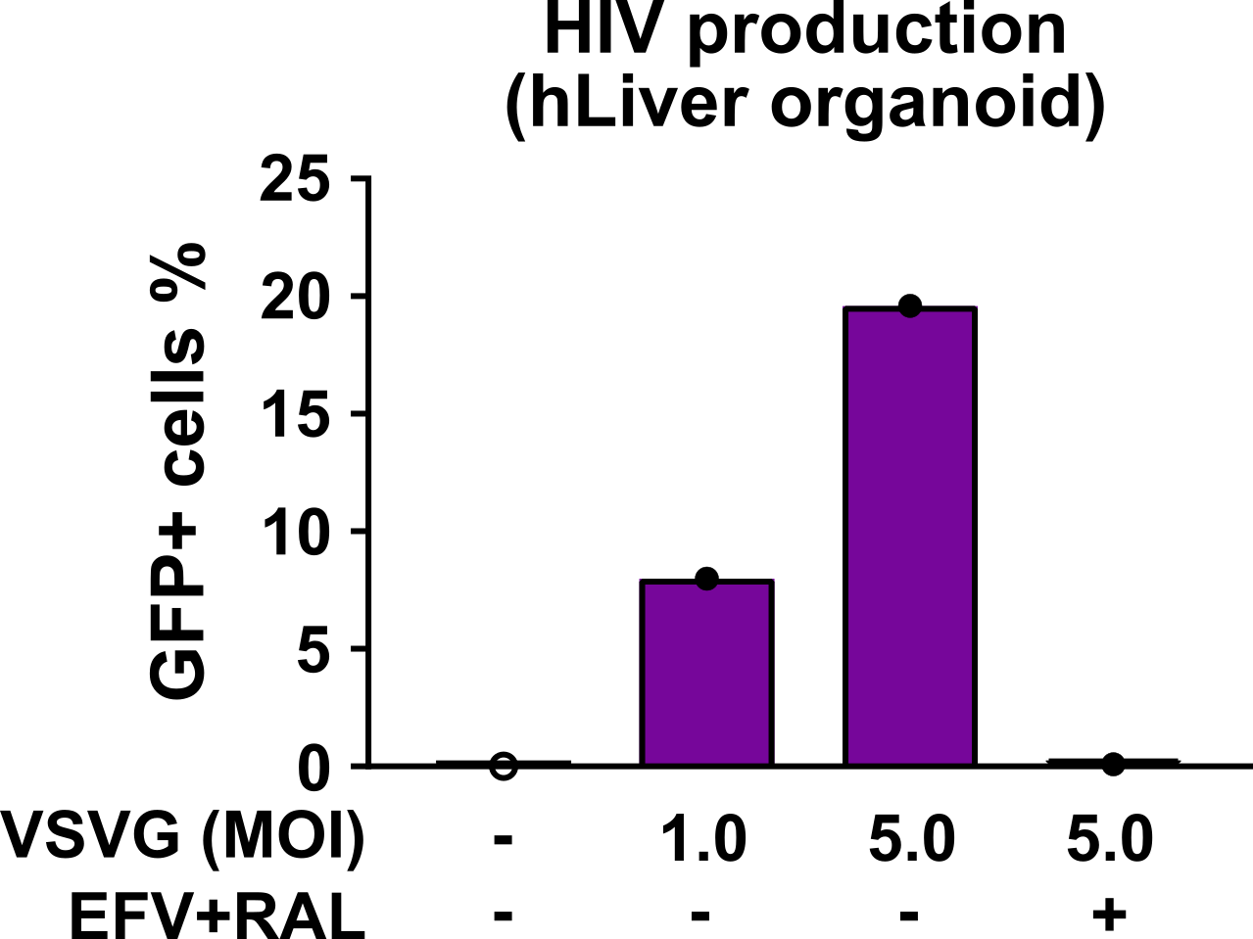
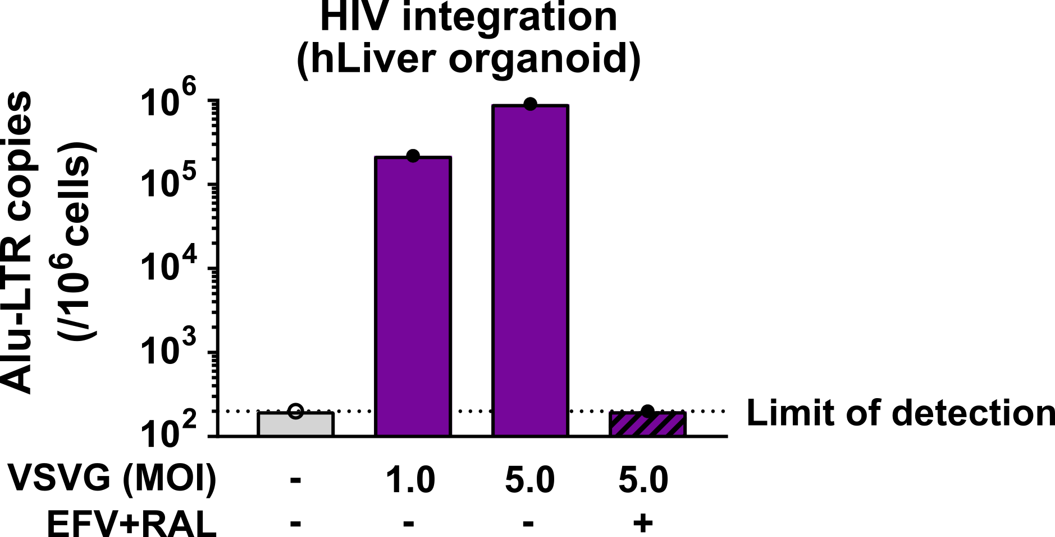
VSV.G-HIV infection led to substantial HIV production and integration in liver organoids
Mock
MOI: 1
MOI: 5
MOI: 5 + EFV / RAL
n = 1

Slide 10
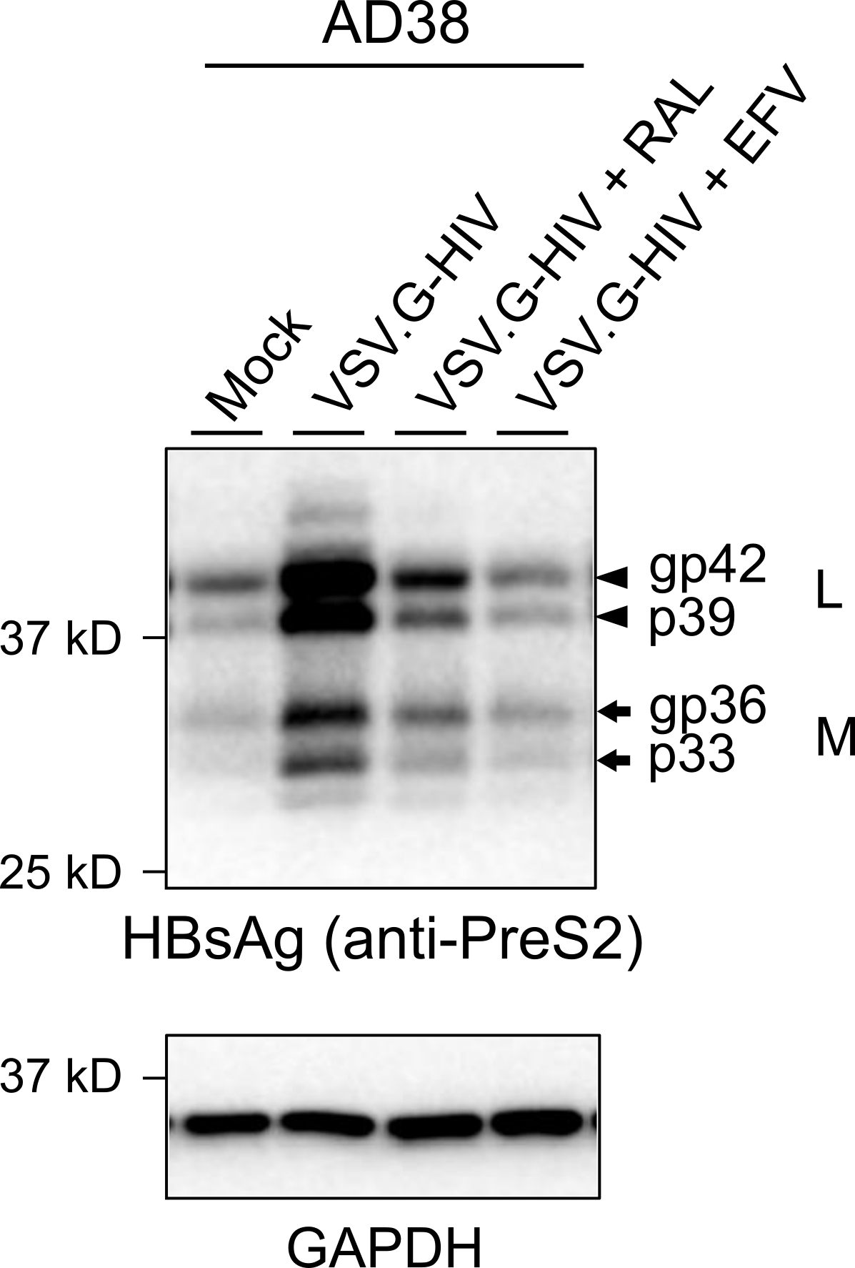
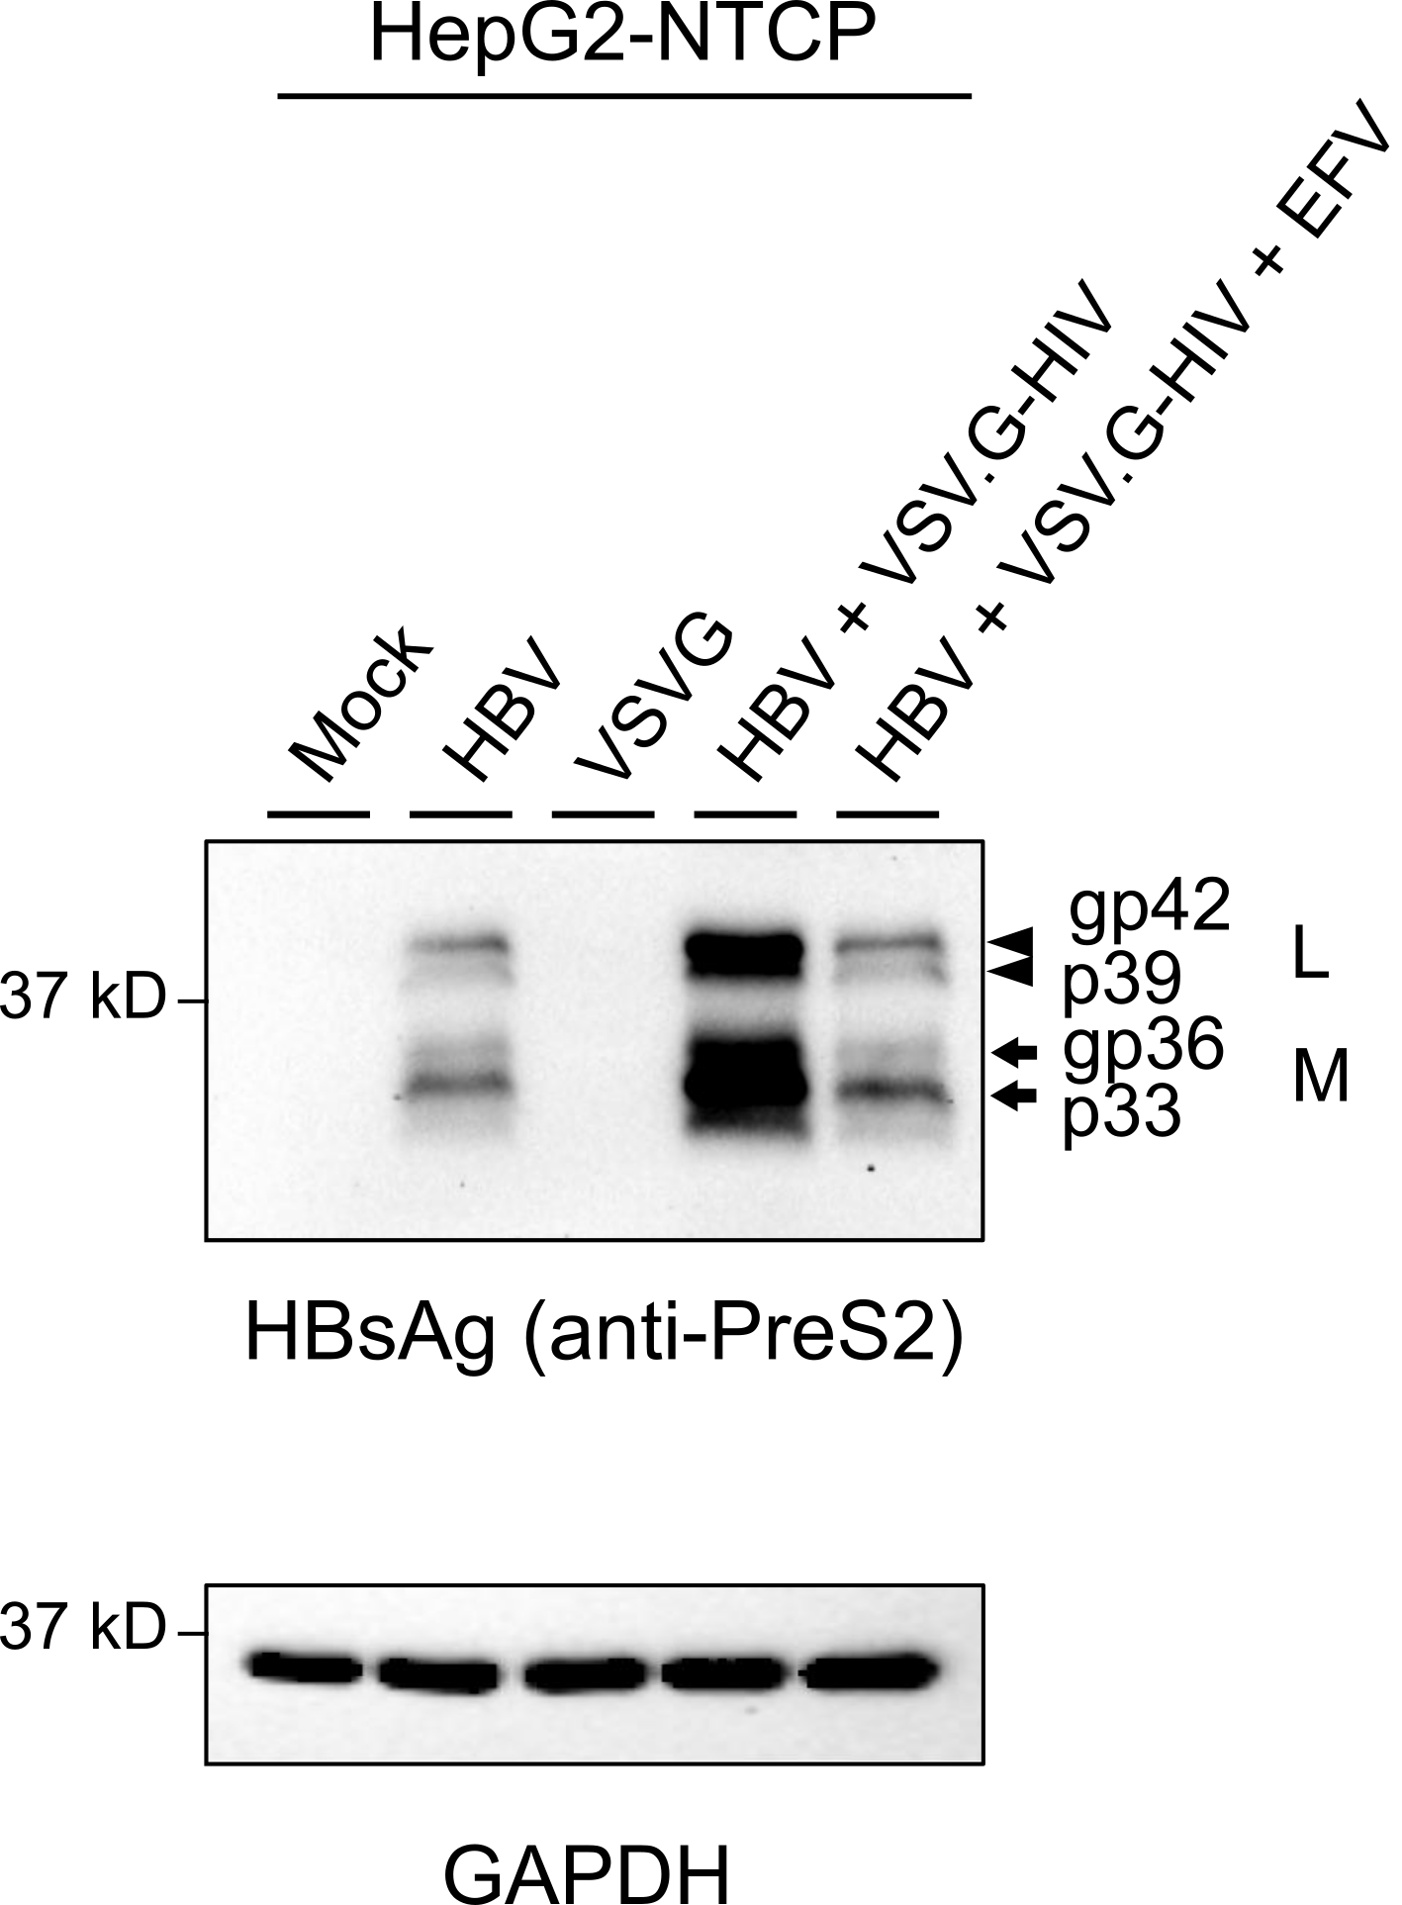
Productive HIV infection led to an increase in intracellular HBs protein in both AD38 and HepG2-NTCP cells
Representative of n >3

Slide 11
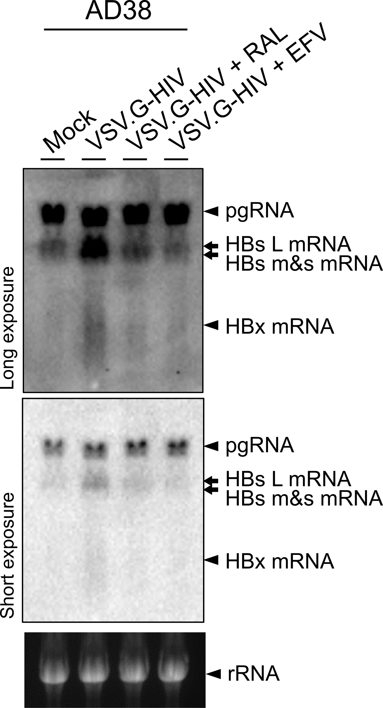
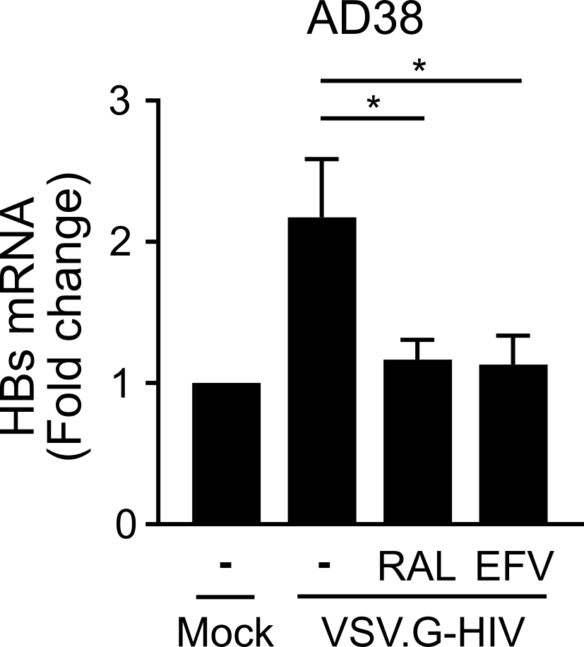
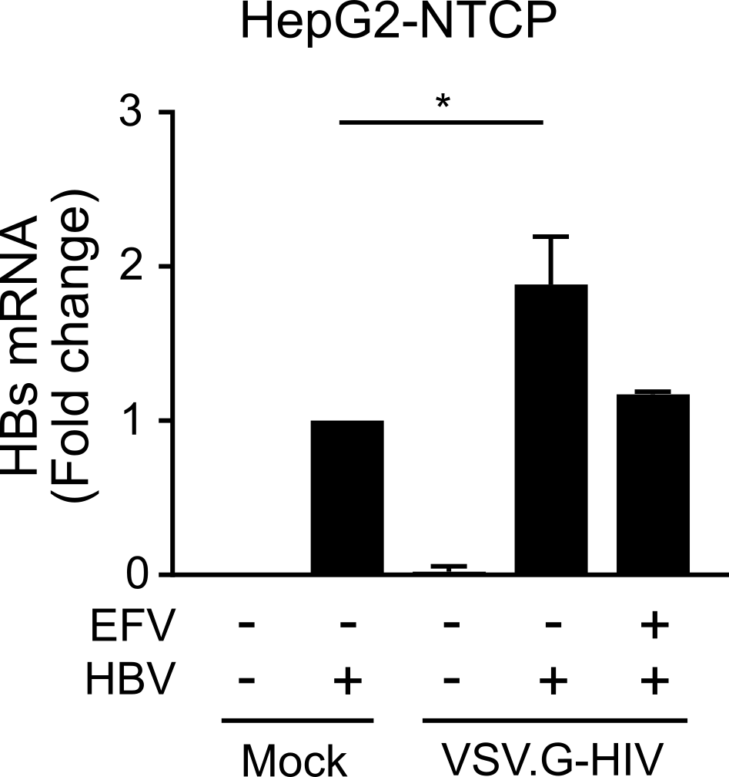
VSV.G-HIV infection led to increase in HBs mRNA in hepatocytes
n = 3, mean + SEM

Slide 12
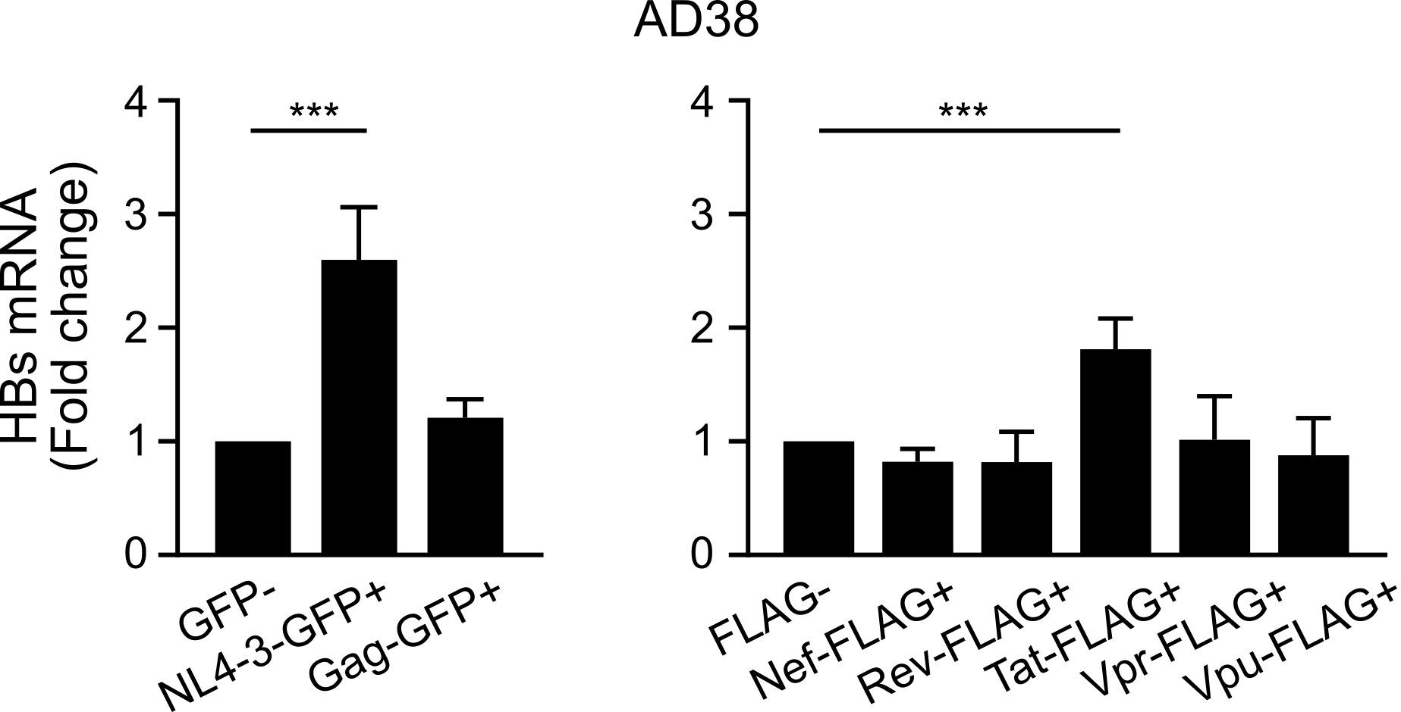
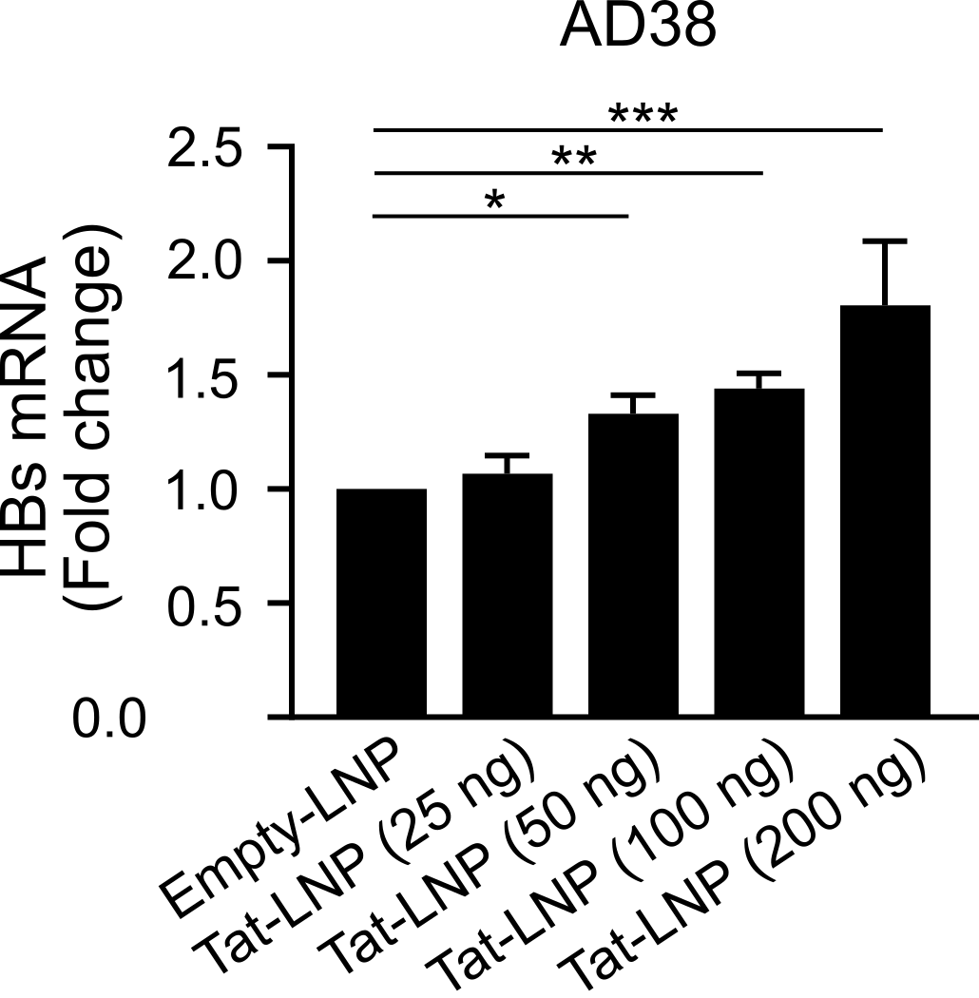
HIV Tat up-regulated HBV surface expression and production
Representative of n >3

Slide 13
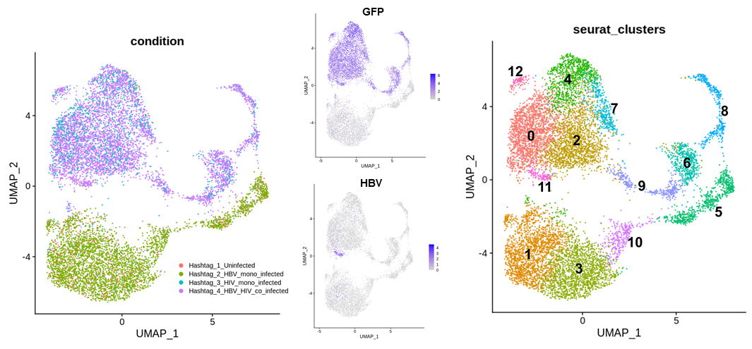
HIV but not HBV had a huge impact on cellular gene expression in hepatocytes
GFP (HIV)
Uninfected
w/ HBV
w/ HIV
w/ HIV-HBV

Slide 14
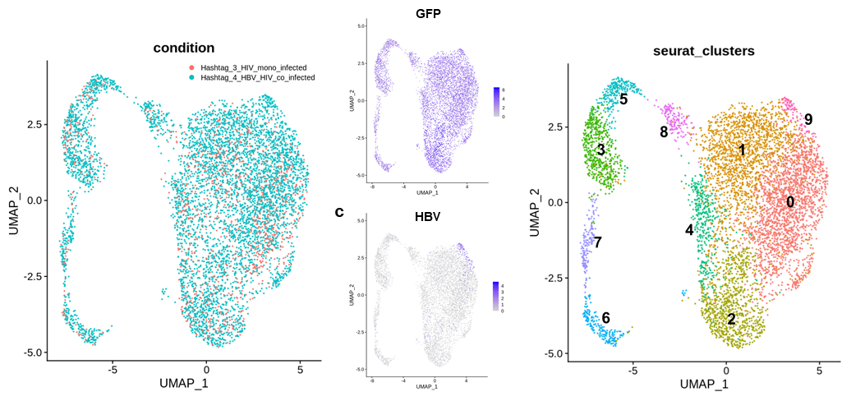
HBV was highly expressed in one cluster in the presence of HIV co-infection
w/ HIV
w/ HIV-HBV

Slide 15
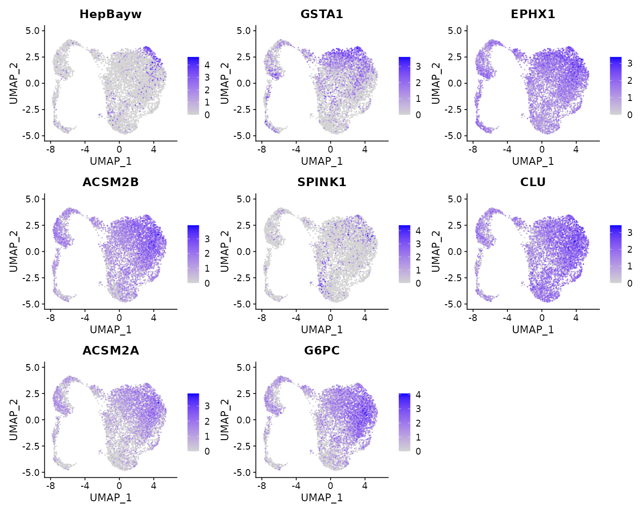
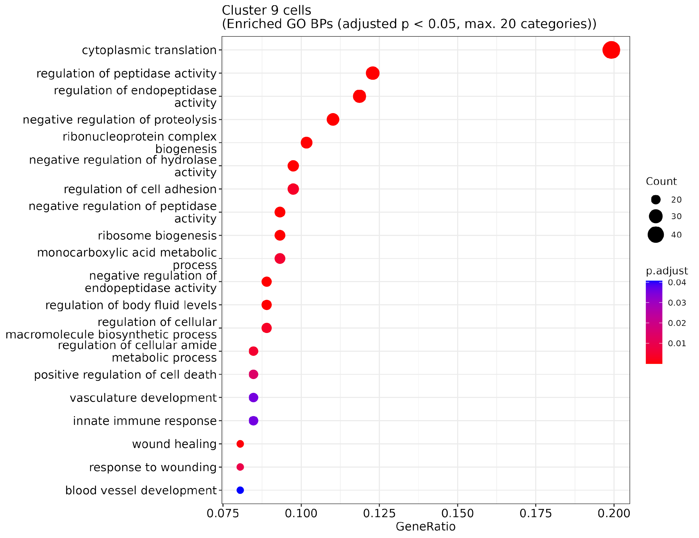
Intracellular protein regulation pathways were associated with high HBV expression in HIV infected hepatocytes
HBV
GSTA1
EPHX1
ACSM2B
SPINK1
CLU
ACSM2A
G6PC

Slide 16
Summary
  Productive HIV infection of HBV-expressing hepatocytes led to increases in HBs mRNA and HBsAg
  Addition of the HIV reverse transcriptase or integrase inhibitor abolished HIV production or integration and rescued HBs up-regulation
  HIV protein Tat may directly stimulate HBs expression level
  HIV but not HBV infection dramatically altered the cellular transcriptome in hepatocytes
  Multiple protein regulation processes were strongly correlated with high HBV expression, indirectly contributing to HBsAg upregulation in the presence of HIV co-infection
  There is a significant and direct effect of HIV co-infection on the HBV life cycle
  This effect is after HIV integration which means it can potentially persist on ART

Slide 17

Acknowledgments
  The Peter Doherty Institute for Infection and Immunity, Melbourne
      Sharon Lewin Damian Purcell Elizabeth Vincan
      Paul Cameron Georges Khoury Bang Tran
      Jennifer Audsley
      Michael Roche
      Jennifer Zerbato
      Kasha Singh
      Megan Crane
      Paula Cevaal
      Chris Chiu
      Danielle Fong
      Jori Symons
  Murdoch University
  Abha Chopra
  University of Melbourne Centre for Cancer Research
  Fernando Rossello
  University of Adelaide
  Michael Beard Luciano Martelotto
  Chuan Kok Lim
  School of Health and Biomedical Sciences, RMIT
  Melissa Churchill
  Victorian Infectious Diseases Reference Laboratory
      Stephen Locarnini
      Peter Revill
      Tina Sozzi
      Hugh Mason
The Biological Optical Microscopy Platform (BOMP), the University of Melbourne

Slide 18


