Slide 1
Bulevirtide Monotherapy at Low and High Doses in Patients With Chronic Hepatitis Delta:
24-Week Interim Data of the Phase 3 MYR301 Study
Heiner Wedemeyer,¹ Soo Aleman,² Maurizia Brunetto,³ Antje Blank,⁴ Pietro Andreone,⁵ Pavel Bogomolov,⁶ Vladimir Chulanov,⁷ Nina Mamonova,⁷ Natalia Geyvandova,⁸ Viacheslav Morozov,⁹ Olga Sagalova,¹⁰ Tatyana Stepanova,¹¹ Dmitry Manuilov,¹²
Vithika Suri,¹² Qi An,¹² John F. Flaherty,¹² Anu Osinusi,¹² Julian Schulze zur Wiesch,¹³ Markus Cornberg,¹ Stefan Zeuzem,¹⁴
Pietro Lampertico,^{15,16}
Presenter: Jacques Yu¹⁷ – jacques.yu10@gilead.com
¹Klinik für Gastroenterologie, Hepatologie und Endokrinologie, Medizinische Hochschule Hannover, Hannover, Germany; ²Karolinska University Hospital/Karolinska Institutet, Department of Infectious Diseases, Stockholm, Sweden; ³Hepatology Unit, Reference Center of the Tuscany Region for Chronic Liver Disease and Cancer, University Hospital of Pisa and Department of Clinical and Experimental Medicine, University of Pisa, Pisa, Italy; ⁴Heidelberg University Hospital, Clinical Pharmacology and Pharmacoepidemiology, Heidelberg, Germany; ⁵Internal Medicine, University of Modena and Reggio Emilia, Modena, Italy; ⁶State Budgetary Institution of Health Care of Moscow region “Moscow Regional Research Clinical Institute after M.F. Vladimirsky,” Moscow, Russian Federation; ⁷FSBI National Research Medical Center for Phthisiopulmonology and Infectious Diseases of the Ministry of Health of the Russian Federation, Moscow, Russian Federation; ⁸Stavropol Regional Hospital, Stavropol, Russian Federation; ⁹LLC Medical Company “Hepatolog,” Samara, Russian Federation; ¹⁰Federal state-funded institution of higher education “Southern Ural State Medical University of Ministry of Health of the Russian Federation,” Chelyabinsk, Russian Federation; ¹¹LLC “Clinic of Modern Medicine,” Moscow, Russian Federation; ¹²Gilead Sciences, Inc., Foster City, CA, USA; ¹³Universitätsklinikum Hamburg-Eppendorf Medizinische Klinik Studienambulanz Hepatologie, Hamburg, Germany; ¹⁴University Hospital Frankfurt, Department of Medicine, Frankfurt am Main, Germany; ¹⁵Foundation IRCCS Ca’ Granda Ospedale Maggiore Policlinico, Division of Gastroenterology and Hepatology, Milan, Italy; ¹⁶CRC “A. M. and A. Migliavacca” Center for Liver Disease, University of Milan, Department of Pathophysiology and Transplantation, Milan, Italy; ¹⁷Gilead Sciences, Hong Kong, China

Slide 2
Disclosures
Jacques Yu is an employee and shareholder of Gilead Sciences, Inc.

Slide 3
Introduction
HDV is a satellite virus of HBV and requires HBV envelope proteins to infect hepatocytes¹
~12 million people are infected with HDV worldwide²
HDV is the most severe form of chronic viral hepatitis,³ with a 2–3-fold increased risk of mortality compared with HBV monoinfection^{4,5}
US FDA guidance for HDV treatment states that a 2-log₁₀ decline in HDV RNA and ALT normalization is an acceptable chronic on-therapy surrogate endpoint⁶
ALT, alanine aminotransferase; FDA, Food and Drug Administration; HBV, hepatitis B virus; HDV, hepatitis D virus.
1. Rizzetto M, et al. J Infect Dis. 1980;141:590–602; 2. Stockdale AJ, et al. J Hepatol. 2020;73:523–32; 3. Wedemeyer H, et al. Nat Rev Gastroenterol Hepatol. 2010;7:31–40; 4. Fattovich G, et al. Gut. 2000;46:420–6; 5. Romeo R, et al. Gastroenterology. 2009;136:1629–38; 6. US FDA. Chronic Hepatitis D Virus Infection: Developing Drugs for Treatment Guidance for Industry. Draft Guidance. November 2019. Available at: https://www.fda.gov/regulatory-information/search-fda-guidance-documents/chronic-hepatitis-d-virus-infection-developing-drugs-treatment-guidance-industry. Accessed May 21, 2022.

Slide 4
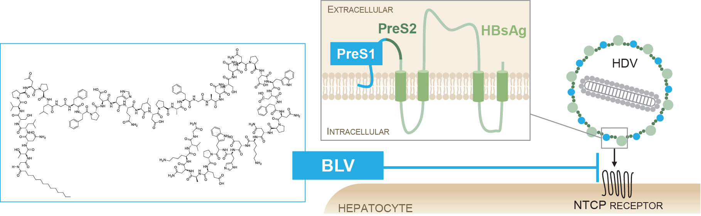
Bulevirtide
First-in-class entry inhibitor for treatment of chronic HDV
Linear 47-amino acid chemically synthesized lipopeptide bearing an N-terminal myristoyl moiety and a C-terminal carboxamide
Specifically binds to NTCP at the basolateral membrane of differentiated hepatocytes
  This transporter is also used by HBV and HDV to enter hepatocytes¹
Shows very low off-target toxicity, and excellent safety and tolerability
2-mg dosage conditionally approved in Europe for treatment of chronic HDV²
BLV, bulevirtide; HBsAg, hepatitis B surface antigen; HBV, hepatitis B virus; HDV, hepatitis D virus; NTCP, sodium taurocholate cotransporting polypeptide.
1. Ni Y, et al. Gastroenterology. 2014;146:1070-83; 2. Hepcludex [SmPC]. Bad Homburg, Germany: Myr GmbH; 7/20.

Slide 5
Objectives
To evaluate the safety and efficacy of BLV administered subcutaneously at a dose of 2 or 10 mg qd for treatment of chronic HDV compared with no treatment at interim week 24
BLV, bulevirtide; HDV, hepatitis D virus; qd, once daily.

Slide 6
Study design
Interim analysis
Primary endpoint: combined response
Undetectable HDV RNA or decrease by ≥2 log₁₀ IU/mL from baseline
Normal ALT
Week 0
24
48
144
240
N=150 randomized 1:1:1, stratified by liver cirrhosis
status
n=51
Follow-up
No treatment
BLV 10 mg sc qd*
n=49
BLV 2 mg sc qd*
n=50
BLV 10 mg sc qd*
*Nucleos(t)ide analogues for treatment of underlying HBV infection were allowed if indicated by treatment guidelines.
Multicenter, open-label, randomized, Phase 3 study (NCT03852719) conducted in Germany, Italy, Russian Federation, Sweden (sites in the US screened but did not enroll patients)
Population: adults with chronic HDV with or without cirrhosis; 1× < ALT < 10× ULN; CPT ≤7 (controlled HIV coinfection was allowed)
Undetectable HDV RNA defined as below lower limit of detection (6 IU/mL)
Liver stiffness measured by elastography
Secondary analyses: undetectable HDV RNA and ALT normalization (week 48); sustained virologic response at weeks 24 and 48; change from baseline in liver stiffness (measured by elastography; weeks 48, 96, 144, 192, and 240)
Statistical analyses: difference in response rates between treatment groups was calculated using Fisher exact test
ALT, alanine aminotransferase; BLV, bulevirtide; CPT, Child-Pugh-Turcotte; HBV, hepatitis B virus; HDV, hepatitis D virus; qd, once daily; sc, subcutaneous; ULN, upper limit of normal.

Slide 7
Baseline characteristics
 | No Treatment n=51 | BLV 2 mg n=49 | BLV 10 mg n=50
Mean age, y (SD) | 40.5 (7.5) | 43.6 (9.0) | 41.3 (8.5)
Men, n (%) | 26 (51) | 30 (61) | 30 (60)
Race, n (%)
White | 40 (78) | 41 (84) | 43 (86)
Asian | 11 (22) | 8 (16) | 6 (12)
Black | 0 | 0 | 1 (2)
Cirrhosis, n (%) | 25 (49) | 23 (47) | 23 (46)
Mean liver stiffness, kPa (SD) | 15.26 (8.95) | 13.99 (8.19) | 14.81 (9.26)
>20 kPa, n (%) | 10 (20) | 9 (18) | 10 (20)
Mean ALT, U/L (SD) | 101.6 (61.9) | 107.9 (62.5) | 123.4 (80.6)
Median HDV RNA, log₁₀ IU/mL (IQR) | 5.38 (1.84) | 5.23 (1.30) | 5.03 (1.85)
HBV genotype, n (%)
A | 0 | 2 (4) | 2 (4)
D | 10 (20) | 16 (33) | 12 (24)
Missing | 41 (80) | 32 (65) | 37 (74)
HDV genotype, n (%)
1 | 51 (100) | 49 (100) | 49 (98)
5 | 0 | 0 | 1 (2)
Mean HBsAg, log₁₀ IU/mL (SD) | 3.676 (0.465) | 3.667 (0.511) | 3.615 (0.575)
Mean HBV DNA, log₁₀ IU/mL (SD) | 0.885 (0.989) | 1.311 (1.300) | 1.110 (1.263)
Positive, n (%) | 13 (25) | 15 (31) | 11 (22)
HBeAg positive, n (%) | 4 (8) | 4 (8) | 7 (14)
ALT, alanine aminotransferase; BLV, bulevirtide; HBeAg, hepatitis B “e” antigen; HBsAg, hepatitis B surface antigen; HBV, hepatitis B virus; HDV, hepatitis D virus; IQR, interquartile range; SD, standard deviation.

Slide 8
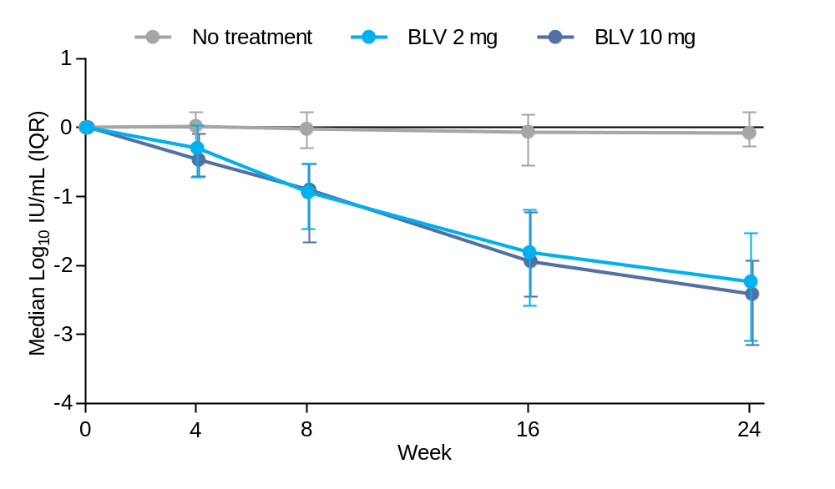
Changes in HDV RNA over time
Compared with no treatment, BLV led to a decline in HDV RNA, with similar rates of HDV RNA decline with BLV 2 and 10 mg over 24 weeks of treatment
BLV, bulevirtide; HDV, hepatitis D virus; IQR, interquartile range.

Slide 9
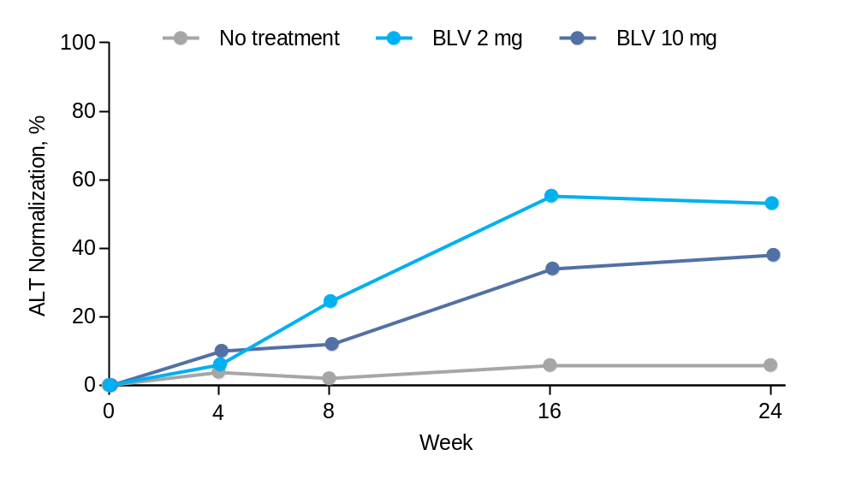
ALT normalization over time
After 24 weeks of treatment, rapid ALT reduction and normalization were observed in >50% of patients in the BLV 2-mg arm
ALT, alanine aminotransferase; BLV, bulevirtide.

Slide 10
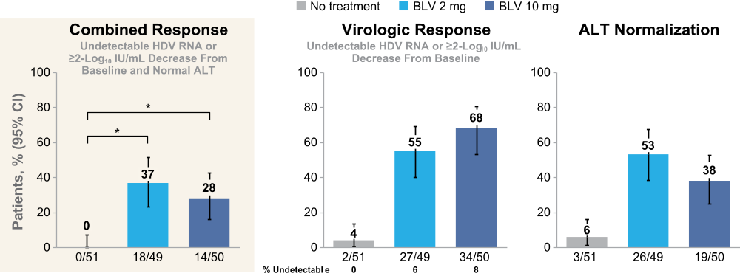
Virologic and biochemical responses at week 24
24 weeks of treatment with BLV 2 mg led to a higher combined viral and biochemical response compared with no treatment or BLV 10 mg
*P <0.0001. ALT, alanine aminotransferase; BLV, bulevirtide; CI, confidence interval; HDV, hepatitis D virus.

Slide 11
Other efficacy endpoints at week 24
Treatment with BLV 2 or 10 mg for 24 weeks led to modest declines in HBV DNA compared with no treatment
 | No Treatment n=51 | BLV 2 mg n=49 | BLV 10 mg n=50
HBsAg decrease >1 log₁₀ IU/mL from baseline, n (%) | 0 | 1 (2) | 0
HBsAg loss/seroconversion, n (%) | 0 | 0 | 0
Mean HBV DNA change from baseline, log₁₀ IU/mL (SD) | 0.025 (0.792) | –0.510 (0.869) | –0.641 (1.006)
BLV, bulevirtide; HBsAg, hepatitis B surface antigen; HBV, hepatitis B virus; SD, standard deviation.

Slide 12
Safety
There were no AEs or serious AEs leading to D/C of study drug
Injection-site reactions were rare and mostly mild in grade
No symptomatic elevations in total bile salts were observed across the BLV 2- and 10-mg arms
 | Patients, n (%) | No Treatment n=51 | BLV 2 mg n=49 | BLV 10 mg n=50
Adverse events* | Any AE | 26 (51) | 32 (65) | 36 (72)
 | Grade 3–4 AE | 2 (4)† | 2 (4)‡ | 1 (2)§
 | Any serious AE | 1 (2) | 0 | 0
 | D/C due to AE | 0 | 0 | 0
 | Death | 0 | 0 | 0
AE of special interest | Injection-site reactions | 0 | 3 (6) | 13 (26)
 | Liver-related AEs | 0 | 0 | 0
Grade 3–4 laboratory abnormalities | Thrombocytopenia | 2 (4) | 0 | 0
 | Leukopenia | 1 (2) | 0 | 1 (2)
 | Neutropenia | 1 (2) | 0 | 0
*All AEs reported in the table were considered treatment emergent; only symptomatic and clinically significant total bile salt elevations were collected; †Cholelithiasis (n=1) and COVID-19 infection (n=1); ‡Foot fracture (n=1), and headache, asthenia, and depression (n=1); §Pneumonia due to COVID-19 infection (n=1).
AE, adverse event; BLV, bulevirtide; D/C, discontination.

Slide 13
Conclusions
BLV monotherapy was safe and well tolerated in patients with compensated chronic HDV, with most AEs being mild to moderate in severity, with no BLV-related serious AEs
24 weeks of treatment with BLV was associated with significant HDV RNA declines and improvements in biochemical disease activity
  BLV 2 and 10 mg had significantly superior responses to the no treatment arm
  BLV 2 mg for 24 weeks had a higher combined response rate than BLV 10 mg
These findings further support the conditional approval of BLV 2 mg
AE, adverse event; BLV, bulevirtide; HDV, hepatitis D virus.

Slide 14
Acknowledgments
We extend our thanks to the patients and their families
This study was funded by MYR Pharmaceuticals, Bad Homburg, Germany
This presentation was funded by Gilead Sciences, Inc.

