Slide 1



Therapeutic Vaccination And Novel Immunotherapies For Functional Cure
  Antonio Bertoletti, MD
  Duke-NUS Medical School-Emerging Infectious Diseases Program
Science of HBV Cure Meeting (HBV Cure 2022)

Slide 2
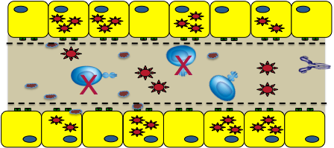
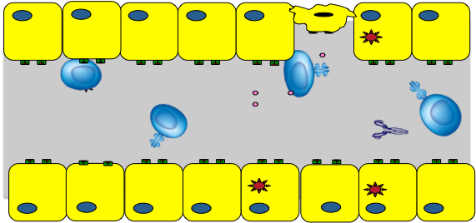
Do we need anti-viral immunity to cure HBV?
Chronic HBV Infection
Resolved HBV
“Functional Cure”

Slide 3
Do we need anti-viral immunity to cure HBV?
Chronic HBV Infection
NO
If we have an antiviral that will be able
to eliminate completely HBV ( cccDNA)…
Resolved HBV
“Functional Cure”

Slide 4
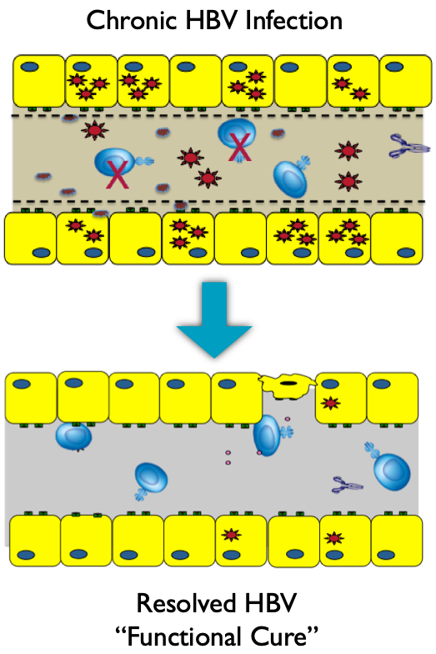
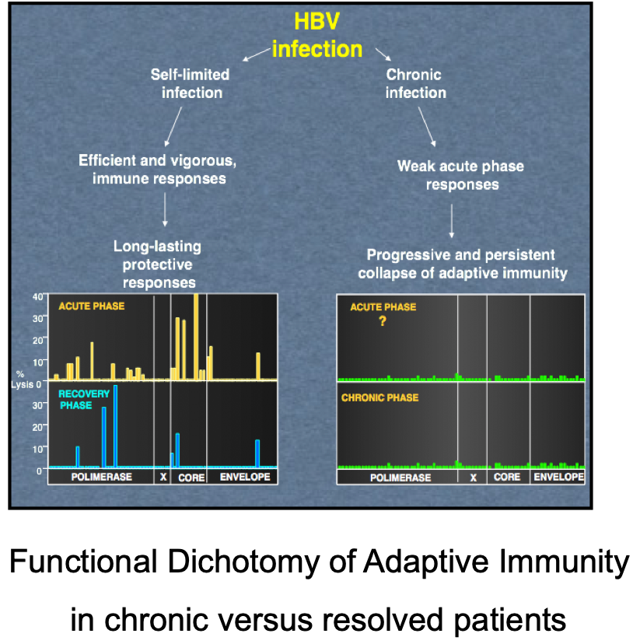
Do we have evidences that Immunity can control HBV ?

Slide 5

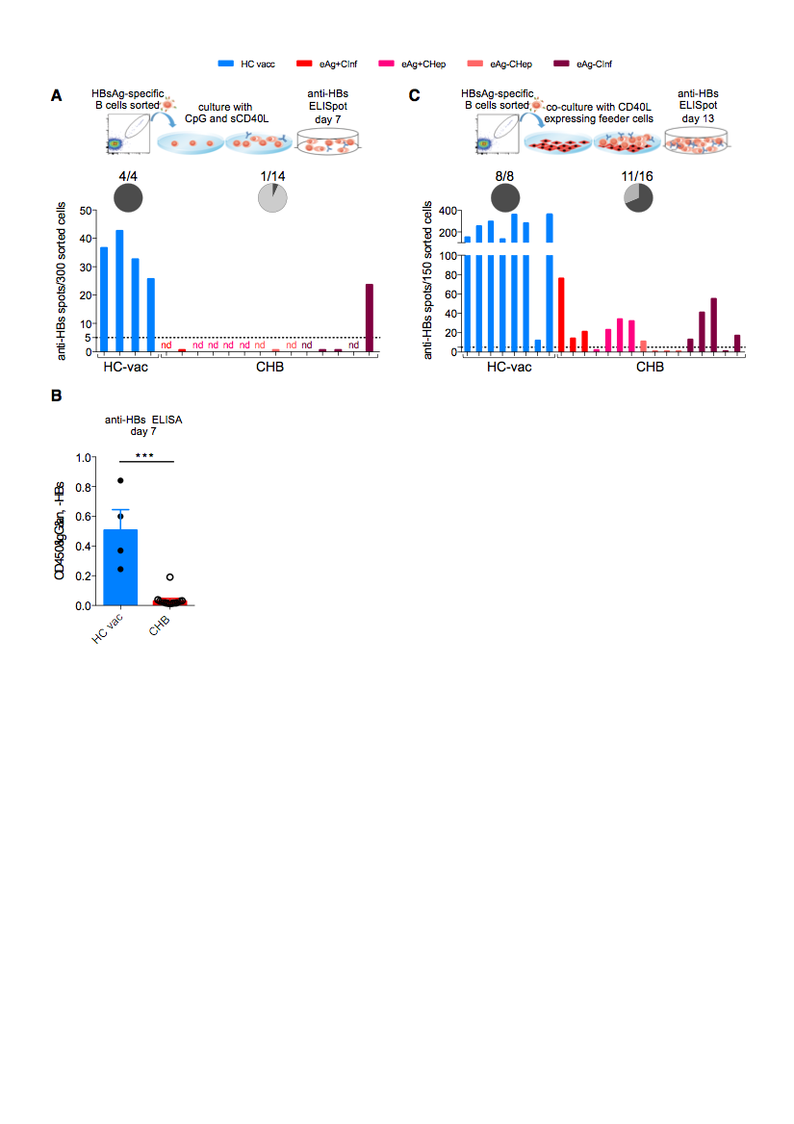
HBs-specific B cells functional defective in CHB
D-550
D-650
B cell
receptor
HBV-specific B cell
[1] Salimzadeh L, Le Bert N, Dutertre C-A, Gill US, Newell EW, Frey C, et al. PD-1 blockade partially recovers dysfunctional virus-specific B cells in chronic hepatitis B infection. J Clin Invest 2018;128:4573–87.

Slide 6
Immunotherapy for CHB: Do we have evidences that HBV-immunity is important for control?
Immune suppression (T and B cells) causes
HBV reactivation
A.Seto et al HBV reactivation in patients treated with rituximab
J. Chin. Oncol 2014;32: 3736-43
Transplant of HBV primed bone marrow causes HBV control
G Lau et al.Clearance of hepatitis B surface antigen after bone marrow transplantation:
role of adoptive immunity transfer. Hepatology 25:1497–1501. d.
HBsAg+ liver became HBsAg negative after transplantation in resolved HBV patients
Loggi et al Anti-HBs re-seroconversion after liver transplantation in a patient with past HBV infection receiving a HBsAg positive graft. J Hepatol 2009, 50:625–630

Slide 7
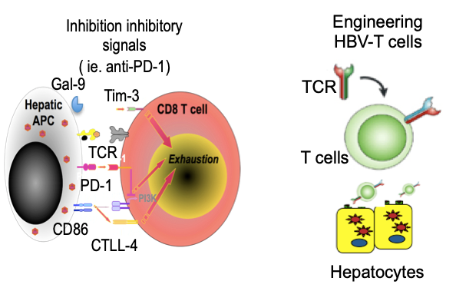
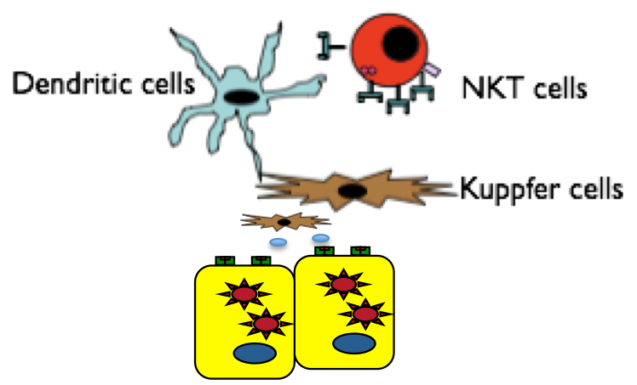
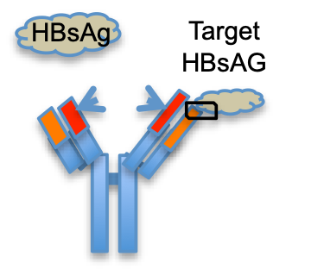
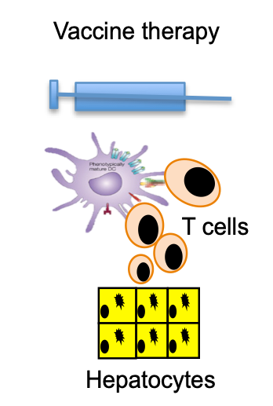
Immunotherapy for CHB: we developed many strategies
Restoring/stimulating Innate Immunity
Restoring/stimulating Adaptive Immunity
Not targeted
HBV-targeted
TLR-agonists ( TLR-7/8/9)
RIG-I agonist
Cytokines
( IFN-alpha)
T cells
Antibodies
Vaccines therapy

Slide 8
Why Immune therapies didn’t (so far) work?
EXCEPTION: IFN-alpha is the only therapy that increases seroconversion.

Slide 9
Why Immune therapies didn’t (so far) work?
EXCEPTION: IFN-alpha is the only therapy that increases seroconversion.
Narrow therapeutic window
Wrong patients populations.

Slide 10
TLR-7 agonist: success in animal models (woodchucks and chimps)
but not in patients
Restoring/stimulating Innate Immunity
But associated with Induction of flares…
TLR-agonists ( TLR-7/8/9)
RIG-I agonist
In CHB patients used in very low doses
(35-100 lower dose than in animals)
NO Response
CONSIDERATION: unlikely that successful immune therapy won’t induce some level of hepatic flares

Slide 11
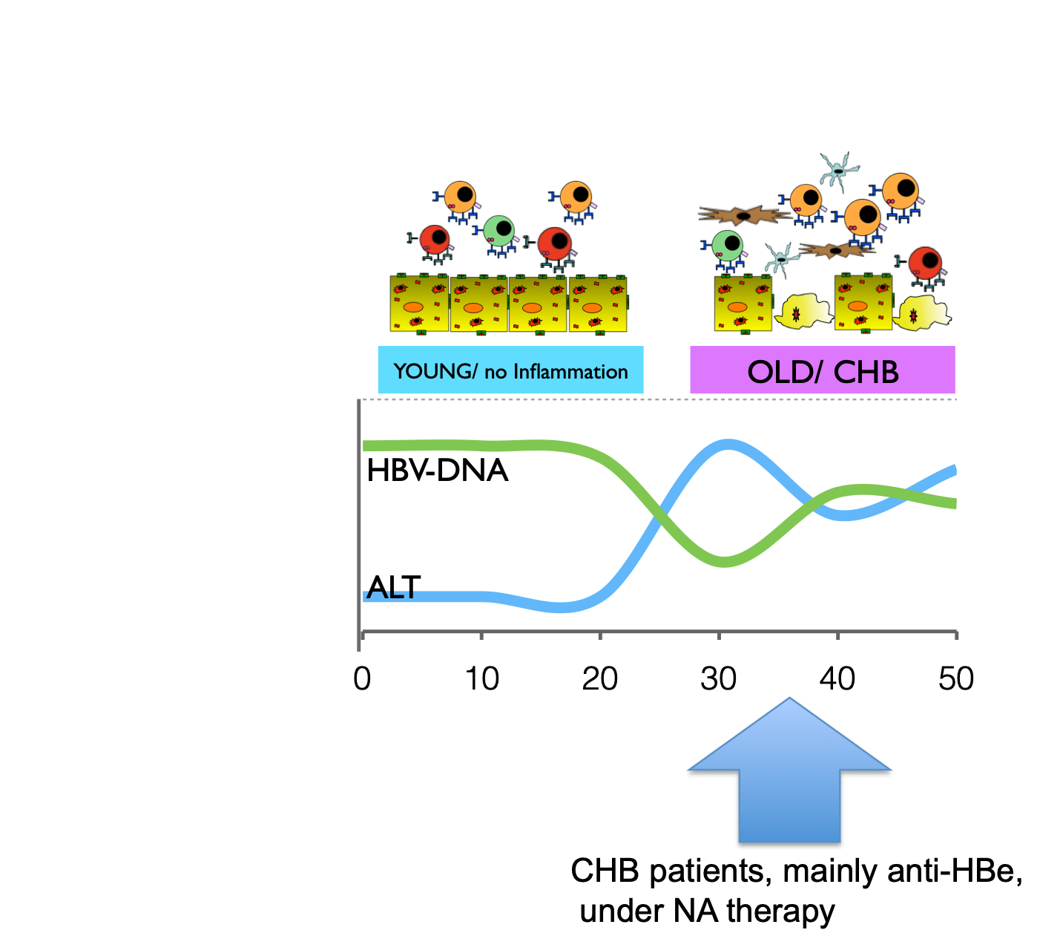
Chronic hepatitis B is not a single entity…
Functional alteration
B and T cell response
Functional alteration
liver environment

Slide 12
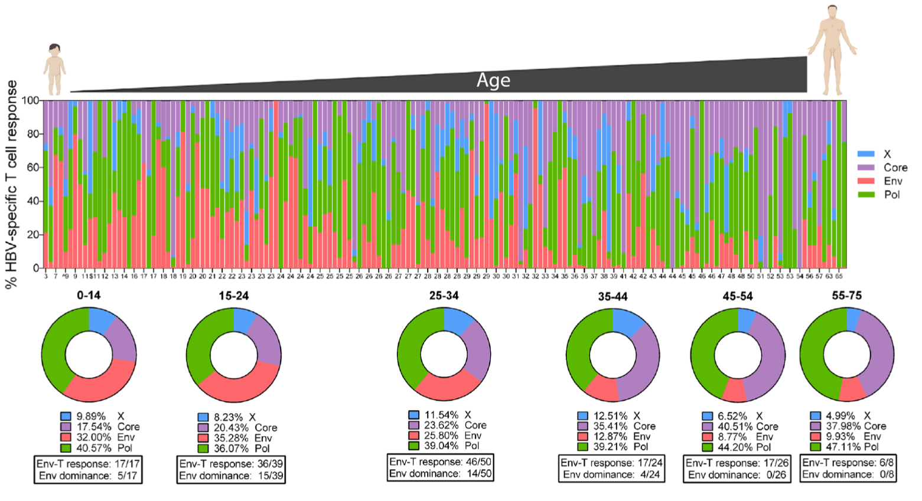
Age (duration of infection) and T cell response
ENV

Slide 13
Chronic hepatitis B is not a single entity…
Functional alteration
B and T cell response
Functional alteration
liver environment
WE should select CHB patients for immunotherapy based on immunological profile and not on virological/inflammatory profile

