Slide 1


Comprehensive immune profiling of intrahepatic environment of functionally cured chronic hepatitis B patients revealed altered adaptive immune response and emergence of innate immune responses
Atefeh Khakpoor,
YLL School of Medicine,
NUS, Singapore

Slide 2
Hepatitis B Virus, the causative agent for chronic HBV infection affecting more than 250 million people worldwide
Despite of current available therapies (NUC, IFN) due to:
  Persistent infection (presence of cccDNA)
  Lack of strong immune response
  The clearance of viral sAg (HBsAg) is considered as Functional cure (FC)

Slide 3
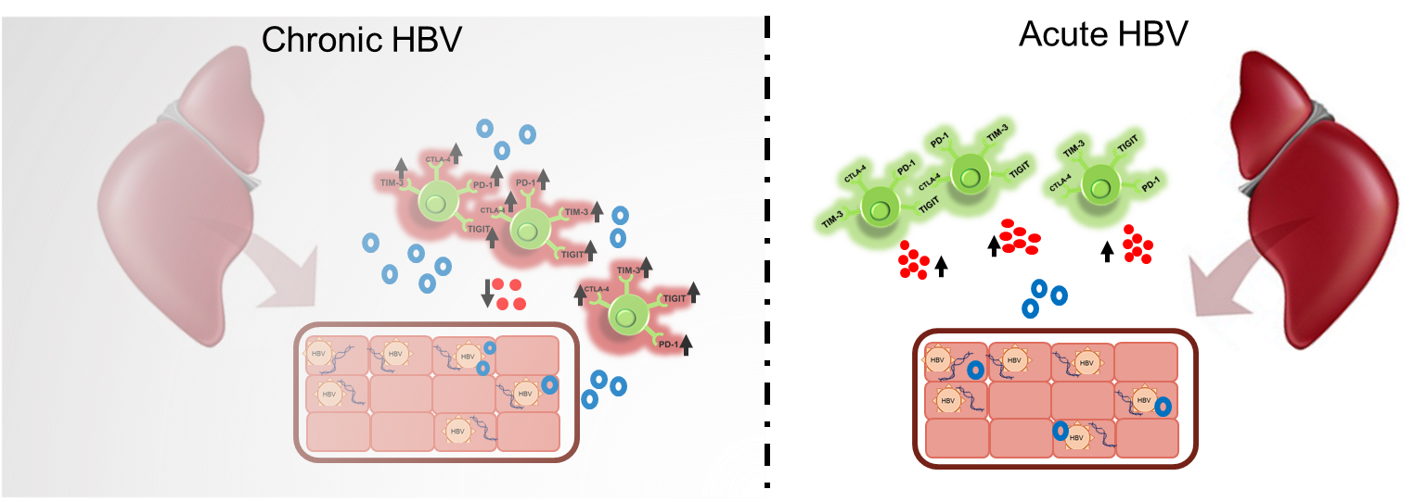
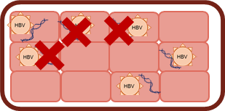



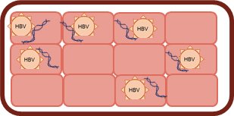






Slide 4
Viral infection clearance in Acute Hepatitis B is through a robust T cells response (mainly CD8 T cells)
In Chronic Hepatitis B patients
  Exposure to large volumes of viral antigen
  Duration of exposure to viral antigen
  Adaptive immune responses are impaired

Slide 5
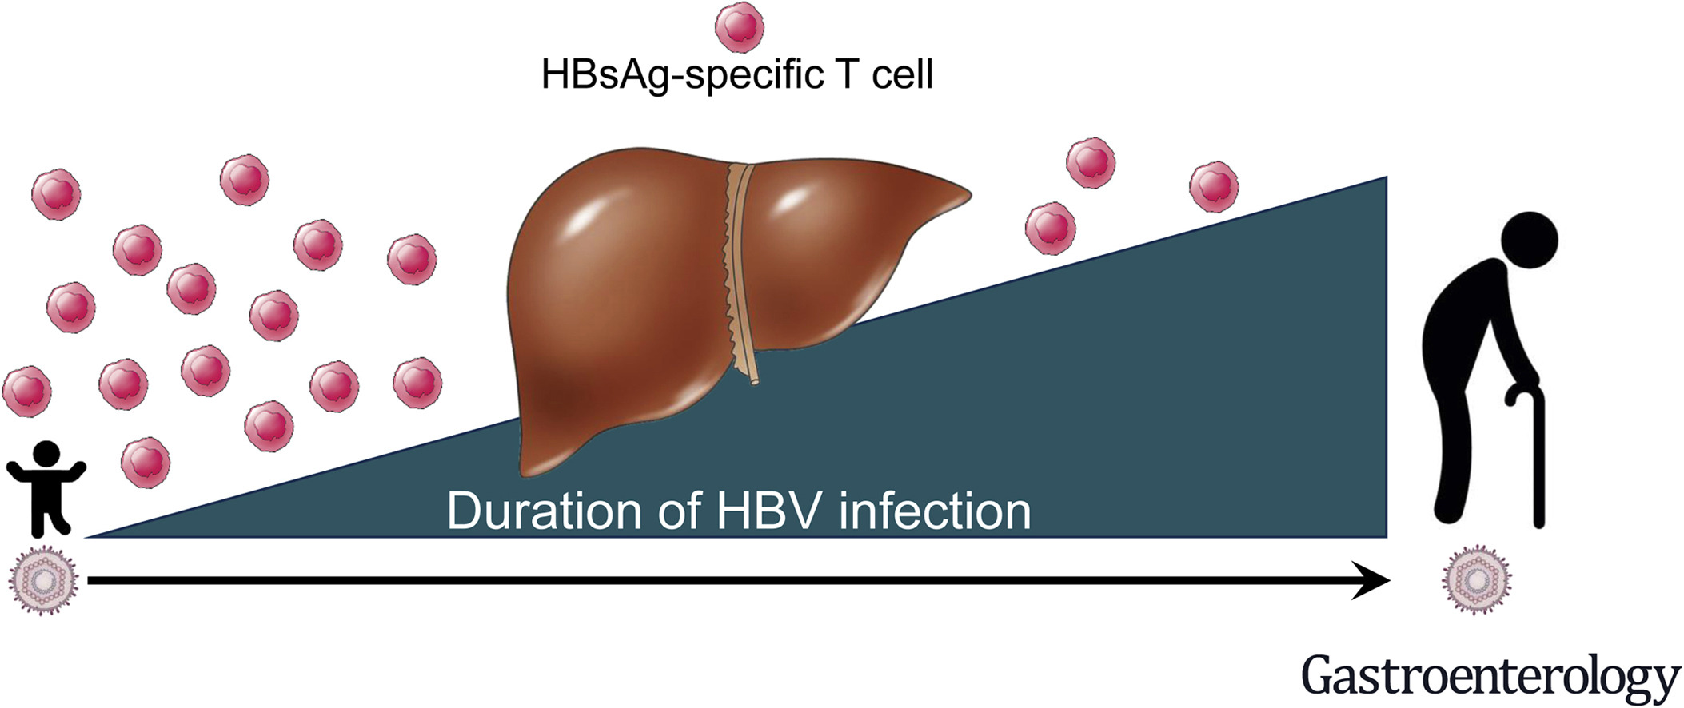
Le Bert.et al, Gastroenterology, 2020.

Slide 6
In general there is not much known about the phenotypic characteristics of T cells
Apart from a study showing activation of NK cells after cessation of NUC therapy is shown
The role of NK cells in clearance of HBsAg is not well described either
Understanding the differences in the immune responses in patients achieving functional cure is crucial for design of effective therapeutical approaches

Slide 7
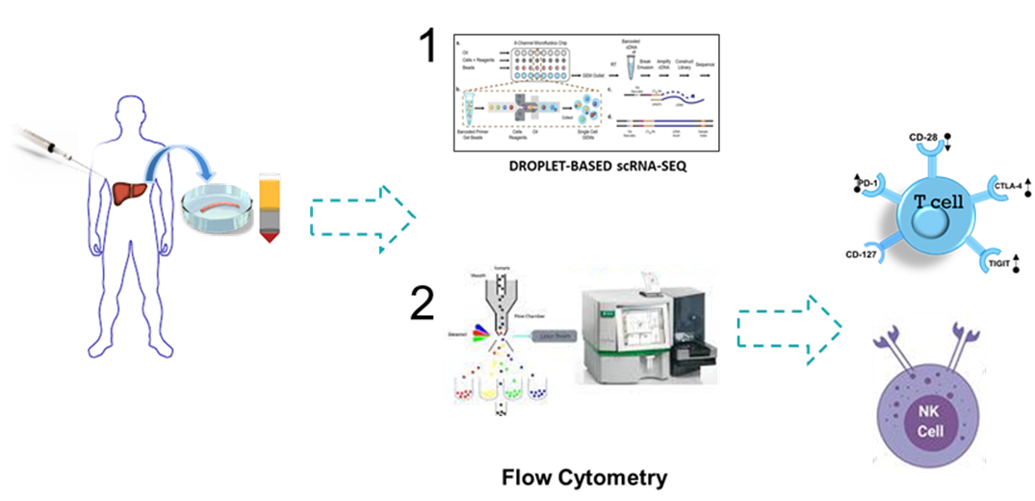
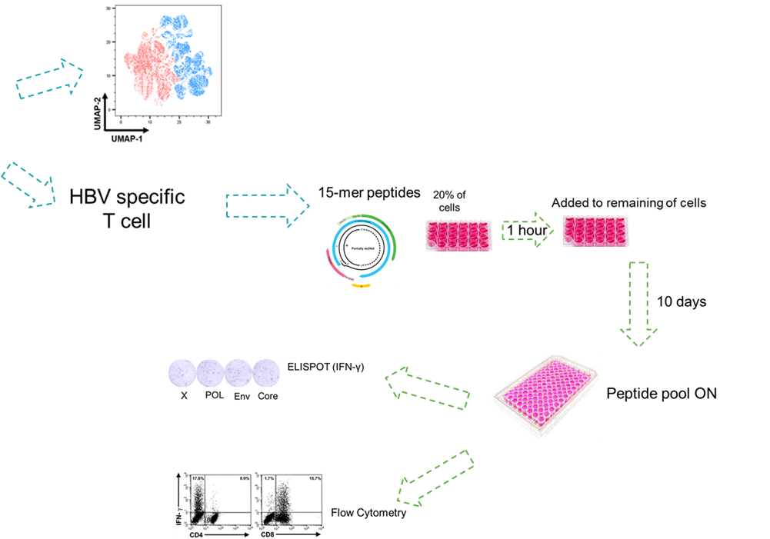
Immune atlas profiles of functionally cured CHB patients
n=29 CHB
n=9 FC

Slide 8
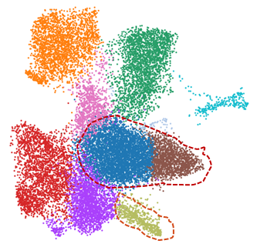
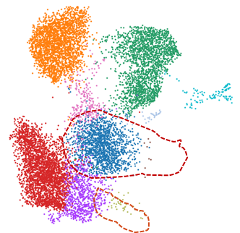
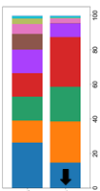
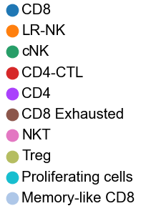
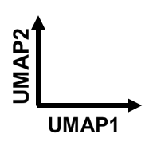
Intrahepatic Single cell transcriptome atlas of
T cell
CHB
FC
LIVER
Exhausted CD8 T cells
CD8
Treg
CHB
FC
in FC patients:
Loss of Tregs
Loss of exhausted cD8 T cells and reduction in cD8 T cells

Slide 9
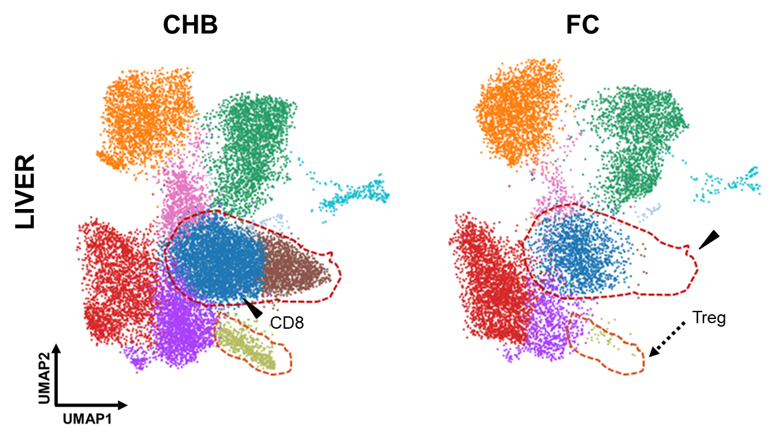
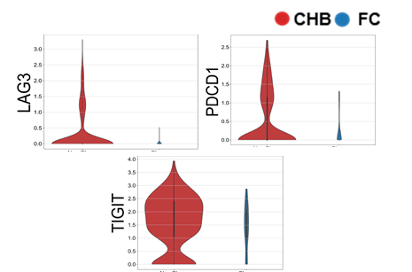
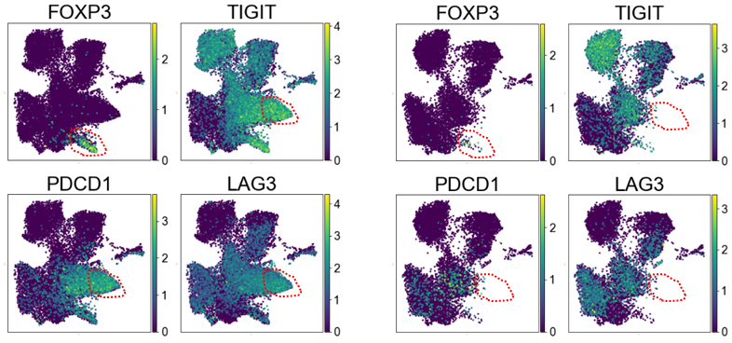
Reduced exhaustion in patients with Functional Cure
Drastic reduction in exhaustion marker expression in FC patients

Slide 10
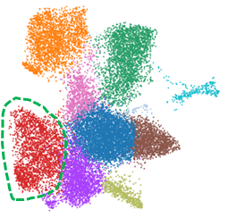
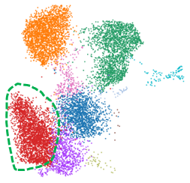
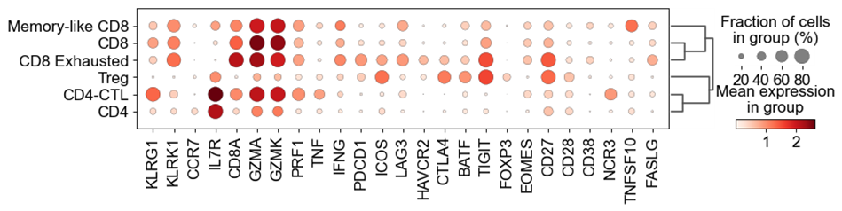
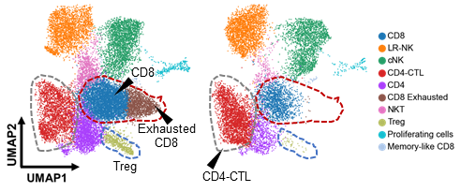
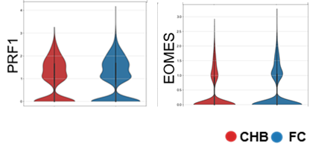
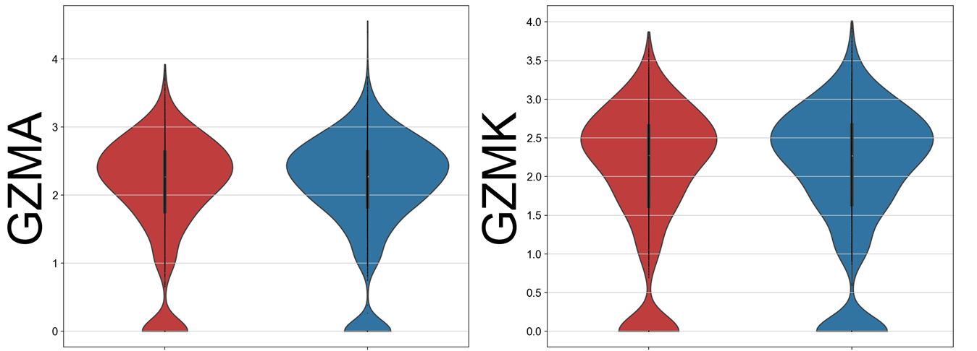
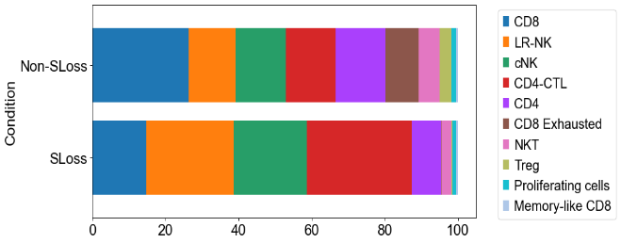
Increased CD4-CTL population in FC patients
CHB
FC
LIVER
CHB
FC
Increased population of CD4 T cells with increased expression of PRF, GZM and EOMES is observed in FC patients

Slide 11
Loss of exhaustion markers with concomitant increase in CD4-CTL population in patients with Functional cure might suggest a shift in adaptive immune response
Deep phenotyping of global T cells using multi-parameteric
FACS analysis
CHB patients are stratified based on qHBsAg levels from (>10000IU/ml , 1000-10000 IU/ml, 0.05-1000 IU/ml)

Slide 12
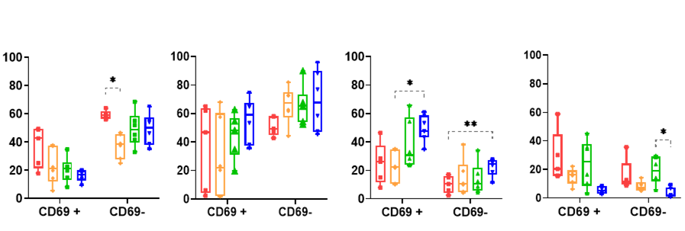
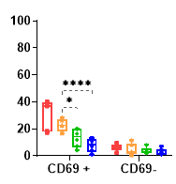

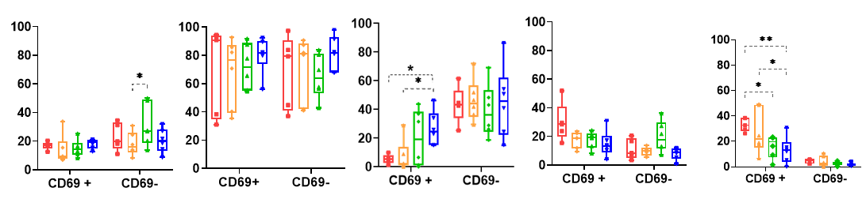
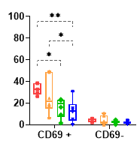
LIVER
% of CD8+ T cells
% of CD4+ T cells
CD57
CD28
CD127
HLA-DR
PD-1

Slide 13
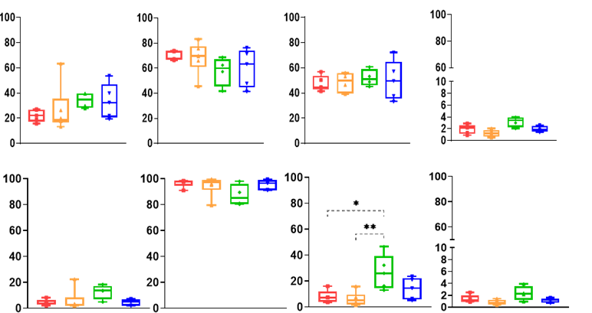
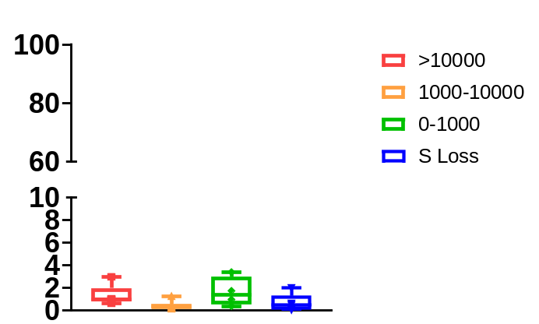
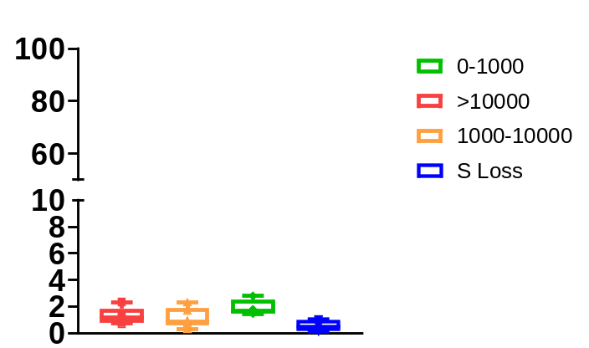
PBMC
% of CD8+ T cells
% of CD4+ T cells
CD57
CD28
CD127
HLA-DR
PD-1

Slide 14
In correlation with declining levels of qHBsAg both CD69 positive ( tissue resident T cells) and CD69 negative T cells :
  Decrease in exhausted T cell
  Increase in memory like T cell
  Decreased frequency of senescence marker
Although CD4 T cells show similar phenotypic characteristics in periphery as intrahepatic environment, in CD8 T cells a reverse pattern in senescence markers and co-stimulatory molecules was observed.
Suggesting the importance of intrahepatic sampling for studying phenotypic changes in immune environment of CHB.

Slide 15
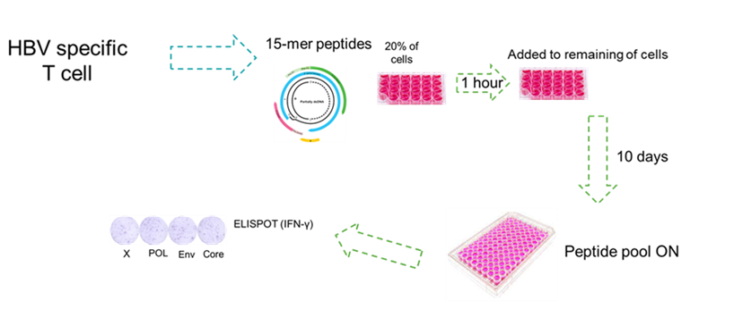
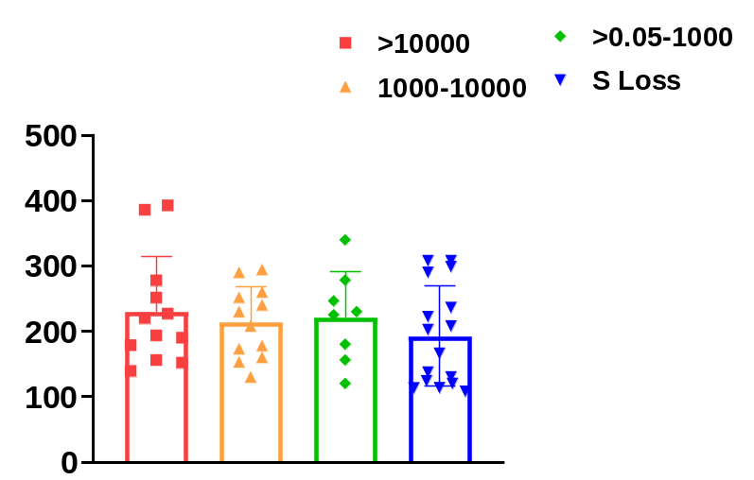
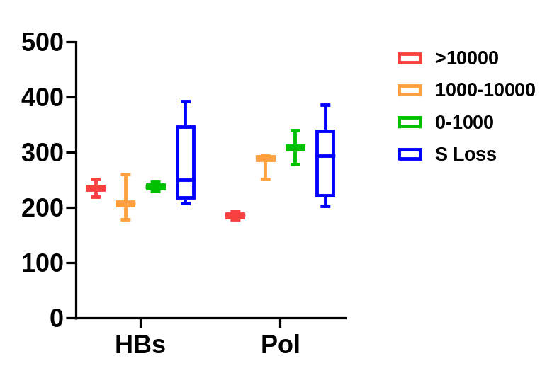
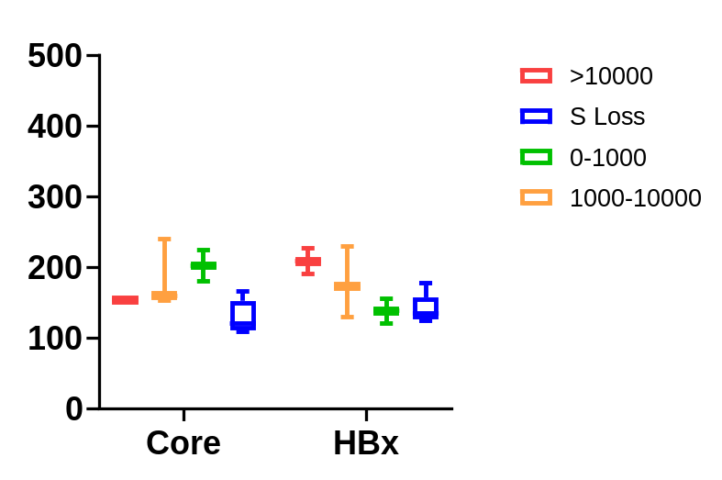
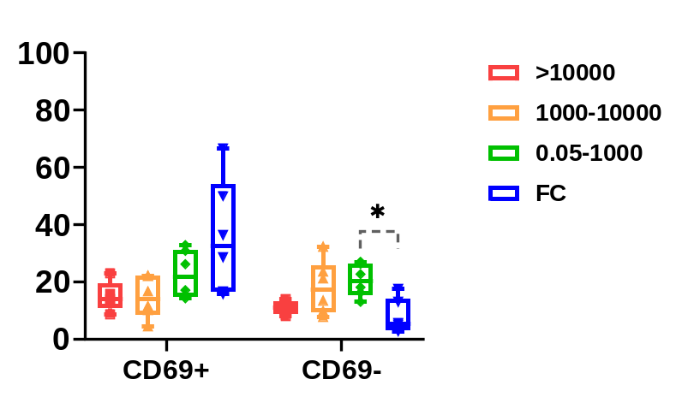
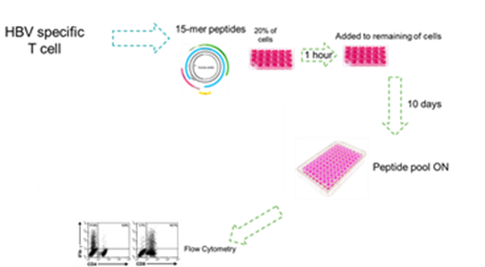
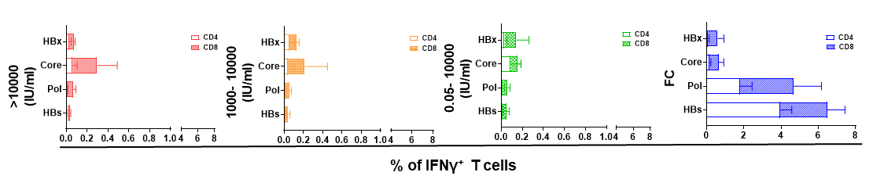
HBV specific T cells
SFC/10⁵cells
SFC/10⁵cells
Total HBV specific T cells

Slide 16
HBV specific T cells
ELIspot analysis:
HBV pol and HBs specific T cells are higher in patients with functional cure (FC)
Increase in HBV pol specific T cells is correlated with declining level of qHBsAg
ICS:
Though HBV specific CD8 T cells ( mainly HBV core and HBx) is observed across all levels of qHBsAg in CHB pateints, CD4 specific T cells were only observed in FC patients
The frequency of HBs specific CD4 T cells secreting IFN-γ is higher in FC patients
Higher frequency of HBV pol specific CD8 and CD4 T cells secreting IFN-γ observed in FC patients

Slide 17
Collectively, sc-RNA seq and multi-parametric Flow Cytometry analysis:
  Decrease in CD8 T cell in concomitant with increase in the CD4-CTL population in FC patients suggesting potential shift in adaptive response
  HBs CD4 specific T cells are dominant in FC patients while CD8 T cells are observed at all levels of qHBsAg (low levels)
  Loss of exhaustion and decrease in senescence markers paired with increased frequency of memory like T cells might suggest gain of proliferation capacity in T cells in FC patients

Slide 18
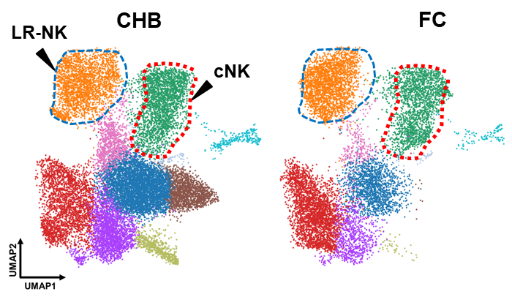
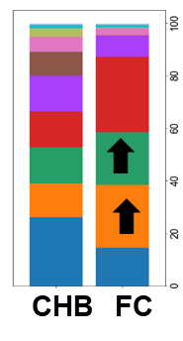
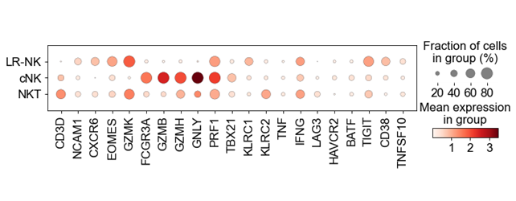
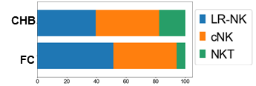
Increased LR-NK population in FC patients
LIVER

Slide 19
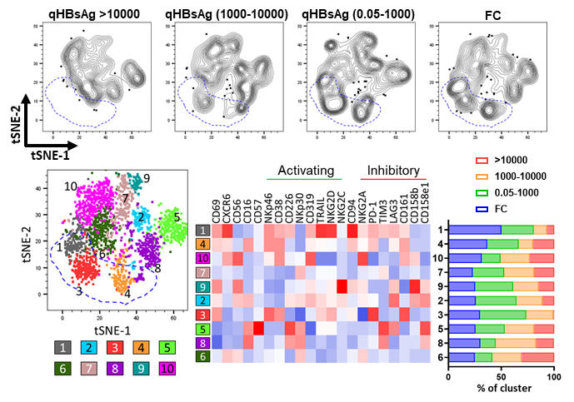
LIVER
Enrichment of CXCR6 + CD69+ NK cells(LR-NK) in correlation with declining levels of qHBsAg

Slide 20
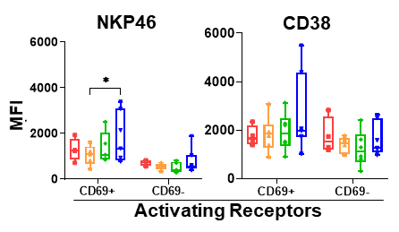
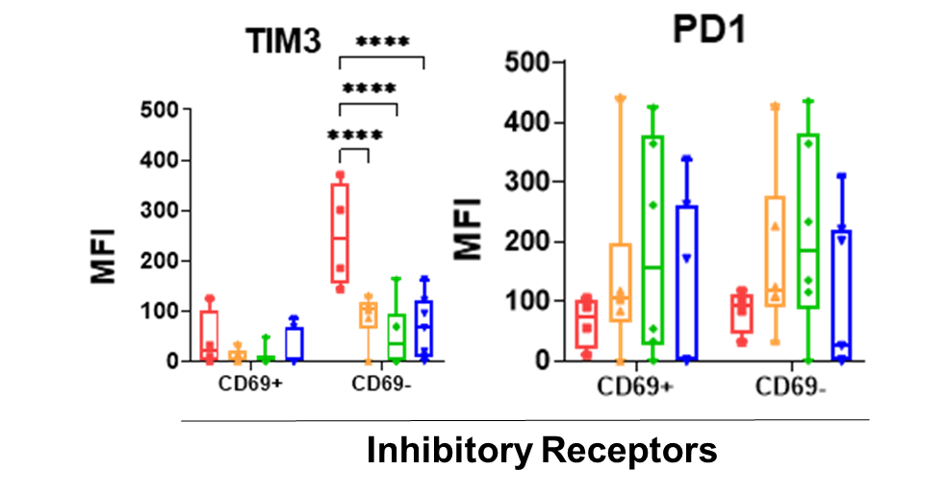
LR-NK cells are at a primed state in FC patients
Increased LR-NK and c- NK cells observed in FC patients Liver
Increased expression of activating receptor and reduced expression of inhibitory receptors is observed on LR-NK and c-NK population

Slide 21
Altogether our data
Highlights the importance of intrahepatic sampling in understanding of phenotypic changes in immune environment
There is a shift in adaptive immune response in FC patients
  Reduced number of CD8 T cells with concomitant increase of CD4-CTLs
  IFN-γ secreting HBV specific CD4 T cells only present in FC patients
Loss of exhaustion of T cells paired with enrichment of LR-NK and c-NK cells in correlation with declined levels of qHBsAg can lay the foundation for therapeutically approaches targeting patients with lower qHBsAg levels to increase the chance of functional cure achievement

