Slide 1


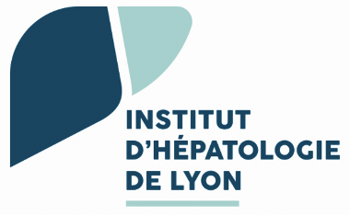

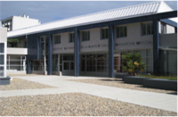


cccDNA silencing or elimination ?
Massimo LEVRERO
INSERM U1052 - Cancer Research Center of Lyon (CRCL) , Lyon, France
Hopital de la Croix-Rousse - Hospices Civils de Lyon, Lyon, France
University Claude Bernard Lyon 1, Lyon, France

Slide 2
Disclosures
Relations that could be relevant for the meeting | Company names
Sponsorship or refund funds | Gilead, MSD, Roche, Abbvie, Bayer, Ipsen, Bayer,
Payment or other financial remuneration (Research Projects) | Gilead, BMS, Ipsen
Shareholder rights | NA
Other relations (Speaking and Teaching) (Advisory Committees or Review Panels) | Gilead, Roche, Abbvie, Ipsen Evotec/Sanofi

Slide 3
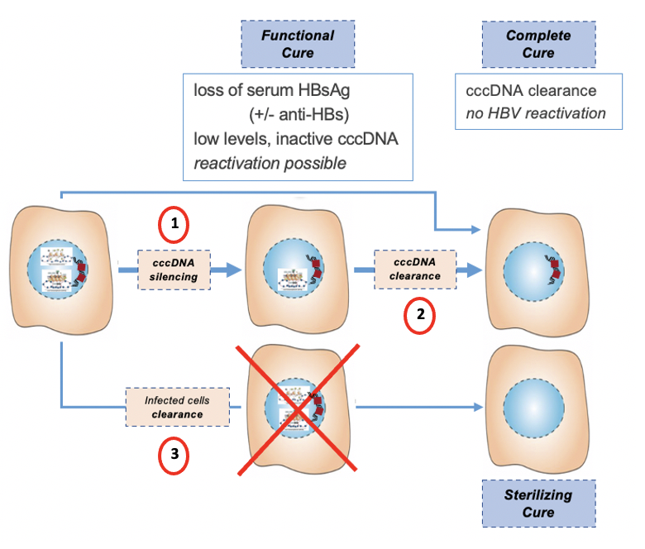
cccDNA silencing vs elimination

Slide 4
cccDNA silencing vs elimination
why to defend the lesser result ?

Slide 5
cccDNA silencing vs elimination
why to defend the lesser result ?
is silencing propedeutic to elimination ?

Slide 6
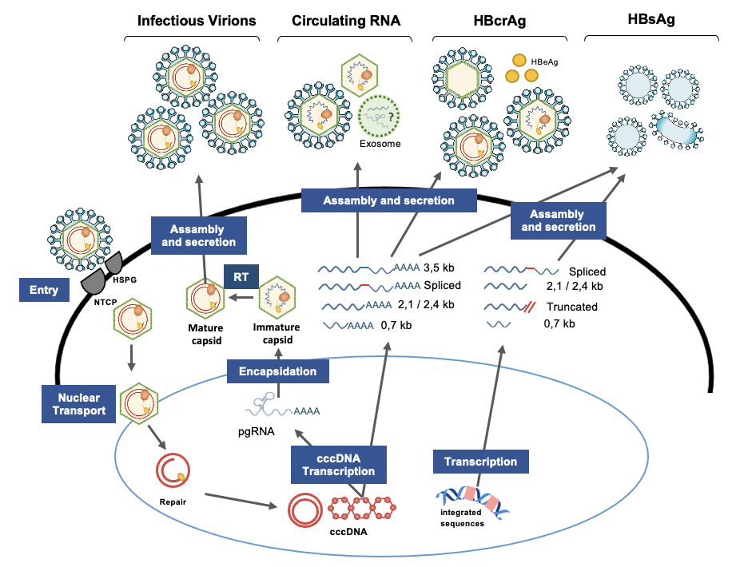
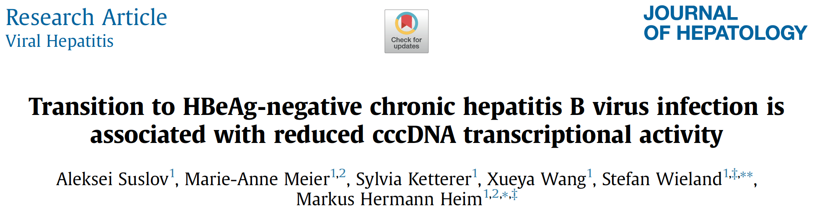
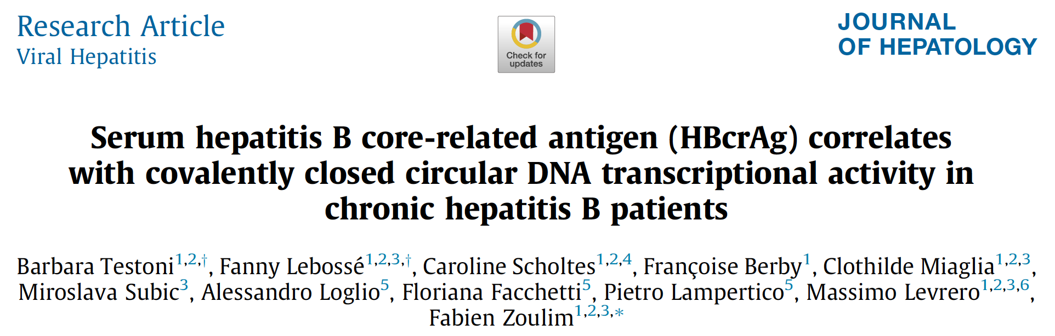
Endpoints and biomarkers
Endpoint:
Functional cure
Sustained virological suppression
Changes in biomarkers (‘proof of concept’)
  i.e. decrease 1 log qHBsAg or < 100 IU/mL
« Gold standard » : intrahepatic assessment of
cccDNA amount
cccDNA transcriptional activity (viral RNA production)
Cornberg et al J Hepatology 2020
Possible dissociation between cccDNA levels and cccDNA transcriptional activity

Slide 7
Endpoints and biomarkers
Endpoint:
Functional cure
Sustained virological suppression
Changes in biomarkers (‘proof of concept’)
  i.e. decrease 1 log qHBsAg or < 100 IU/mL
« Gold standard » : intrahepatic assessment of
cccDNA amount
cccDNA transcriptional activity (viral RNA production)
Cornberg et al J Hepatology 2020
Possible dissociation between cccDNA levels and cccDNA transcriptional activity
HBV complete cure
cccDNA
clearance
Mesure cccDNA levels
HBV functional cure
cccDNA
« inactivation »
Mesure 3.5Kb RNA/cccDNA
Hampered by the necessity of using invasive techniques (biopsy)
and by technical limitations (lack of a standardized assay)
HBcrAg and cHBV-RNA are good surrogate markers of cccDNA transcriptional activity, their combined use must be better studied
depending on the mode of action of the NMEs the biomarker will reflect “target engagement” or “cccDNA targeting”
however, detecting “target engagement” might still predict “funtional cure” or “complete cure”

Slide 8
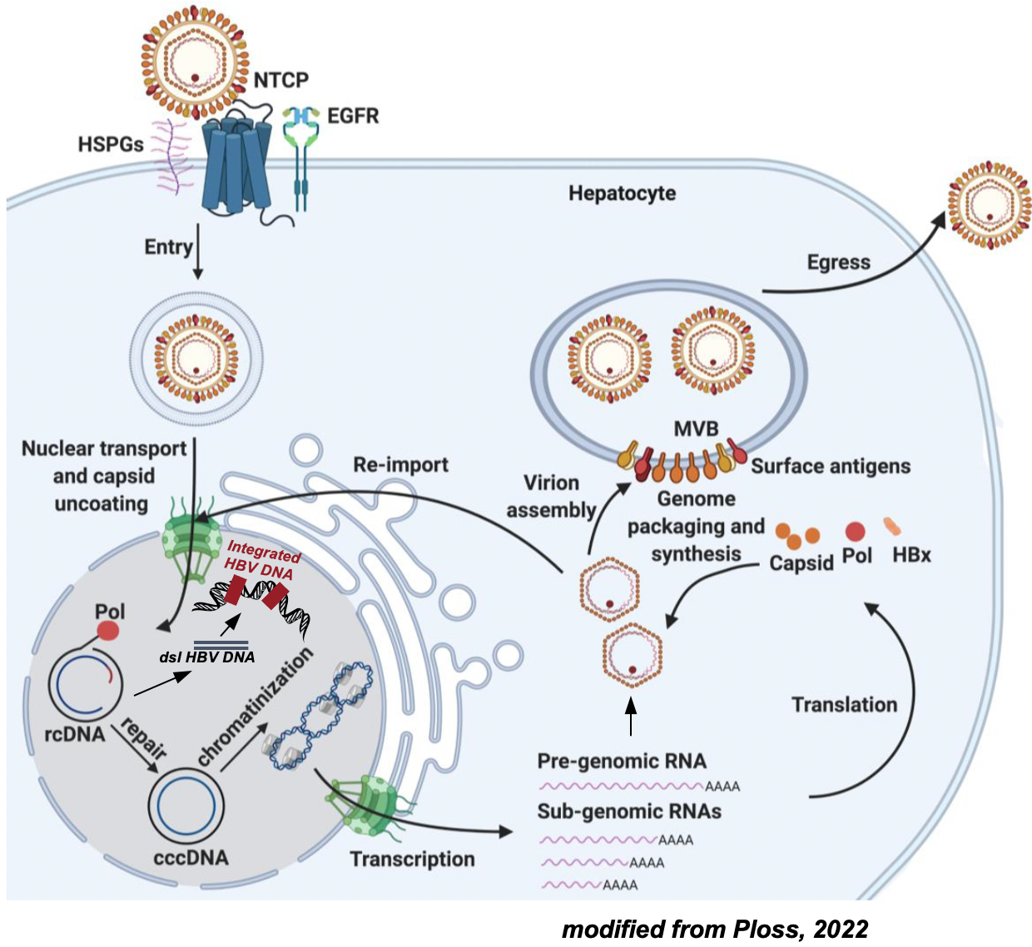
The cccDNA minichromosome:
a key molecule for viral persistence and cure
modified from Wei L & Ploss A, 2021

Slide 9
The cccDNA minichromosome:
a key molecule for viral persistence and cure
cccDNA
key molecule in HBV lifecycle
formed in the nucleur («repair» of the relaxed circular DNA)
template for all HBV transcripts
(pgRNA and all subgenomic RNAs)
modified from Wei L & Ploss A, 2021

Slide 10
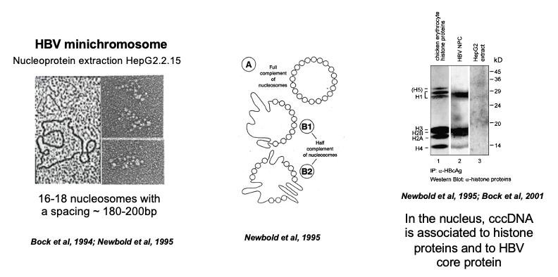
The cccDNA minichromosome:
a key molecule for viral persistence and cure
cccDNA
key molecule in HBV lifecycle
formed in the nucleur («repair» of the relaxed circular DNA)
template for all HBV transcripts
(pgRNA and all subgenomic RNAs)
organized as a viral minichromosome
cccDNA-ChIP and cccDNA-ChIP-Seq assays
transcription regulated by epigenetic mechanisms
  (as the host chromosomes)
modified from Wei L & Ploss A, 2021

Slide 11
The cccDNA minichromosome:
a key molecule for viral persistence and cure
cccDNA
key molecule in HBV lifecycle
formed in the nucleur («repair» of the relaxed circular DNA)
template for all HBV transcripts
(pgRNA and all subgenomic RNAs)
organized as a viral minichromosome
cccDNA-ChIP and cccDNA-ChIP-Seq assays
transcription regulated by epigenetic mechanisms
  (as the host chromosomes)
responsible for viral persistence
  long t1/2
  continuous replenishment
  not affected by NUCs
modified from Wei L & Ploss A, 2021

Slide 12

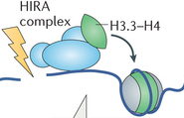

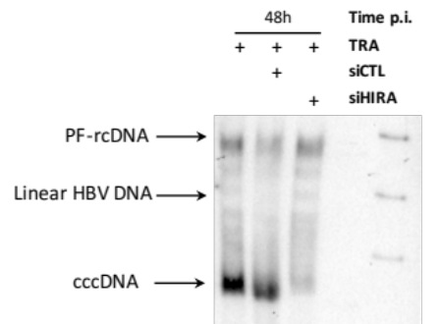


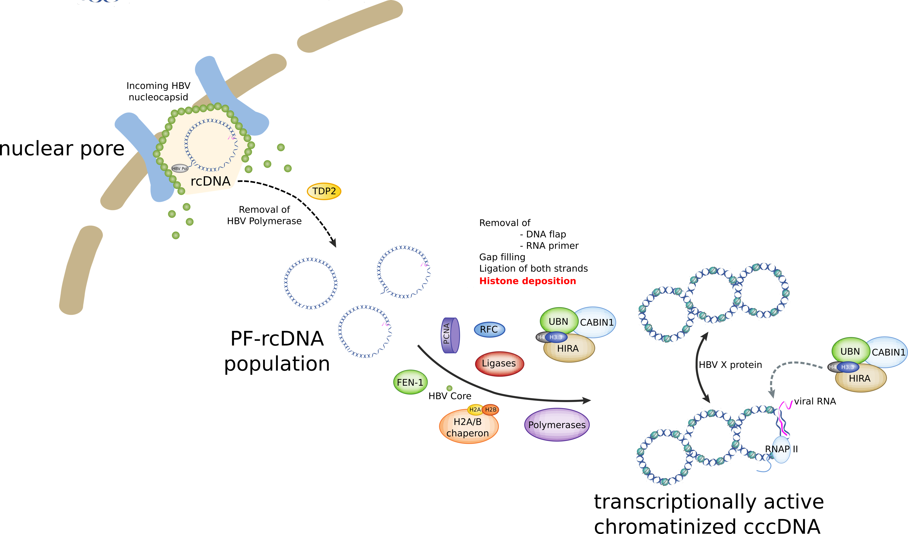
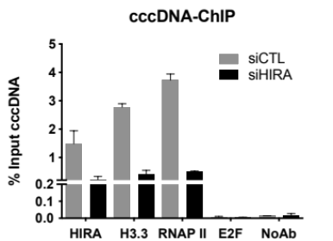
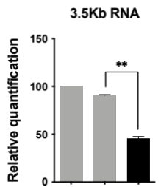
cccDNA chromatin is a dynamic structure (and is epigenetically regulated)
HIRA histone chaperone HIRA supports hepatitis B virus minichromosome establishment and transcriptional activity in infected hepatocytes
Southern Blot 48h p.i.
DNA repair
Ligation
Histone deposition
HIRA mediates H3.3 deposition on naked DNA
HBV
HepG2-NTCP
PHH
+
+
+
TRA
P
TRA
+
siCTL
+
siHIRA
Locatelli et al, CMGH 2022

Slide 13
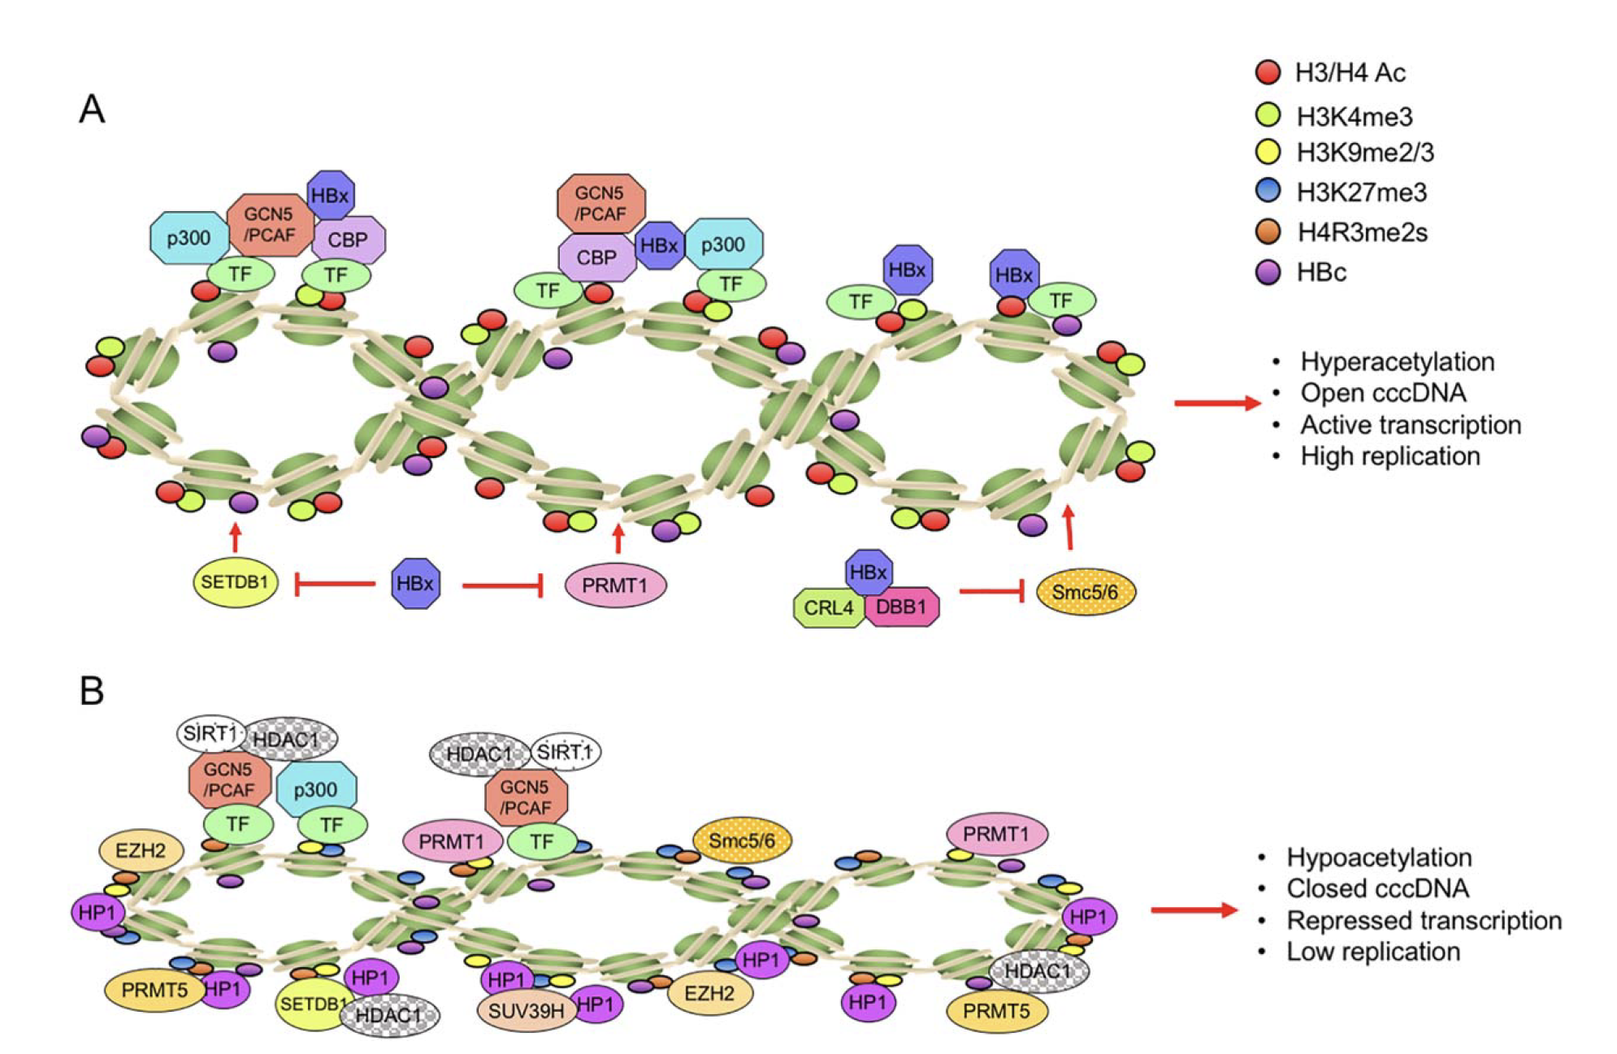
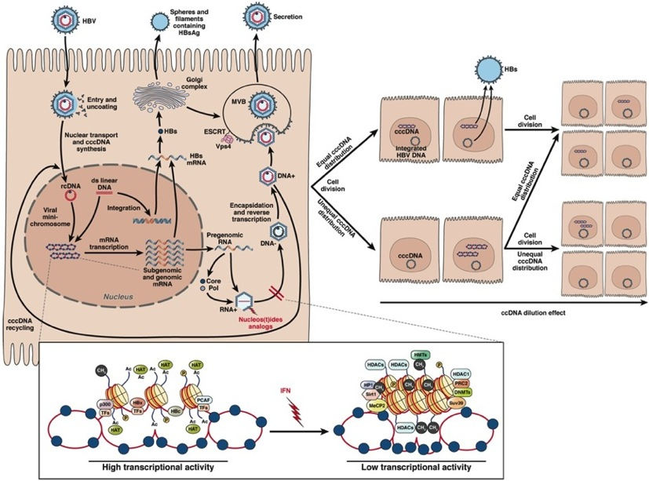
cccDNA chromatin is a dynamic structure (and is epigenetically regulated)
Host factors : histones, TFs, Regulators…
Viral factors : HBc, HBx
cccDNA
Open
Condensed
Hong et al., 2017
Pollicino et al. 2006; Belloni et al., 2009; Belloni et al., 2012; Liu et al., 2013; Benhenda et al., 2013; Rivière et al., 2015; Ren et al., 2017; Zhang et al., 2017

Slide 14
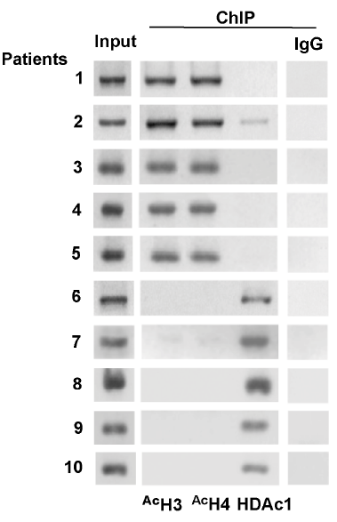
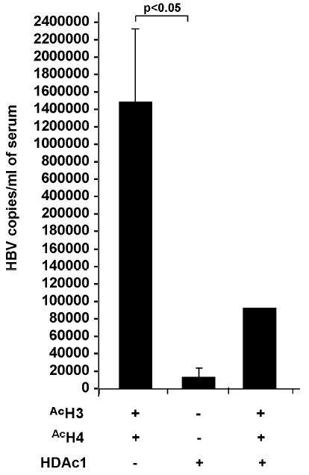
cccDNA chromatin is a dynamic structure (and is epigenetically regulated)
cccDNA ChIP – CHB liver biopsies
cccDNA
Open
Condensed
HBV replication is regulated by the acetylation status of cccDNA-bound H3/H4 histones
Pollicino, Gastroenterology 2006

Slide 15

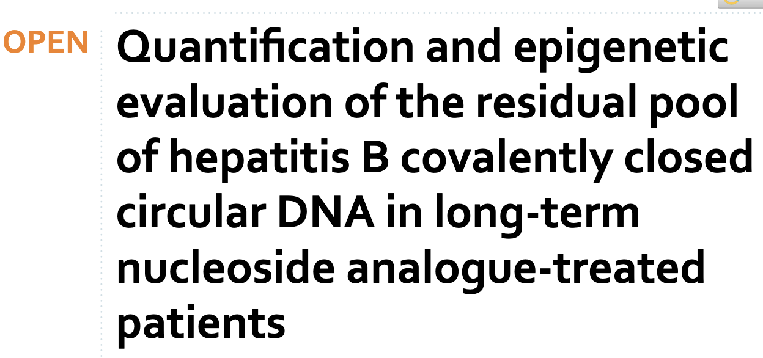
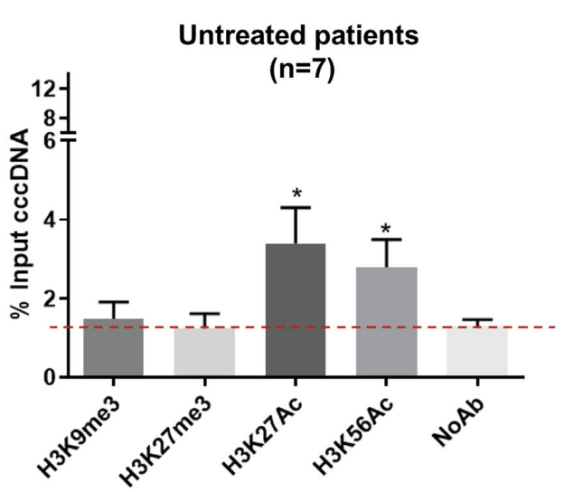
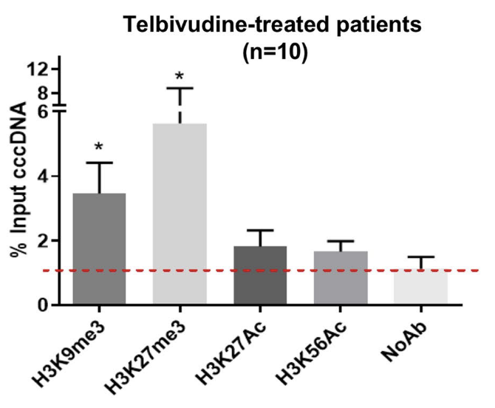
cccDNA chromatin is a dynamic structure (and is epigenetically regulated)
cccDNA ChIP – CHB liver biopsies
cccDNA
Open
Condensed
HBV replication is regulated by the acetylation status of cccDNA-bound H3/H4 histones
Pollicino, Gastroenterology 2006
Lebossé et al., Sci Reports 2020

Slide 16
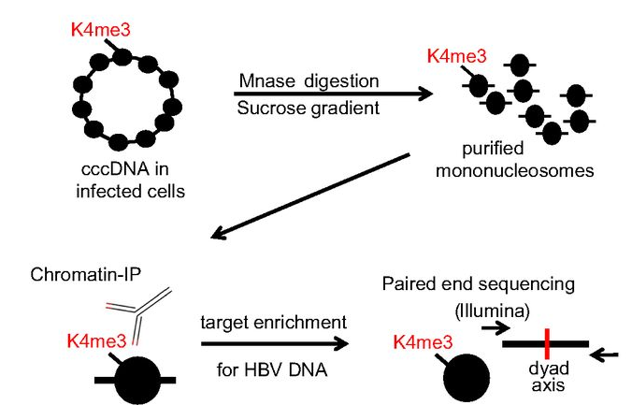
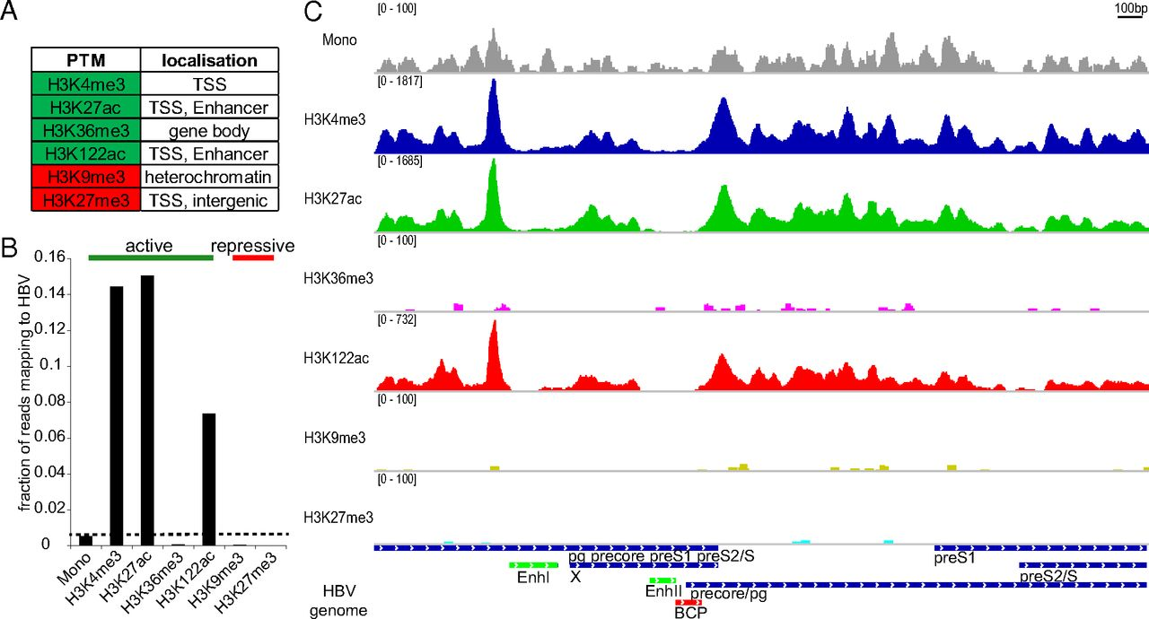
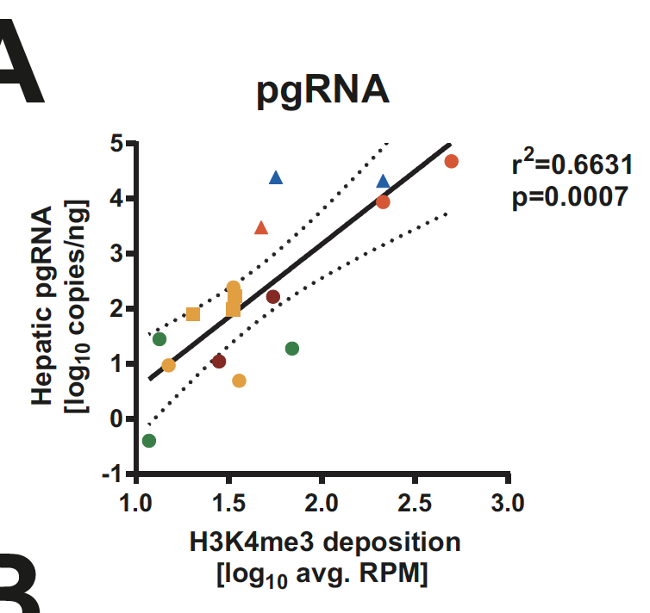
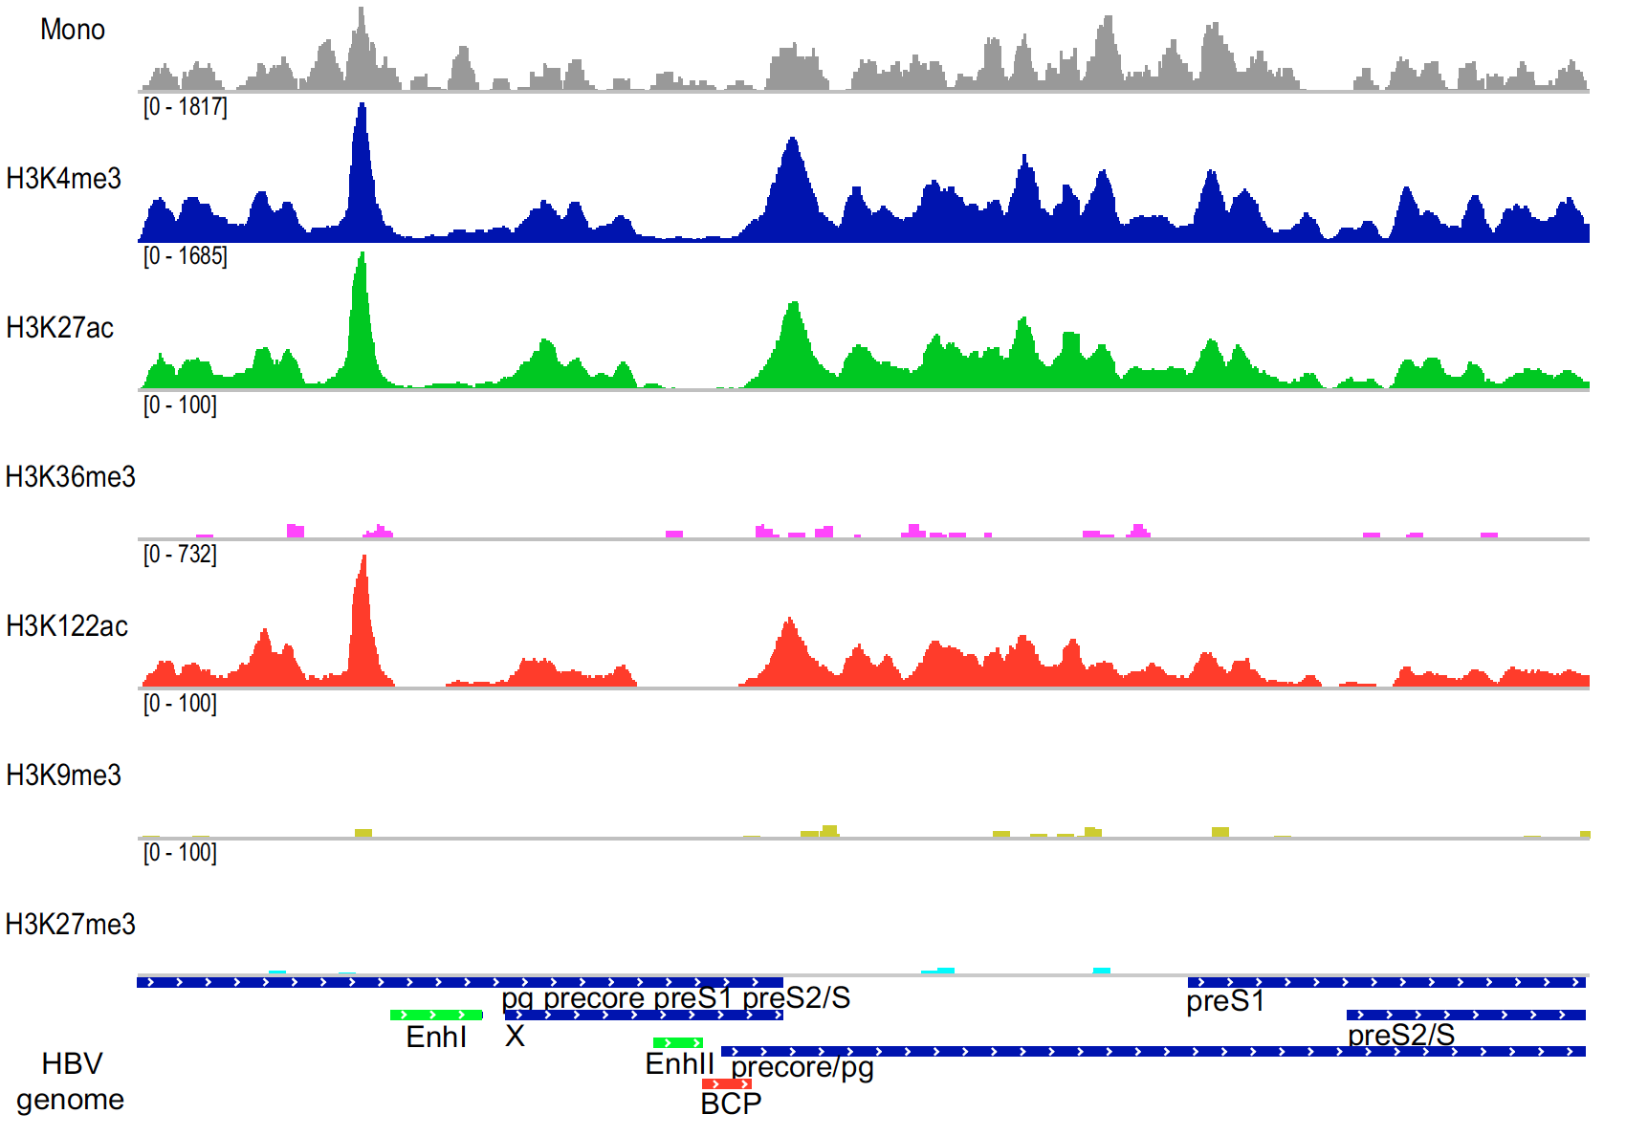
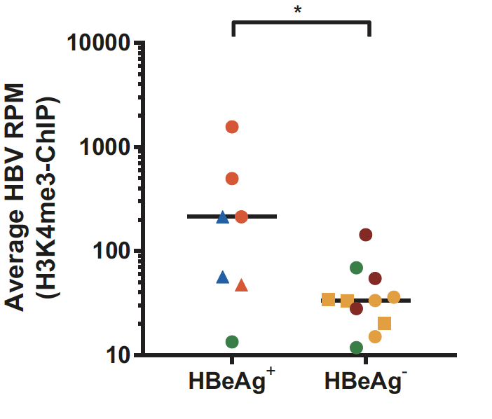
cccDNA chromatin is a dynamic structure (and is epigenetically regulated)
ChIP-Seq - HBV infected PHH
cccDNA
cccDNA-ChIP-Seq assay - CHB liver biopsies
Open
Condensed
Tropberger, PNAS 2015
Ren, 2018; Flecken, 2019

Slide 17
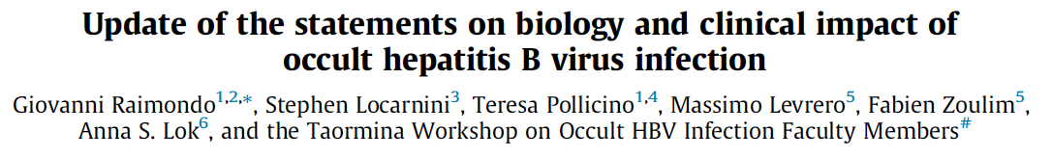




cccDNA chromatin is a dynamic structure (and is epigenetically regulated
cccDNA is deacetylated and hypermethylated in OBI
Occult HBV infection (OBI) is defined as the presence of replication-competent HBV DNA (i.e. episomal HBV covalently closed circular DNA [cccDNA]) in the liver and/or HBV DNA in the blood of people who test negative for hepatitis B surface antigen (HBsAg) by currently available assays.
J Hepatol (2019), https://doi.org/ 10.1016/j.jhep.2019.03.034
cccDNA-ChIP
Input 1 2 3 4 5 6 IgG
Occult HBV
1: HP1
2: SUV39
3: MECP2
Overt HBV
4: HDAC1
5: Ac.H3
6: Ac.H4
Pollicino, unpublished

Slide 18

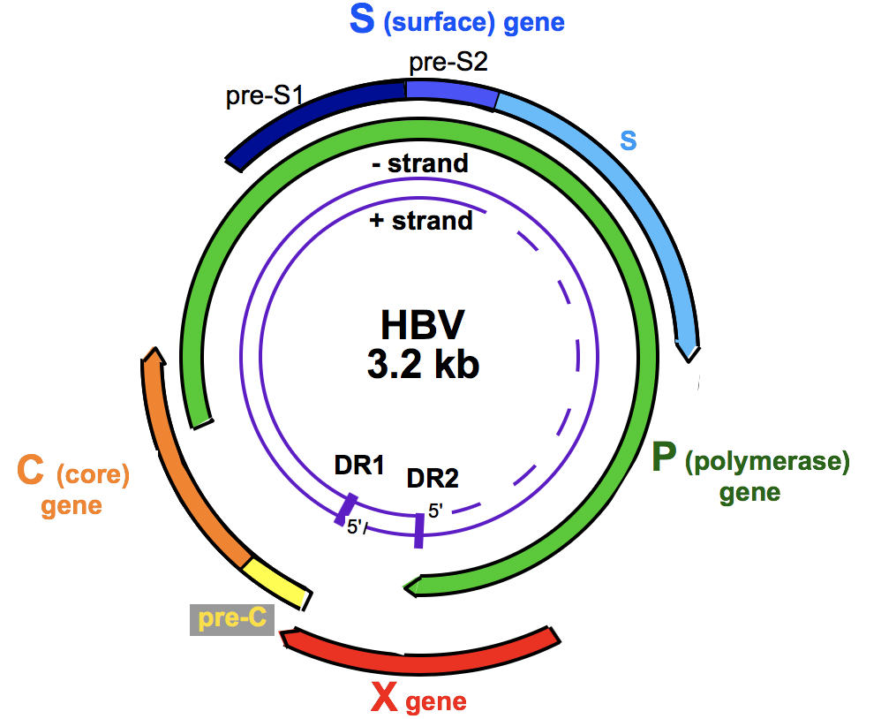
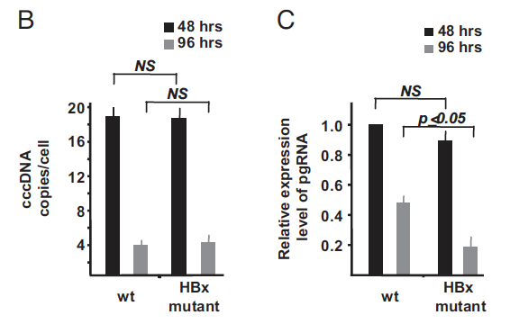

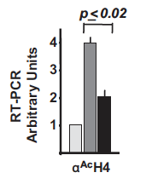
PHH
dHepaRG
PHH
cccDNA chromatin is a dynamic structure (and is epigenetically regulated)
HBx is required for cccDNA transcription
HepG2 1.0Tx
Belloni, 2009
HBx
PHH
Lucifora 2011
PHH dHepaRG
Riviere, 2015
HBx binds to and is required for full cccDNA transcription and viral replication
HBx binding correlates with histone marks of active transcription on the cccDNA

Slide 19
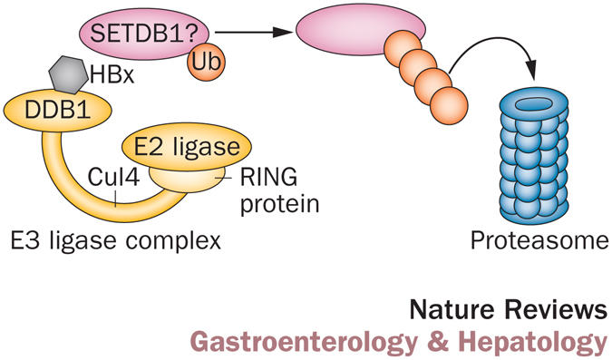

cccDNA chromatin is a dynamic structure (and is epigenetically regulated)
HBx degrades the Smc5/6 restriction factor (DDB1 –Cul4 E3 ligase complex)
Smc5/6
Smc5/6
Decorsière, Nature 2016
Decorsiere, Nature 2016
Murphy, Cell Rep 2016
Kim. JVI 2016
Attractive target for cccDNA silencing
Virus specific
Off-cccDNA effects beneficial
HBx
Transcription
+++
Set1A
HATs
p300
PMTs
HATs
p300
Set1A
TF
TF
HBx
TF
H3K4me3
H3K27ac
H3K122ac
HBx
HBx
Belloni, PNAS 2009; Benhenda, JVI 2013;
Ducroux, PlosPath 2014; Riviere, J Hepatol 2015; Decorsiere, Nature, 2015; Alarcon, SciRep 2016
HDAC1
HP1
Sirt1
SETDB1
Suv39
HBx prevents cccDNA epigenetic silencing

Slide 20
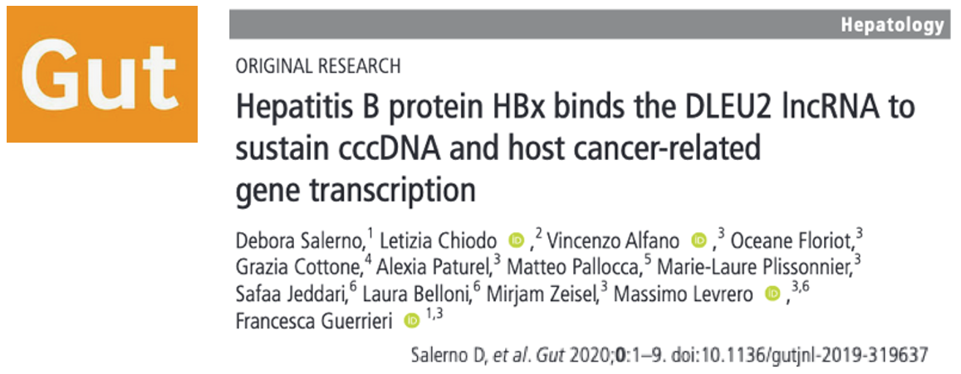
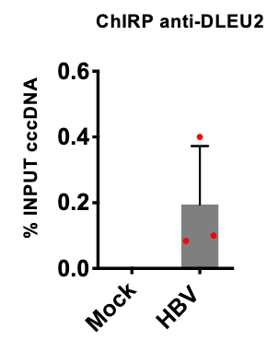
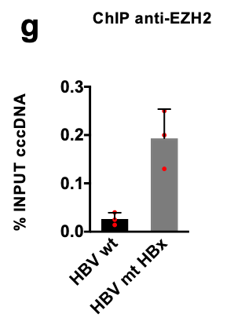
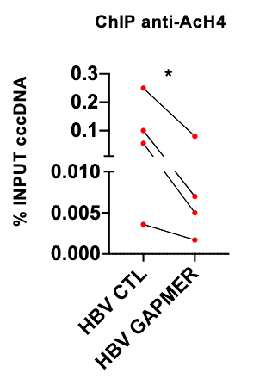
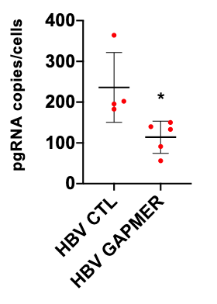
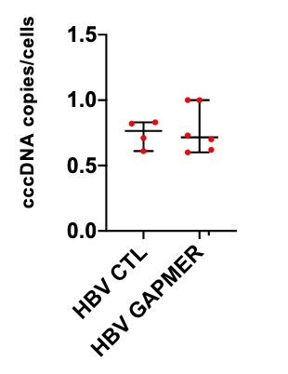
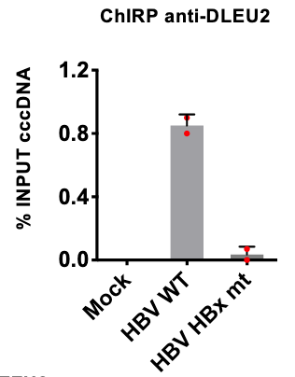
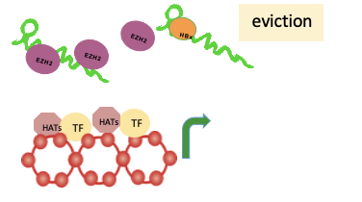
cccDNA chromatin is a dynamic structure (and is epigenetically regulated)
Dleu2 RNA binds HBx and Ezh2
cccDNA
Open
PHH
ddPCR pgRNA
PHH
ddPCR cccDNA
Condensed
Targeting DLEU2 silences the cccDNA and reduces HBV replication

Slide 21
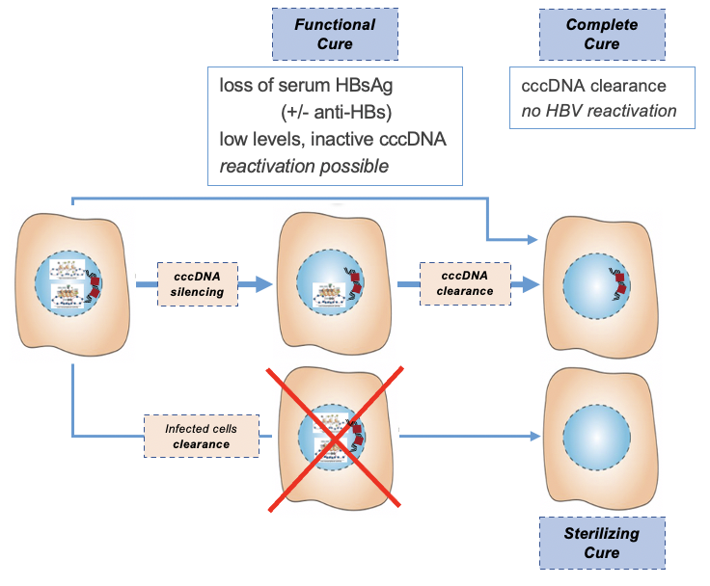
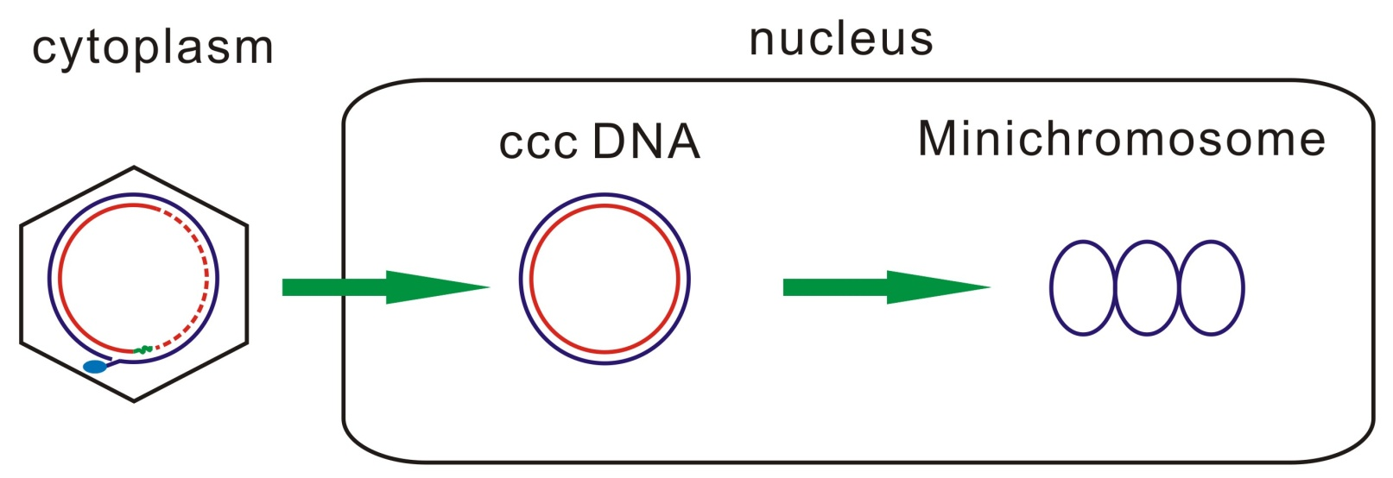
cccDNA silencing vs elimination
Strategies to target pharmacologically the cccDNA
RC DNA
Thousands
copies
1-50 copy
Inhibiting
cccDNA biosynthesis
Reducing
cccDNA stability
Silencing
cccDNA transcription

Slide 22
cccDNA silencing vs elimination
Strategies to target pharmacologically the cccDNA
RC DNA
Thousands
copies
1-50 copy
Inhibiting
cccDNA biosynthesis
Reducing
cccDNA stability
Silencing
cccDNA transcription
Cytokines and immune signaling affect cccDNA stability (IFNa, IFNg, TNFa, LTb) and the epigenetic control of cccDNA transcription (IFNa, IFNl, IL1-b, IL6)
The « Immune control » of HBV infection and the « Epigenetic control » of cccDNA function are, if not the exactly same, at least largely overlapping

Slide 23
cccDNA silencing vs elimination
Strategies to target pharmacologically the cccDNA
RC DNA
Thousands
copies
1-50 copy
Inhibiting
cccDNA biosynthesis
Reducing
cccDNA stability
Silencing
cccDNA transcription
Epigenetic modifiers
- cytokines
- small molecules
- CRISPR/dCas9…
Target Liver-enriched transcription factors
HBx inhibitors

Slide 24
HBx targeting SiRNA restores Smc6 expression and decreases viral replication in cultured hepatocytes
Targeting HBx .1
RNA interference strategies
Komeyeyev et al, J Virol 2019

Slide 25
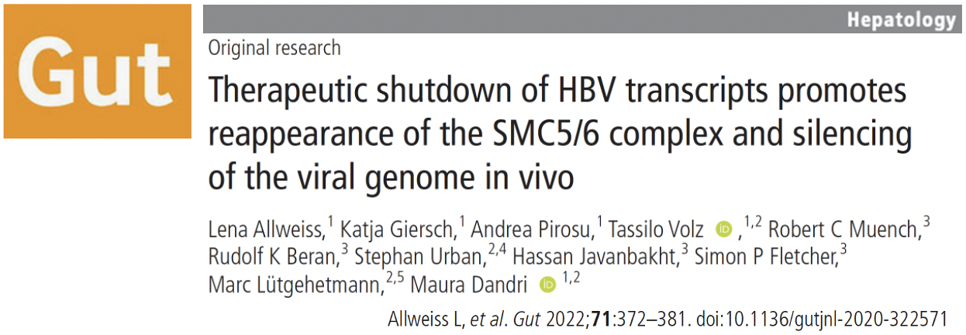
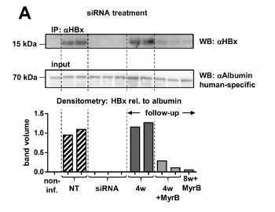
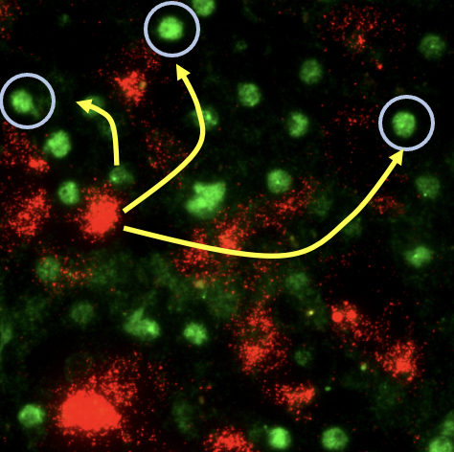
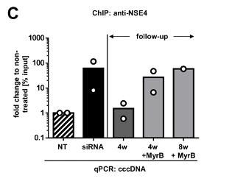
Targeting HBx .2
RNA interference strategies
HBV infected
USG mice
+ BLV
4w siRNA
Follow up
HBV RNAs
8 weeks follow up
in presence of BLV
SMC6 protein
+ 4 w siRNA
4 weeks follow up
Treatment with siRNA lowered all HBV markers, including HBx, but not intrahepatic cccDNA levels
RNAi treatment enabled reappearance of SMC5/6 complex and its recruitment onto the cccDNA and silencing
siRNA reduces HBx &
recruits smc5/6 to cccDNA
Allweiss et al, Gut 2022
Dual MoA of siRNAs at single cell level: HBV RNA degradation + cccDNA transcriptional silencing

Slide 26
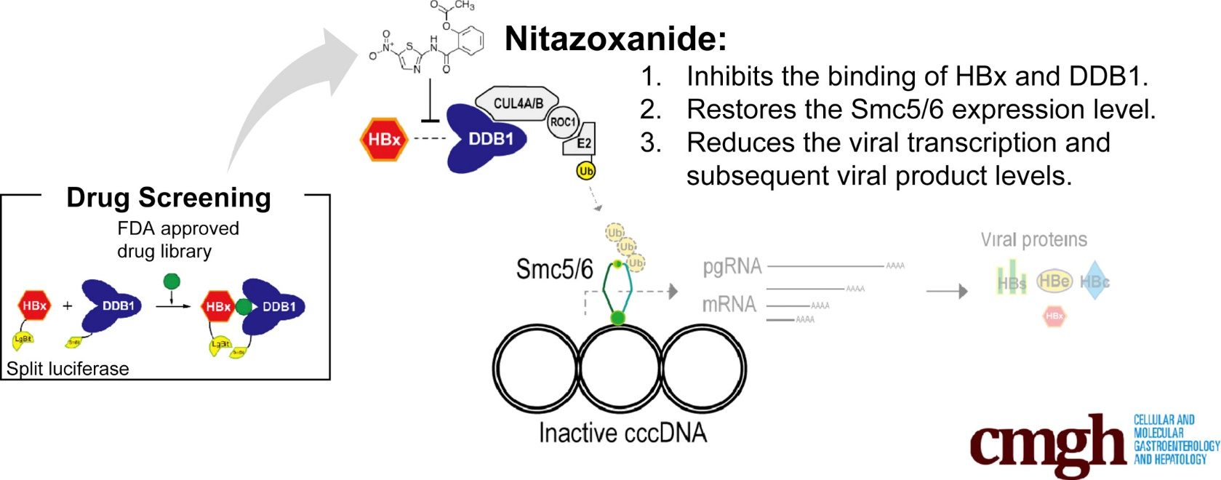
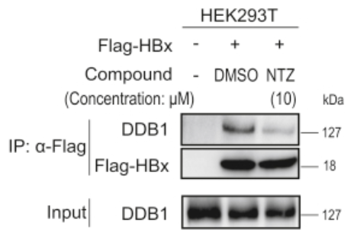
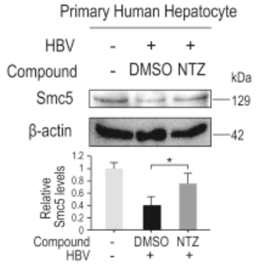
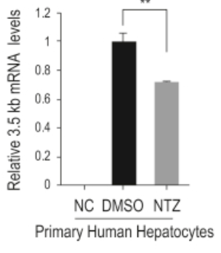
Targeting HBx .3
Targeting HBx-DDB1 interaction
(NTZ)
Sekiba CMGH, 2019
Inhibitors of HBx-DDB1 interaction silence cccDNA

Slide 27
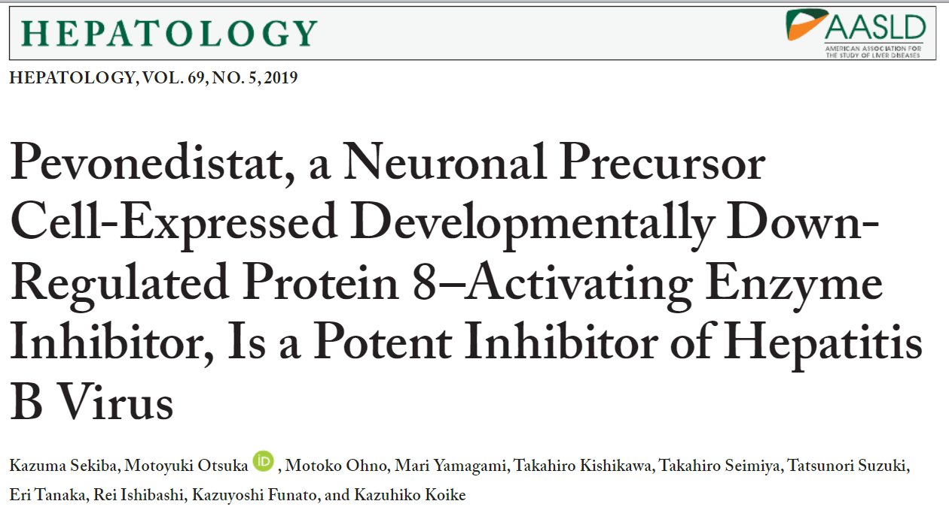
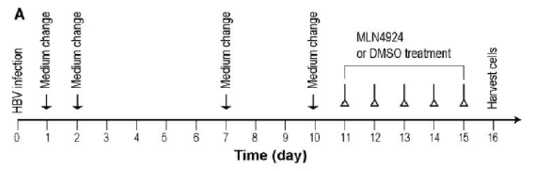



Targeting HBx .4
Targeting HBx-DDB1 interaction
Inhibiting cccDNA transcription may lead to cccDNA destabilization

Slide 28


Targeting HBx .5
Targeting HBx-DDB1 interaction
Monoclonal HBx antibodies inhibit HBx-DDB1 interaction
Single-chain fragment variable (ScFv) / intrabodies
Cell penetrating peptide (CPP)
Tao et al, Scientific Reports 2019

Slide 29





Targeting HBx .6
Targeting HBx-20S proteasome interaction
Dicoumarol, an NQO1 inhibitor,
blocks cccDNA transcription by promoting HBx degradation
Cheng J Hepatol 2021

Slide 30









cccDNA activity can be epigenetically modulated
Alpha-IFN:
inhibits cccDNA transcription (no reduction in cccDNA levels)
reduces the acetylation of cccDNA-bound histones
modulates cccDNA chromatin accessibility
IFNα/λ
as the first HBV epidrug
In vivo
HBV infection
Belloni, 2012
DHBV
Tet-on cell line
Liu, 2013
+ IFNα
HBV-infected
HepG2-NTCP
Tropberger, 2015
cccDNA accessibility
MNase-Sec
HBV-infected
HepG2-NTCP
Wang, 2021

Slide 31







cccDNA epigenetic silencing
Dual MoA of IFN alpha : epigenetic cccDNA regulation / RNA containing capsids destabilization
+ IFNα
peg-IFNα
Belloni, Allweiss et al. JCI 2012; Allweiss et al. J Hepatol. 2014; Uchida et al. AAC 2017;
HBV RNAs
SMC6 protein
pgRNA is reduced by peg-IFNα treatment in liver & blood
Allweiss, Giersch et al Gut 2022
cccDNA accessibility
MNase-Sec
HBV-infected
HepG2-NTCP
Wang, 2021

Slide 32




cccDNA epigenetic silencing

Slide 33


cccDNA epigenetic silencing
Serrano et al., Mol Cell 2020

Slide 34
cccDNA epigenetic silencing
Different classes of compounds acting as epidrugs (PCAF/p300 inhibitor, Sirt3 agonist, JMD3 inhibitors)
inhibit cccDNA transcription
modulate acetylation/methylation of cccDNA-bound histones
Tropberger, 2015; Palumbo unpublished
Warnings
complexity of responses
functional redundancy
duration of response
off target effects

Slide 35


Targeting cccDNA to cure HBV
Should we change the paradigm ?
Should HBV virologists become bolder and learn from the HIV community
shock
and kill
HIV
shock
and
degrade

Slide 36


Targeting cccDNA to cure HBV
Should we change the paradigm ?
Should HBV virologists become bolder and learn from the HIV community
shock
and kill
HIV
shock
and
degrade

Slide 37
Open Questions
cccDNA gets silenced in HBV carriers
Silencing vs epigenetic suppression
  loss of activators vs recruitment of repressors
  the role of histones repressive marks vs compaction
Silencing vs degradation
  silencing --- > degradation ? e. g. the role of chromatin accessibility
Do we really want to silence cccDNA ??

Slide 38











INSERM U1052
Equipe Levrero
INSERM U1052
Equipe Zoulim
Lab of Gene Expression
Laura Belloni
Natalia Pediconi
Debora Salerno
Fabien Zoulim
Barbara Testoni
and her team
Massimo Levrero
Collaborators
Mirjam Ziesel
Claude Caron de Fromentel
Francesca Guerrieri
Marie Laure Plissonnier
Vincenzo Alfano
Francesca Casuscelli
Yasmina Chouik
Alexia Paturel
Jean Yves Mabrut
Mickael Lesulter
Kayvan Mohkam
Philippe Merle
Jerome Dumortier
Guillaume Rossignol
Xavier Muller
Thomas Baumert – Strasbourg, FR
Maura Dandri - Hamburg, DE
Jane Mc Keating – Oxford, UK
Adam Zlotnick - Indiana University, USA
Raymond Schinazi – Emory Univ Atlanta –USA
Antonio Craxi – Palermo, IT
Letizia Chiodo, Giancarlo Ruocco – Roma, IT
Carlo Ferrari - Parma, IT
Pietro Lampertico – Milano, IT
Teresa Pollicino, Giovanni Raimondo – Messina, IT
Sabrina Strano, Giovanni Blandino – Roma, IT
Financial support

