Slide 1


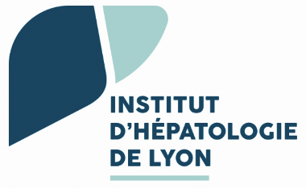

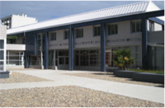


Which Antiviral Strategies For Functional Cure? An Overview
Massimo LEVRERO
INSERM U1052 - Cancer Research Center of Lyon (CRCL) , Lyon, France
Hopital de la Croix-Rousse - Hospices Civils de Lyon, Lyon, France
University Claude Bernard Lyon 1, Lyon, France

Slide 2
Disclosures
Relations that could be relevant for the meeting | Company names
Sponsorship or refund funds | Gilead, MSD, Roche, Abbvie, Bayer, Ipsen, Bayer,
Payment or other financial remuneration (Research Projects) | Gilead, BMS, Ipsen
Shareholder rights | NA
Other relations (Speaking and Teaching) (Advisory Committees or Review Panels) | Gilead, Roche, Abbvie, Ipsen Evotec/Sanofi

Slide 3
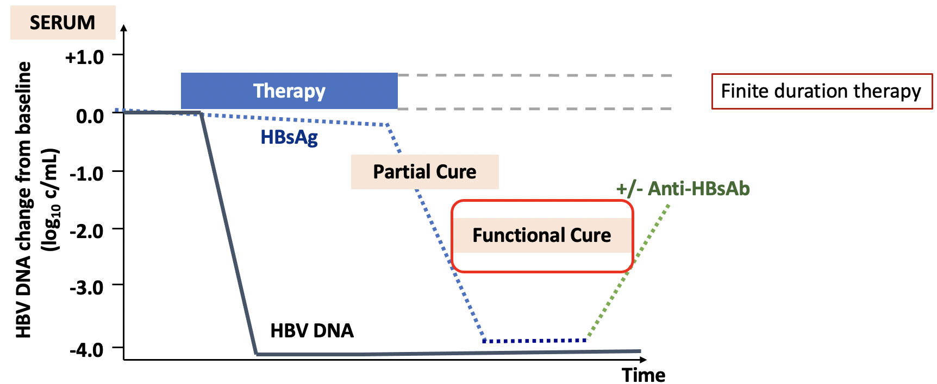
HBV functional cure
Major goals of current strategies to cure CHB infection
- To reduce liver inflammation, prevent development of cirrhosis and HCC
- To achieve sustained suppression of serum HBV DNA post-therapy with loss of serum HBsAg (+/- seroconversion)
Functional cure
Testoni et al. Semin Liv Dis. 2017; Cornberg M. J Hepatol. 2020; Martinez, J Hepatol. 2021 ...

Slide 4
HBV functional cure
Major goals of current strategies to cure CHB infection
- To reduce liver inflammation, prevent development of cirrhosis and HCC
- To achieve sustained suppression of serum HBV DNA post-therapy with loss of serum HBsAg (+/- seroconversion)
Partial cure
Functional cure
Testoni et al. Semin Liv Dis. 2017; Cornberg M. J Hepatol. 2020; Martinez, J Hepatol. 2021 ...

Slide 5
HBV functional cure
Endpoint:
Functional cure
Sustained virological suppression
Changes in biomarkers (‘proof of concept’)
  i.e. decrease 1 log qHBsAg or < 100 IU/mL
Cornberg et al J Hepatology 2020
Major goals of current strategies to cure CHB infection
- To reduce liver inflammation, prevent development of cirrhosis and HCC
- To achieve sustained suppression of serum HBV DNA post-therapy with loss of serum HBsAg (+/- seroconversion)
Partial cure
Functional cure
Testoni et al. Semin Liv Dis. 2017; Cornberg M. J Hepatol. 2020; Martinez, J Hepatol. 2021 ...

Slide 6
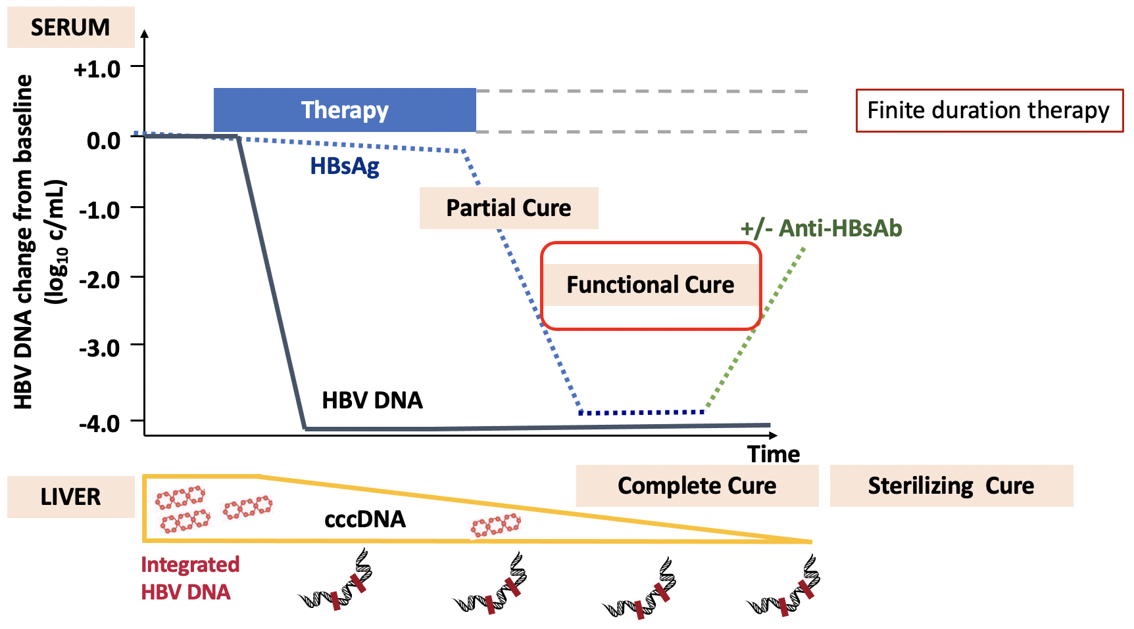
HBV functional cure
Endpoint:
Functional cure
Sustained virological suppression
Changes in biomarkers (‘proof of concept’)
  i.e. decrease 1 log qHBsAg or < 100 IU/mL
Cornberg et al J Hepatology 2020
Major goals of current strategies to cure CHB infection
- To reduce liver inflammation, prevent development of cirrhosis and HCC
- To achieve sustained suppression of serum HBV DNA post-therapy with loss of serum HBsAg (+/- seroconversion)
Partial cure
Functional cure

Slide 7
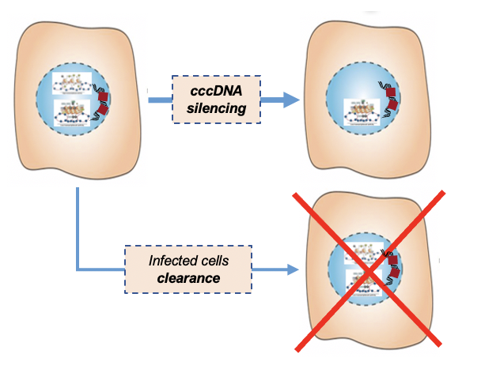

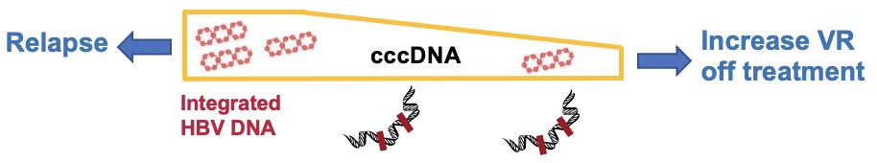
HBV functional cure
Functional Cure
loss of serum HBsAg (+/- anti-HBs)
inactive / reduced cccDNA
reactivation possible
let’s focus in
Mechanistically
cccDNA silencing
reduction of cccDNA
elimination of infected cells

Slide 8
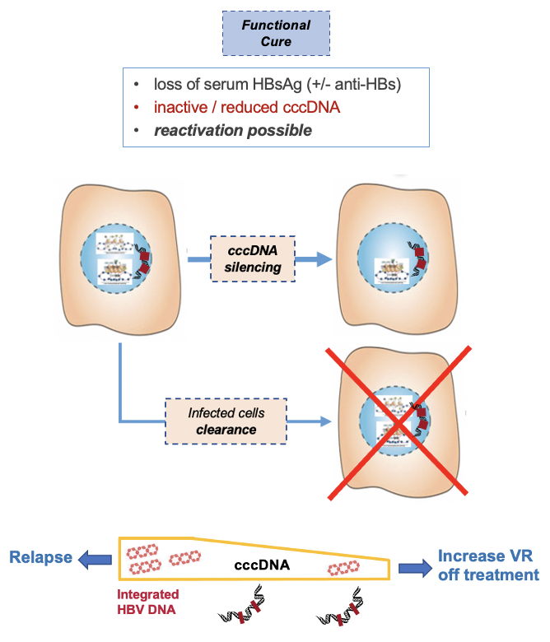
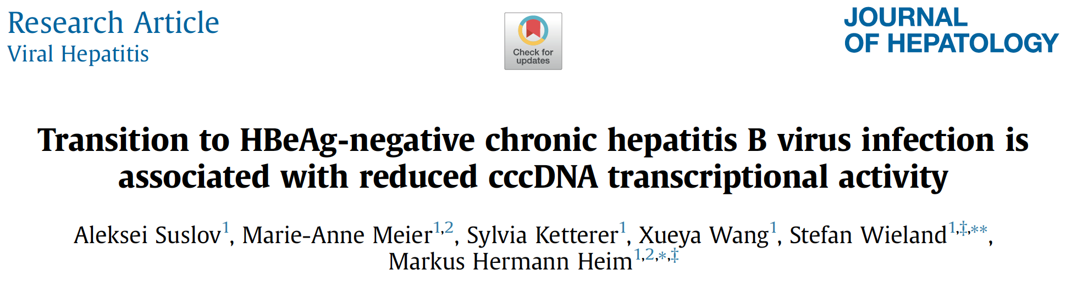
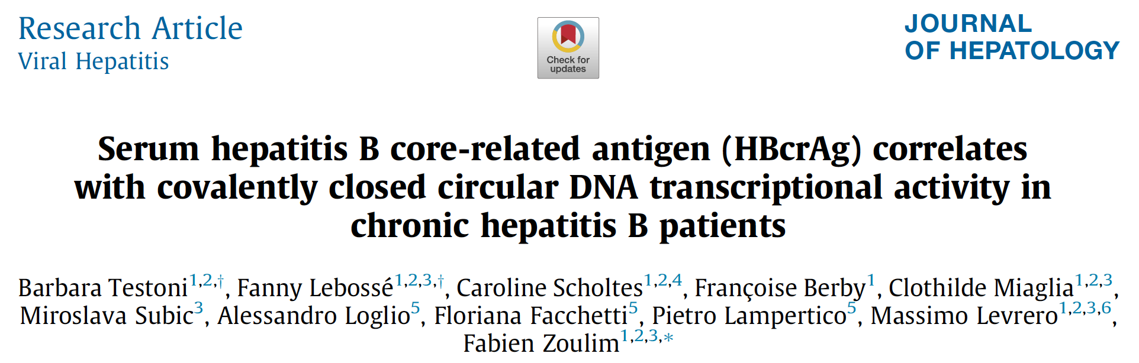
cccDNA silencing and HBV functional cure
cccDNA silencing
residual cccDNA is (transcriptionally) inactive
« Gold standard » : intrahepatic assessment of
cccDNA levels
cccDNA transcriptional activity
(viral RNA production: 3.5Kb RNA/cccDNA ratio )
let’s again focus in
Possible dissociation between cccDNA levels and cccDNA transcriptional activity

Slide 9
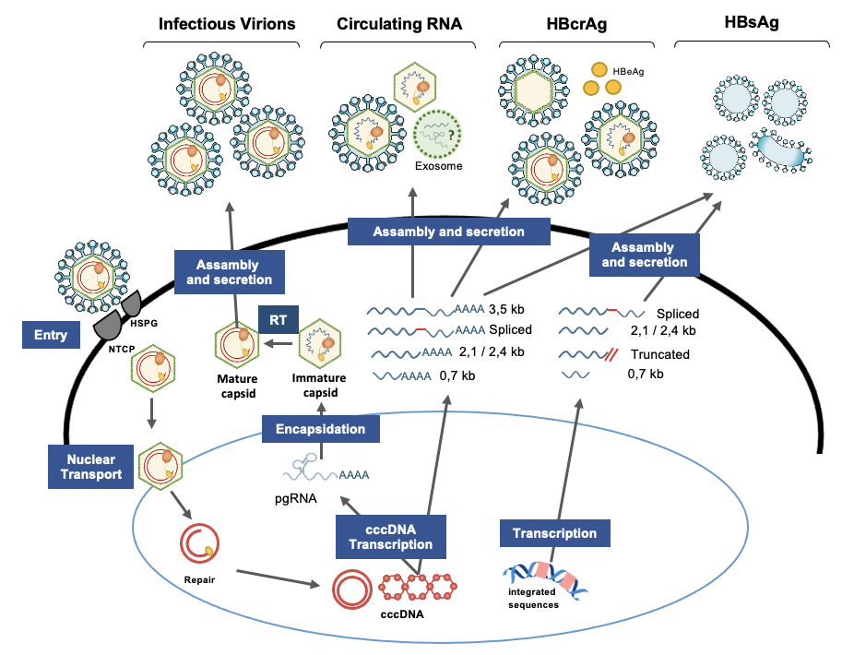
cccDNA silencing and HBV functional cure
cccDNA silencing
let’s again focus in
Hampered by the necessity of using invasive techniques (biopsy or FNA)
and by technical limitations (lack of a standardized assay)
HBcrAg and cHBV-RNA are good surrogate markers of cccDNA transcriptional activity, their combined use must be better studied
depending on the mode of action of the NMEs the biomarker will reflect
“target engagement” or “cccDNA targeting”
however, detecting “target engagement”
might still predict “funtional cure” or “complete cure”

Slide 10
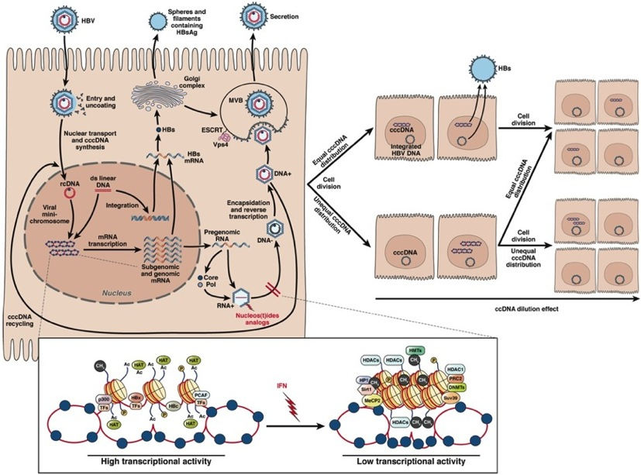

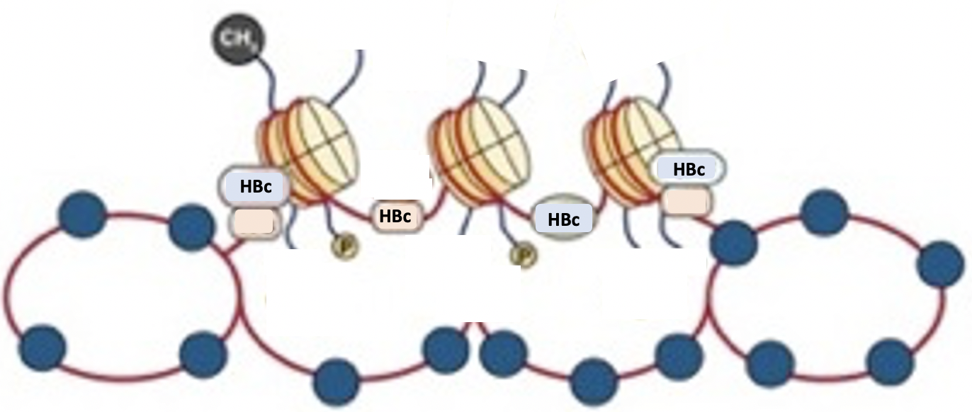
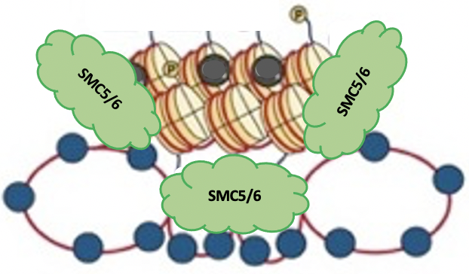
cccDNA silencing and HBV functional cure
cccDNA
organized as a viral minichromosome
  host proteins (histones, transcription factors,
  co-activators, co-repressors, chromatin modulators)
transcription regulated by epigenetic mechanisms
  (as the host chromosomes)
let’s again focus in
cccDNA silencing correlates
“deserted”
loss of TFs, coactivators, acetylation marks
“compacted”
Smac5/6 recruitment, no acetylation
“repressed”
recruitment of co-repressors, K9 / K27 methylation
Calaminus, HBV meeting 2021

Slide 11




cccDNA silencing and HBV functional cure
cccDNA silencing
IL12
HBV
IFN-a
pDC
PD-1
NK
NKT
let’s again focus in
CD4+
T cell
CD8+
T cell
B cell
IL1-b
KC
IL6
Cytokines and immune signaling affect the epigenetic control of cccDNA transcription (IFNα, IFNl, IL1-b, IL6) and cccDNA stability (IFNα, IFNγ, TNFα, LTβ)
The « Immune control » of HBV infection and the « Epigenetic control » of cccDNA function are, if not the exactly same, at least largely overlapping
Boosting innate and adaptive immunity has the potential to achieve all levels of HBV cure

Slide 12
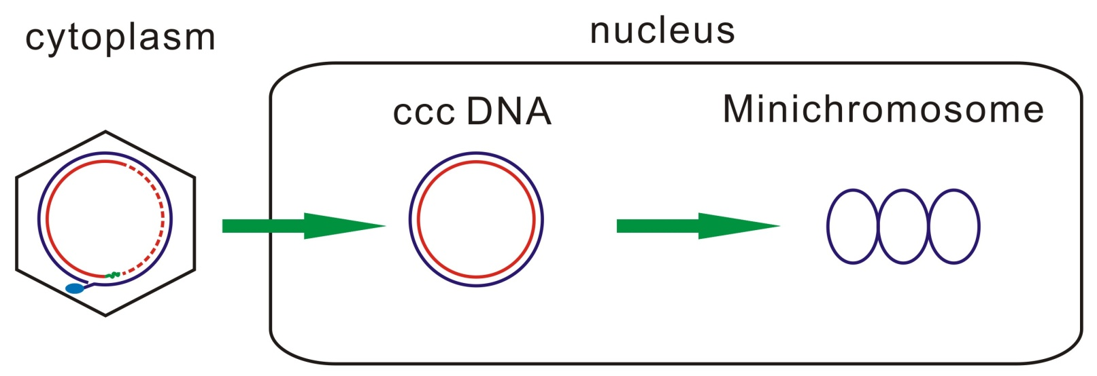
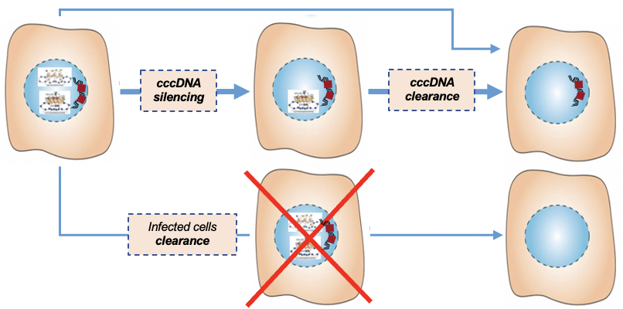
Strategies to target pharmacologically the cccDNA
cccDNA silencing vs elimination
Functional Cure
Complete Cure
loss of serum HBsAg
(+/- anti-HBs)
low levels, inactive cccDNA
reactivation possible
cccDNA clearance
no HBV reactivation
RC DNA
Thousands
copies
1-50 copy
Inhibiting
cccDNA biosynthesis
Reducing
cccDNA stability
Silencing
cccDNA transcription
Sterilizing Cure
is silencing propedeutic to elimination ?

Slide 13
Strategies for HBV (functional) cure
Replication inhibition
Reduce HBV antigens
Immunomodulation
+
+
_
_
hNTCP
Entry inhibitors: bulevirtide
HBV polymerase
NUC: ETV, TDF, TAF, novel NUCs and RNAseH inhibitors
Nucleocapsids
CAM: ABI-H0731, JNJ-56136379, RO7049389
Transcription
FXR agonist: EYP001
Viral RNAs
siRNA: JNJ-3989 VIR-2218
ASO: GSK3228836
LNA: RO7062931
HBsAg release
NAPs: REP 2139 or REP 2165
STOPS
RNA destabilizers
FXR agonists
Invigorate immune responses
Innate immunity
TLR7: GS9620, RO6864018, RO7020531, JNJ6479464
TLR8: GS9688
Immune check points
Anti-PD1: nivolumab
Anti-PDL1
PDL1 LNA
Oral PDL1 sm
Stimulate HBV specific B/T cells
Therapeutic Vaccines
GS4774
TG1050
T101
SCI-B-VAC
Fanning et al. Nat Rev Drug Discov. 2019 Nov;18(11):827-844; Roca Suarez et al, Liver International 2021

Slide 14
Combination of antivirals
Replication inhibition
Reduce HBV antigens
Immunomodulation
+
+
_
_
NUC: ETV, TDF, TAF
CAM: ABI-H0731, JNJ-56136379, RO7049389
siRNA: JNJ-3989 VIR-2218
ASO: GSK3228836
LNA: RO7062931
Courtesy of Fabien Zoulim

Slide 15
Combination of antivirals and immunomodulation
Antiviral
Immune stimulation
+
_
Peg-IFN alpha
Invigorate immune responses
Anti-PD1: nivolumab
Entry inhibitors: bulevirtide
NUC: ETV, TDF, TAF
NAPs: REP 2139 or REP 2165
Boosting innate immunity
TLR7: GS9620, RO6864018, RO7020531, JNJ6479464
TLR8: GS9688
Stimulate HBV specific B/T cells – Therapeutic Vaccines
Courtesy of Fabien Zoulim

Slide 16
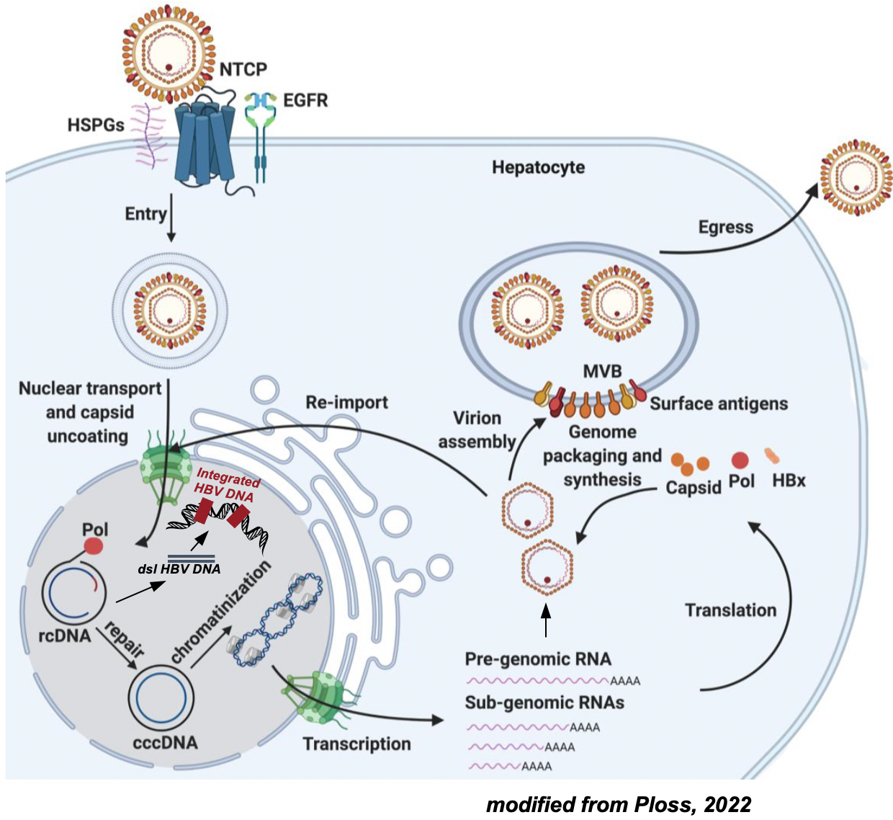
Antiviral strategies to target pharmacologically the cccDNA
cccDNA silencing vs elimination
RC DNA
Thousands
copies
1-50 copy
Inhibiting
cccDNA biosynthesis
Reducing
cccDNA stability
Silencing
cccDNA transcription
modified from Wei L & Ploss A, 2021
mechanistic insigths mainly from pre-clinical models
(cell culture and chimeric mice HBV infection models)

Slide 17
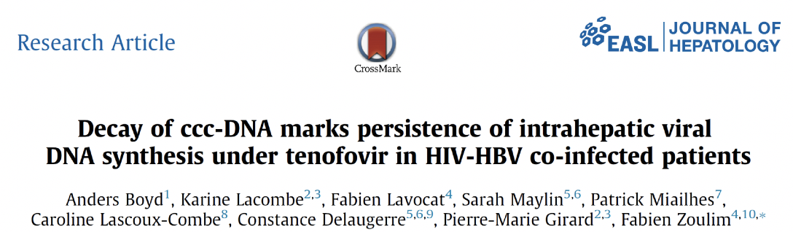
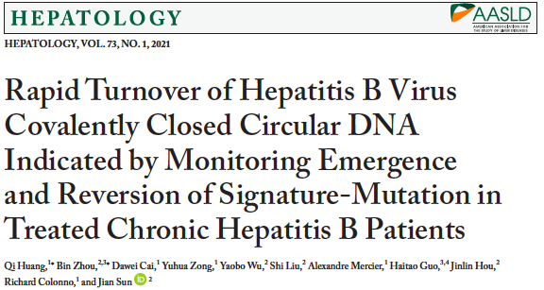
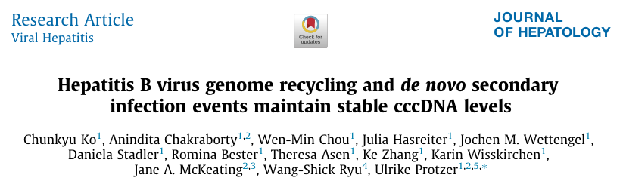
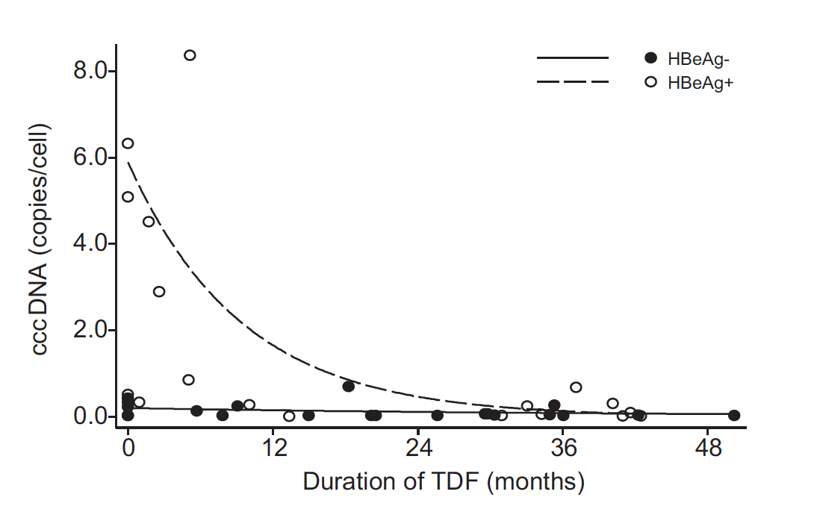
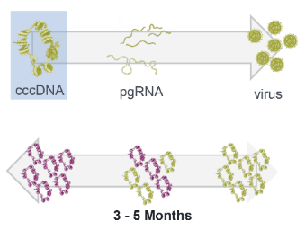
cccDNA pool is maintained by inherent stability and replenishment
Both arms should be blocked in order to decrease and ultimately eliminate the cccDNA pool
HIV/HBV
Co-infected
Longitudinal studies conducted on samples from patients with emerging resistance to NUCs
(liver HBV DNA, pgRNA, cccDNA and serum)
A selected HepG2 cell clone expressing NTCP supports long term HBV infection.
HBV establishes 1–9 copies of cccDNA per cell which have an estimated half-life of 40 days.
Genetic source of resistance shown to be cccDNA
Turnover of cccDNA from sensitive to resistant and from resistant to sensitive occurs in 3–5 months, suggesting relatively rapid turnover of both pgRNA and cccDNA pools of infected cells
26 months for HBeAg(-)
Estimated cccDNA half-life
9 months for HBeAg(+)
Rapid (∼3-4 months) establishment of newly formed cccDNA pools harboring NUC-resistant mutations
cccDNA half-life could be shorter than previously suggested

Slide 18
Antiviral strategies to target pharmacologically the cccDNA
cccDNA silencing vs elimination
RC DNA
Thousands
copies
1-50 copy
Inhibiting
cccDNA biosynthesis
de novo cccDNA synthesis
- neutralizing antibodies
- entry inhibitors
- nuclear import blockers (e.g. CAMs…)
Intracellular recycling
- DNA replication inhibitors that reduce rcDNA production (pgRNA degrader, CAMs, NUCs, RNase H inhibitors…)
inhibitors targeting cccDNA intermediates (DP-rcDNA, CM-rcDNA…)
rcDNA nuclear import / uncoating
- CAMs
Reducing
cccDNA stability
Silencing
cccDNA transcription
modified from Wei L & Ploss A, 2021
mechanistic insigths mainly from pre-clinical models
(cell culture and chimeric mice HBV infection models)

Slide 19
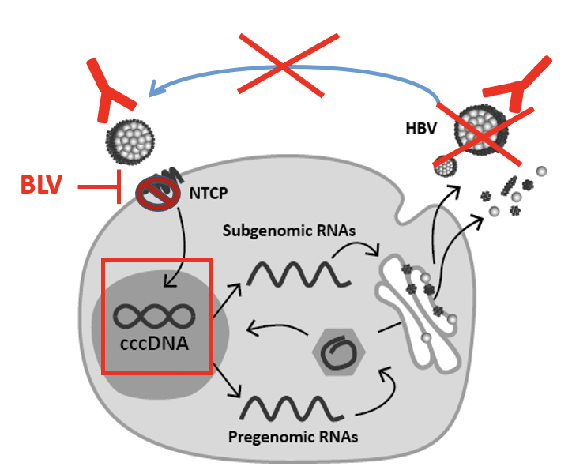


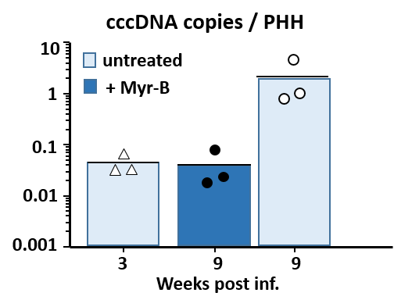
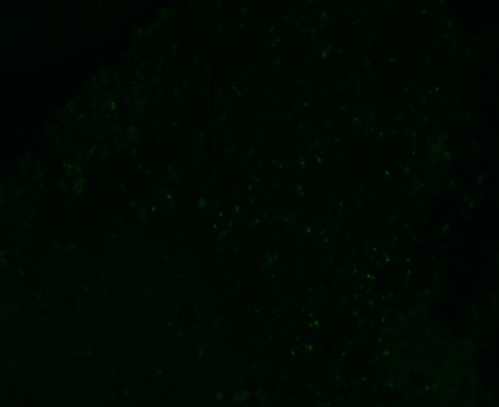
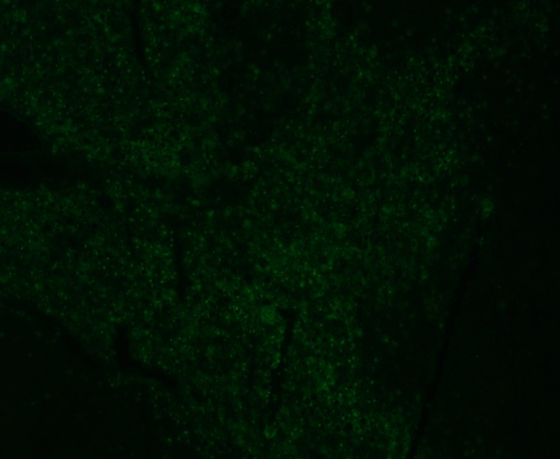
Agents blocking HBV entry & cccDNA establishment
BLV binding to NTCP blocks HBV (& HDV) infection, intrahepatic spreading and cccDNA establishment in uninfected cells in vivo
HBsAg neutralizing antibodies can hinder new infection events / intrahepatic spreading (i.e. VIR3434)
HBV
BLV (MyrB)
0
3
6
9
weeks
HBV DNA viremia
IF: HBcAg 9 w. post inf.
9
8
+ Mycludex
Log HBV DNA/ml
7
6
control
5
3
6
9
→ intracellular amplification of the cccDNA pool may be inefficient in stably infected PHHs
weeks
Volz, Allweiss, et al. J Hepatol 2013
Petersen, Dandri, Urban, Nature Biotech.2008; Lütgehetmann, Hepatol. 2012; Allweiss, Gut 2018; Wisskirchen, Kah, J Clin Invest 2019; Allweiss, Giersch Gut 2022

Slide 20
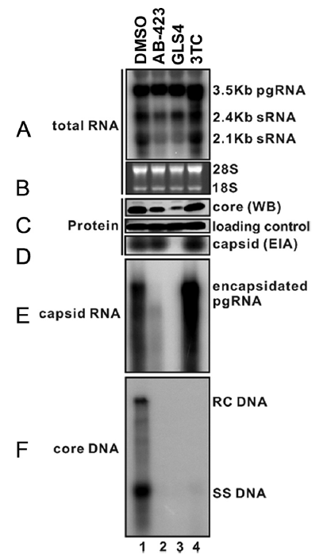
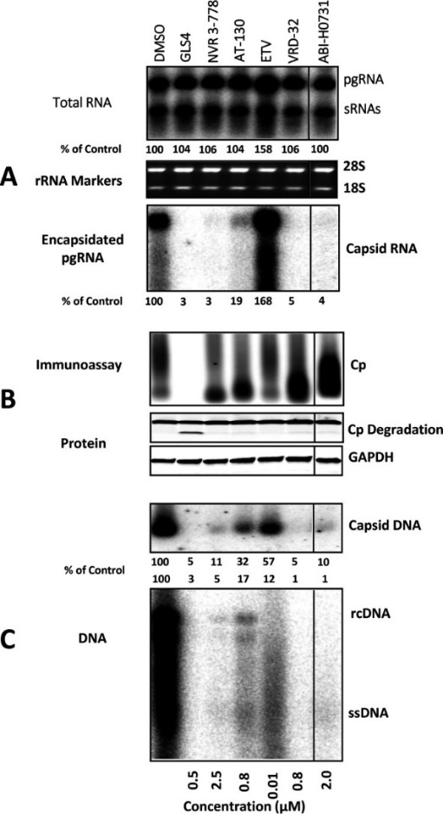
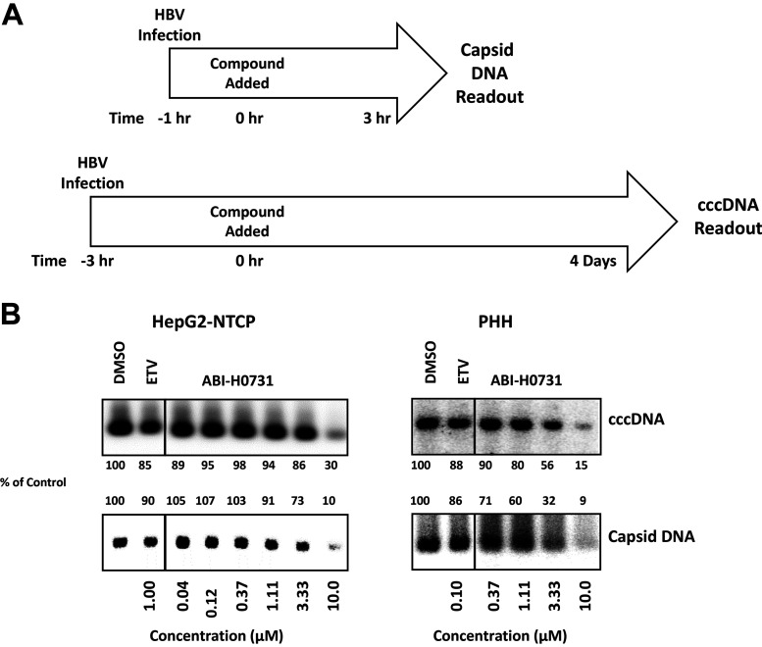
CAMs inhibit cccDNA formation via a dual mechanism
reduce de novo rcDNA synthesis
Induce premature rcDNA uncoating -”Melting”
(Mani 2018)
(Huang 2020)
Strong antiviral activity of CAMs and synergy with NUCs or PEG-IFN in clinical trial
however, no cure or HBsAg seroconversion yet , and virus relapsed after treatment cessation
Need more potent CpAM, longer treatment duration or combination with other HBV inhibitors?

Slide 21
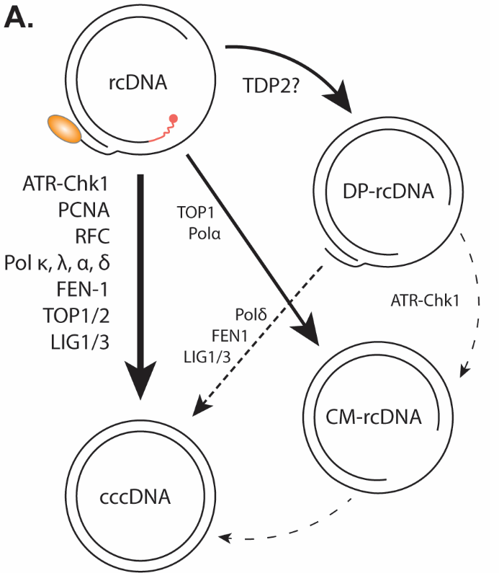
host DNA replication/repair factors involved in cccDNA formation
ATR-Chk1 (Luo et al, mBio 2020)
UV-DDB (Marchetti et al, JVI in revision)
Cellular polymerases (κ, λ, α). (Qi et al, Plos Path, 2016) (Tang et al, Plos Path, 2019)
TOP1 and TOP2 (Sheraz et al, JVI 2019)
Flap endonuclease I (FEN1) (Kitamura et al, Plos Path, 2018)
MUS81 flap nuclease (Zhang and Long et al #O25)
Lig I/III (Long et al, Plos Path, 2017)
Core components of lagging strand DNA synthesis machinery (PCNA, RFC, pol δ, FEN1, Lig I) (Wei and Ploss, Nat Micro, 2020)
(Marchetti and Guo, Cells 2020)

Slide 22
Targeting cccDNA formation
Pros:
In combination with NUCs and other replication inhibitors:
1. Block de novo HBV infection;
2. Additional layer of blocking intracellular cccDNA recycling 3. Block cccDNA repair
4. Inhibitors of DNA repair enzymes are used in cancer
Cons:
No direct effect on preexisting cccDNA
Uncertain long-term efficacy and toxicity
Redundant functions among DNA repair factors
(Marchetti and Guo, Cells 2020)
all preclinical

Slide 23
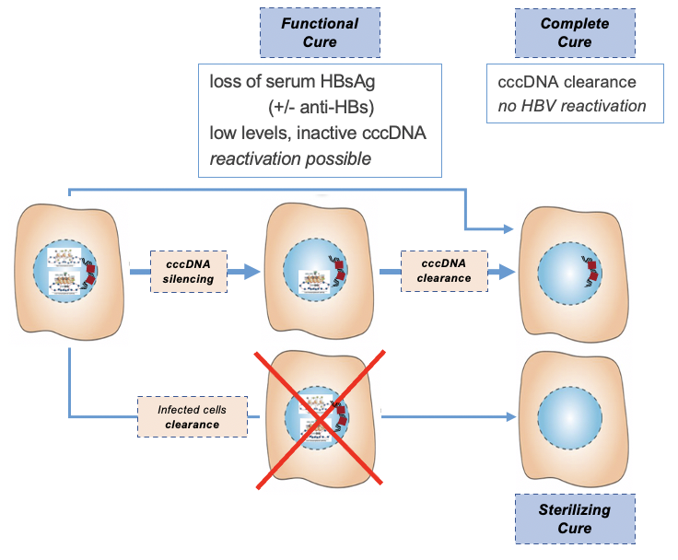
cccDNA silencing vs elimination
Strategies to target pharmacologically the cccDNA
RC DNA
Thousands
copies
1-50 copy
Inhibiting
cccDNA biosynthesis
Reducing
cccDNA stability
DNA sequence targeted antivirals
- deaminases
- designer nucleases
(ZFN, TALEN, CRISPR/Cas9)
cytokines-induced DNA deaminases
(A3A/B, AID…)
cccDNA destabilizers
Silencing
cccDNA transcription

Slide 24
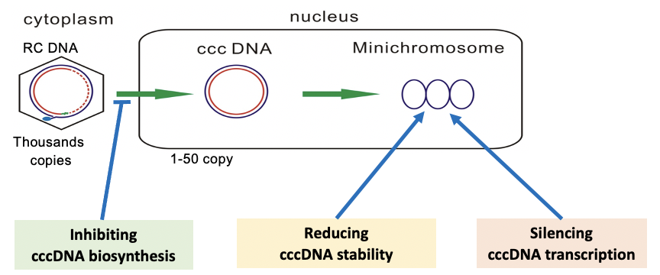
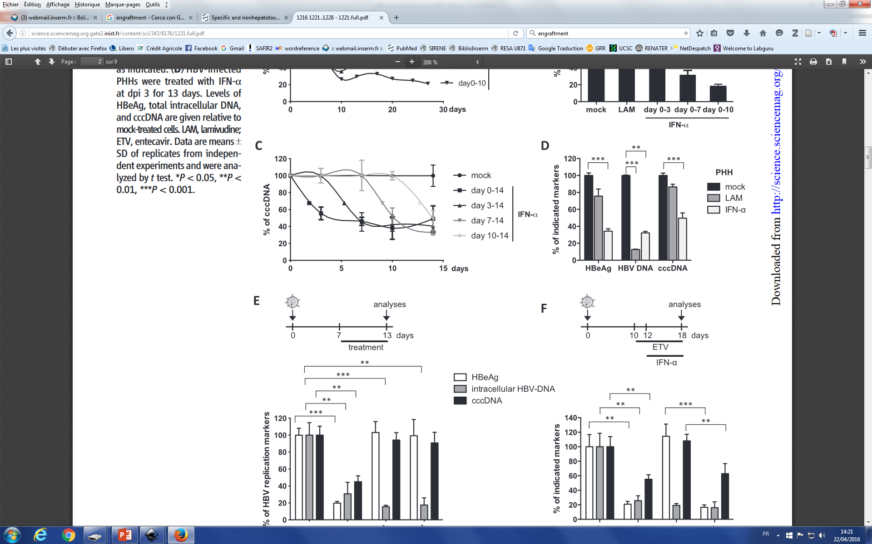
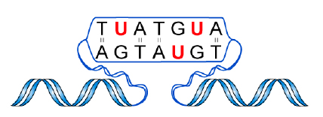
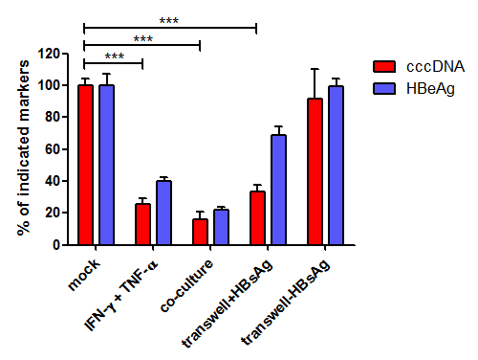
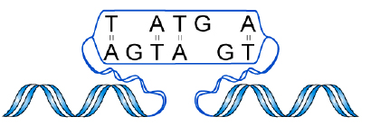

cccDNA direct targeting .1
Cytokine-directed
cccDNA degradation
DNA deamination
Lucifora, 2014
non-cytolytic
Specificity in vivo
cytolytic killing
Partial effect
only a subset of cccDNA molecules is targeted ?
selection of a resistant cccDNA pool ?
Endonucléases
Stenglein et al Nat Struct Mol Biol. 2010
Lucifora et al Science 2014
Xia et al Gastrroenterology 2015
Xia, 2015

Slide 25
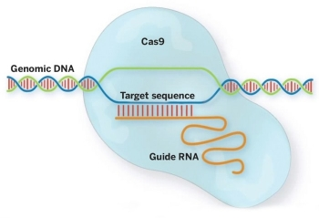
cccDNA direct targeting .2
“molecular scissors”
CRISPR-Cas, TALEN, NgAgo
CRISPR/Cas
cccDNA degradation
Cluster of regularly interspaced short palindromic repeats /
Cas nucleases
Cytosine Base Editors
Off-target effects
Partial effect
Cradick et al., Molecular Therapy, 2010
Weber et al., PLoS ONE, 2014
Seeger and Sohn, Mol Ther-Nucleic Acids, 2014
Chen et al., Molecular Therapy, 2014
Seeger and Sohn, Mol Ther-Nucleic Acids, 2016
Martinez, HBV Meeting 2021

Slide 26

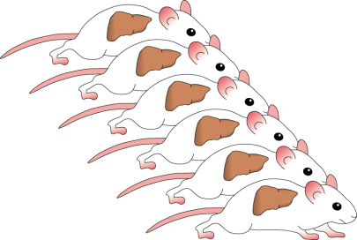


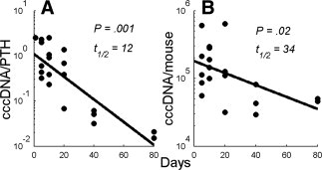
Targeting the cccDNA
Hepatocytes turnover
HBV
cccDNA
dilution
HBV-inf. PHHs
8
8
1. recipient
2. recipients
8
8
unequal
distribution
8
8
8
8
8
cccDNA loss
8
Risk of decompensation

Slide 27
Targeting the cccDNA
Decrease cccDNA synthesis
Non-cytolytic curing of the infected hepatocyte
  cytokines : IFNα, IFNγ, TNFα, LTβ
  - genome editing
  - small molecules cccDNA destabilizers
Increased hepatocyte turnover
Efficiency vs duration of therapy
Efficiency vs safety
Efficiency vs liver reserve
If efficiency is not 100 % be aware of residual cccDNA and the possible generation of a protected / resistant cccDNA pool ??!!

Slide 28
cccDNA silencing vs elimination
Strategies to target pharmacologically the cccDNA
RC DNA
Thousands
copies
1-50 copy
Inhibiting
cccDNA biosynthesis
Reducing
cccDNA stability
Silencing
cccDNA transcription
Epigenetic modifiers
- cytokines
- small molecules
- CRISPR/dCas9…
Target Liver-enriched transcription factors
HBx inhibitors

Slide 29
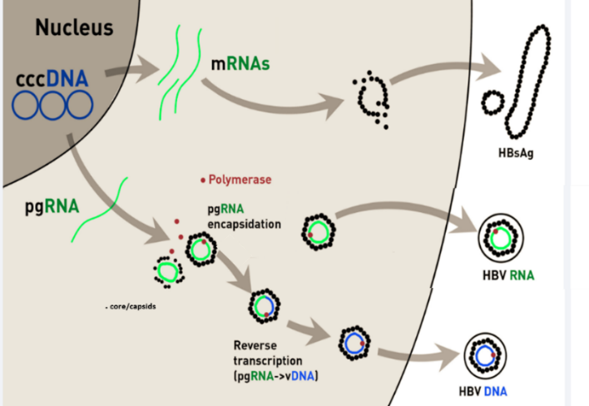
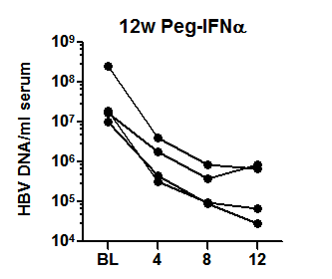
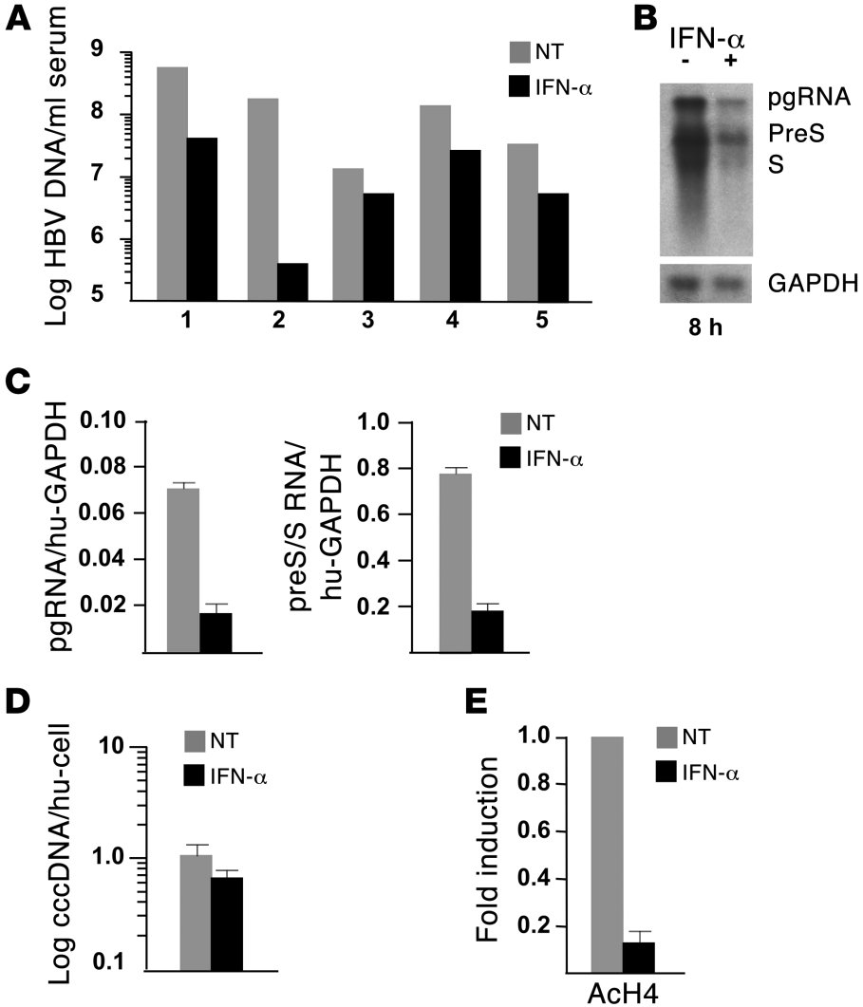
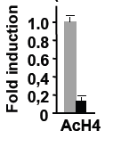

cccDNA epigenetic silencing
Dual MoA of IFN alpha : epigenetic cccDNA regulation / RNA containing capsids destabilization
+ IFNα
peg-IFNα
Belloni, Allweiss et al. JCI 2012; Allweiss et al. J Hepatol. 2014; Uchida et al. AAC 2017;
Different classes of compounds acting as epidrugs (PCAF/p300 inhibitor, Sirt3 agonist, JMD3 inhibitors)
inhibit cccDNA transcription
modulate acetylation/methylation of cccDNA-bound histones
Tropberger, 2015; Palumbo unpublished
Warnings
complexity of responses
functional redundancy
duration of response
off target effects

Slide 30
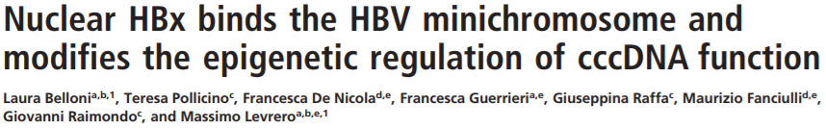
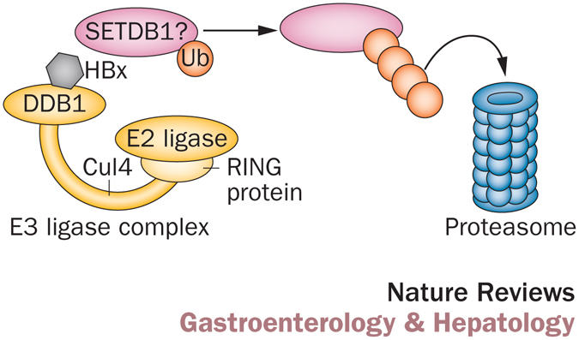
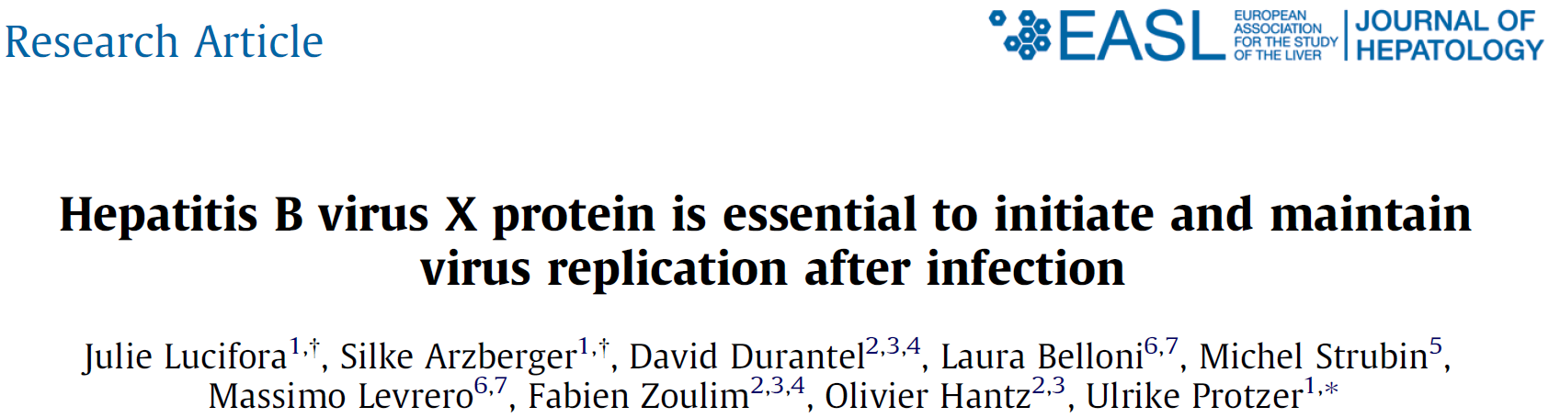
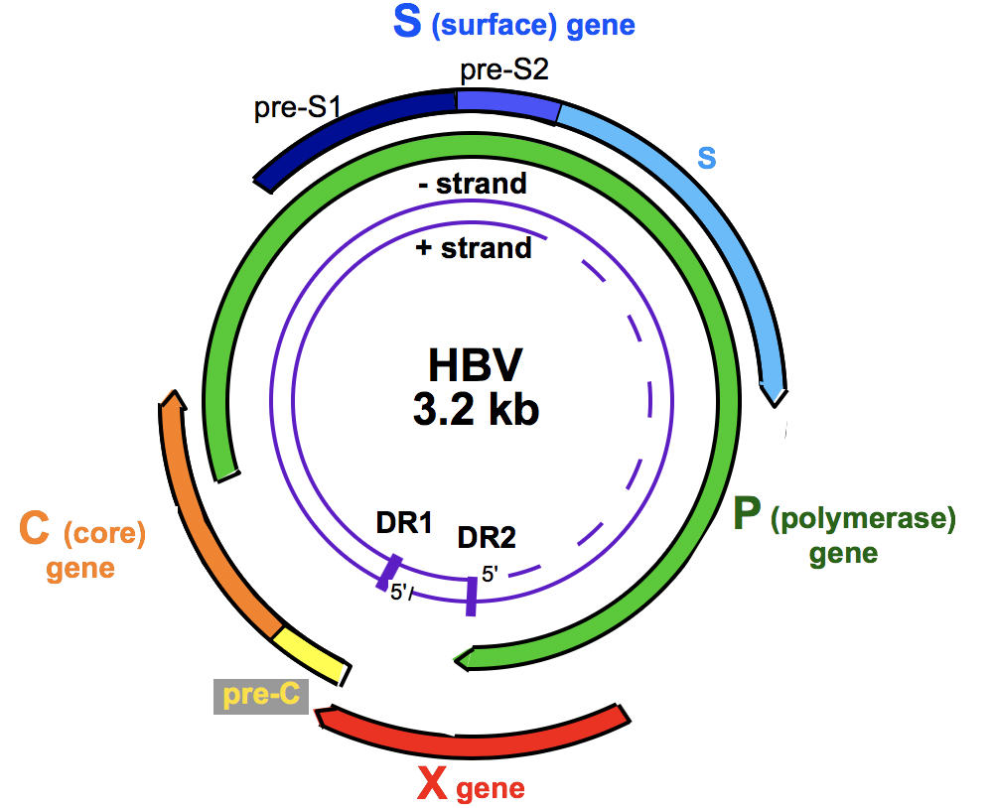
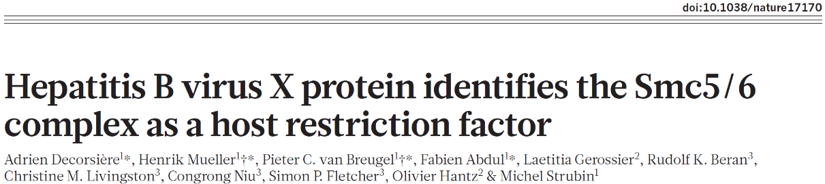

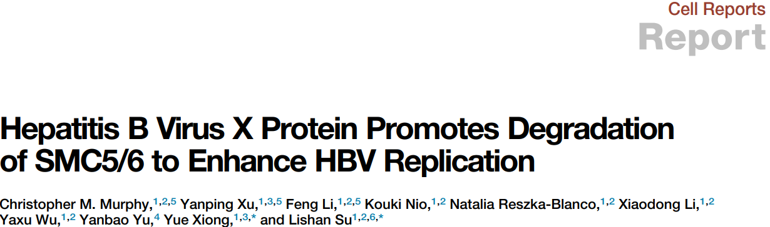

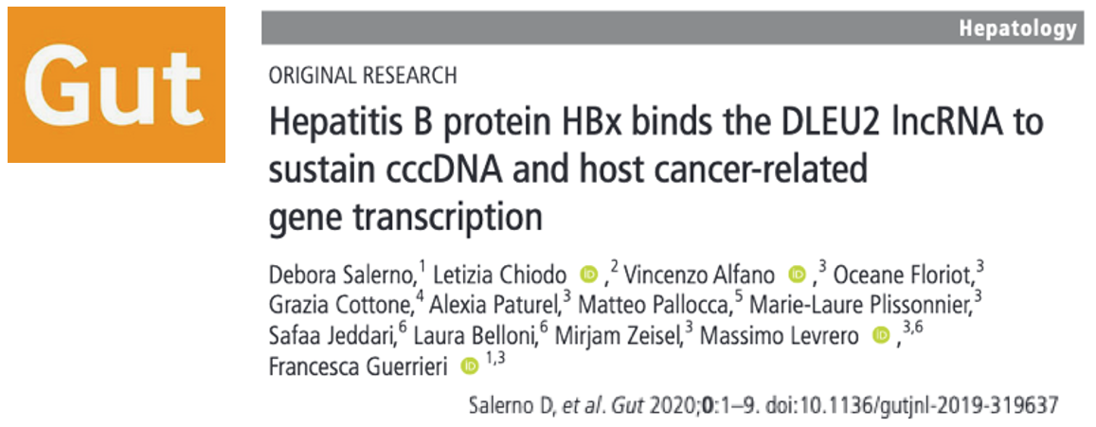
Targeting HBx to silence the cccDNA
HBx degrades the Smc5/6 restriction factor (DDB1 –Cul4 E3 ligase complex)
Smc5/6
Smc5/6
Decorsière, Nature 2016
Decorsiere, Nature 2016
Murphy, Cell Rep 2016
Kim. JVI 2016
HBx
Transcription
+++
HATs
p300
Set1A
HATs
p300
PMTs
TF
TF
HBx
TF
Set1A
H3K4me3
H3K27ac
H3K122ac
HBx
HBx
Belloni, PNAS 2009; Benhenda, JVI 2013;
Ducroux, PlosPath 2014; Riviere, J Hepatol 2015; Decorsiere, Nature, 2015; Alarcon, SciRep 2016
HDAC1
HP1
Sirt1
SETDB1
Suv39
HBx prevents cccDNA epigenetic silencing

Slide 31
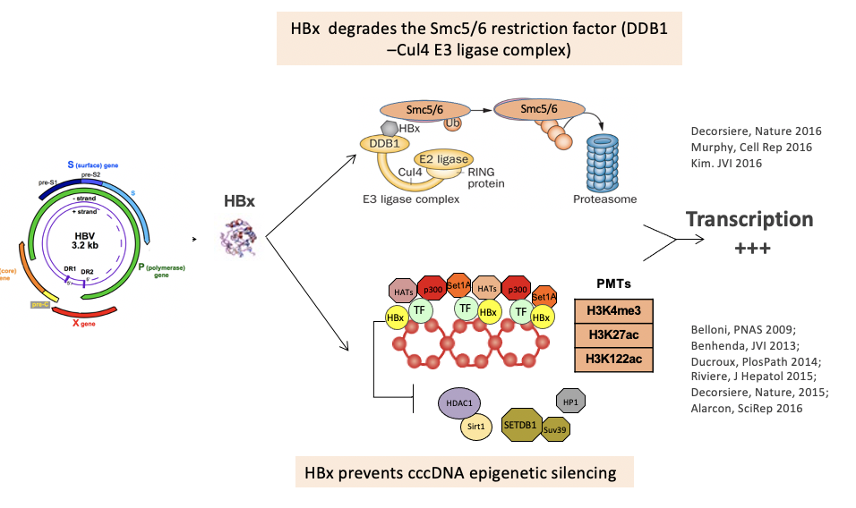
Targeting HBx to silence the cccDNA
Targeting HBx-DDB1 interaction
  Nitazoxanide
  NEDD8 agonist
  Mabs
  ScFv / intrabodies
  Cell penetrating peptide (CPP)
Targeting HBx-20S proteasome interaction
  Dicumarol
RNA interference strategies
  siRNA
  PEG-IFN
Attractive target for cccDNA silencing
Virus specific
Off-cccDNA effects beneficial
Sekiba et al, CMGH, 2019; Sekiba et al, Hepatology, 2019; Komeyeyev et al, J Virol 2019; Tao et al, Sci Reports 2019; Allweiss et al, Gut 2022
all preclinical

Slide 32




Targeting HBx
Targeting HBx-DDB1 interaction
(NTZ)
Sekiba CMGH, 2019
Inhibitors of HBx-DDB1 interaction silence cccDNA

Slide 33





Targeting HBx
Targeting HBx-DDB1 interaction
Inhibiting cccDNA transcription may lead to cccDNA destabilization

Slide 34




Targeting HBx
RNA interference strategies
HBV infected
USG mice
+ BLV
4w siRNA
Follow up
HBV RNAs
8 weeks follow up
in presence of BLV
SMC6 protein
+ 4 w siRNA
4 weeks follow up
Treatment with siRNA lowered all HBV markers, including HBx, but not intrahepatic cccDNA levels
RNAi treatment enabled reappearance of SMC5/6 complex and its recruitment onto the cccDNA and silencing
siRNA reduces HBx &
recruits smc5/6 to cccDNA
Allweiss et al, Gut 2022
Dual MoA of siRNAs at single cell level: HBV RNA degradation + cccDNA transcriptional silencing

Slide 35







cccDNA activity can be epigenetically modulated
Alpha-IFN:
inhibits cccDNA transcription (no reduction in cccDNA levels)
reduces the acetylation of cccDNA-bound histones
modulates cccDNA chromatin accessibility
IFNα/λ
as the first HBV epidrug
In vivo
HBV infection
Belloni, 2012
DHBV
Tet-on cell line
Liu, 2013
+ IFNα
HBV-infected
HepG2-NTCP
Tropberger, 2015

Slide 36



cccDNA epigenetic silencing
Dual MoA of IFN alpha : epigenetic cccDNA regulation / RNA containing capsids destabilization
+ IFNα
HBV RNAs
SMC6 protein
pgRNA is reduced by peg-IFNα treatment in liver & blood
Allweiss, Giersch et al Gut 2022
cccDNA accessibility
MNase-Sec
HBV-infected
HepG2-NTCP
Wang, 2021
cccDNA desertification vs compaction vs active repression

Slide 37






cccDNA epigenetic silencing
HBx inhibition and Smac5/6 restoration (by siRNAs or PEG-IFNa) induces cccDNA compaction rather than active repression
Serrano et al., Mol Cell 2020

Slide 38


Combination therapies (i.e. NA + CAM) induce more profound viral suppression
RNAi strategies can reduce all HBV markers including HBx (important therapeutic target!)
Preclinical evidence indicates that cccDNA transcriptional silencing may be an achievable clinical goal (to be demonstrated in patients)
Shielding the hepatocytes from infection may be key to support cccDNA silencing / cccDNA amplification
CAMs optimization to increase potency and exploits all MoAs
Combination with immune modulatory approaches may be required in a first step while awaiting for agents that efficiently and directly target cccDNA
Use investigational biomarkers apprpriately (e.g. according to drug MoA; target engagement vs cccDNA targeting)
Conclusions .1
Courtesy of Haitao Guo
Preferred combinations
NUC + CAM
+ immunomodulation
functional cure
NUC + siRNA
+ immunomodulation + therapeutic vaccine
functional / complete cure
NUC +
+ immunomodulation + therapeutic vaccine
functional / complete cure

Slide 39




Conclusions .2
Can HBV complete/functional cure be achieved by antiviral therapy alone?
YES
CpAMs
If cccDNA half life is shorter than presumed
You may think of it as « intensification »
Complete Cure
Entry inhibitors
cccDNA clearance
Inhibitors
of HBsAg release
If lowering HBsAg is sufficient to restore immune responses
Functional Cure
RNA interference
Courtesy of Maura Dandri
RNA destabilizers
cccDNA silencing
In any case cure will likely to be long (a year?) and need exceptionally safe drugs

Slide 40











INSERM U1052
Equipe Levrero
INSERM U1052
Equipe Zoulim
Lab of Gene Expression
Laura Belloni
Natalia Pediconi
Debora Salerno
Fabien Zoulim
Barbara Testoni
and her team
Massimo Levrero
Collaborators
Mirjam Ziesel
Claude Caron de Fromentel
Francesca Guerrieri
Marie Laure Plissonnier
Vincenzo Alfano
Francesca Casuscelli
Yasmina Chouik
Alexia Paturel
Jean Yves Mabrut
Mickael Lesulter
Kayvan Mohkam
Philippe Merle
Jerome Dumortier
Guillaume Rossignol
Xavier Muller
Thomas Baumert – Strasbourg, FR
Maura Dandri - Hamburg, DE
Jane Mc Keating – Oxford, UK
Adam Zlotnick - Indiana University, USA
Raymond Schinazi – Emory Univ Atlanta –USA
Antonio Craxi – Palermo, IT
Letizia Chiodo, Giancarlo Ruocco – Roma, IT
Carlo Ferrari - Parma, IT
Pietro Lampertico – Milano, IT
Teresa Pollicino, Giovanni Raimondo – Messina, IT
Sabrina Strano, Giovanni Blandino – Roma, IT
Financial support

