Slide 1
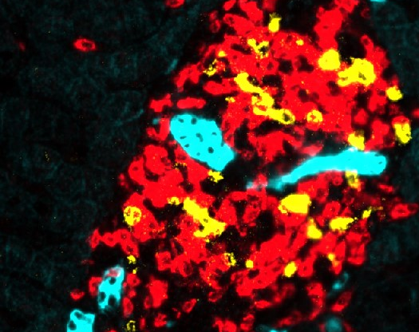
Single cell transcriptomic landscape of functionally cured CHB patients
Ramanuj DasGupta, Ph. D.
Senior Group Leader
Laboratory of Precision Oncology and Cancer Evolution
Genome Institute of Singapore
Email: dasguptar@gis.a-star.edu.sg
Science of HBV Cure
Singapore 30th May, 2022

Slide 2
Liver damage (distinct etiologies) followed by inflammation, tissue regeneration/repair may induce reprogramming of disease microenvironment into a pro-tumorigenic niche
Notes:
My lab works on cancer evolution and fundamentally we are interested in this question of how liver damage (with distinct etiologies) followed by tissue regeneration and repair can reprogram the intra-hepatic microenvironment into a pro-tumorigenic niche….

Slide 3
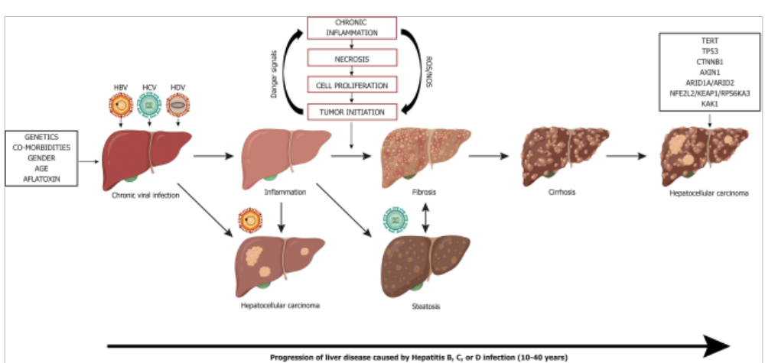
Liver disease progression to HCC from chronic viral hepatitis infection
D’souza et al., WJG 2020
Notes:
In that context we are specifically interested in understanding how how long chronic viral hepatitis could result in sustained liver damage and may drive progression to HCC

Slide 4
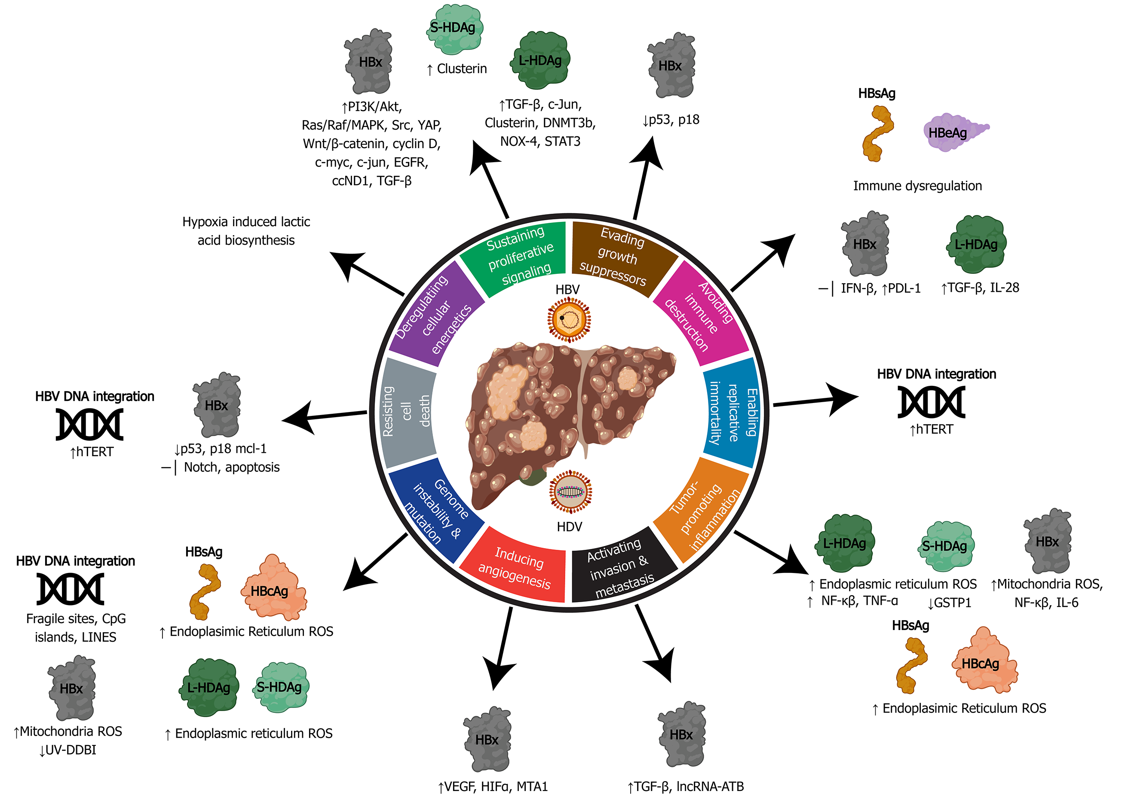
Hepatitis B virus can activate all ten hallmarks of cancer using viral proteins (HBx, HBsAg, HBeAg, HBcAg) and DNA integration
D’souza et al., WJG 2020
Notes:
What is really interesting is that HepB visrus can in fact activate all the different hallmarks of cancer using viral proteins or by integrating into host DNA

Slide 5
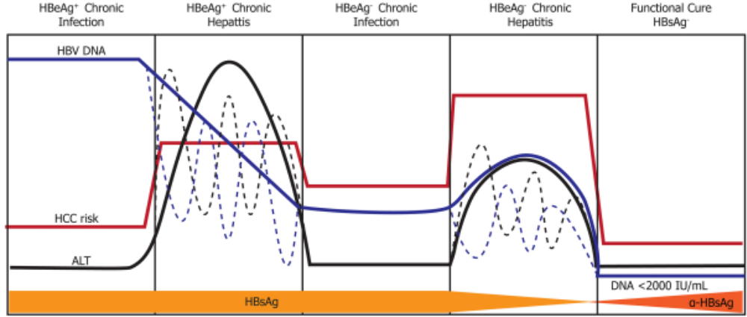
Natural history of HBV infection and HCC risk
HBsAg loss: Functional cure for HBV
minimal risk for progression to HCC
Mechanisms underlying long-term functional cure?
Notes:
And what’s quite evident from looking at the natural history of HBV infection, is that functional cure of CHB, as defined by the loss of S antigen, minimizes the risk for progression to HCC. However the mechanisms underpinning long term functional cure remain poorly defined. Therefore in this context, we are interested in defining mechanisms and cell states that are associated with sustained, long term functional cure.

Slide 6
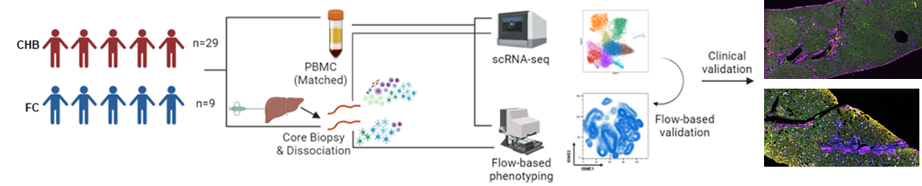

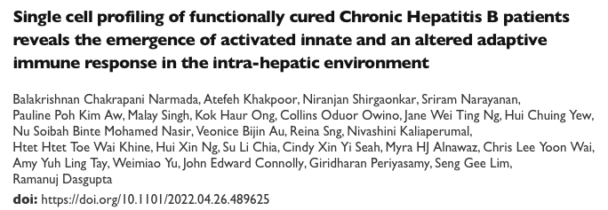
Single cell atlas of immuno-pathological cell states associated with functionally cured CHB patients
n=15
n=8
n=23 | Biopsy | PBMC
Cells | 47562 | 56583
  Investigate the specificity of these “cell-state associated” biomarkers
    Intrahepatic (Tissue level marker)
    Circulating immune compartment (Not reflective of tissue level changes)
    Present in both (Reflective of tissue level changes; surrogate blood level marker)
Balakrishnan, Khakpoor et al., manuscript under review
Notes:
So to address this question we have generated a single cell atlas to define the immuno-pathological cell states, @scResolution, associated with functionally cured CHB patients….and the hope is that such approaches will help us generate new testable hypotheses regarding mechanisms that drive functional cure.
So this figure highlights the workflow…we generated single cell RNA-seq data from both liver core needle biopsies and matched PMBCs isolated from either CHB or functionally cured patients. Overall generated scRNA-seq data from ~100K cells to identify cell-state associated expression biomarkers that are present either in the tissue or peripheral circulation and those that are present in both compartments.

Slide 7

Why single cells?
Dissect heterogeneity/rare cell types/states
Identify all individual parts (cell types/cell states) and localize them in time and space…Atlas)
Identify regulatory interactions Figure out how they work together in time and space (cell-cell interaction; signaling nodes and networks)…Novel Biology

Slide 8
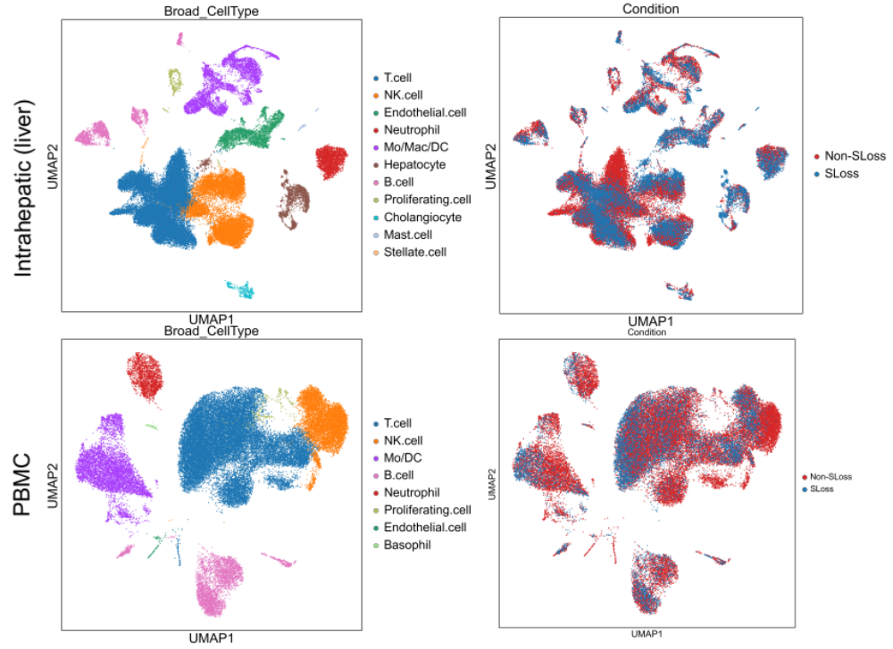
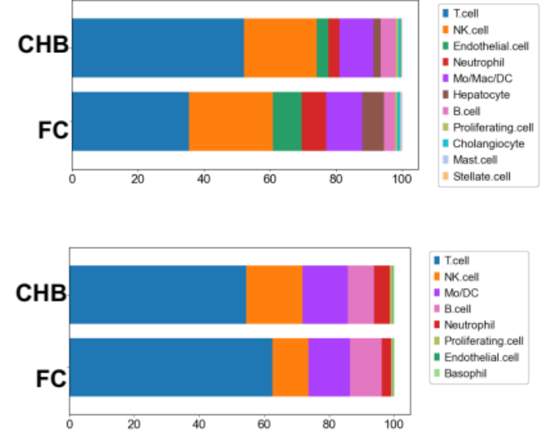


Intrahepatic atlas reveals unique cell states and alterations that may not reflected in PBMC
Notes:
Single cell transcriptomic atlas of 23 CHB patient Intrahepatic liver (IHL) and matched PBMC represents all the important cell subtypes in a robust manner

Slide 9
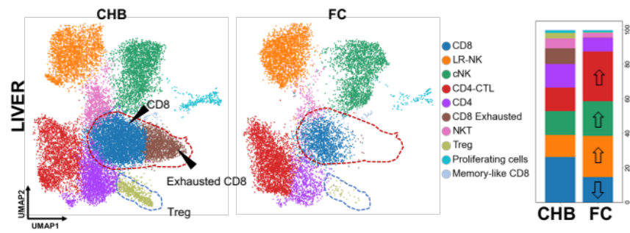
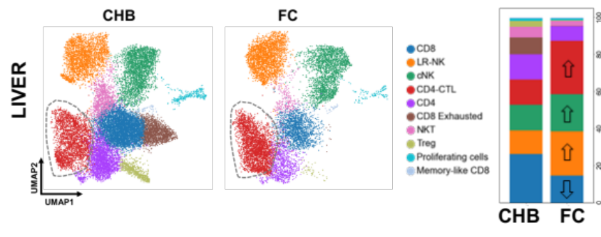


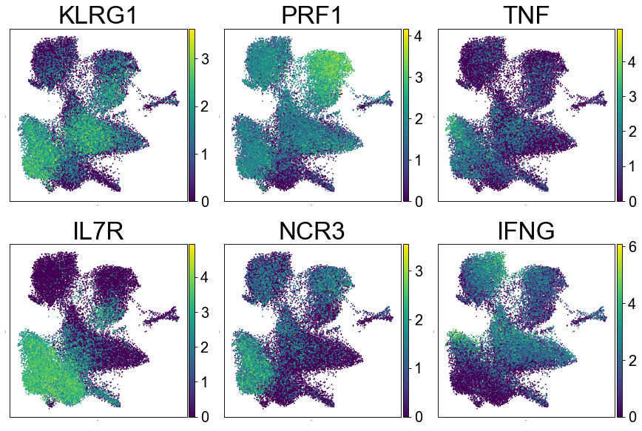
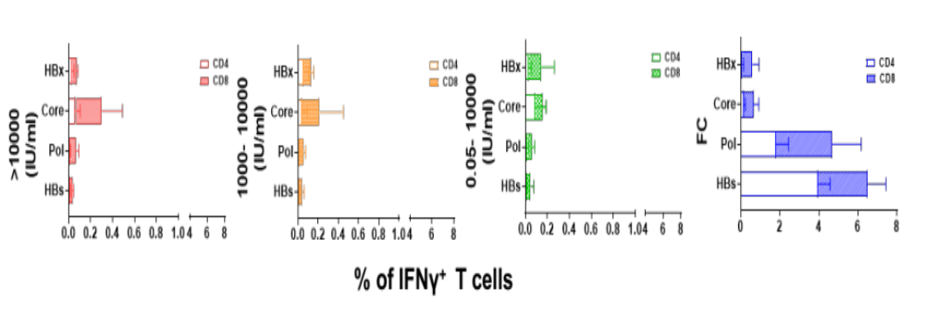
An “altered” adaptive immune response in FC patients marked by the emergence of CD4-CTLs!
Loss of exhausted CD8 T cells and Tregs
CD4-CTL population is marked by increased expression of IL7R, KLRG1, PRF1, TNF, IFNG and NCR3
CD4-CTLs gain innate-like function
Dominant peptide specific CD4 effector response in FC patients
Gain of innate-like CD4-CTLs

Slide 10
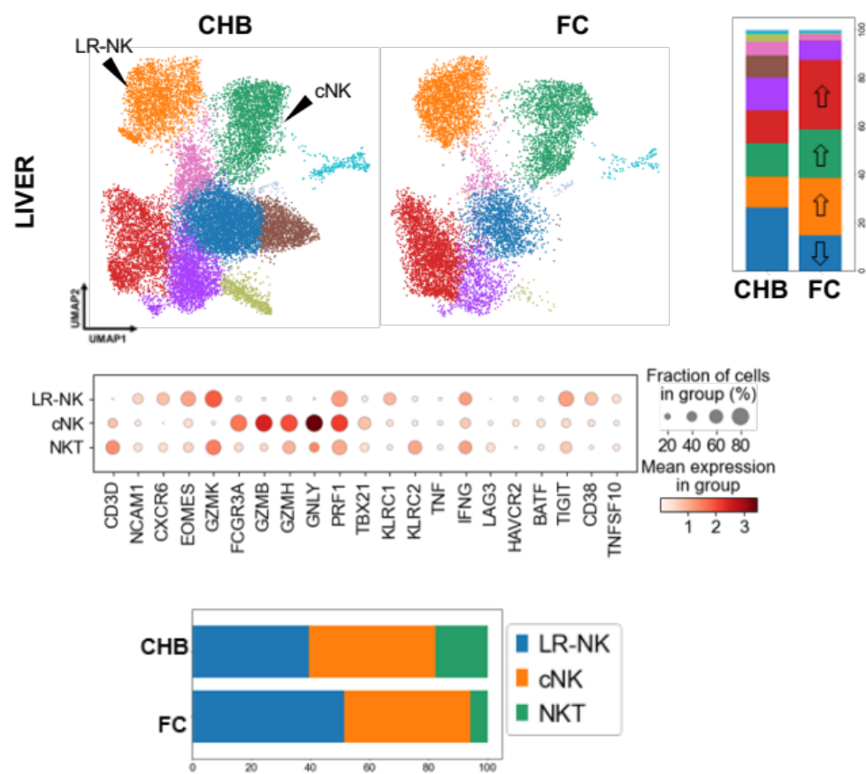
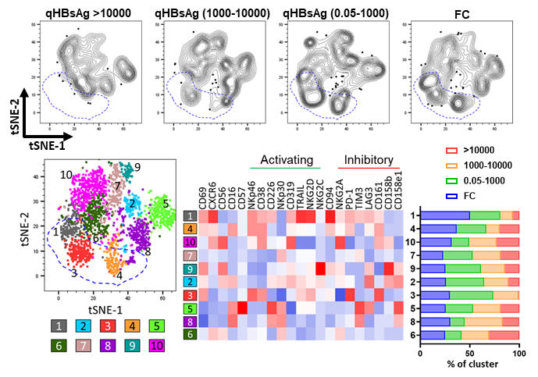
Enhanced innate immune activation and priming towards memory-like NK cells in FC patients
LIVER
(CXCR6, EOMES, IFNγ)
(FCGR3A, GZMB, PRF1)
Ex- vivo multiparametric Flow Cytometry analysis on total NK cells:
Gradual enrichment of clusters representing LR-NK (cluster 1) and cNK (cluster 4) cells in correlation with reduced qHBsAg
LR-NK and cNKs display increased expression of activating receptors (NKP46, CD38, NKG2D and TRAIL) and lower expression of inhibitory receptors such as TIM3 (cl4)

Slide 11
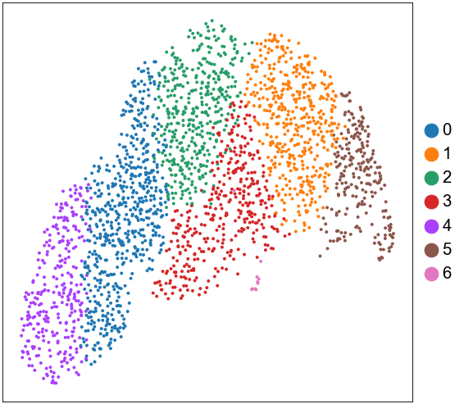
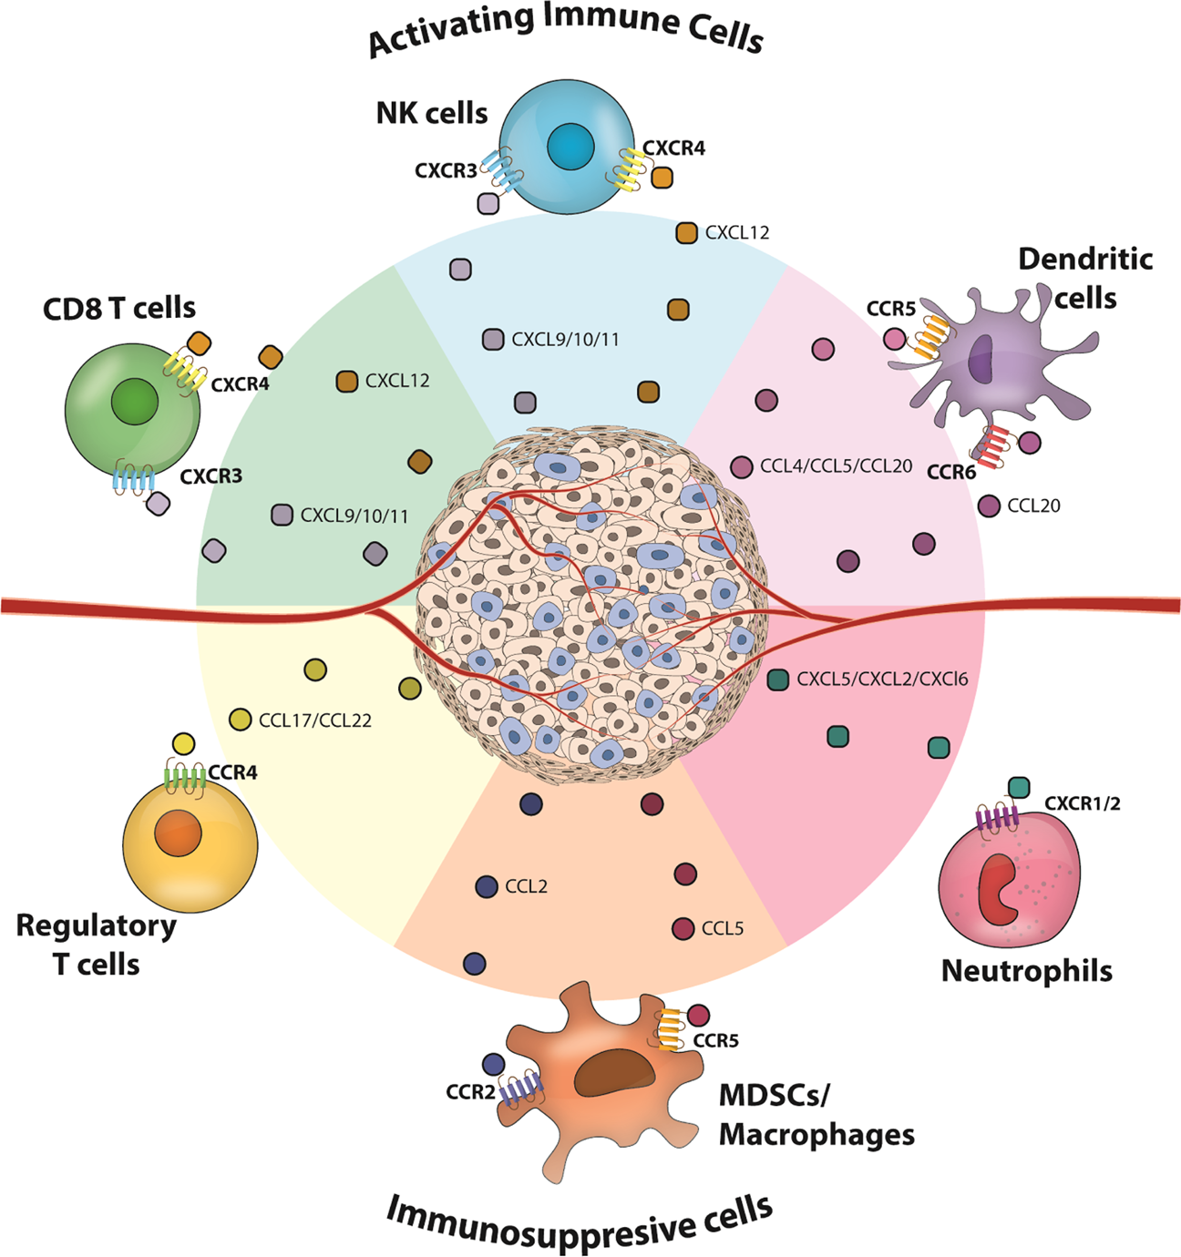
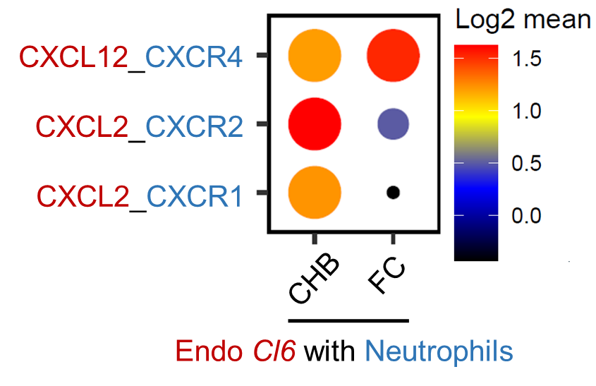
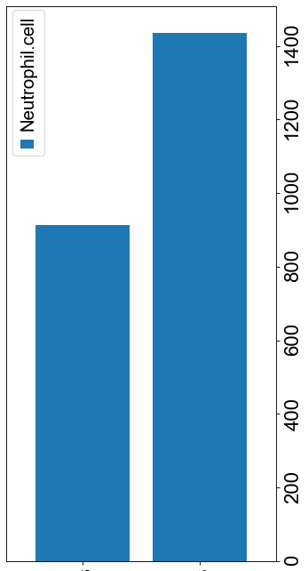
Enhanced innate immune activation: marginated neutrophils in the liver of FC patients
Gain of marginated neutrophils in FC liver
Likely recruited and retained by CXCL12 expressing endothelial cells via CXCL12-CXCR4 interaction (CellPhoneDB): Activation of immune response
Loss of CXCL2-CXCR1/2 interaction (immuno-suppressive)
Kohli et al., Cancer Gene Ther 29, 10–21 (2022)

Slide 12
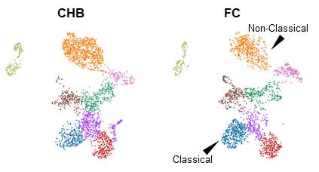
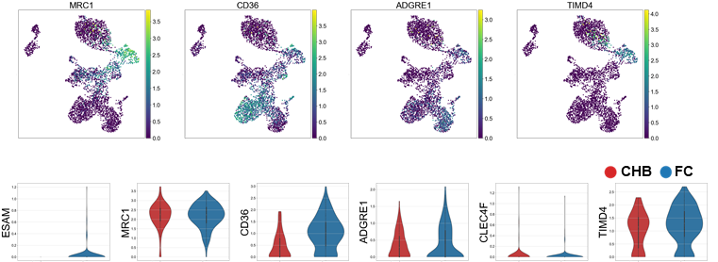
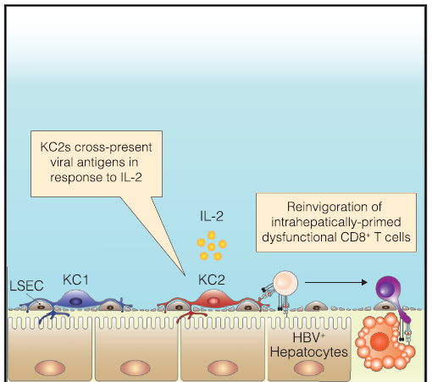
Shift from immune-suppressed to immune-active state in FC liver (Myeloid profiling by scRNA-seq)
“gain of APC function and presence of low grade inflammation”
Gain of pro-inflammatory classical monocytes and reduction of anti-inflammatory non-classical monocytes in FC patients
Gain of a FOLR2, VSIG4 Kupffer cell subtype in FC liver (marked by ESAM, MRC1, TIMD4 and ADGRE1)
Giorgia De Simone,.., Matteo Iannacone et al. Immunity 2021
Re-invigoration of dysfunctional CD8 (via cross-presentation) and enhanced presentation to CD4 T cells in FC patients?

Slide 13
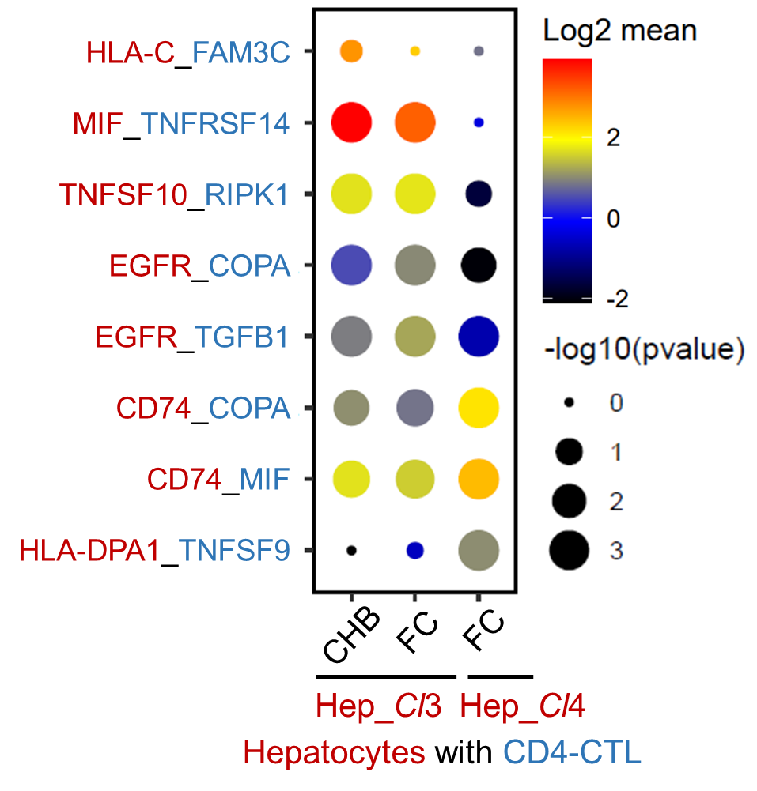
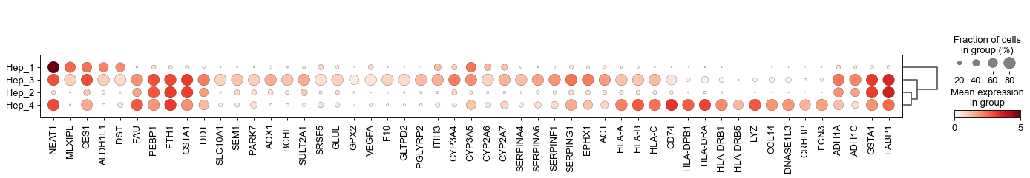
Emergence of MHCII expressing hepatocytes in FC patients
display enhanced interactions with CD4-CTLs
Hepatocytes gain APC function upon IFNα treatment?

Slide 14
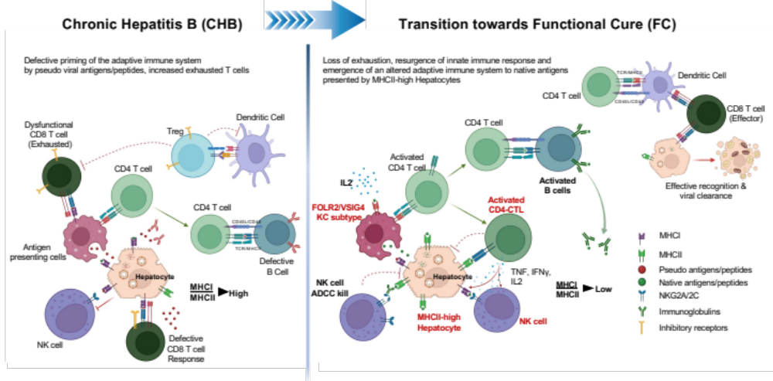
Working model

Slide 15
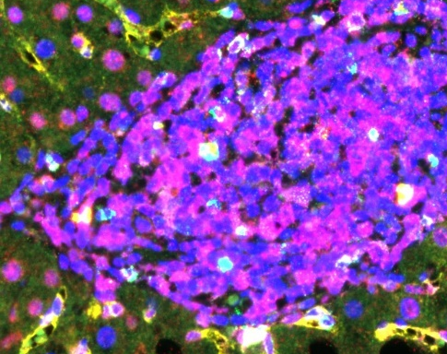

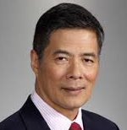
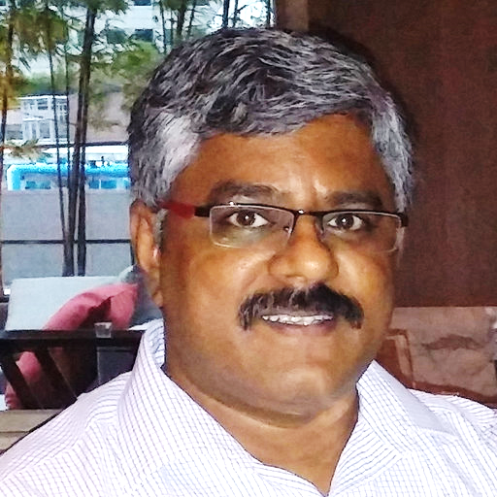
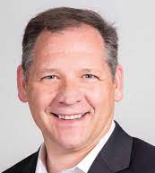

Acknowledgements
Narmada Balakrishnan
Atefeh Khakpoor
Niranjan Shirgaonkar
Prof. Lim Seng Gee
Dr. Sriram Narayanan
John Connolly

