Slide 1
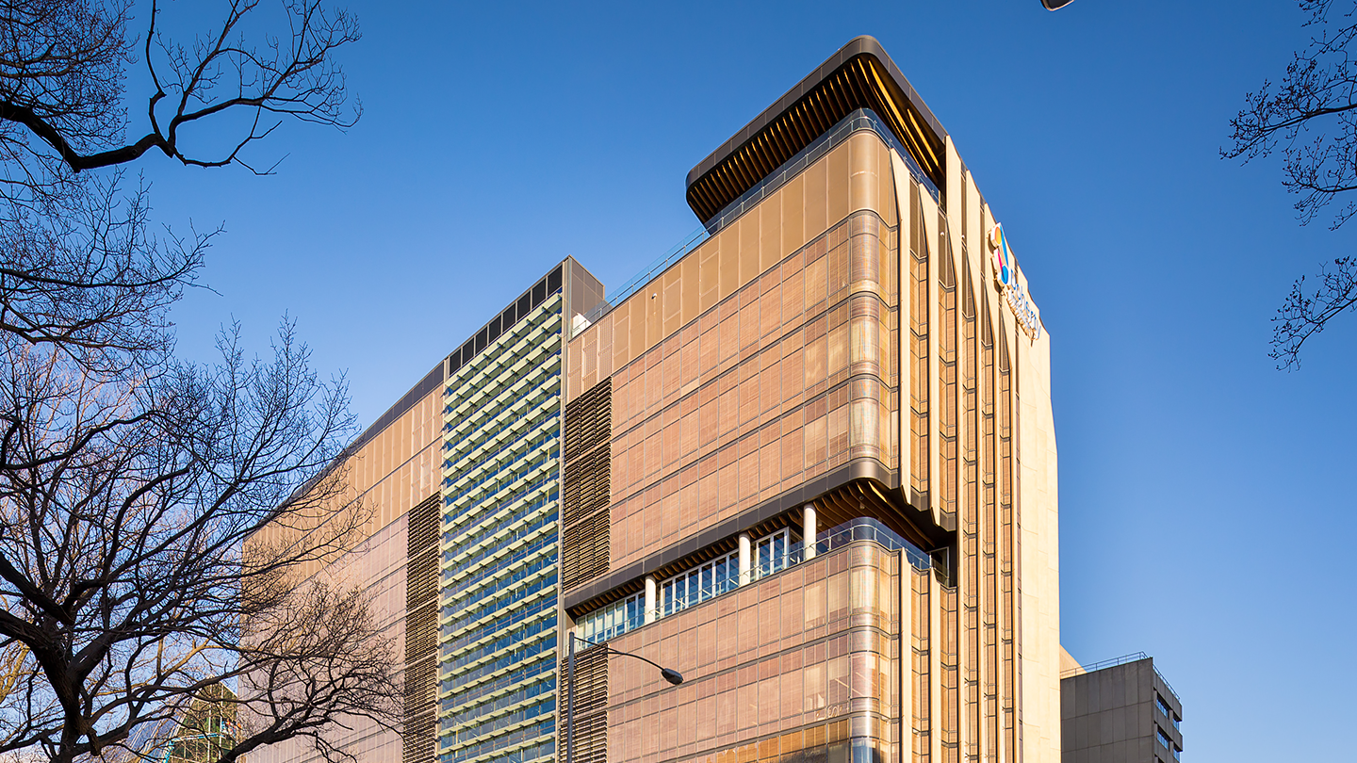


What can we learn about HBV cure from HIV?
Professor Sharon R Lewin AO, FRACP, PhD, FAHMS
Director, Peter Doherty Institute for Infection and Immunity
Melbourne Laureate Professor, University of Melbourne
Consultant physician, Alfred Hospital and Royal Melbourne Hospital, Melbourne, Australia
The Science of HBV Cure Meeting 2022 (HBV Cure 2022)
May 30th., 2022

Slide 2
Similarities and differences: HIV and HBV cure
 | HIV | HBV
Effective treatment | Yes (antiretroviral therapy) | Yes (NRTI/IFN)
Rebound off treatment | Nearly everyone 2-3 weeks | Not everyone Months/years
Major barrier | Integrated latent provirus Residual virus production Immune defects | Unintegrated cccDNA (Integrated HBV DNA) Immune defects
Remission | Very rare | 10-20%
Biomarker of remission | ????? | HBsAg seroconversion

Slide 3
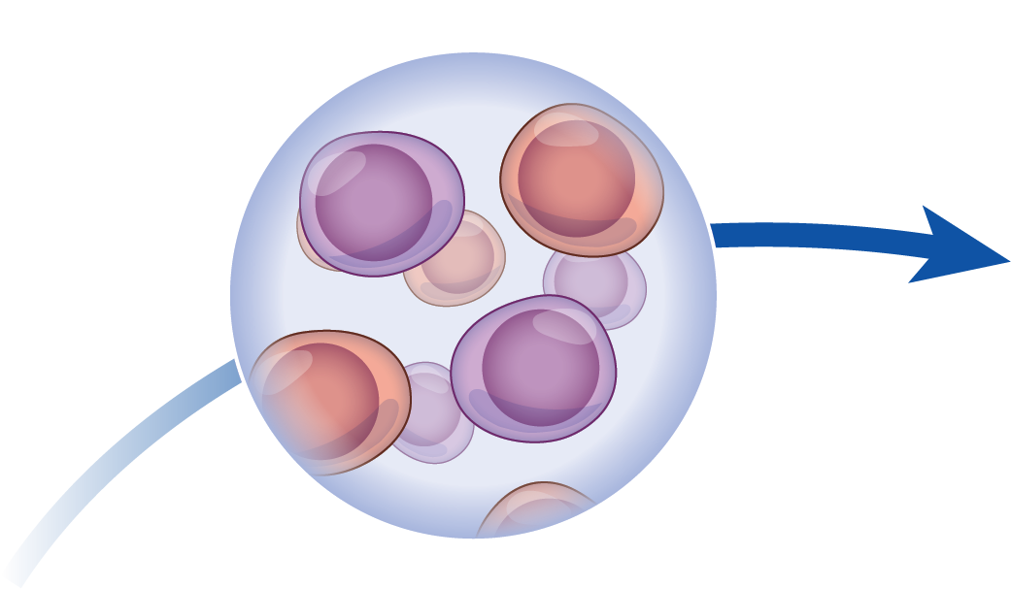




HIV cure is rare: examples of eradication and remission
Timothy Brown
Berlin
Adam Castallejo
London
The New York patient
2009
2019
2022
Hutter, N Engl J Med 2010; Gupta, Nature 2019; Gupta, Lancet HIV 2019; Bryson, CROI 2022

Slide 4
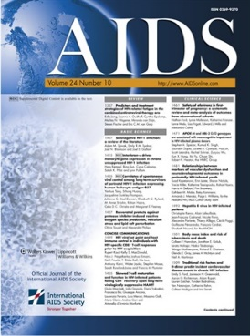
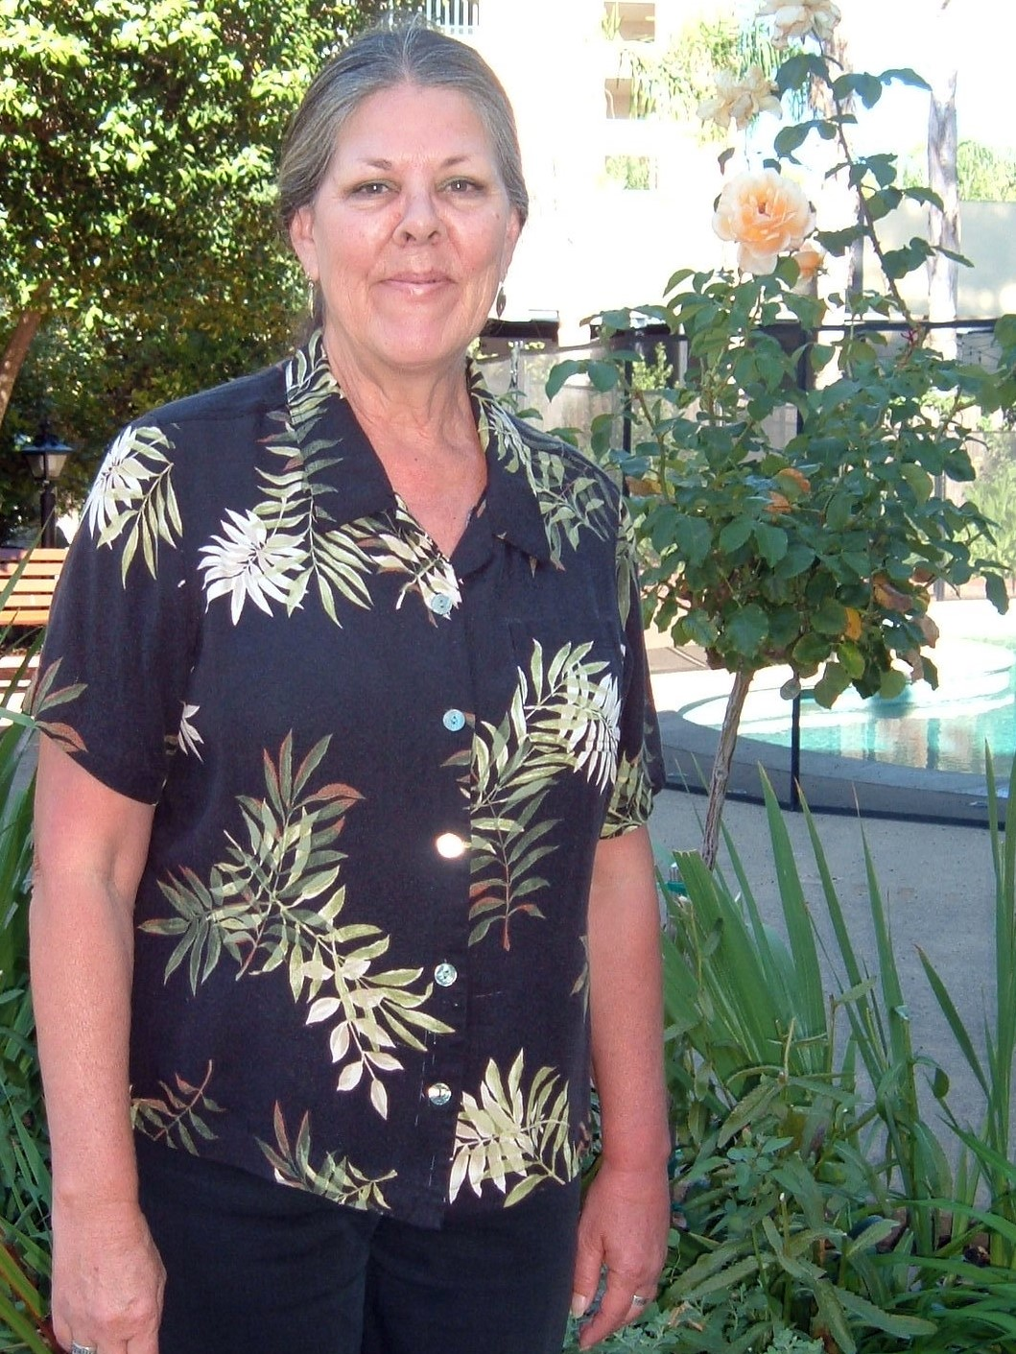
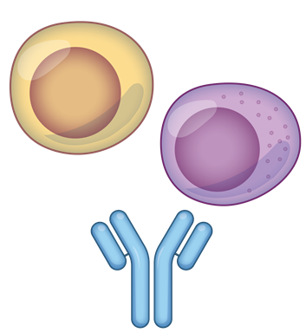
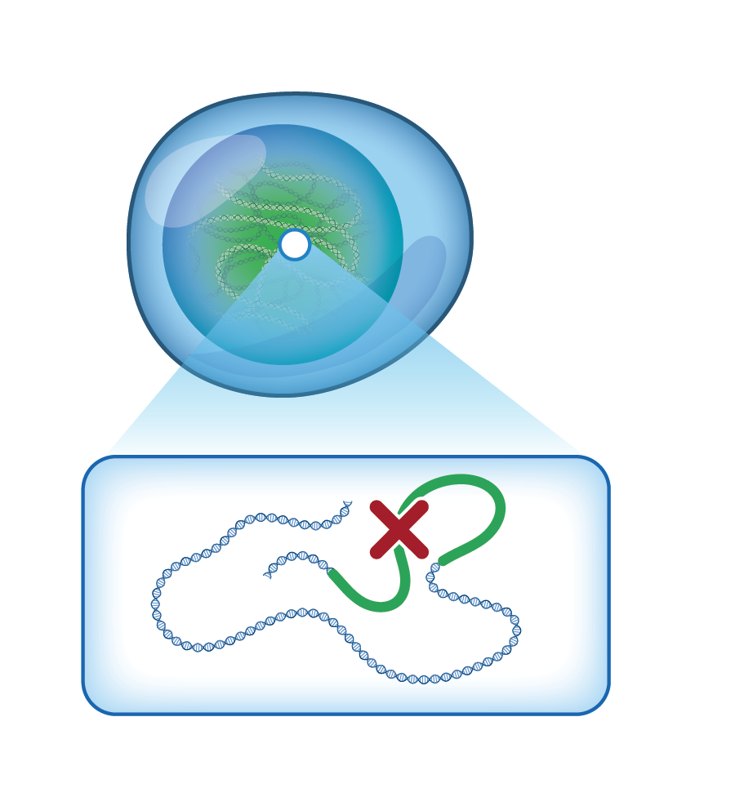
HIV cure is rare: examples of eradication and remission
VISCONTI
SPARTAC
CHAMP
Post treatment control (remission)
Adam Castallejo
London
The New York patient
Timothy Brown
Berlin
2009
2019
2022
2010
2020
2021
Lorraine
Willenberg
San Francisco
The Esperanza
patient
; Saez Cirion Plos Path 2015; Namazi JID 2018; McMahon et al, Curr Op HIV AIDS 2021; Jiang Nature 2020; Turk Annals Int Med 2021

Slide 5
Outline
New concepts in understanding HIV latency
  Clonal proliferation
  Integration site
Clinical strategies for an HIV cure
  Immunotherapy
  Gene therapy

Slide 6
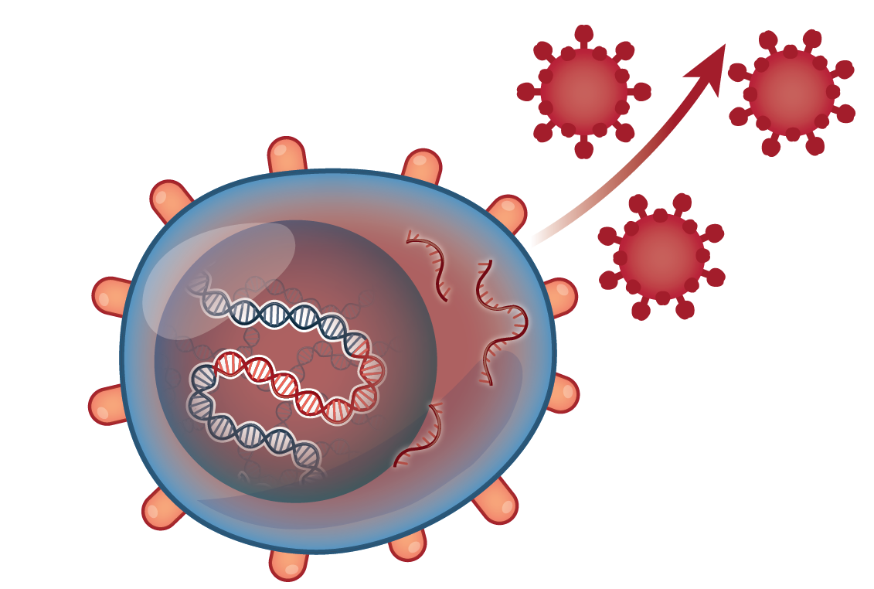
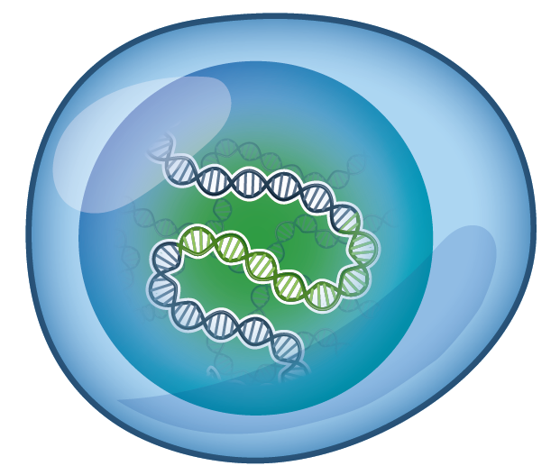


Two major forms of HIV infected cells
Productive infection
DNA positive
RNA positive
HIV protein positive
DEATH
Latent infection
DNA positive
RNA negative
HIV protein negative
SURVIVAL

Slide 7
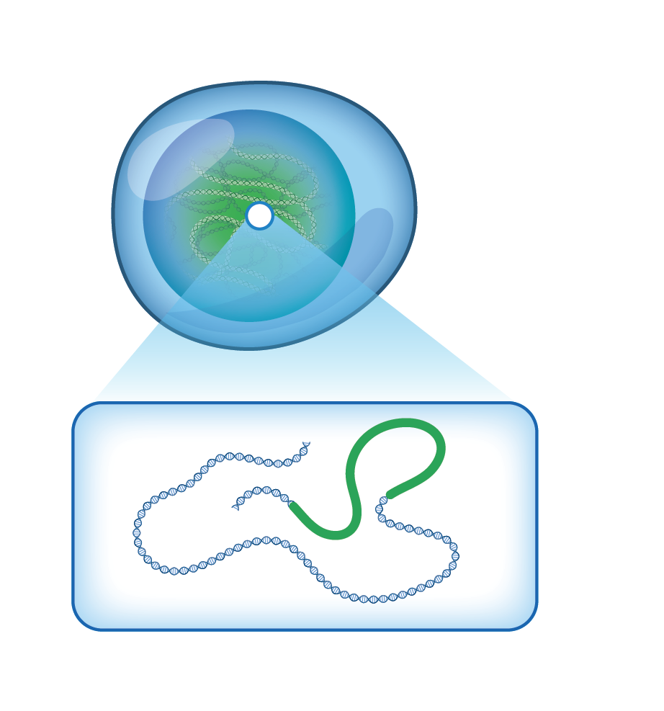

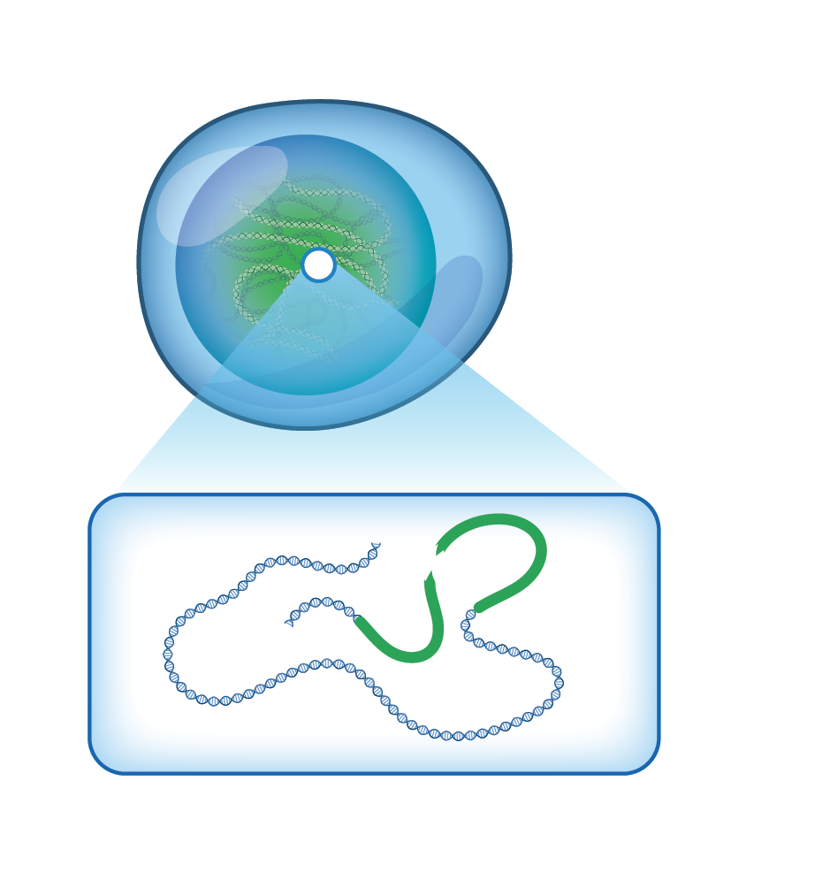

New concepts in HIV persistence and latency
3.
Position matters
1.
Reservoir ‘activity’
2.
Proliferation
4.
Defective and
intact virus

Slide 8

Proliferation: latently infected cells clonally expand
Long lived cell
T cell proliferation
Clonally expanded cells make up 50% of the reservoir¹
Clonally expanded cells can contain intact virus and contribute to plasma virus²
Clonally expanded infected cells are responding to common antigens^{3,4}
Integration site may also play a role^{5,6}
1 Lorenzo, et al., Proc Natl Acad Sci USA 2016;; 2 De Scheerder et al., Cell Host Microbe 2019; 3 Gantner Nat Comms 2020; 4 Mendoza J Exp Med 2020; 5 Wanger Science 2015; 6 Malderelli Science 2015

Slide 9
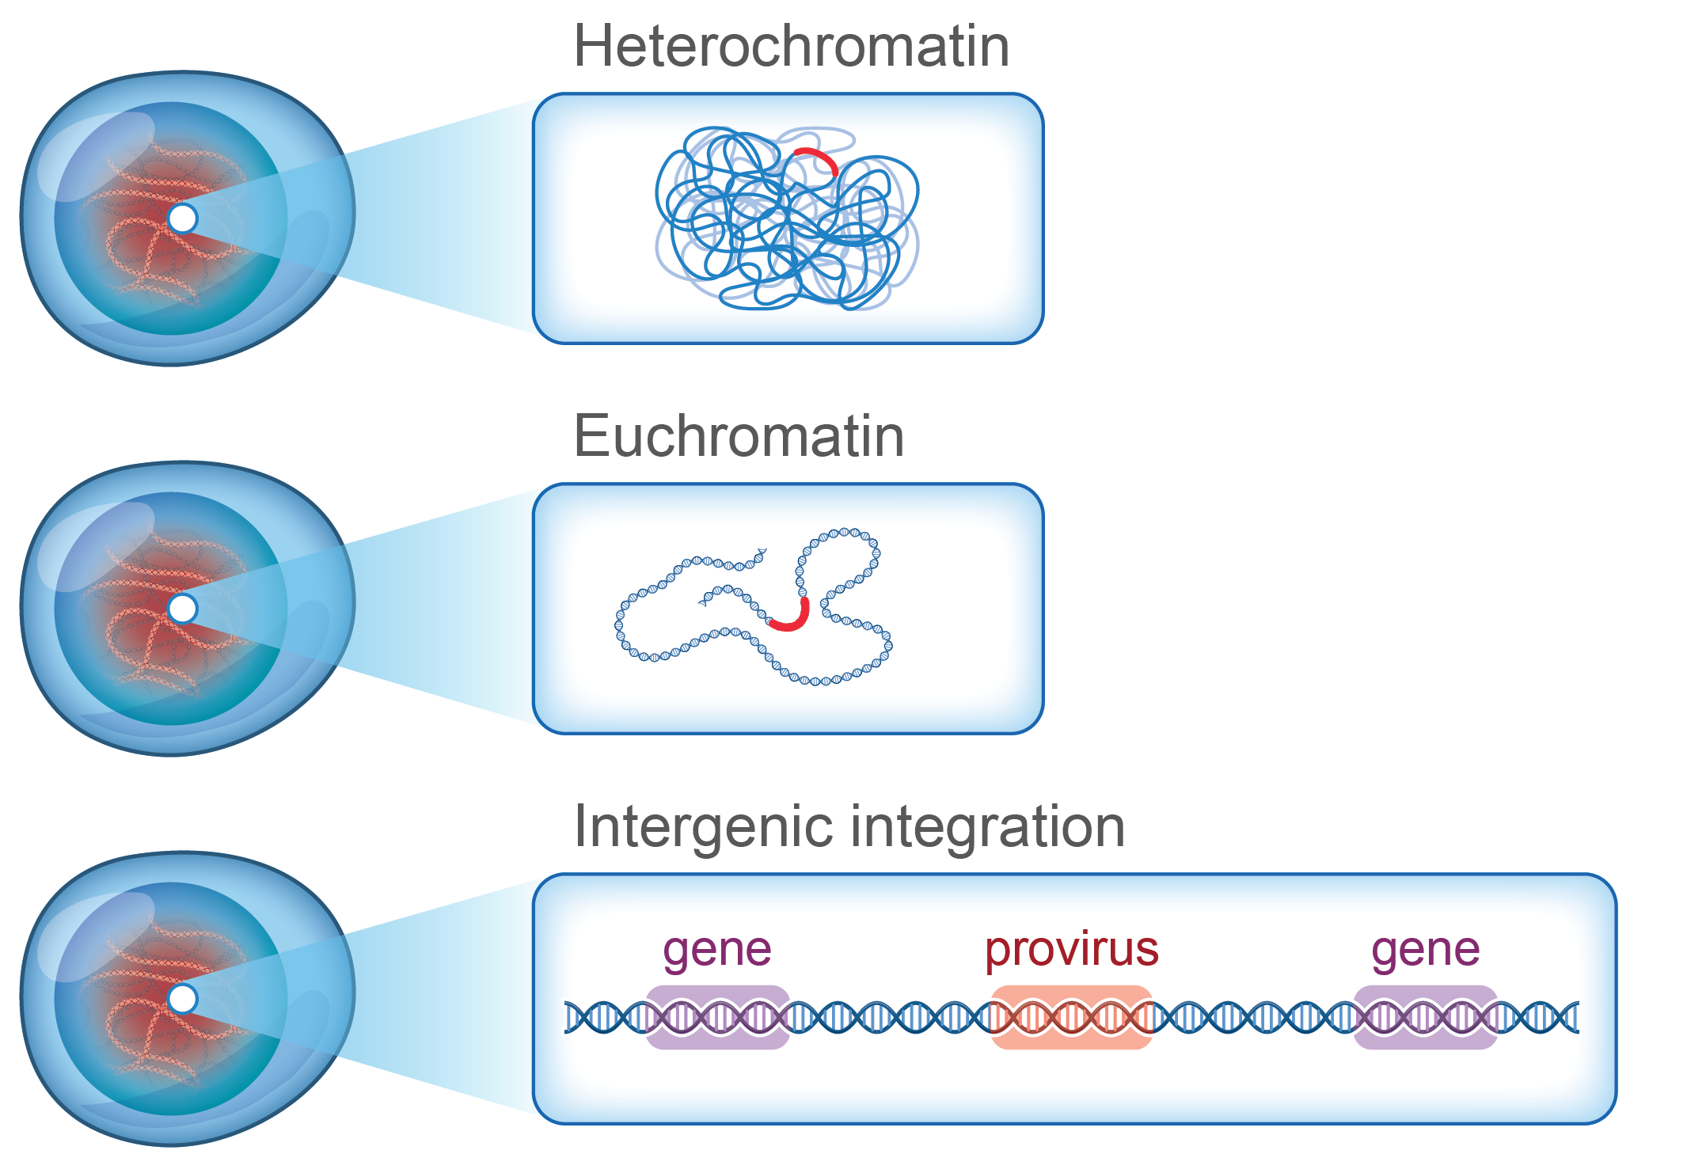
Position matters: HIV integration is important for virus transcription…..allowing it to stay silent or activate
Integration sites determine the likelihood of a virus being active or silent^{1,2}
In elite controllers, intact virus more commonly found in gene deserts ie limited or no transcription^{3,4}
New techniques determine integration site, sequence and transcription in the same cell (MIP-seq, PRIP-seq)
Integration in gene deserts
1 Jordan et al., EMBO J 2010; 2 Chen et al., Nat Struct Mol Biol 2017; 3 Einkauf et al., J Clin Inv 2019; 4 Yu et al., Nature 2020

Slide 10
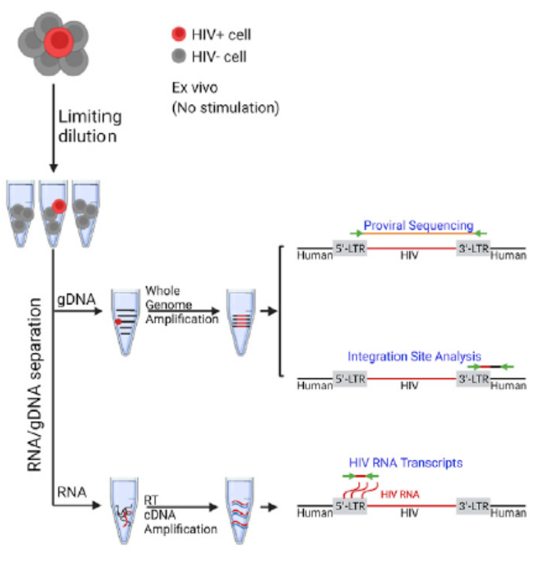
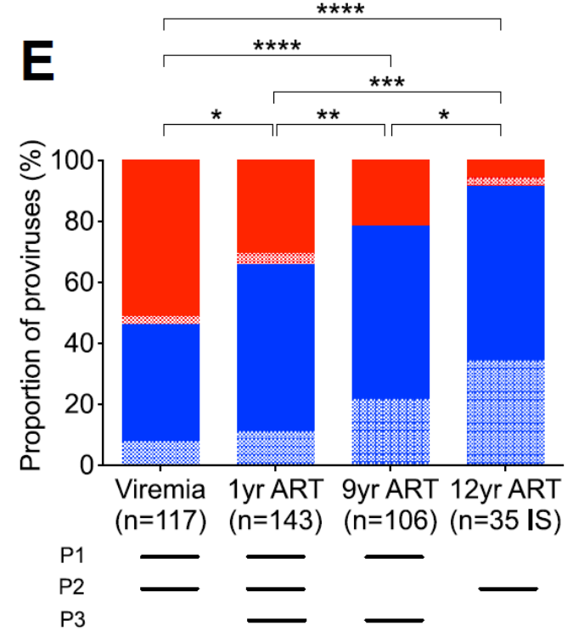
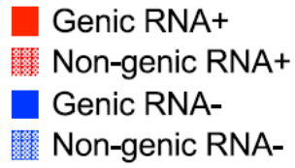
PRIP-seq is giving us dramatically new insights into a very dynamic reservoir on ART
Einkaupf et al., Cell 2022

Slide 11
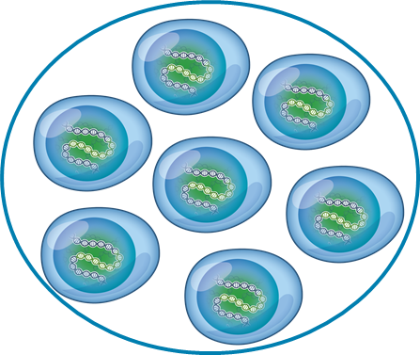


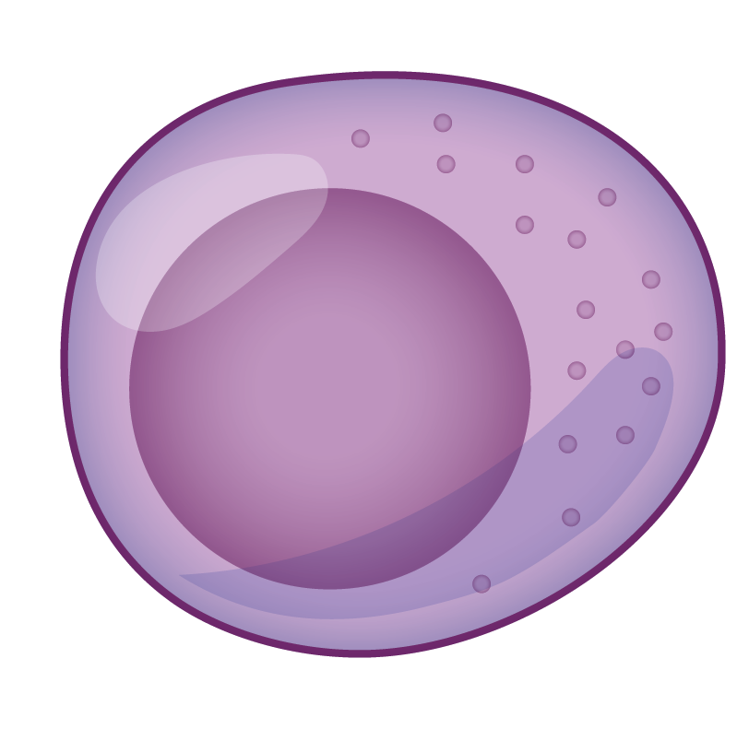
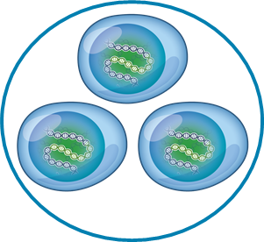


Overarching goals of cure strategies
eradication
Cytotoxic T-cells
NK cells
remission
antibodies
reduce
control

Slide 12

Targeting the virus and immune system
Broadly neutralising antibodies (bNAbs)
Very early ART
Latency reversal
T-cell vaccines
Pro-apoptotic drugs
Immunomodulation
virus
Immune system
Immunotoxins
CAR T-cells
Latency silencing
Gene
editing
Gene
editing

Slide 13
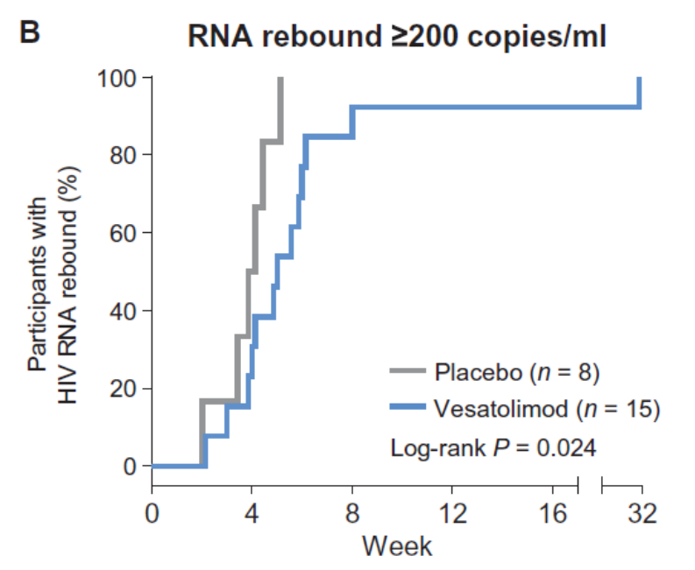
Immunomodulation: vesatolimod (TLR7 agonist)
Vesatolimod is a TLR7 agonist with important immunomodulating activities and can reverse HIV latency – in vitro and in (some) non human primates
In one monkey study, TLR7 agonist plus antibodies led to cure in 50% of animals
In PLWH on ART (n=48) vesatolimod (1-12mg) was safe with evidence of activation of innate immunity but no latency reversal
In viremic controllers (n=25) randomised to vesatolimod or placebo, vesatolimod induced a delayed time to viral rebound off ART
Borducchi et al., Nature 2018; Riddler et al., Clin Infect Dis 2020; Rasmussen and Lewin, Clin Infect Dis 2020; SenGupta, Science Trans Med 2021

Slide 14
Immune checkpoints and HIV latency
PD-1 and CTLA-4, dampen the immune response and are expressed on exhausted T cells in treated and untreated HIV^{1,2,3}
Latent HIV is enriched in PD-1⁺ cells in blood and lymph nodes from people on ART and in both PD-1+ and CTLA4+ cells in non human primates on ART ⁴⁻⁷
Case reports of anti-PD1 in HIV-infected individuals on ART with cancer show a decline in infected cells ^{7,8,9}
1 Ahmed J Immunol 2010; 2 Day Nature 2006; 3 Chiu J Immunol 2022; 4 Chomont Nat Med 2010; 5 Fromentin PLoS Pathogens 2015; 6 Banga Nat Med 2016; 7 McGarry Immunity 2017; 8 Evans AIDS 2018; Chomont Nat Comms 2018; 9 Lau AIDS 2021

Slide 15
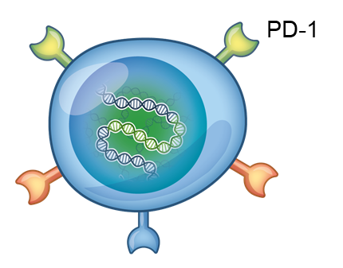
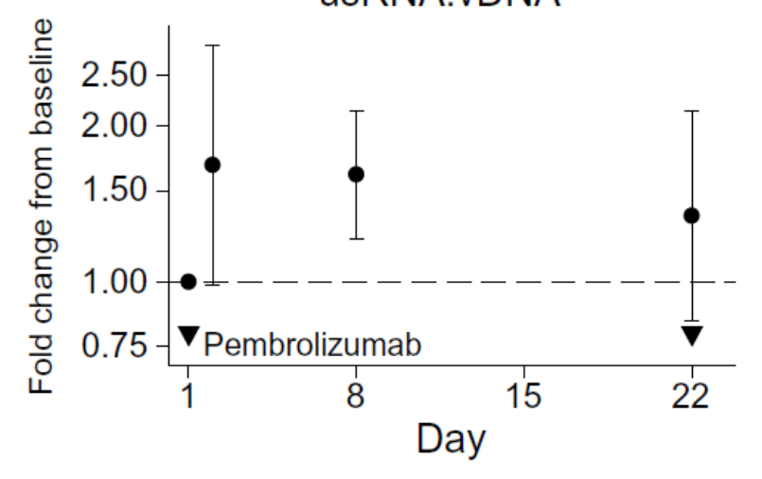
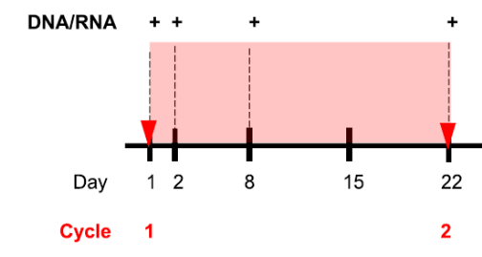
Anti-PD1 reverses HIV latency in vivo in PLWH on ART
Unspliced HIV RNA: DNA ratio
Dashed line indicates no change from baseline;
and exclusion of dashed line from confidence interval indicates P < 0.05 by Wald test of regression coefficient
CITN12: n=35 PLWH with malignancy received pembrolizumab 200mg IV; 3 cohorts with low, intermediate and high CD4 counts. Toxicity profile similar to observations in HIV negative cohorts
Uldrick et al., JAMA Oncology 2018; Uldrick et al., Science Translational Medicine 2022

Slide 16

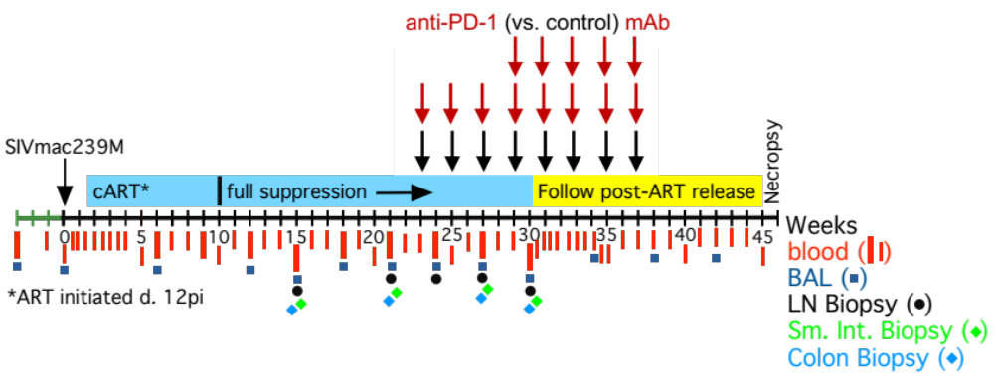
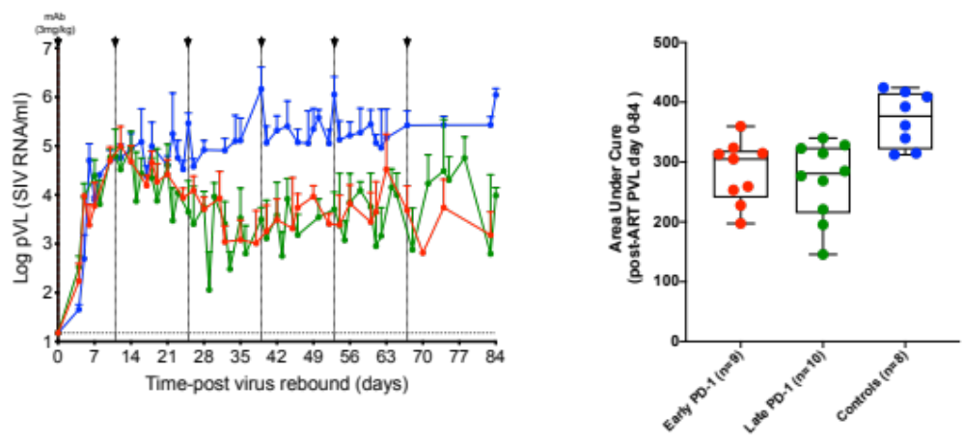
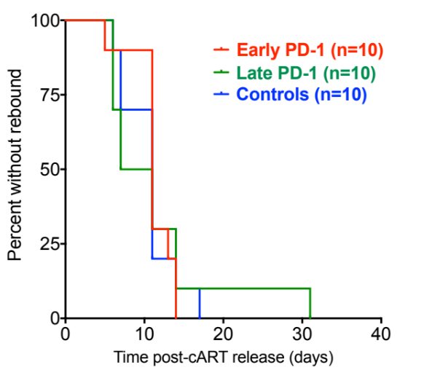
Anti-PD1 can also induce virus ‘control’ off ART
control Ab
early anti-PD1
late anti-PD1
Okoye et al., CROI 2021 virtual

Slide 17


Gene therapy: targets and strategies
        Attack: enhance anti-HIV immune responses
Protect: engineer uninfected cells to be resistant to HIV
        Purge: directly eliminate the virus itself
Delivery of gene therapy a major challenge :
ex vivo (gene editing of cells outside the body) or in vivo (gene editing in the body)
Slide courtesy of Paula Cannon

Slide 18
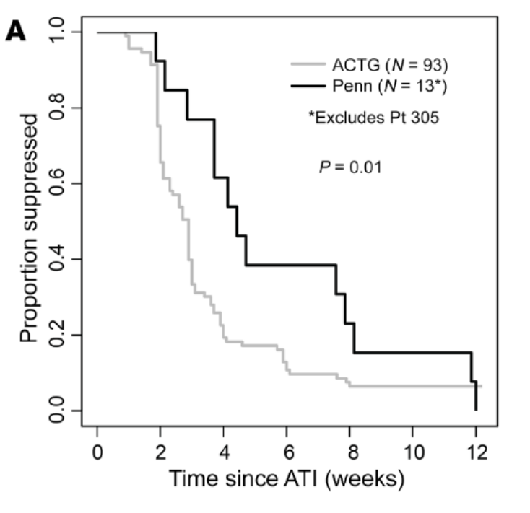





Gene therapy: ex vivo gene modification
Ex vivo gene therapy
Leukapheresis
CCR5 positive
ZFN cut
CCR5
gene
CCR5 negative
PLWH on ART
Participants were PLWH on ART who received ex vivo CCR5-modified cells (SB-728mRT) ± cyclophosphamide had delayed time to viral load rebound after interruption of ART
Re-infuse
Tebas et al., N Engl J Med 2014; Xu et al., N Engl J Med 2019; Tebas et al., J Clin Inv 2021

Slide 19
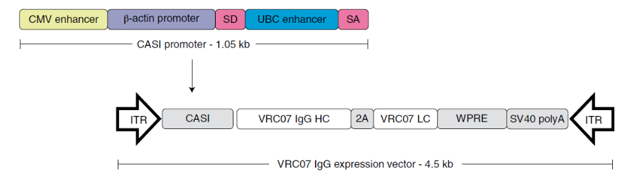


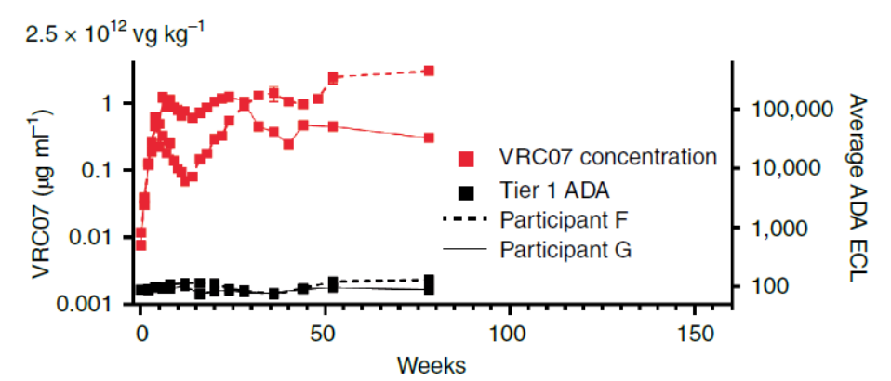

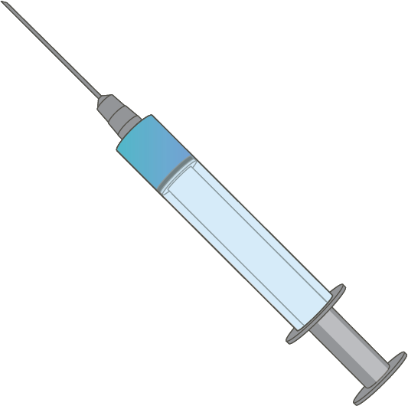
Gene therapy: in vivo modification
In vivo gene therapy
nanoparticle
AAV
AAV1-PG9
AAV8 – VRC07
Priddy et al., Lancet HIV 2019; Casazza Nat Med 2022

Slide 20
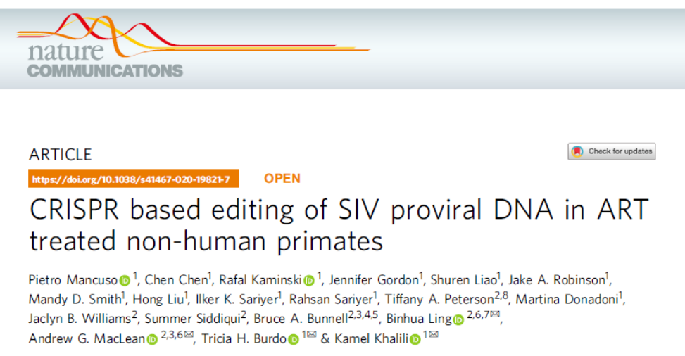
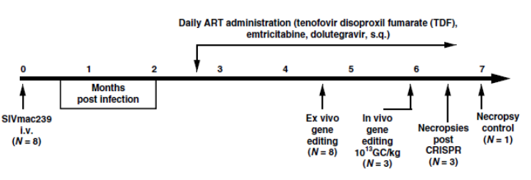
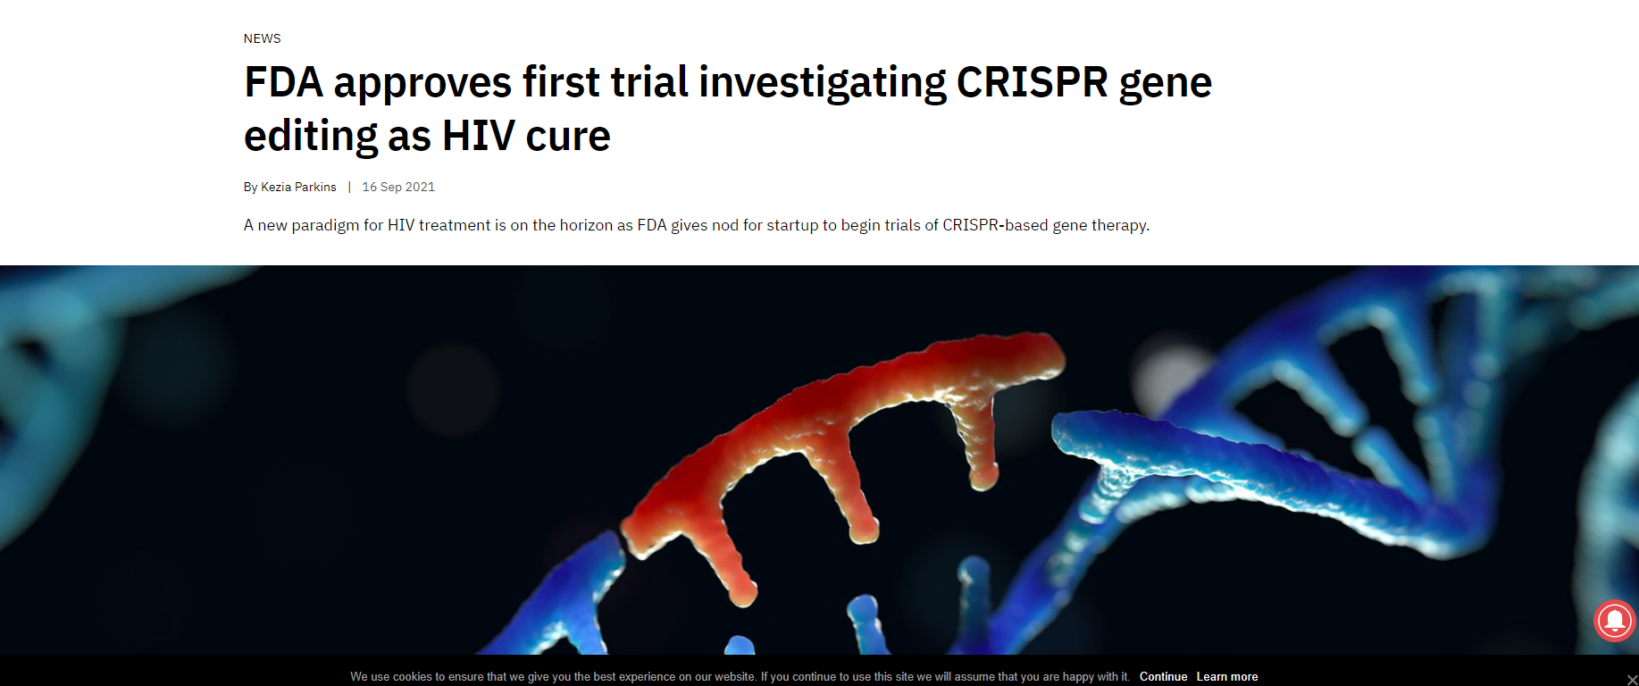
In vivo gene therapy for SIV/HIV with CRISPR-Cas9
Excision Biotherapeutics: first-in-human Phase I/II trial to evaluate the safety, tolerability and efficacy of EBT-101 in healthy individuals living with HIV. EBT-101 uses Adeno Associated virus (AAV), CRISPR-Cas9 plus 2 x gRNAs

Slide 21
Summary and implications for HBV cure
Many new concepts in understanding HIV latency: active reservoir, proliferation and site of integration – new tools beyond quantification alone.
  Could similar approaches be used to understand HBV integration and/or transcriptional control of cccDNA?
Immune checkpoint blockade is being actively pursued as a strategy to reverse HIV latency and enhance immunity. Safety remains a major concern
  An active area of investigation in HBV. Role for other ICBs beyond anti PD-1? Anti-TIGIT? Anti-TIM3? Alone or in combination?
Some optimism for gene therapy including strategies to attack, protect and purge the virus using both ex vivo and now in vivo strategies
  Potential relevance to HBV cure in relation to neutralising antibodies

Slide 22





Acknowledgements
Doherty Institute, Uni Melb
and Royal Melbourne Hospital
Thomas Rasmussen
Jori Symons
Michael Roche
Jared Stern
Chris Chiu
Celine Gubser
Jenn Zerbato
Wei Zhao
Rachel Pascoe
Zuwena Richardson
Matthew Pitman
Youry Kim
Haoming Liu
Abdalla Abbas
Paula Cavaal
Ajantha Solomon
Ashanti Dantanarayana
Judy Chang
Jennifer Audsley
Barbara Scher
Paul Cameron*
Renee van der Sluis*
Vanessa Evans*
Jenny Anderson*
Nitasha Kumar*
Surekha Tenakoon*
The Alfred Hospital
James McMahon
Jill Lau
Janine Roney
Michelle Boglis
Julian Elliott
Christina Chang
WEHI
Daniel Cameron
Murdoch University, Perth
Simon Mallal
Abha Chopra
Shay Leary
Don Cooper
Fred Hutchinson Cancer Centre
Tom Uldrick
Scott Adams
Cancer Immunotherapy Network
Mac Cheever
Steve Fling
Johns Hopkins University
Christine Durand
Murdoch University, Perth
Simon Mallal
Abha Chopra
Shay Leary
Don Cooper
University of Montreal
Nicolas Chomont
Remi Fromentin
UCSF, San Francisco
Steven Deeks
Peter Hunt
Charline Bacchus-Souffan
Mike McCune
Becky Ho
Jeff Milush
Rachel Rutishauser
Peter Baccheti
Rick Hecht
Oregon Health Sciences University
Afam Okoye
Louis Picker
Lydie Trauttman
NCI-Frederick
Frank Maldarelli
Jeff Lifson
Rob Gorelick

Slide 23
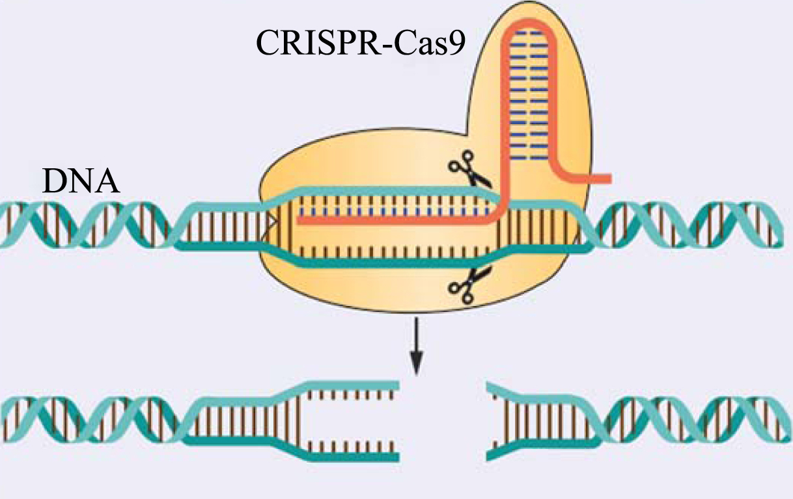
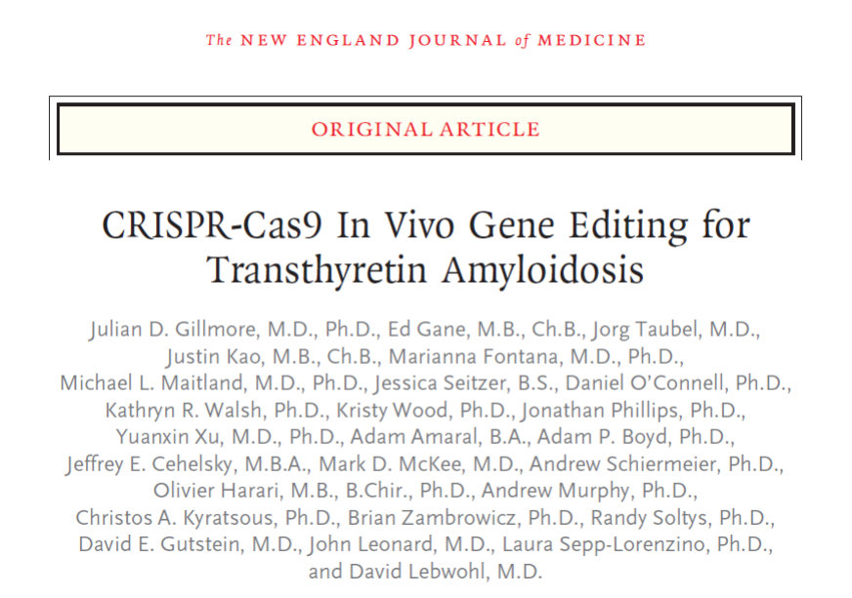
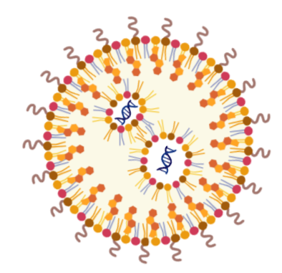


Gene therapy: in vivo modification
In vivo gene therapy
Lipid nanoparticle
Lipid nanoparticle (LNP) can efficiently deliver CRISPR-Cas mRNA
Gillmore N Engl J Med 2021

